Slide 1
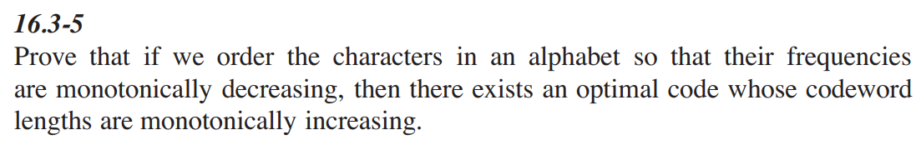

Homework on Chap 16
16.1-5， 16.3-5

Slide 2
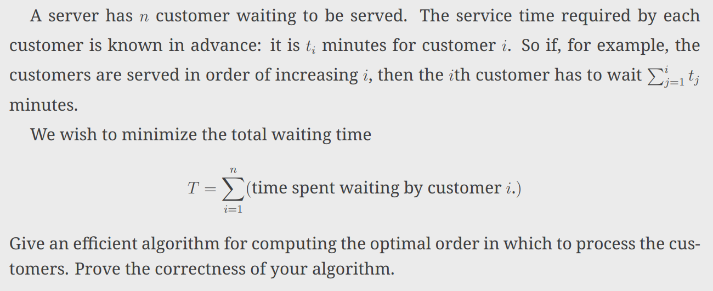
Homework on Chap 16

Slide 3
Homework on Chap 17&22
17.1-3，17-3-3
22.2-6

