Slide 1
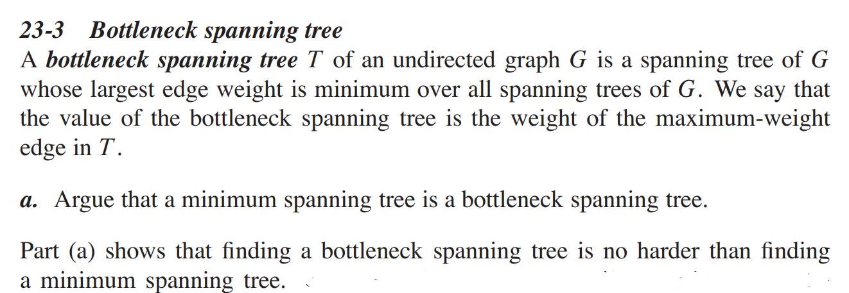
Homework
22.3-8，22.5-4
23.1-6, 23-3（a)
Let G=(V, E) be an undirected graph with cost c_{e}>0 on each edge and you are given a minimum spanning tree T in G. Now assume that a new edge (v, w) is added to G with cost c. Please given an efficient algorithm to test if T remains a MST in G.

