Slide 1

Homework
Given an array of n integers x1, x2, ..., xn, there are queries of the following form: given an integer 1 ≤ k ≤ n, you need to return the smallest k integers in the array (in no particular order).
1）Design an O(n) time algorithm;
2) Design an O(n) preprocessing algorithm so that you can answer each query in O(k) time.

Slide 2
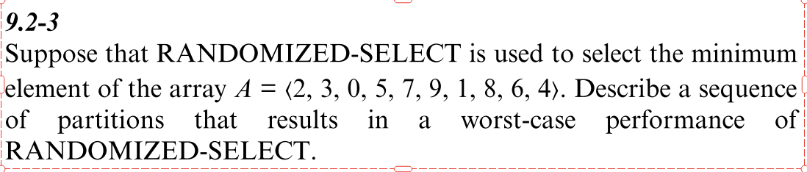
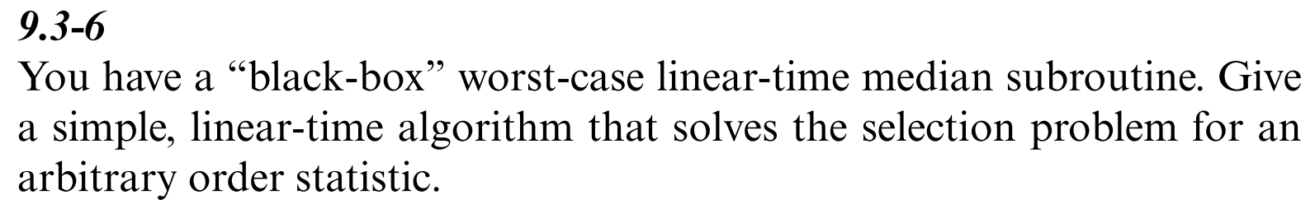

Homework
9.2-3, 9.3-6
Problem 9-1

