Slide 1
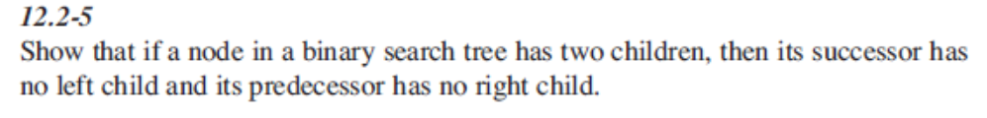
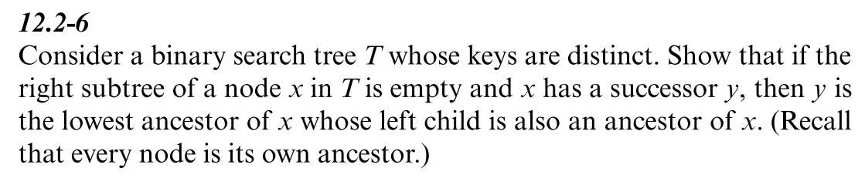

Homework on Chap 12
12.2-5, 12.2-6，12.3-3

Slide 2
Homework on Chap 12
Is it possible to give the result of the post-order tree-walk if both pre-order and in-order tree walk results are given? Justify your answer.

