Slide 1
Chapter 12.
Binary Search Trees

Slide 2
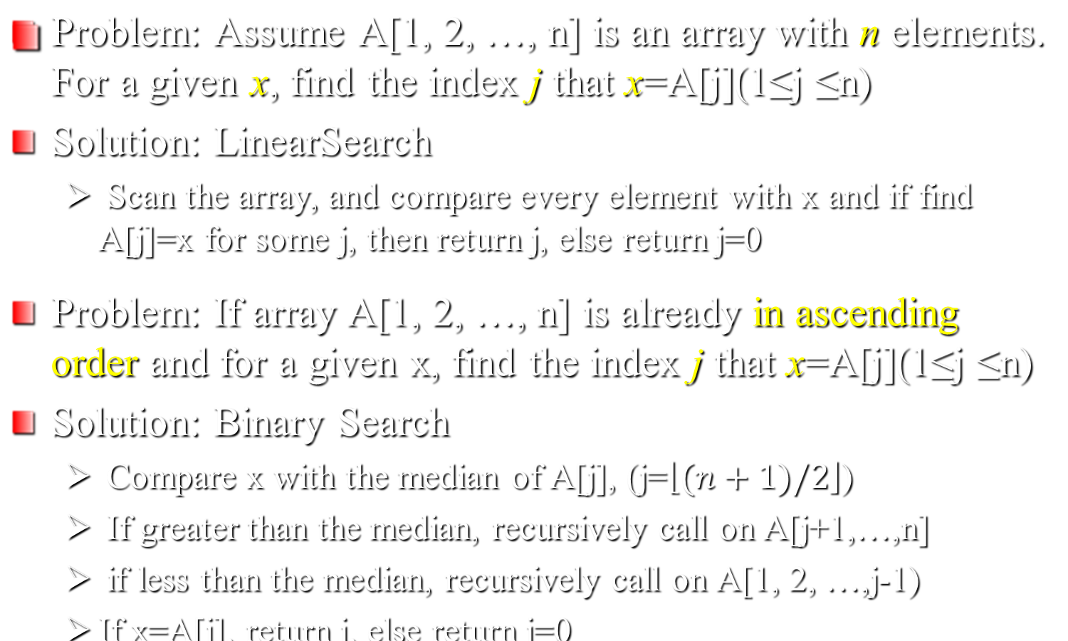
Search Problem

Slide 3

Search Problem(2)
Linear Search
  Sequentially Scan
  Worst-case: Θ(n)
Binary Search
  Worst-case: Θ(lgn)
  T(n)=T(n/2)+Θ(1)
  Execution of binary search is like decision-tree

Slide 4
Search Trees
Data structures that support many dynamic-set operations.
Can be used both as a dictionary and as a priority queue.
Basic operations take time proportional to the height of the tree.
  For complete binary tree with n nodes: worst case Θ(lg n).
  For linear chain of n nodes: worst case Θ(n).
Different types of search trees include binary search trees, red-black trees (ch.13), and B-trees(ch.18).

Slide 5
Binary Search Trees
Binary search trees are an important data structure for dynamic sets.
Accomplish many dynamic-set operations in O(h) time,
where h = height of tree.
We represent a binary tree by a linked list data structure in which each node is an object.
root [T ] points to the root of tree T .
Each node contains the fields
  key (and possibly other satellite data).
  left: points to left child.
  right: points to right child.
  p: points to parent. p[root[T ]] = NIL.

Slide 6

Property
Stored keys must satisfy the binary-search-tree property.
  If y is in left subtree of x, then key[y] ≤ key[x].
  If y is in right subtree of x, then key[y] ≥ key[x].
The difference between binary-search-tree property and max-heap property?
For max-heaps (largest element at root), max-heap property: for all nodes i, excluding the root, A[PARENT(i )] ≥ A[i].

Slide 7
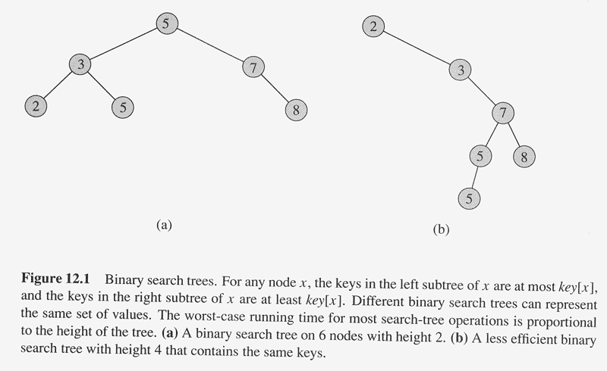

Slide 8
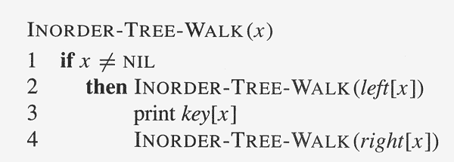
The binary-search-tree property allows us to print keys in a binary search tree in order, recursively, using an algorithm called an inorder tree walk. Elements are printed in monotonically increasing order.

Slide 9
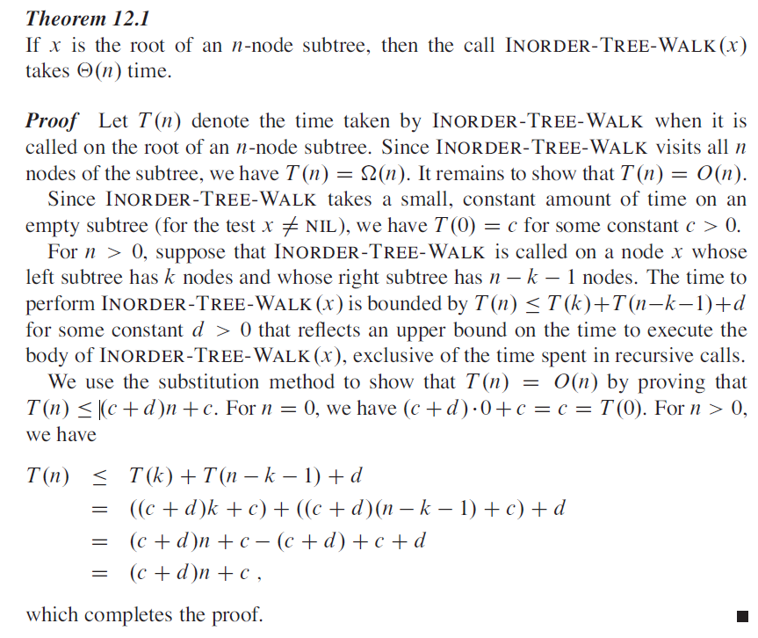

Slide 10

Correctness
Follows by induction directly from the binary-search-tree property.
Time: Intuitively, the walk takes Θ(n) time for a tree with n nodes, because we visit and print each node once.

Slide 11
Pre-order and Post-order Tree Walk
PREORDER-TREE-WALK(x)
if x = NIL
then print key[x]
PRE-ORDER-TREE-WALK(left[x])
PRE-ORDER-TREE-WALK(right[x]).
POSTORDER-TREE-WALK(x)
if x = NIL
then POST-ORDER-TREE-WALK(left[x])
POST-ORDER-TREE-WALK(right[x]).
print key[x]

Slide 12
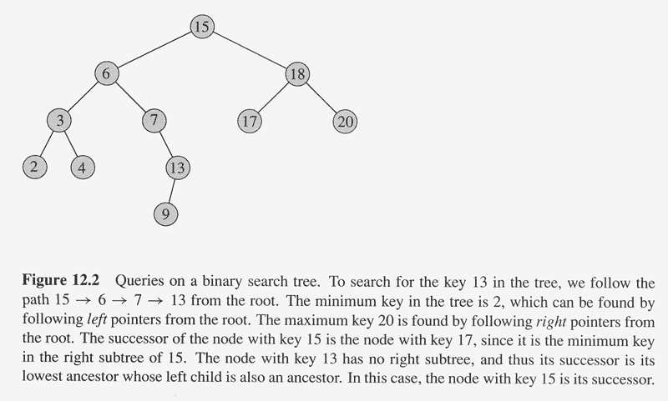
Querying a binary search tree

Slide 13
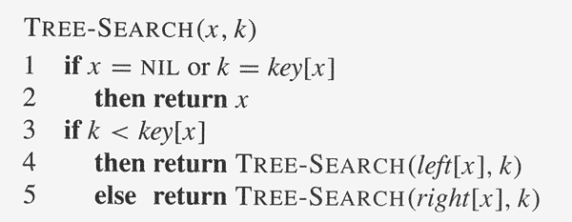
Initial call: TREE-SEARCH(root[T ], k).
Time:
The algorithm recurses, visiting nodes on a downward path from the root.
Thus, running time is O(h), where h is the height of the tree.

Slide 14
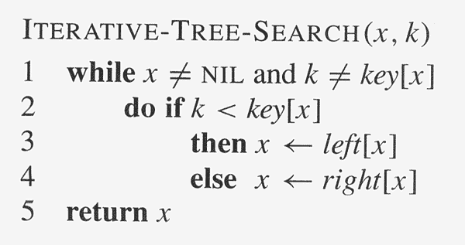

Slide 15
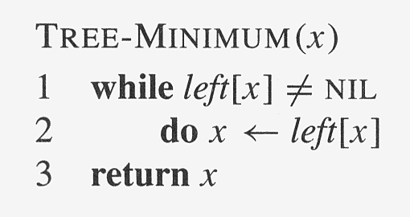
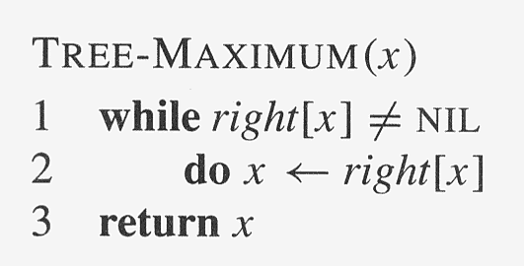
Minimum and maximum
The binary-search-tree property guarantees that
  the minimum key of a binary search tree is located at the leftmost node, and
  the maximum key of a binary search tree is located at the rightmost node.
Traverse the appropriate pointers (left or right) until NIL is reached.
Time: Both procedures run in O(h) time, where h is the height of the tree.
-- Both visit nodes that form a downward path from the root to a leaf.

Slide 16
Successor
Assumption: all keys are distinct.
The successor of a node x is the node y such that key[y] is the smallest of the key > key[x].
  We can find x’s successor based entirely on the tree structure.
  (No key comparisons are necessary).
  If x has the largest key in the binary search tree, then we say that x’s successor is NIL.
There are two cases:
1. If node x has a non-empty right subtree,
then x’s successor is the minimum in x’s right subtree.
2. If node x has an empty right subtree, notice that:
  As long as we move to the left up the tree (move up through right children), we’re visiting smaller keys.
  x’s successor y is the node that x is the predecessor of y
  (x is the maximum in y’s left subtree).

Slide 17
Predecessor
Assumption: all keys are distinct.
The predecessor of a node x is the node y such that key[y] is the largest of the key < key[x].
  We can find x’s predecessor based entirely on the tree structure.
  (No key comparisons are necessary).
  If x has the smallest key in the binary search tree, then we say that x’s predecessor is NIL.
There are two cases:
1. If node x has a non-empty left subtree,
then x’s predecessor is the maximum in x’s left subtree.
2. If node x has an empty left subtree, notice that:
  As long as we move to the right up the tree (move up through left children), we’re visiting larger keys.
  x’s predecessor y is the node that x is the successor of y
  (x is the minimum in y’s right subtree).

Slide 18
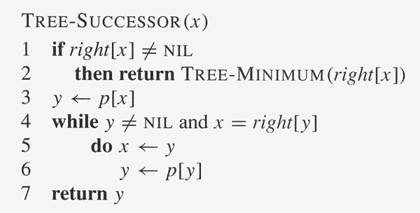
TREE-PREDECESSOR is symmetric to TREE-SUCCESSOR.
Running time is O(h), where h is the height of the tree

Slide 19
Example:
Find the successor of the node with key value 15. (Answer: Key value 17)
Find the successor of the node with key value 6. (Answer: Key value 7)
Find the successor of the node with key value 4. (Answer: Key value 6)
Find the predecessor of the node with key value 6. (Answer: Key value 4)
Time:
Running time is O(h), where h is the height of the tree.
For both the TREE-SUCCESSOR and TREE-PREDECESSOR
procedures, in both cases, we visit nodes on a path down the tree
or up the tree.
15
6
18
3
7
17
20
2
4
13
9

Slide 20
Insertion
To insert value v into the binary search tree, the procedure is given node z, with key[z] = v, left[z] = NIL, and right[z] = NIL.
Beginning at root of the tree, trace a downward path, maintaining two pointers.
  Pointer x: traces the downward path.
  Pointer y: “trailing pointer” to keep track of parent of x.
Traverse the tree downward by comparing the value of node at x with v, and move to the left or right child accordingly.
When x is NIL, it is at the correct position for node z.
Compare z’s value with y’s value, and insert z at either y’s left or right, appropriately.
Time: Same as TREE-SEARCH.
  On a tree of height h, procedure takes O(h) time.
  TREE-INSERT can be used with INORDER-TREE-WALK to sort a given set of numbers.

Slide 21
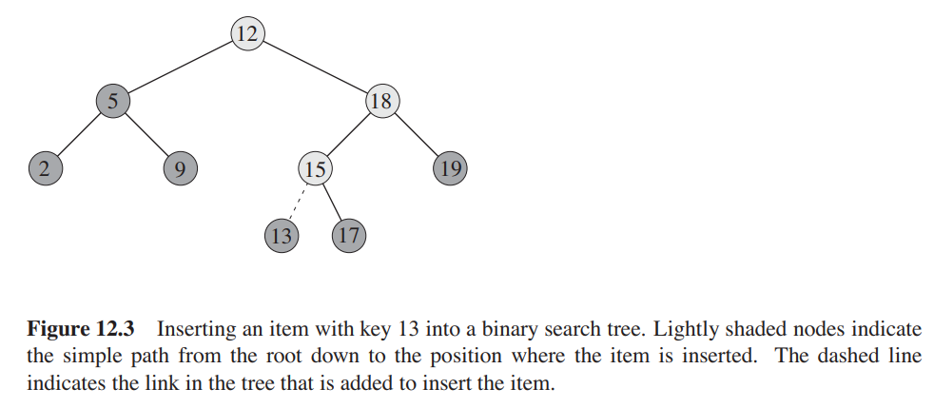
Insertion

Slide 22
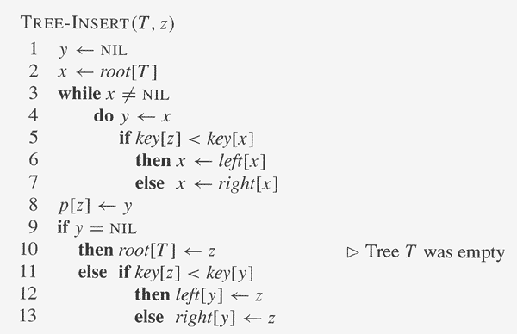
Insertion and deletion
allows the dynamic set represented by a binary search tree to change.
The binary-search-tree property must hold after the change.
Insertion is more straightforward than deletion.
x is where z should be placed
z is left or right child of its parent

Slide 23
Deletion
TREE-DELETE is broken into three cases.
Case 1: z has no children.
  Delete z by making the parent of z point to NIL, instead of to z.
Case 2: z has one child.
  Delete z by making the parent of z point to z’s child, instead of to z.
Case 3: z has two children.
  z’s successor y has either no children or one child. (y is the minimum node—with no left child—in z’s right subtree.)
  Delete y from the tree (via Case 1 or 2), Replace z’s key and data with y’s.
Example: Demonstrate on the above sample tree.
  For Case 1, delete K.
  For Case 2, delete H.
  For Case 3, delete B, swapping it with C.
Time: O(h), on a tree of height h.
F
B
H
A
D
K
C

Slide 24
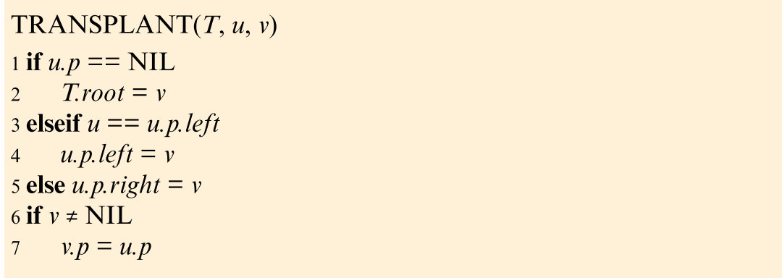
TRANSPLANT
The subroutine TRANSPLANT replaces one subtree as a child of its parent with another subtree
// u is the root of the Tree
// replace u with v
// connect v with u’s parent

Slide 25
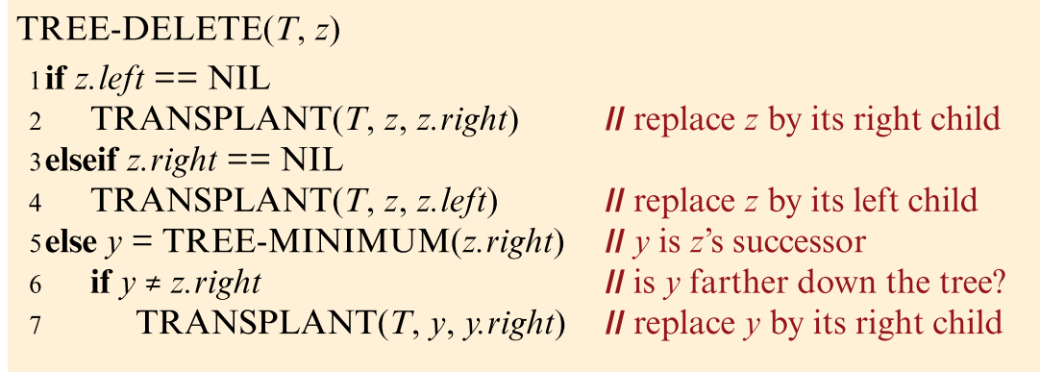
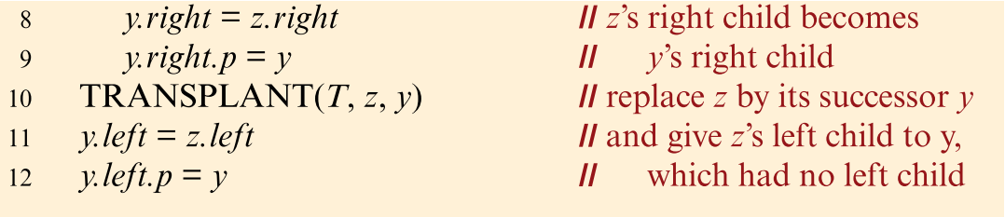

Slide 26
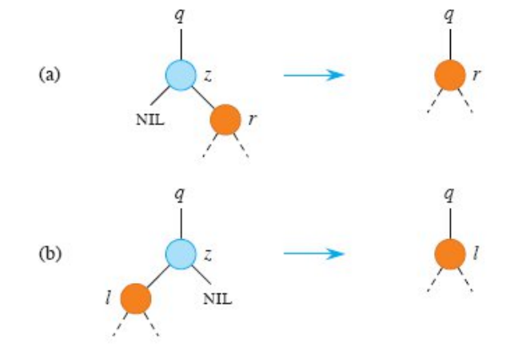

Slide 27
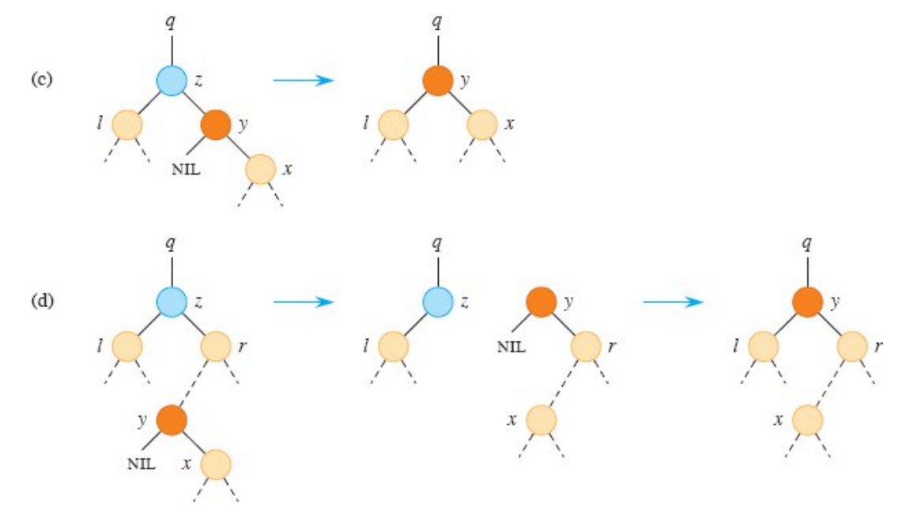

Slide 28
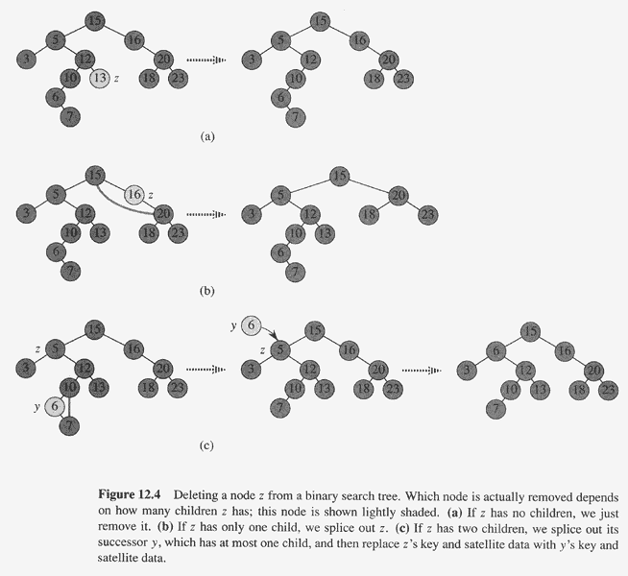

Slide 29
Minimizing running time
We’ve been analyzing running time in terms of h (the height of the binary search tree), instead of n (the number of nodes in the tree).
  Problem: Worst case for binary search tree is Θ(n)
—no better than linked list.
  Solution: Guarantee small height (balanced tree) — h = O(lg n).
In later chapters, by varying the properties of binary search trees, we will be able to analyze running time in terms of n.
  Method: Restructure the tree if necessary. Nothing special is required for querying, but there may be extra work when changing the structure of the tree (inserting or deleting).
Red-black trees are a special class of binary trees that avoids the worst-case behavior of O(n) like “plain” binary search trees. – chap. 13.

