Slide 1
Chapter 13.
Red-Black Trees
A variation of binary search trees.
Balanced:
height is O(lg n), where n is the number of nodes.
Operations will take O(lg n) time in the worst case.

Slide 2
Red - Black Trees
A red-black tree is a binary search tree + 1 bit per node: an attribute color, which is either red or black.
All leaves are empty (nil) and colored black.
  We use a single sentinel, nil[T ], for all the leaves of red-black tree T.
  color[nil[T ]] is black.
  The root’s parent is also nil[T ].
All other attributes of binary search trees are inherited by red-black trees (key, left, right, and p).
We don’t care about the key in nil [T ].

Slide 3
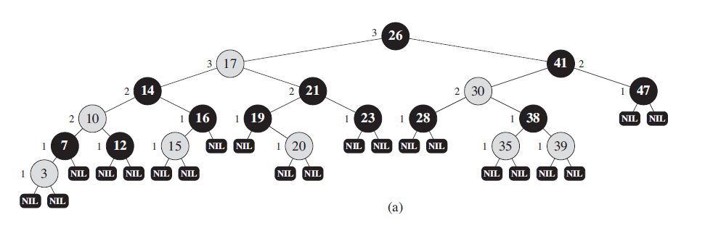
Properties of red-black trees(1)
Every node is either red or black.
The root is black.
Every leaf (nil[T ]) is black.
If a node is red, then both its children are black. (Hence no two reds in a row on a simple path from the root to a leaf.)
For each node, all paths from the node to descendant leaves contain the same number of black nodes.
Example:

Slide 4

Height of red-black trees(1)
Height of a node is the number of edges in a longest path to a leaf.
Black-height of a node x:
bh(x) is the number of black nodes (including T.nil) on the path from x to leaf, not counting x. By property 5, black-height is well defined.
Claim : Any node with height h has black-height bh ≥ h/2.
Proof
By property 4, ≤ h/2 nodes on the path from the node to a leaf are red. Hence ≥ h/2 are black.
Claim
The sub-tree rooted at any node x contains ≥ 2^{bh(x)}-1 internal nodes.

Slide 5
Proof
Proof : By induction on height of x.
Basis:
Height of x = 0 ⇒ x is a leaf ⇒ bh(x) = 0.
The subtree rooted at x has 0 internal nodes. 2⁰-1=0.
Inductive step:
Inductive Hypothesis: Let the height of x be h and bh(x) = b.
Any child of x has height h-1 and
black-height either b (if the child is red)
or b-1 (if the child is black).
By the inductive hypothesis, each child has ≥ 2^{bh(x)-1}-1 internal nodes.
Thus, the subtree rooted at x contains ≥ 2(2^{bh(x)-1}-1)+1=2^{bh(x)}-1
internal nodes. (The +1 is for x itself.)

Slide 6
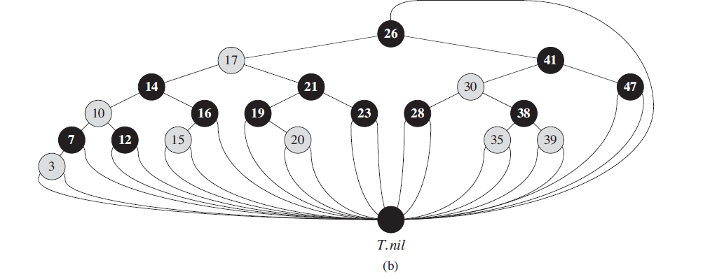
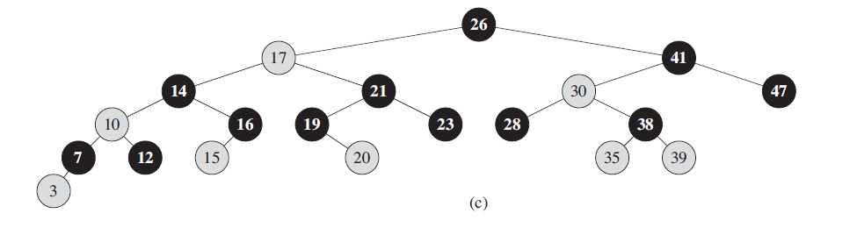

Slide 7
Height of red-black trees(2)
Lemma
A red-black tree with n internal nodes has height ≤ 2 lg(n+1)
Proof :
Let h and b be the height and black-height of the root, respectively. By the above two claims,
  n ≥ 2^{b} -1 ≥ 2^{h/2} -1
  Adding 1 to both sides and then taking logs gives lg(n + 1) ≥ h/2,
  which implies that h ≤ 2 lg(n + 1).

Slide 8
Operations on red-black trees
MINIMUM, MAXIMUM, SUCCESSOR, PREDECESSOR, and SEARCH operations in BST: O( height ) time.
Thus, on red-black trees: O(lg n) time.
Insertion and deletion are not so easy.
If we insert, what color to make the new node?
  Red? Might violate property 4, 2
  Black? Might violate property 5.

Slide 9
Continue
If we delete, what color was the node that was removed?
  Red? OK, since we won’t have changed any black-heights, nor will we have created two red nodes in a row.
  Also, cannot cause a violation of property 2, since if the removed node was red, it could not have been the root.
  Black? Could cause there to be two reds in a row (violating property 4), and can also cause a violation of property 5.
  Could also cause a violation of property 2, if the removed node was the root and its child - which becomes the new root - was red.

Slide 10
Rotations
The basic tree-restructuring operation.
Needed to maintain red-black trees as balanced binary search trees.
Changes the local pointer structure. (Only pointers are changed.): O(1)
Won’t upset the binary-search-tree property.
Have both left rotation and right rotation. They are inverses of each other.
A rotation takes a red-black-tree and a node within the tree.

Slide 11
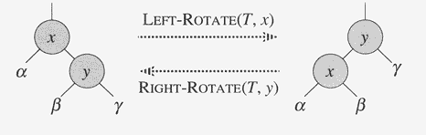
Rotation

Slide 12
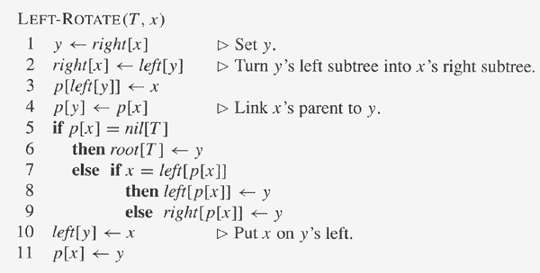
The pseudocode for LEFT-ROTATE assumes that
  right[x] (=y) ≠ nil[T ], and root’s parent is nil[T ].
  Pseudocode for RIGHT-ROTATE is symmetric: exchange left and right everywhere.

Slide 13
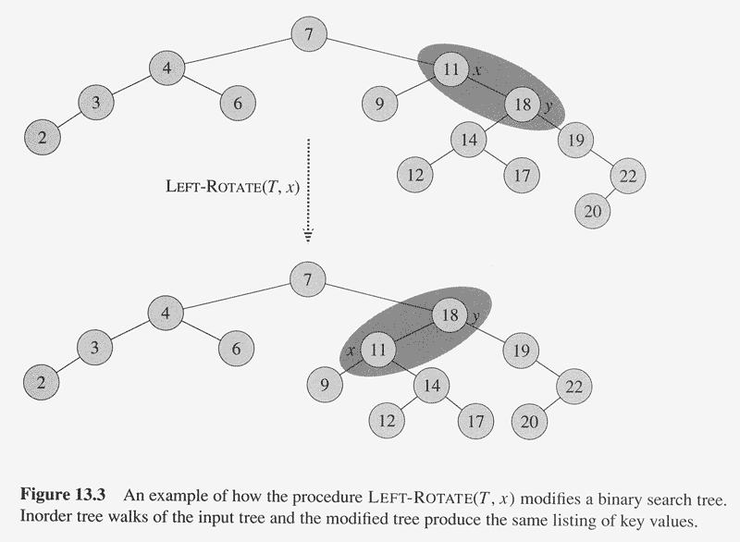
The height of tree is decreased and the tree is balanced

Slide 14
Example
Before rotation:
keys of x’s left subtree ≤ 11 (=x’s key) ≤ keys of y’s left sub-tree ≤ 18 (=y’s key) ≤ keys of y’s right subtree.
Rotation makes y’s left subtree into x’s right subtree.
After rotation:
keys of x’s left subtree ≤ 11(=x)
≤ keys of x’s right subtree ≤ 18 (=y)≤ keys of y’s right subtree.
Time:
O(1) for both LEFT-ROTATE and RIGHT-ROTATE, since a constant number of pointers are modified.

Slide 15
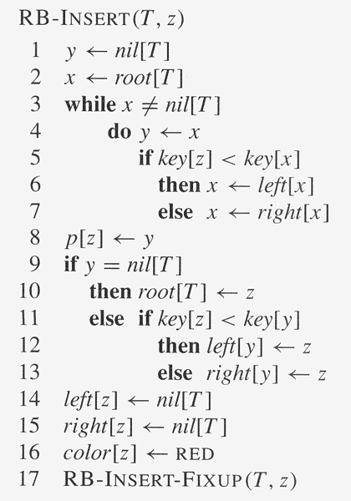
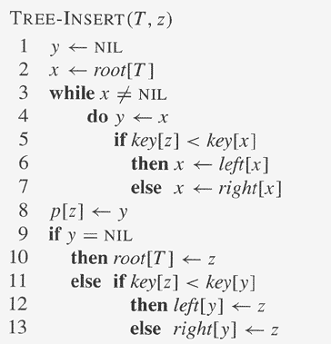

Slide 16
Insertion
Start by doing regular binary-search-tree insertion:
RB-INSERT ends by coloring the new
node z red.
Then it calls RB-INSERT-FIXUP
because we could have violated
a red-black property.
Which property might be violated?
1. OK.
2. If z is the root,
then there’s a violation. Otherwise, OK.
3. OK.
4. If p[z] is red, there’s a violation:
both z and p[z] are red.
5. OK.
Remove the violation by calling RB-INSERT-FIXUP:

Slide 17
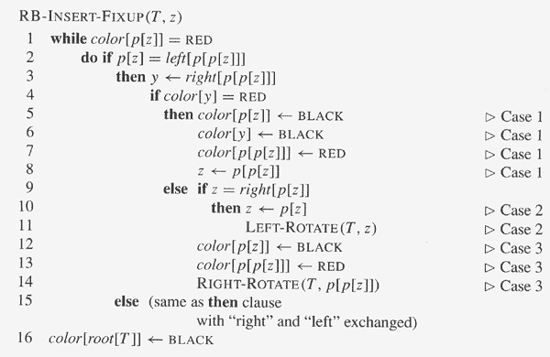
//both p and its parent are red
// find z’s uncle y
// y is red
// y is black and z is right child
// p(z) is right child

Slide 18
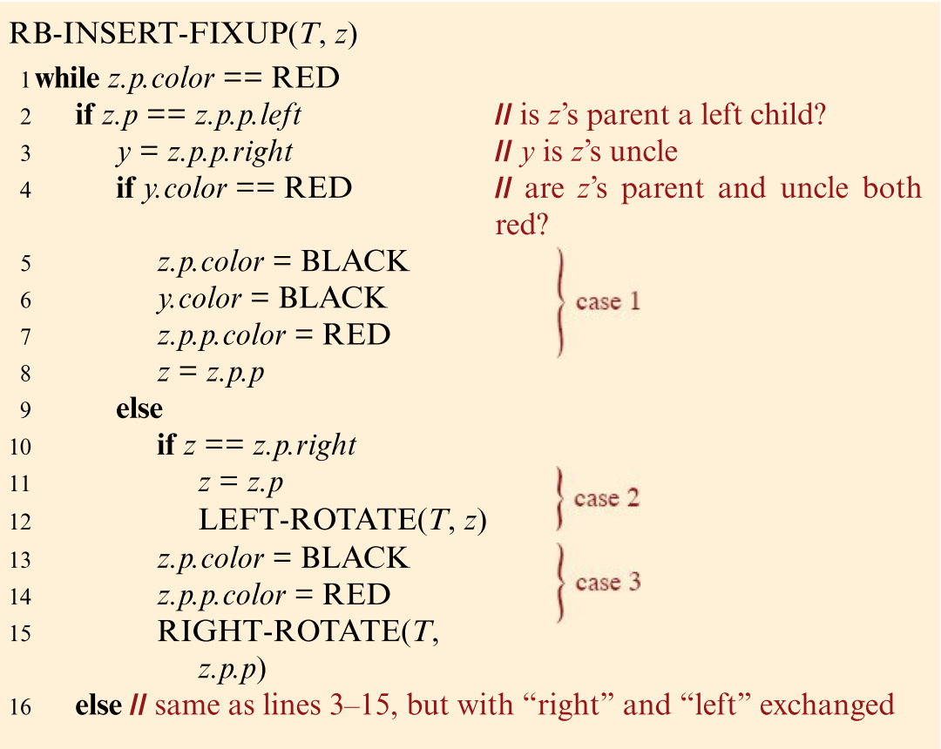
// y is black and z is right child

Slide 19
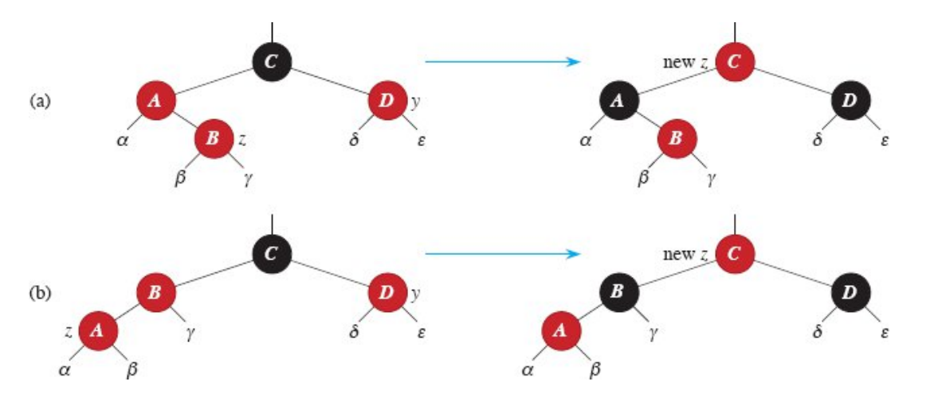
Case1: y is red (Red Uncle)
p[p[z]] (z’s grandparent) must be black, since z and p[z] are both red and there are no other violations of property 4. Make p[z] and y black ⇒ now z and p[z] are not both red. But property 5 might now be violated. Make p[p[z]] red ⇒ restores property 5. The next iteration has p[p[z]] as the new z (i.e., z moves up 2 levels).

Slide 20
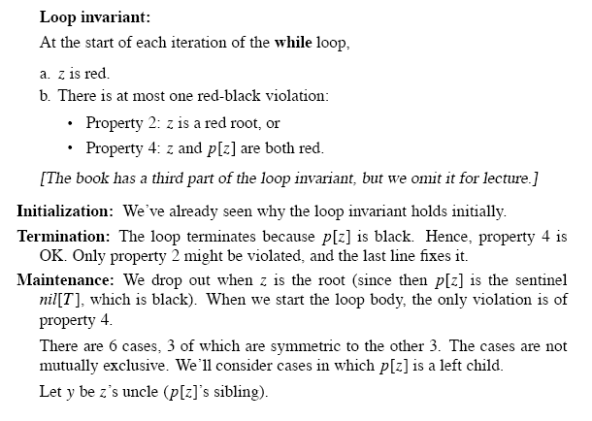
// Proof

Slide 21
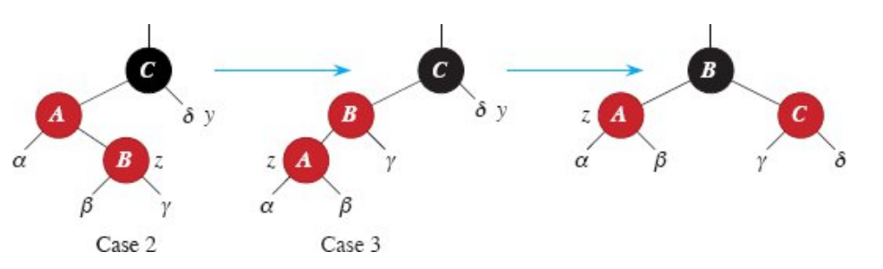
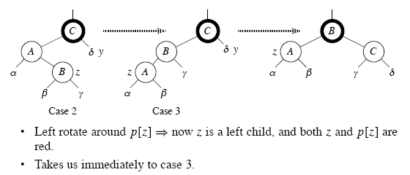
Case 2: uncle y is black, z is a right child

Slide 22
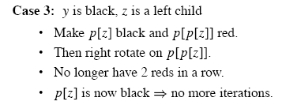

Slide 23
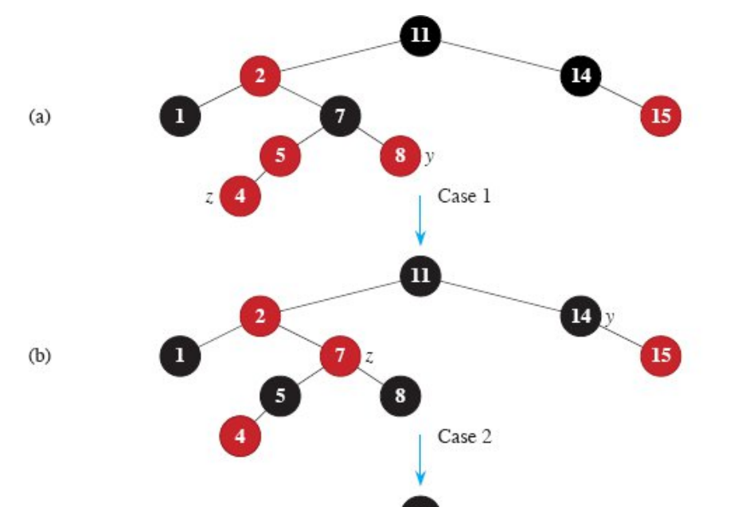

Slide 24
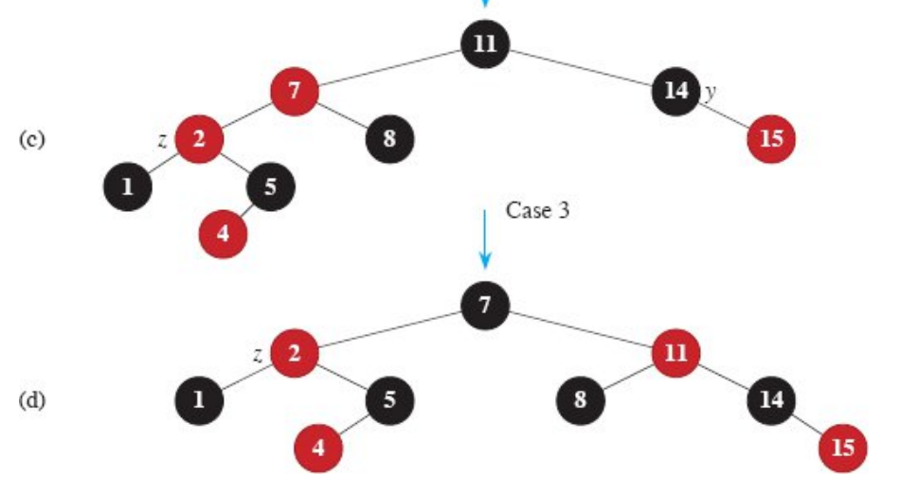
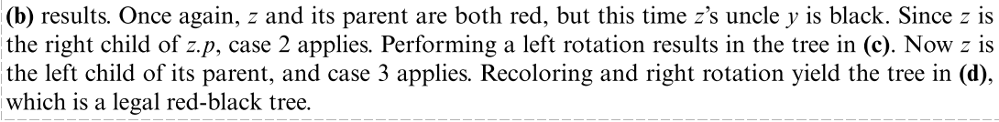

Slide 25
Analysis
O(lg n) time to get through RB-INSERT up to the call of RB-INSERT-FIXUP.
Within RB-INSERT-FIXUP:
  Each iteration takes O(1) time.
  Each iteration is either the last one or it moves z up 2 levels.
  O(lg n) levels ⇒ O(lg n) time.
  Also note that there are at most 2 rotations overall.
Thus, insertion into a red-black tree takes O(lg n) time.

Slide 26
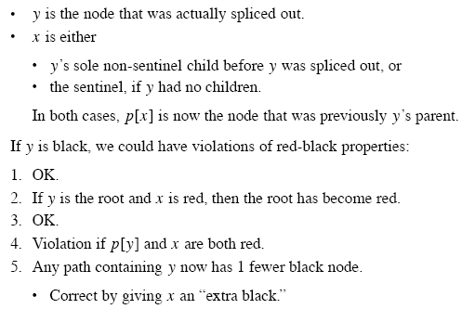
Deletion: delete node z
y has no children or has one child

Slide 27
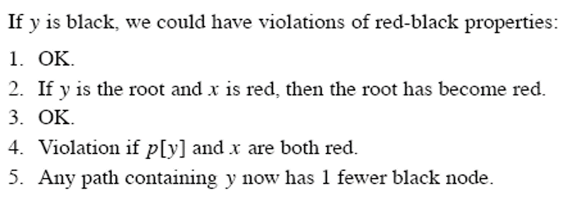
Deletion(2): delete node z
Delete node38: y=39
x is y’s only child or x=NIL
Delete node7: y=7
Delete node 17: y=19

Slide 28
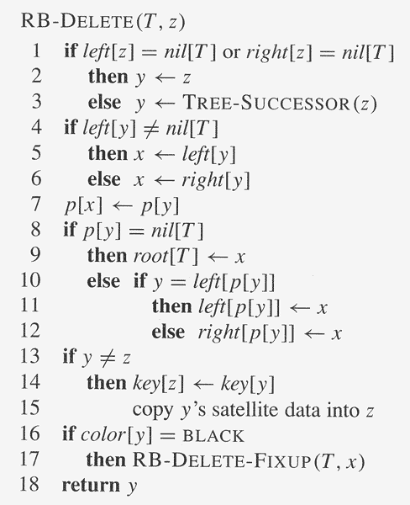
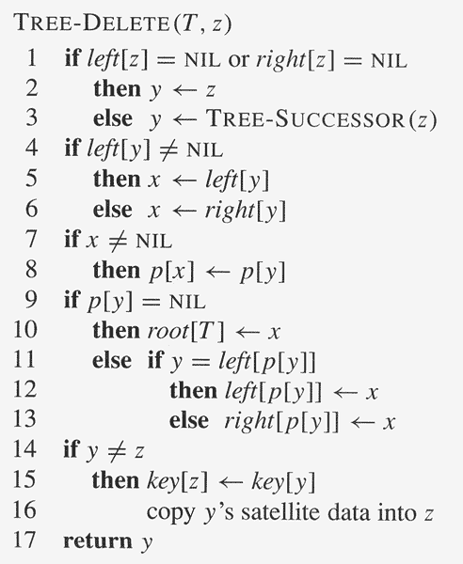
x is y’s only child or x=NIL

Slide 29
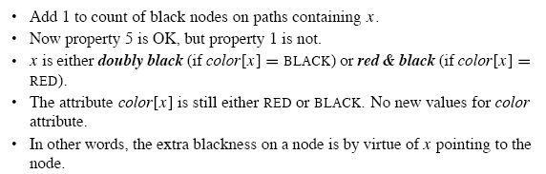
Method

Slide 30
Idea（1）
The truly deleted node is y, y is black
y has no children or only child x is black(delete node 47)
  check sibling w
  if sibling w is red, change w into black, w’s parent into red, right rotate around p[y]
  if sibling w is black, check whether w has red child

Slide 31
Idea （2）
The truly deleted node is y
y has one child x （delete node 17, y=19)
  y is black
  x is red
  splice out y and set x as black

Slide 32
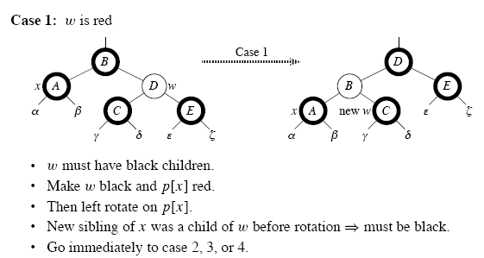
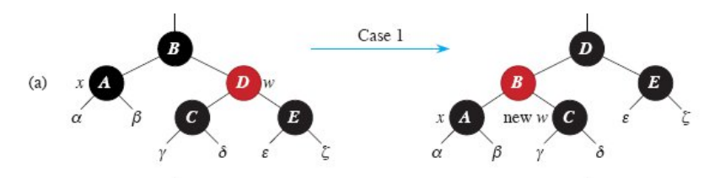
Sibling w is red

Slide 33
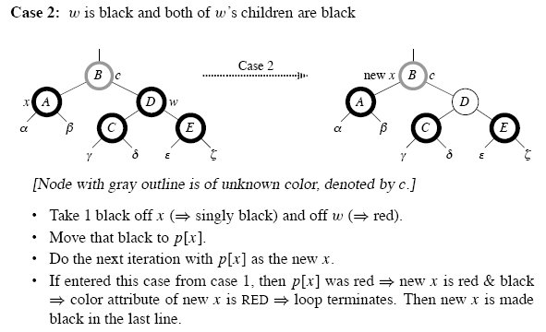
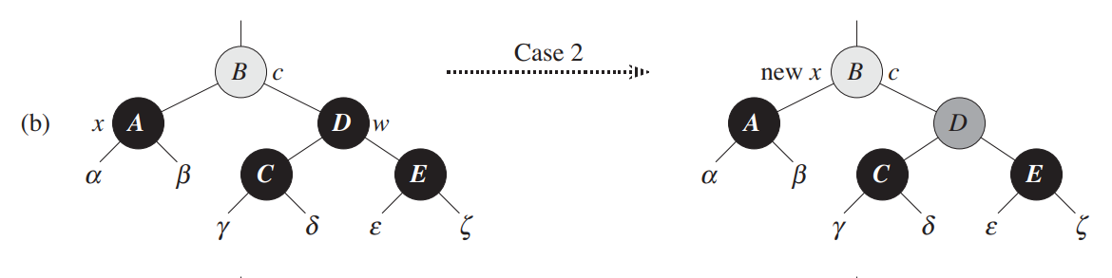
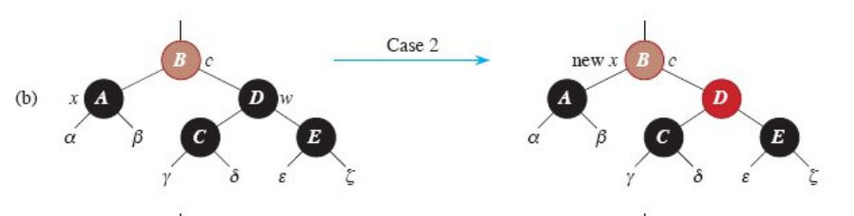
Sibling w is black (1)

Slide 34
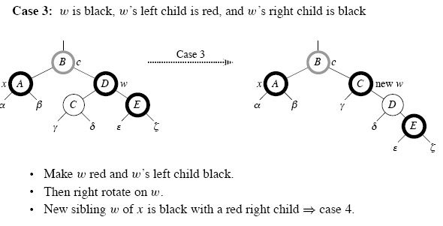
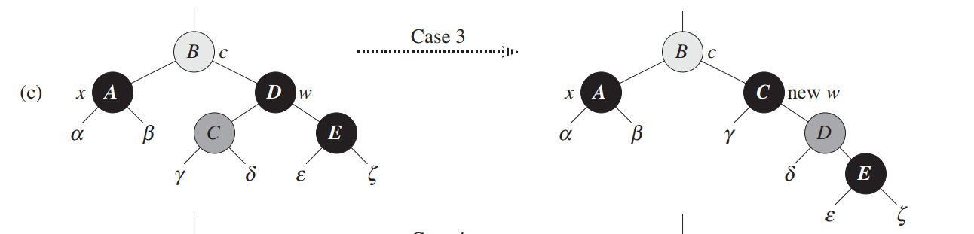
Sibling w is black (2)

Slide 35
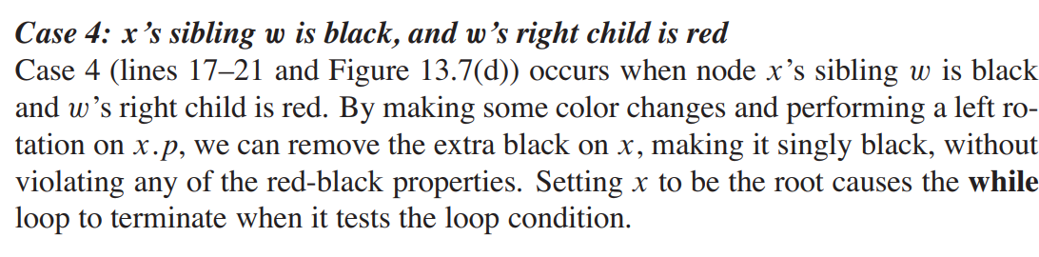
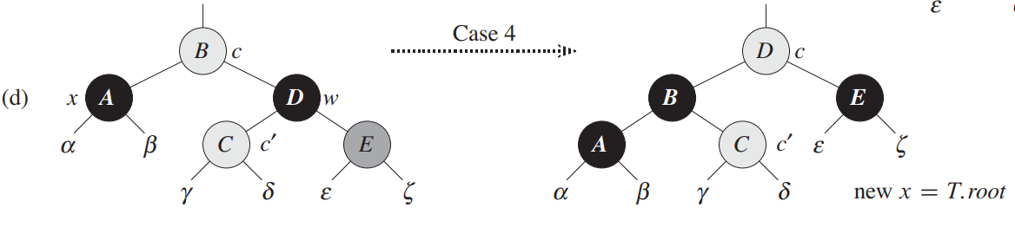
Sibling w is black (3)

Slide 36
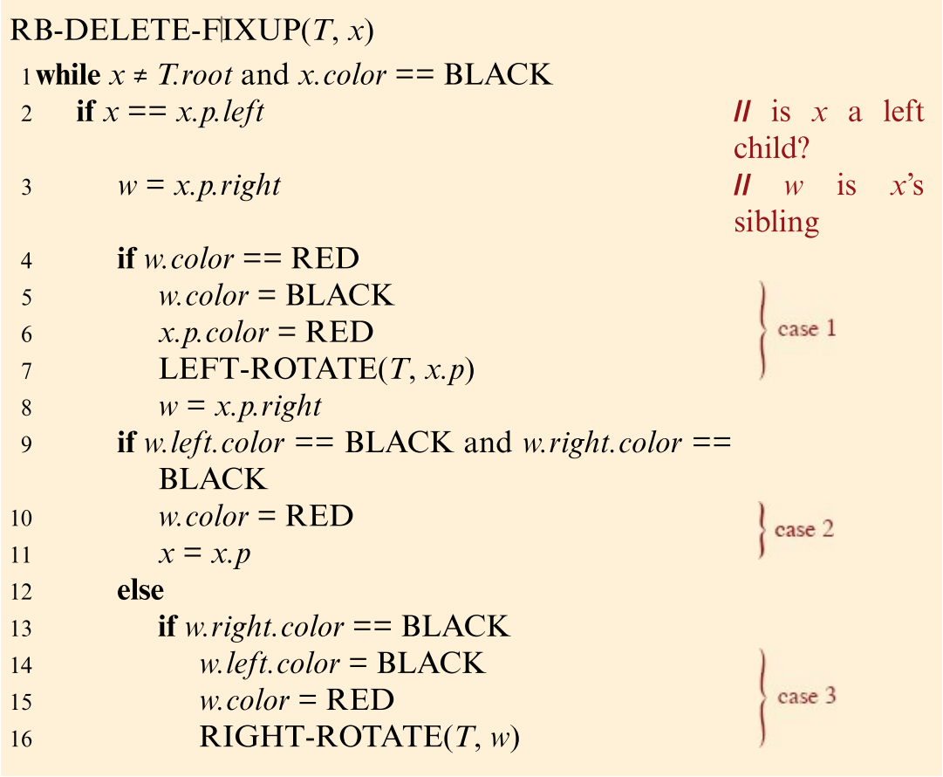
// find x’s sibling w

Slide 37
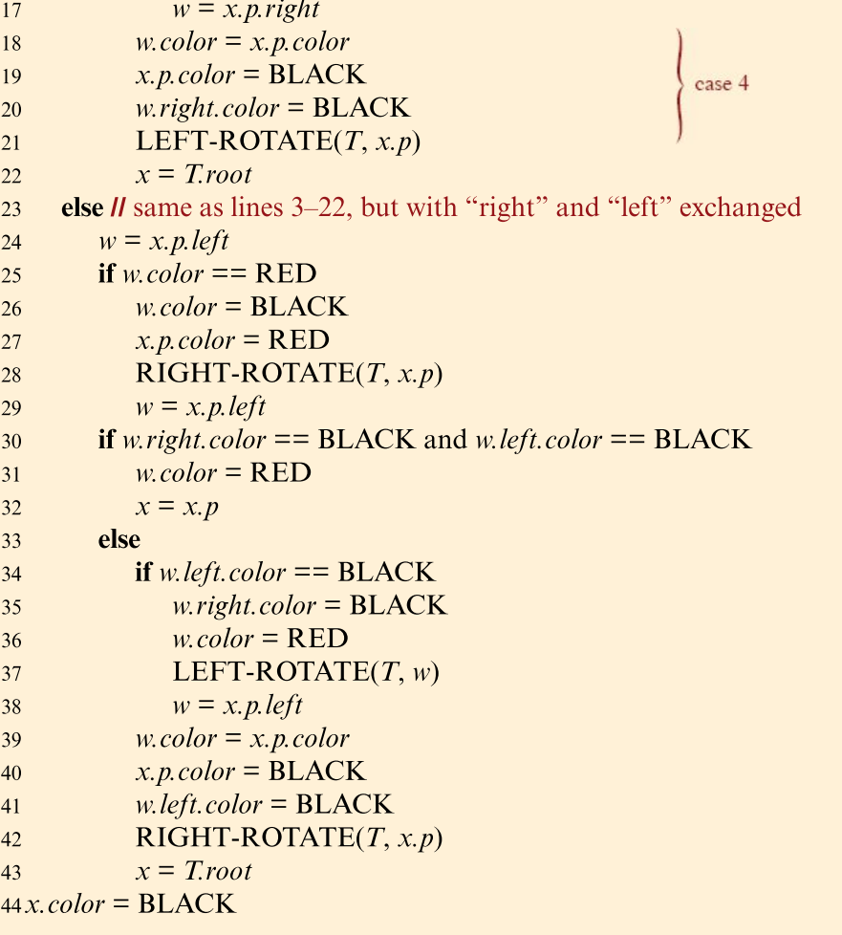

Slide 38


Analysis
O(lg n) time to get through RB-DELETE up to the call of RB-DELETE-FIXUP.
Within RB-DELETE-FIXUP:
  Case 2 is the only case in which more iterations occur.
    X moves up 1 level.
    Hence, O(lg n) iterations.
  Each of cases 1, 3, and 4 has 1 rotation ⇒ ≤ 3 rotations in all.
  Hence, O(lg n) time.

