Slide 1

PARTIV. Advanced Design and Analysis Techniques
Chap 15: Dynamic Programming
  Typically applies to optimization problems in which a set choices must be made in order to arrive at an optimal solution
Chap 16. Greedy Algorithm
  Also applies to optimization problems
  Make each choice in a locally optimal manner
Chap 17. Amortized Analysis
  A tool for analyzing algorithms that perform a sequence of operations on a data structure. It is used to provide a bound on the actual cost for the entire sequence instead of each operation separately.

Slide 2
Chapter 15.
Dynamic Programming

Slide 3
Outline
What is dynamic programming
What is its main characteristics
What is the main differences between dynamic programming and divide-and-conquer method
When to apply dynamic programming to the problem?

Slide 4
Dynamic Programming
Is typically applied to optimization problems (there can be many possible solutions)
We wish to find a solution to the problem with the optimal values (maximum or minimum)
Solves problems by combining the solution to sub-problems. (just like divide-and-conquer)
Dynamic programming is applicable when the sub-problems are not independent. (share common sub-sub-problems)
Solves each sub-sub-problems only once and then saves its answers in a table

Slide 5
Steps of Solution
Characterize the structure of an optimal solution
Recursively define the value of an optimal solution
Compute the value of an optimal solution in a bottom-up fashion
Construct an optimal solution from computed information (not necessary when only the value of the problem is required)

Slide 6
Problem(1): Assembly-line Scheduling
Scenario:
Two assembly lines with n stations (1, 2, …n) each.
Assembly line is used to assemble an auto from a chassis
Corresponding station in each line has the same function each other (S_{1,j} /S_{2,j})with different completing time
jth station in ith (i=1, or 2) line could be transferred to (j+1)th station on the same line with negligible time and to another line with t_{i,j} required time
Entry time e_{i} and exit time x_{i} are also defined
Problem:
For “rush order”, how to get a minimum time to produce an auto from a chassis (manufactured the auto as quick as possible)

Slide 7
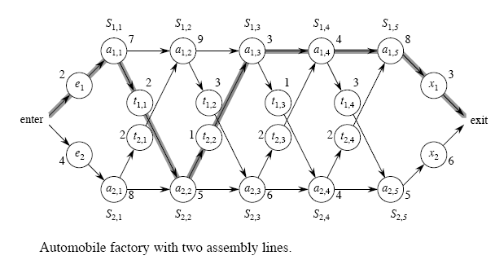
Problem

Slide 8
Naïve method
Claim
There are 2^{n} possible ways to choose stations.
Determining the fastest way through the factory by enumerating all possible ways and computing how long each takes would require
Ω (2^{n}) time.

Slide 9
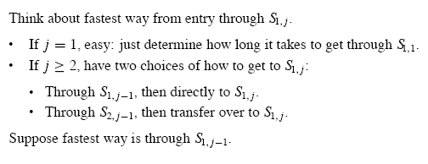
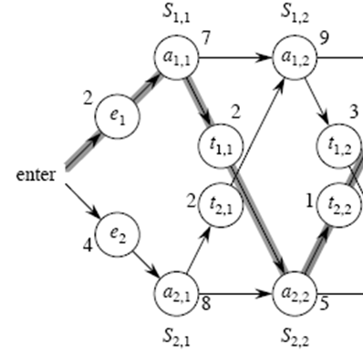
Structure of the fastest way through the factory
The possible fastest way to S_{1,2}:
1) Through S_{1,2} : 2=7=9=18
2) Through S_{2,1}: 4+8+2+9=23
By comparison, the fastest way to S_{1,2} is entry->S_{1,1}->S_{1,2}.

Slide 10
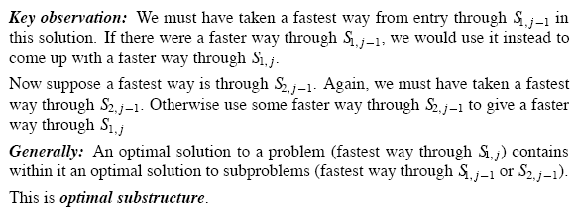
Step1: Optimal Substructure

Slide 11
Optimal Substructure-example
Problem S_{i j}: the fastest way to station a_{i,j}
As for this example, the optimal substructure is: if an optimal solution is (enter, a₁₁, a₂₂, a₁₃, a₁₄, a₁₅, exit), then (enter, , a₁₁, a₂₂, a₁₃, a₁₄, a₁₅) must be the optimal solution for S₁₅ and (enter, , a₁₁, a₂₂, a₁₃, a₁₄) is the optimal solution for S₁₄ , (enter, , a₁₁, a₂₂) is the optimal solution for S₂₂
Observation: In order to compute S06, we need first compute S15, S14….--→Bottom Up

Slide 12
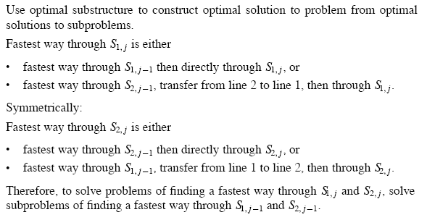
Continue

Slide 13
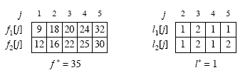
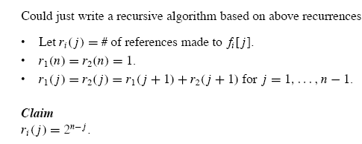
Example

Slide 14
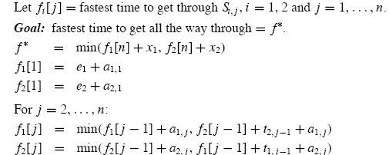
Step2: A Recursive Solution
To define the value of an optimal solution recursively in terms of the optimal solutions to sub-problems

Slide 15
Continued…
Step 3 computing the fastest times
The problem with a recursive algorithm: the running time is exponential in n.
So many repeat references, total reference to all f_{i}[j] is Θ (2^{n})
Observation: the value of f_{i}[j] depends only on the value of f₁[j-1] and f₂[j-1]
By recording each f_{i}[j] in table, Dynamic programming for assembly-line scheduling could be achieved in Θ (n)
See pseudocode of algorithm Fastest-Way (a, t, e, x, n)

Slide 16
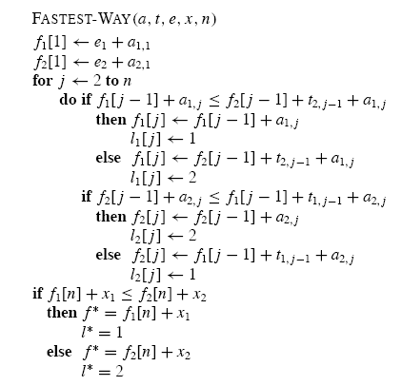
Θ (n) running time

Slide 17
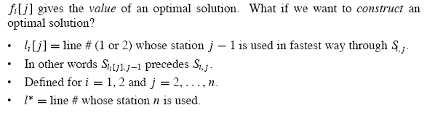
Step4: Constructing the solution

Slide 18
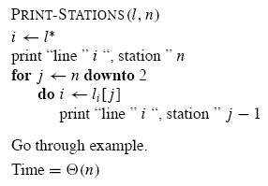
Continue…

Slide 19
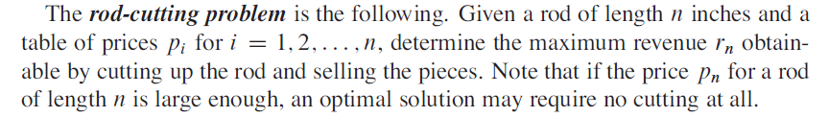

Problem (2): Rod Cutting

Slide 20
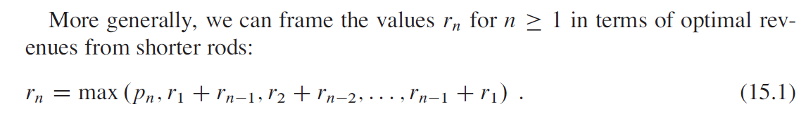
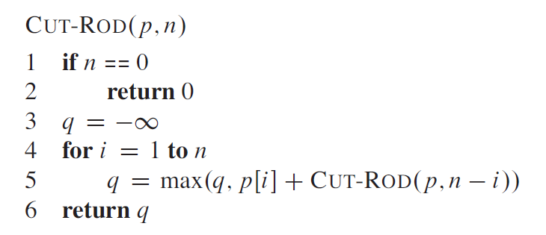
Brute-force Method(1)

Slide 21
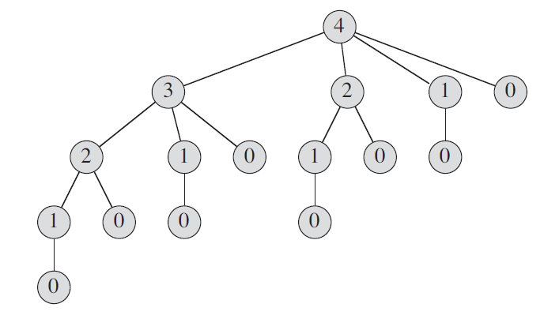
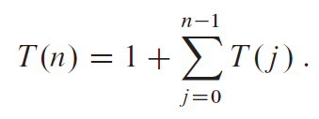

Brute-force Method(2)

Slide 22

Optimal Substructure
If in the optimal solution of rod cutting with length n, the first cutting is at the position of i, then the remaining part must also be the optimal solution of rod cutting with length n-I
We can solve r₁, r₂,…r_{n} sequentially.

Slide 23
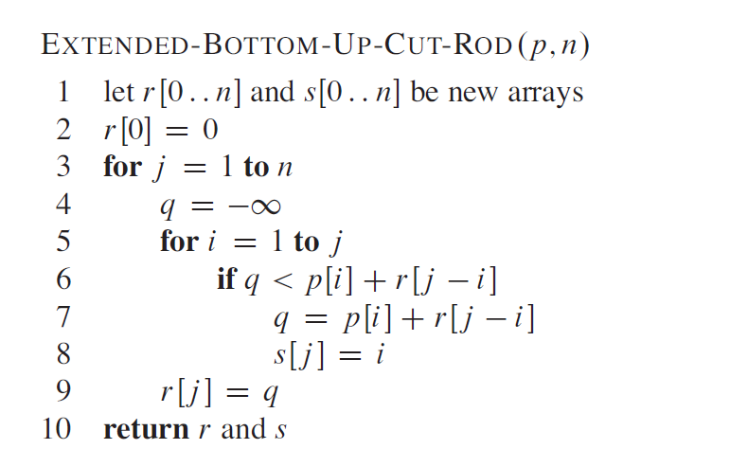
Constructing the Solution
Θ(n²)

Slide 24
Problem (3): Matrix-Chain Multiplication
Problem: We are given a sequence (chain)(A₁, A₂ , … , A_{n} ) of n matrices to be multiplied and we wish to compute the product A₁A₂ … A_{n} efficiently
A product of matrices is fully parenthesized if it is either a single matrix or the product of two fully parenthesized matrix products, surrounded by parentheses.
E.g. A₁A₂ A₃ A₄:
(A₁ ( A₂ (A₃ A₄)) ) ((( A₁ A₂) A₃ ) A₄)
(A₁ (( A₂A₃ )A₄) ) ((A₁ ( A₂ A₃ )) A₄)
(( A₁ A₂) (A₃ A₄) )

Slide 25
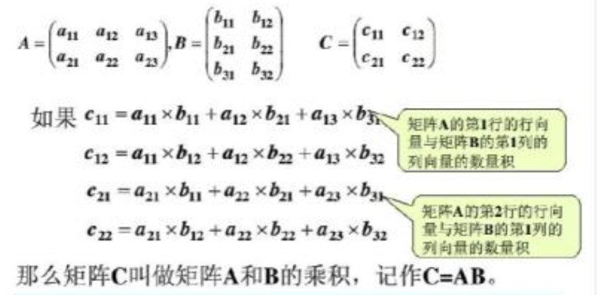
Matrix Multiplication

Slide 26
Optimization Problem
Note: The way we parenthesize a chain of matrices can have a dramatic impact on the cost of evaluation the product.
Cost: number of scalar multiplications
Example: A₁A₂ A₃ with 10*100, 100*5, 5*50.
Given a chain of (A₁, A₂ , … , A_{n} ) of n matrices, A_{i} has the dimension p_{i-1} *p_{i} , fully parenthesize the product A₁, A₂ … A_{n} in such a way that minimize the number of scalar multiplications

Slide 27
Counting the number of
Parenthesizations
Exclusive checking all possible parenthesization is inefficient or even infeasible.
Claim: let P(n) denote the number of alternative parenthesization of a sequence of n matrices. The order of growth for P(n) is Ω (2^{n}). The number of solutions is exponential in n.
Step 1 The structure of an optimal parenthesization
Convention: A_{i…j} (i<=j)→ Optimal sub-structure
Observation: Any parenthesization of the product A_{i}A_{I+1} … A_{j} must split the product between A_{k} and A_{k+1} (i=<k<j) into A_{i}A_{i+1} … A_{k,} A_{k+1} … A_{j ..} Parenthesizations of both A_{i}A_{i+1} … A_{k} and A_{k+1} … A_{j} within this optimal parenthesization A_{i}A_{I+1} … A_{j} are also optimal.

Slide 28
Discussion
What is the optimal substructure for the problem of matrix chain multiplication?
A₁A₂ A₃ A₄ A₅ A₆
If ((A₁(A₂ A₃)) ((A₄ A₅) A₆), then (A₁(A₂ A₃)) must be the optimal solution for A₁A₂ A₃ , ((A₄ A₅) A₆) must be the optimal solution for A₄ A₅ A₆.
Observation: We can find the optimal solution in bottom up way.

Slide 29
Continued…
Step2. A recursive Solution
Define the cost of an optimal solution recursively in terms of the optimal solutions to sub-problems.
Sub-problems: determining the minimum cost of a parenthesization of A_{i}A_{i+1} … A_{j}
Convention: m[i,j]—minimum number of scalar multiplications
m[i,j]=min{m[i,k]+ m[k+1,j]+p_{i-1}p_{k}p_{j,}}, (i<j)
K is unknown and have j-i possible values

Slide 30
Step3. Computing the optimal cost
Directly recursive implementation incur exponential in n running time.
Observation: We have relatively fewer sub-problems: Θ (n²)
  One problem for each choice of i and j satisfying (1=<i<j<=1)
Hallmark: overlapping sub-problems
Use a tabular , bottom-up approach
Point1: we compute in term of length l
Point2: the value of sub-sub-problems are recorded in the tabular once computed and are used many times later by just look up in the table
Point3: use an auxiliary s[i,j] to denote which index k achieved the optimal cost in computing m[i,j]

Slide 31
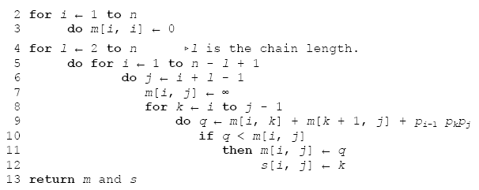
Pseudocode
Θ (n³) running time

Slide 32
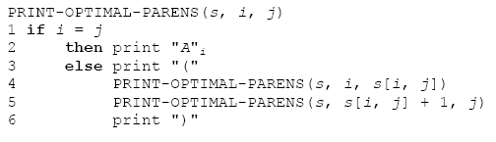
Continued…
Step4. Constructing an optimal solution
We know from table s[1…n,1…n]the final matrix multiplication in computing A₁A₂ … A_{n} is A₁… _{s[1,n]}A_{s[1,n]+1…} A_{n}
A₁… _{s[1,n]} could be recursively determined by A₁… _{s[1,s[1,n]]}

Slide 33
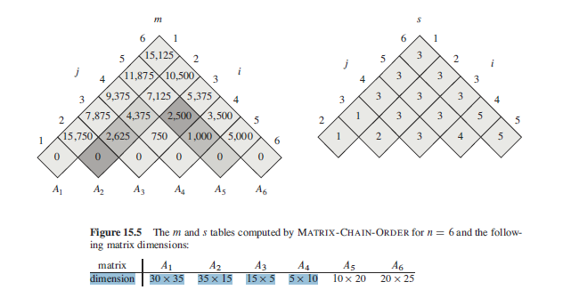

Example

Slide 34
Elements of dynamic programming
When should we look for a dynamic programming solution to a problem?
Optimal sub-structure
- Common pattern
- number of sub-problems vs. choices need to made
- subtleties (unweighted shortest path vs. longest path)
Overlapping sub-problems
- differ dynamic programming from divide-and-conquer

Slide 35
Optimal Sub-structure
Assembly-line scheduling
  Θ (n) sub-problems overall
  Two choices to examine
Matrix-chain multiplication
  Θ (n²) sub-problems overall
  At most n-1 choices to examine
Bottom-up vs. top-down
  dynamic programming: bottom-up
  Greedy algorithm: top-down

Slide 36
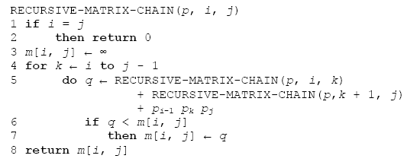
Overlapping Sub-problems

Slide 37
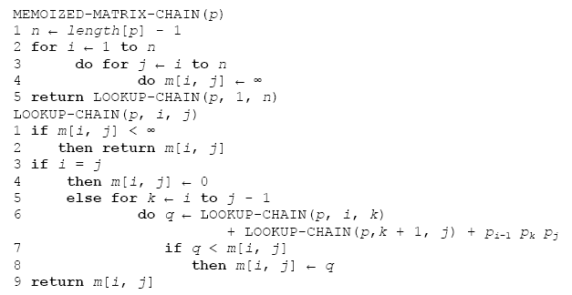
Memoization

Slide 38
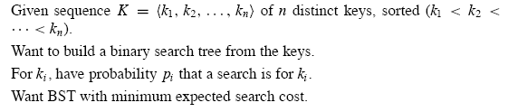

Problem (4): Optimal Binary Search Tree
Problem background: Dictionary translation
Optimal BST: with smallest expected search cost

Slide 39
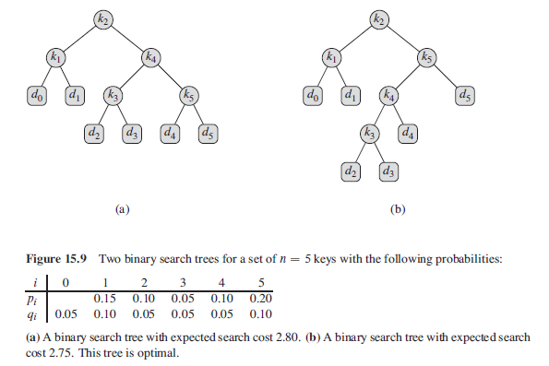
Two Binary Search Trees

Slide 40
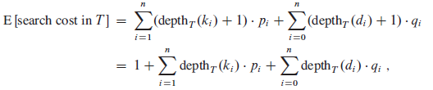
Expected Search Cost

Slide 41
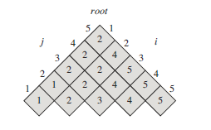
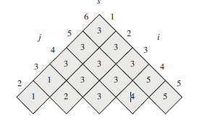
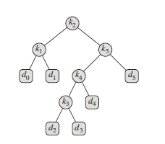
Similarity between MCM and OBST
K_{1,} k_{2 ,} k_{3 ,} k₄ , k₅
A₁A₂ A₃ A₄ A₅ A₆

Slide 42
Discussion
What is the optimal substructure for the problem of optimal binary search tree with following nodes?
k_{1,} k_{2 ,} k_{3,} k_{4,} k₅
If an optimal binary search tree containing k_{1,} k_{2 ,} k_{3,} k_{4,} k₅ is rooted at k₃, then the left subtree containing (k_{1,} k₂₎ and the right right subtree containg (k_{4,} k₅) must be optimal binary search tree respectively.
Observation: We can find the optimal solution in bottom up way.

Slide 43

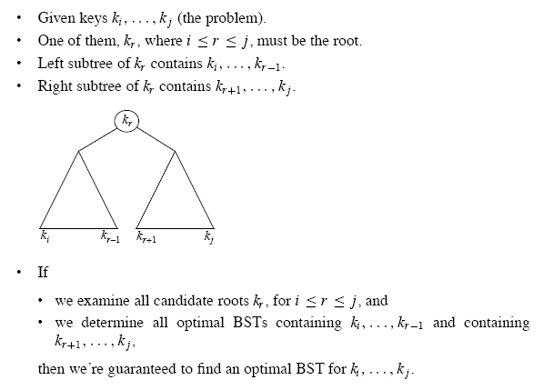
Step1: Optimal Substructure

Slide 44
Step2: A Recursive Solution(1)
What happens to the expected search cost of a sub-tree T when it becomes a sub-tree of a node?
The depth of each node in the T increases by 1.
The expected search cost of this subtree increases by the sum of all the probability in the subtree.

Slide 45
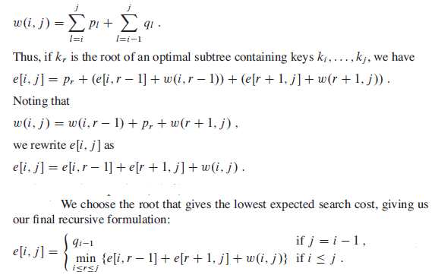
Step2: A Recursive Solution(2)

Slide 46
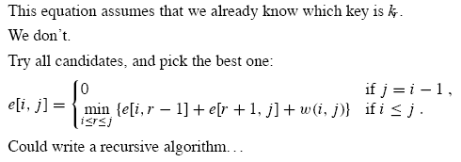
Continue…

Slide 47
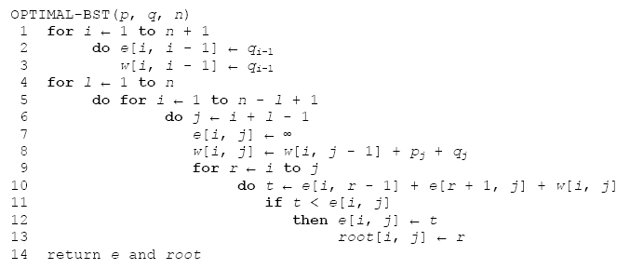
Step 3: Computing the Expected Search Cost of an Optimal BST
Θ (n³) running time

Slide 48
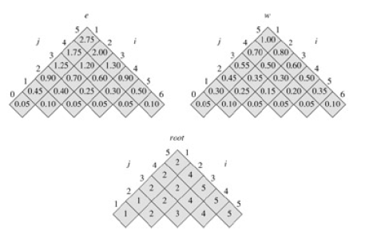
Result Optimal BST

Slide 49
Problem(5): Maximum Sub-Array Sum
Problem
Given a sequence of n integers A[1,2,..n], A[i] could be negative. Find the continuous sub-array A[i, i+1,…j] with the maximum sum.
Example
Given sequence { -2, 11, -4, 13, -5, -2 }, its maximum sub-array is A[2,3,4] : { 11, -4, 13 } with the largest sum being 20.

Slide 50
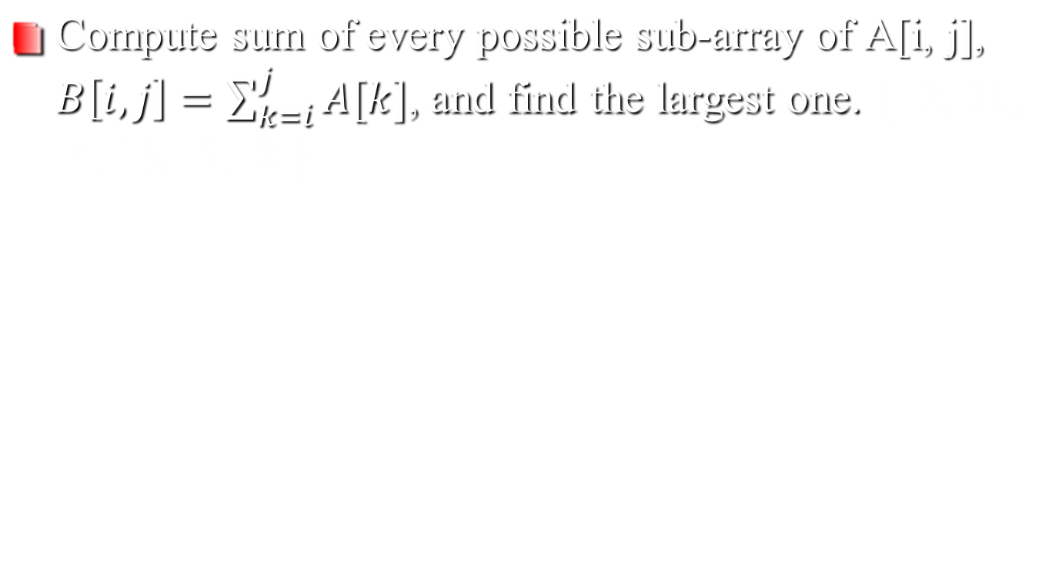
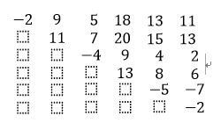
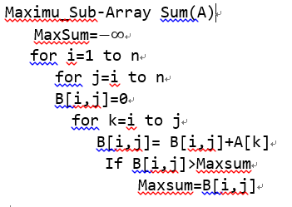
Method (1)—Brute force
Θ (n³) running time
Faster algorithm?

Slide 51
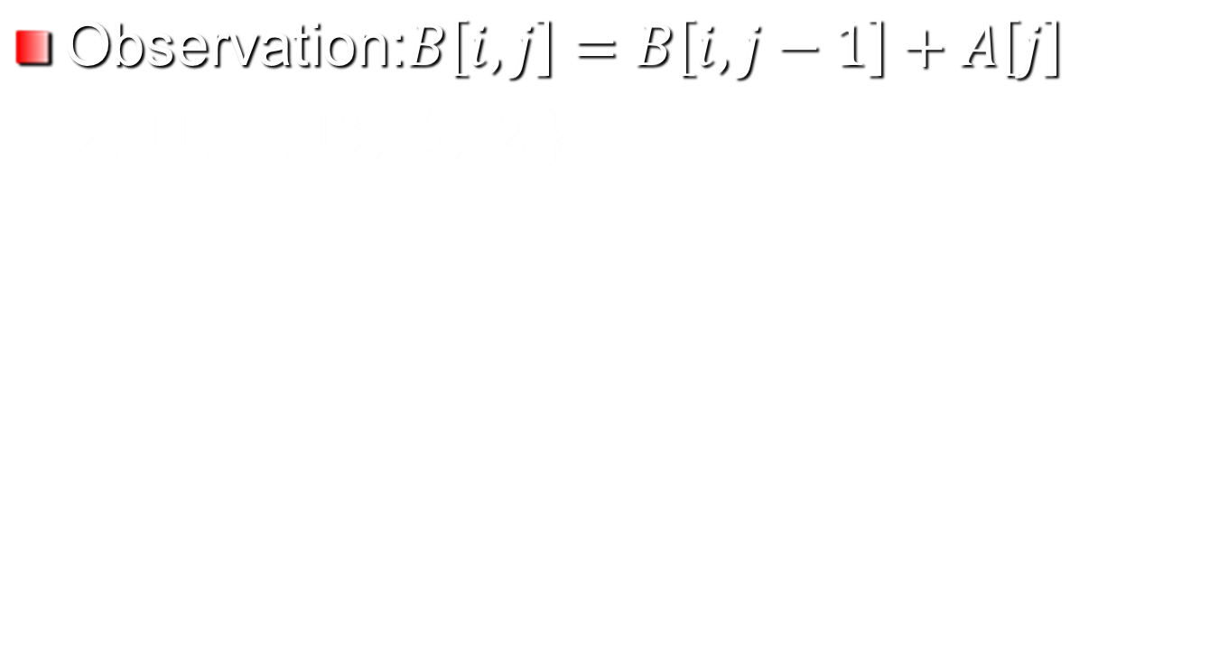
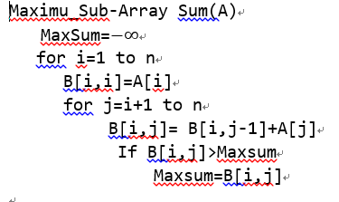
Method (2)—optimized B[i,j] Computing
Θ (n²) running time
Faster algorithm?

Slide 52
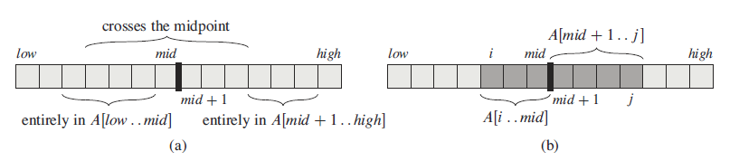
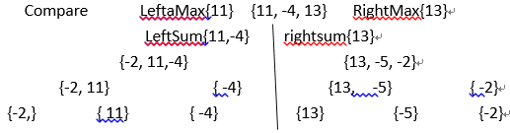
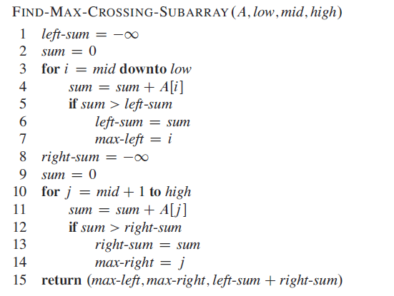
Method (3)—Divide-and-Conquer
Θ (nlogn) running time
Faster algorithm?

Slide 53
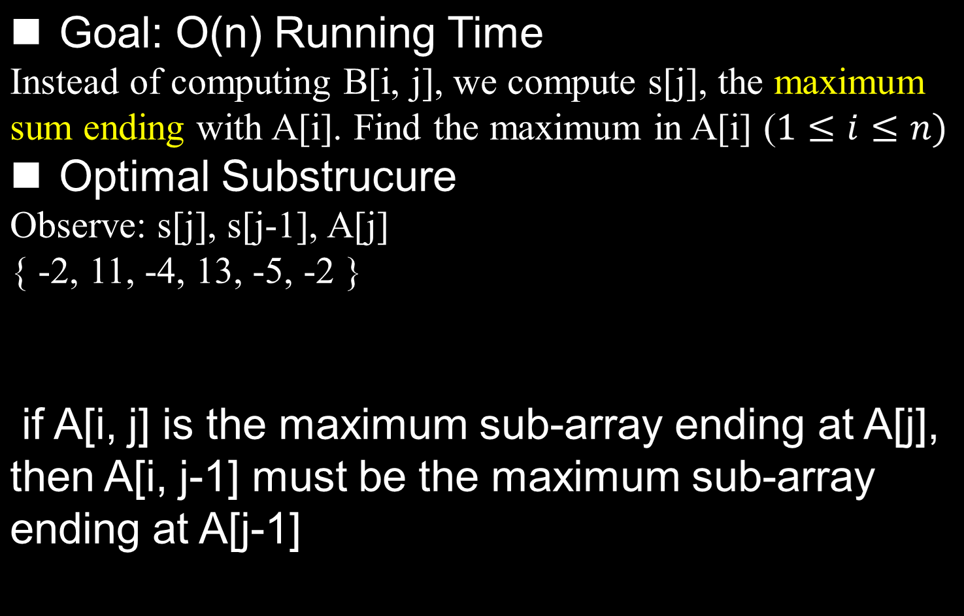
Method (4)—Dynamic Programming

Slide 54
Problem(6): Longest Common Subsequence
Problem (LCS)- Similarity between two sequences
In the longest-common-subsequence problem, we are given two sequences X( x₁, x₂, … , x_{m}) and Y(y₁, y₂, … , y_{n})and wish to find a maximum length common subsequence of X and Y. How to efficiently solve the LCS problem using dynamic programming.
Prefix of sequence
To be precise, given a sequence X( x₁; x₂; … ; x_{m}), we define the i th prefix of X, for i = 0; 1; … ;m, as Xi=(x₁; x₂; ... ; x_{i} ).

Slide 55

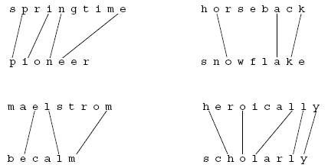
Longest Common Subsequence

Slide 56
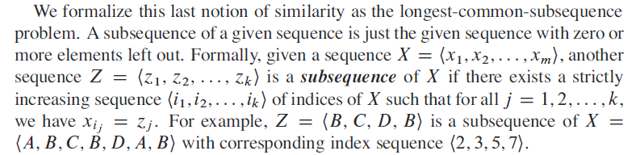
Sebsequnce

Slide 57
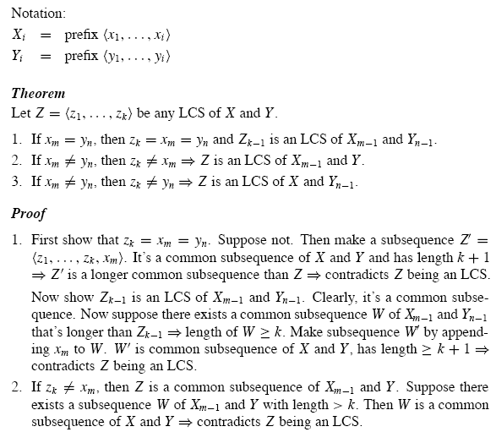
X=ABCBDAB
Y=BDCABA

Slide 58
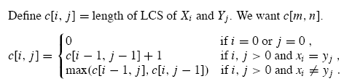
Recursive Formulation
Optimal substructure: an LCS of two sequences contains as a prefix an LCS of prefixes of the sequences.

Slide 59
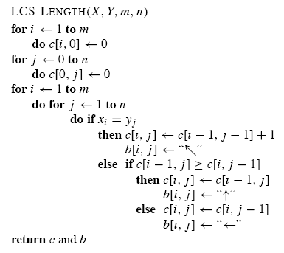
Computing the length of an LCS
Θ (mn) running time

Slide 60
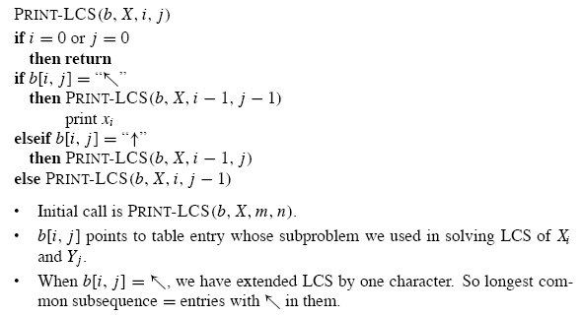
Constructing an LCS
Θ (m+n) running time

Slide 61
