Slide 1
Advanced Design and
Analysis Techniques

Slide 2
Introduction
Three important techniques for the design and analysis of efficient algorithms:
Earlier Techniques:
  Divide-and-Conquer,
  the solution of Recurrences,
  Randomization.
Dynamic Programming
Greedy Algorithm
Amortized Analysis

Slide 3
Chapter 16
Greedy Algorithms

Slide 4

Introduction
It applies to Optimization Problem
When we have a choice to make, make the one that looks best right now. – Make a locally optimal choice in hope of getting a globally optimal solution.
Greedy algorithms don’t always yield an optimal solution, but sometimes they do.

Slide 5
An Activity Selection Problem
The problem of scheduling several competing activities that require exclusive use of a common resource.
n activities require exclusive use of a common resource.
E.g. scheduling the use of a classroom.
Set of activities S={a₁, …. , a_{n}}.
a_{i} needs resource during period [ s_{i} , f_{i} ), which is a half-open interval, where s_{i} = start time and f_{i} = finish time.
Goal: Select the largest possible set of non-overlapping (mutually compatible) activities.
Note: Could have many other objectives:
  Schedule room for longest time.
  Maximize income rental fees.

Slide 6
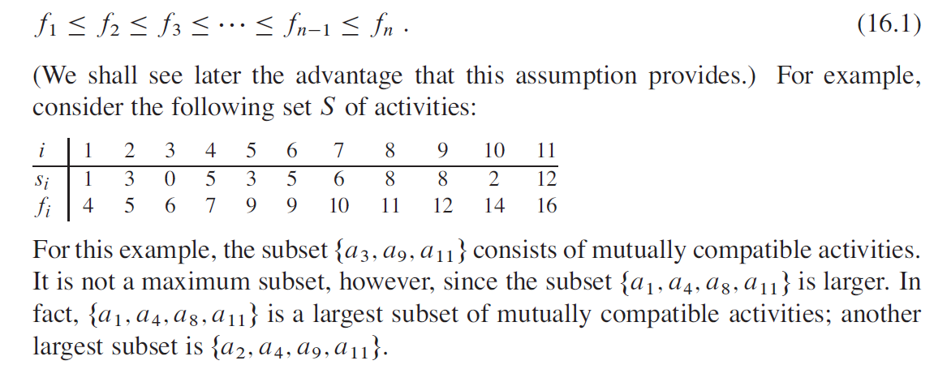
Example

Slide 7
Designing a Greedy Algorithm
The basic idea in a greedy algorithm for interval scheduling is to use a simple rule to select a first request. Once a₁ is accepted, we reject all requests that are not compatible with a₁.
  Rule 1: Starts earliest (does not work)
  Rule 2: Requires the smallest interval of time-namely, f(i)-s(i) is as small as possible (does not work)
  Rule 3: Selects the interval with the fewest conflicts (does not work)
Rule: finish earliest

Slide 8
DP： The Optimal Substructure
S_{ij} = {a_{k} ∈ S : f _{i} ≤ s _{k} < f _{k} ≤ s _{j} } = activities that start after a_{i} finishes and finish before a _{j} starts
Activities in S _{i j} may not be compatible each other and we wish to find a maximum set of mutually compatible activities in S _{i j}
Activities in S _{i j} are compatible with
  all activities that finish by f _{i}, and
  all activities that start no earlier than s_{j} .
To represent the entire problem, add fictitious activities:
a₀ = [ -∞, 0 )
a_{n+1} = [∞, “∞+1” )
We don’t care about - ∞ in a ₀ or “∞+1” in a_{n+1}.
Then S = S _{0, n+1.}
Range for S _{i j} is 0 ≤ i, j ≤ n + 1.

Slide 9
Continue
Assume that activities are sorted by monotonically increasing finish time:
f 0 ≤ f 1 ≤ f 2 ≤ · · · ≤ f n < f n+1 .
Then i ≥ j ⇒ S_{i j} = ∅.
  If there exists a_{k} ∈ S _{i j} : f _{i} ≤ s_{k} < f _{k} ≤ s_{j} < f _{j} ⇒ f _{i} < f _{j} .
  But i ≥ j ⇒ f _{i} ≥ f _{j} . Contradiction.
So only need to worry about S_{i j} with 0 ≤ i < j ≤ n + 1.
All other S_{i j} are ∅.

Slide 10

Observations
Suppose that a solution to S _{i j} includes a_{k}. Have 2 sub-problems:
  S _{i k} (start after a_{i} finishes, finish before a_{k} starts)
  S _{k j} (start after a_{k} finishes, finish before a _{j} starts)
Solution to S_{i j} is { solution to S_{ik} } ∪ {a_{k} } ∪ { solution to S_{kj} }.
Since a_{k} is in neither sub-problem, and the sub-problems are disjoint:
| solution to S | = | solution to S_{i k} | + 1 + | solution to S_{kj} | .
If an optimal solution to S _{ij} includes a_{k} , then
the solutions to S _{ik} and S _{kj} used within this solution must be optimal as well.
Let A _{ij} = optimal solution to S_{ij} .
So A _{i j} = A _{i k} ∪ {a_{k}} ∪ A _{k j}, assuming:
  S_{i j} is nonempty, and we know a_{k} .

Slide 11
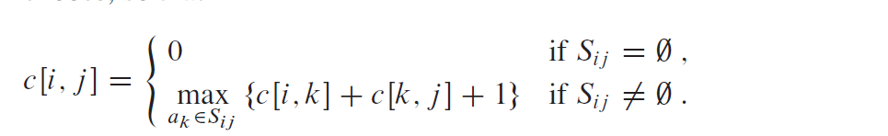

Recursive solution to Activity Selection
c[i, j] = size of maximum-size subset of mutually compatible activities in S_{ij} .
    i ≥ j ⇒ S i j = ∅ ⇒ c[i, j] = 0.
If S_{ij} ≠ ∅, suppose we know that a_{k} is in the subset. Then c [i, j] = c [i, k] + 1 + c [k, j] .
But, we don’t know which k to use, and so

Slide 12

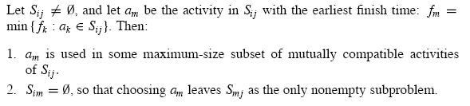
Continue
Why this range of k?
Because S_{i j} = {a_{k} ∈ S : f_{i} ≤ s _{k} < f _{k} ≤ s_{j} } ⇒ a_{k} can’t be a_{i} or a_{j}.
Also need to ensure that a_{k} is actually in S_{i j} (i.e. a_{k} ∈ S_{i j} ), since i < k < j is not sufficient on its own to ensure this.
Theorem 16.1

Slide 13
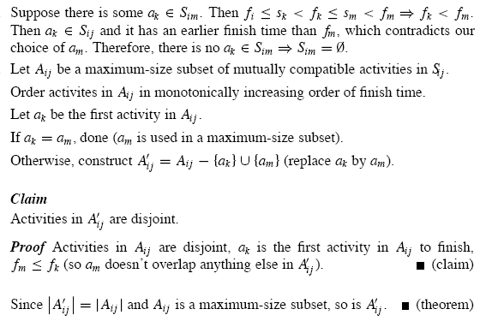
Proof

Slide 14
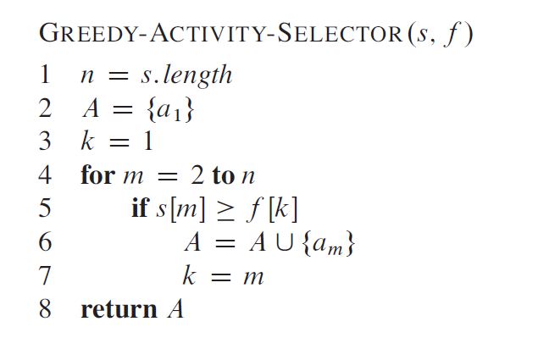
A Recursive Greedy Algorithm
Assumes activities already sorted by monotonically increasing finish time. (If not, then sort in O(n lg n) time.)
Return an optimal solution for S_{i,n+1}:
Initial call: REC-ACTIVITY-SELECTOR(s, f, 0, n).
Time： Θ(n)

Slide 15
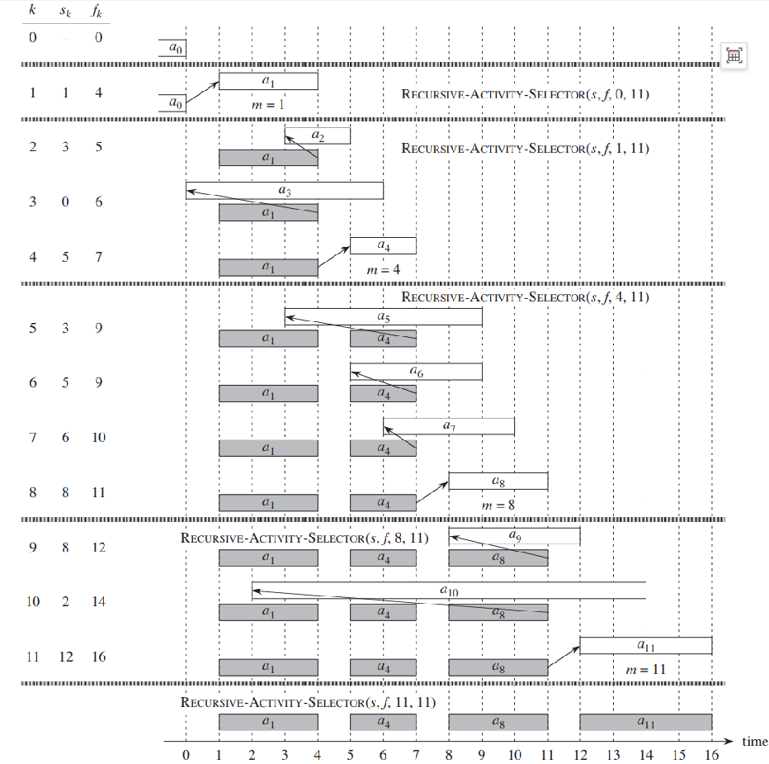

Slide 16
Elements of the Greedy Strategy
The choice that seems best at the moment is the one we go with.
What did we do for activity selection?
  1. Determine the optimal substructure.
  2. Develop a recursive solution.
  3. Prove that at any stage of recursion, one of the optimal choices is the greedy choice.
  Therefore, it’s always safe to make the greedy choice.
  4. Show that all but one of the sub-problems resulting from the greedy choice are empty.
  5. Develop a recursive greedy algorithm.
  6. Convert it to an iterative algorithm.

Slide 17
Continue…
At first, it looked like dynamic programming.
Typically, we streamline these steps.
Develop the substructure with an eye toward
  making the greedy choice,
  leaving just one sub-problem.

Slide 18
Activity Selection
For activity selection, we showed that the greedy choice implied that in S_{ij}, only i varied, and j was fixed at n + 1.
We could have started out with a greedy algorithm in mind:
  Define S_{i} = { a_{k} ∈ S : f _{i} ≤ s_{k} }.
  activities starting after activity i finishes
  Then show that the greedy choice - first a_{m} to finish in S_{i} - combined with optimal solution to S_{m} ⇒ optimal solution to S_{i} .

Slide 19
Typical streamlined steps
  Cast the optimization problem as one in which we make a choice and are left with one sub-problem to solve.
  2. Prove that there’s always an optimal solution that makes the greedy choice, so that the greedy choice is always safe.
  Show that greedy choice and optimal solution to sub-problem ⇒ optimal solution to the problem.

Slide 20
Two Points
No general way to tell if a greedy algorithm is optimal, but two key ingredients are
  1. greedy-choice property and
  2. optimal substructure.

Slide 21
Greedy-choice property
A globally optimal solution can be arrived at by making a locally optimal (greedy) choice.
Dynamic programming:
  Make a choice at each step.
  Choice depends on knowing optimal solutions to subproblems.
  Solve subproblems first.
  Solve bottom-up.
Greedy:
  Make a choice at each step.
  Make the choice before solving the subproblems.
  Solve top-down.

Slide 22
Continue…
Typically show the greedy-choice property by what we did for activity selection:
  Look at a globally optimal solution.
  If it includes the greedy choice, done.
  Else, modify it to include the greedy choice, yielding another solution that’s just as good.
Can get efficiency gains from greedy-choice property.
  Preprocess input to put it into greedy order.
  Or, if dynamic data, use a priority queue.

Slide 23
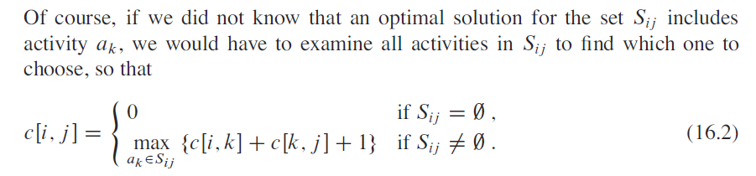
Optimal Substructure
A problem exhibits optimal substructure if an optimal solution to the problem contains within it optimal solutions to subproblems.
  A_{ij} = A_{ik} ∪ {a_{k}} ∪ A_{k j}
Just show that optimal solution to sub-problem and greedy choice ⇒ optimal solution to problem.

Slide 24

Huffman Codes: Application of Greedy Algorithm
A technique for compressing data – widely used and effective.
Problem: How to compress a file w/o losing information?
  Compression saves TIME as well as SPACE.
Use a Binary Character code
Example: A 100,000-character data file of 6 characters {a, b, c, d, e, f}

Slide 25
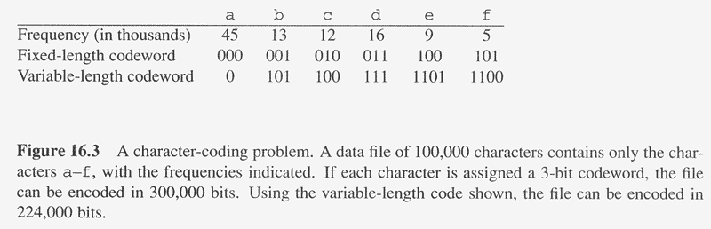

Slide 26
Example
A Fixed-length code:
  a=000, b=001, … f=101
  100,000 * 3 = 300,000 bits to code the entire file.
A Variable-length code:
  a=0, b=101, c=100, d=111, e=1101, f=1100
  ∑ frequency of char(i) * | code(i) |
  = (45*1+13*3+12*3+16*3+9*4+5*4)*1000 = 224,000 bits

Slide 27
Prefix codes
Definition: codes in which no codeword is also a prefix of some other codeword.
The optimal data compression achievable by a character code can always be achieved with a prefix code.
Encoding:
e.g.) abc = 0·101·100 = 0101100
They simplify decoding. – no ambiguity

Slide 28
Continue…
Decoding: Binary tree representation
  Interpretation of the binary codeword for a character as the path from the root to that character, where 0 means ‘go to the left child’ and 1 ‘to the right child’.
An optimal code is represented by a FULL binary tree. (each node has two children or no child)
  If C = the alphabet from which characters(c) are drawn and frequency (character) > 0
  then the tree for an optimal prefix code has exactly |C| leaves and exactly |C| -1 internal nodes.
Different definitions

Slide 29
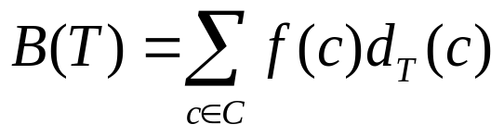
.. continued
Given a tree T corresponding to a prefix code, the number of bits required to encode a file is:
for each character c in the alphabet C,
f(c) : the frequency of c in the file
d_{T} (c) : the depth of c’s leaf in the tree
which is the length of the codeword for character c.
Then, the number of bits required to encode a file is:
  - the cost of the tree T

Slide 30
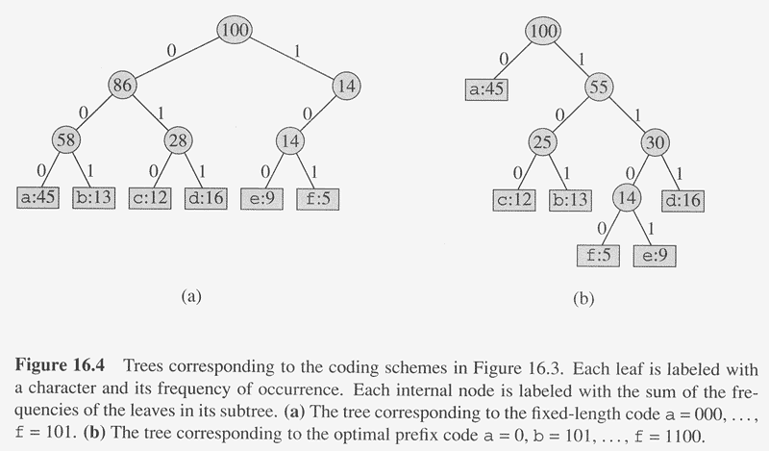

Slide 31
Constructing a Huffman Code
An optimal prefix code invented by Huffman by applying a greedy algorithm.
The algorithm builds the tree T corresponding to the optimal code in a bottom-up manner.
  It begins with a set of |C| leaves and performs a sequence of |C| -1 merging operations to create the final tree.
  A min-priority queue Q, keyed on f, is used to identify the two least-frequent objects to merge together.
  The result of the merger of two objects is a new object whose frequency is the sum of the frequencies of the two objects that were merged.

Slide 32
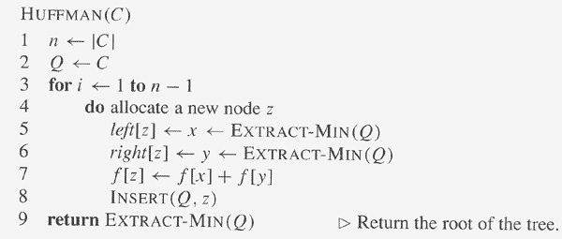

Slide 33
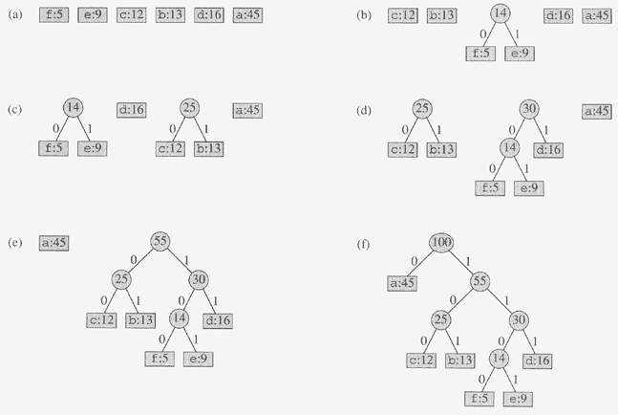

Slide 34
Correctness of Huffman’s Algorithm
Suppose C is an alphabet in which each character c in C with frequency f[c]. Let x and y be two characters in C having the lowest frequencies.
Lemma 16.2 (Greedy choice)
There exists an optimal prefix code for C in which the codewords for x and y have the same length and differ only in the last bit.
Lemma 16.3 (Optimal substructure)
Let C’ be the alphabet C with characters x and y removed and (new) character z added, so that C’=C-{x,y|}U{z}; define f for C’ as for C, except that f[z]=f[x]+f[y]. Let T’ be any tree representing an optimal prefix code for the alphabet C’. Then the tree T, obtained from T’ by replacing the leaf node for z with an internal node having x and y as children, represents an optimal prefix code for the alphabet C.

Slide 35

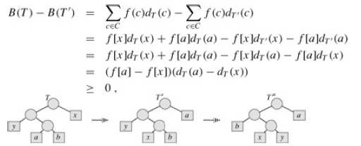
Lemma 16.2

Slide 36
Lemma 16.2 (Cont.)
Lemma 16.2 implies that the process of building up an optimal tree by mergers can, without loss of generality, begin with the greedy choice of merging together those two characters of lowest frequency. Why is this a greedy choice? We can view the cost of a single merger as being the sum of the frequencies of the two items being merged. Of all possible mergers at each step, HUFFMAN chooses the one that incurs the least cost.

Slide 37
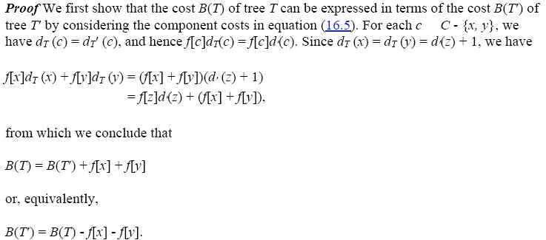
Lemma 16.3
in

Slide 38
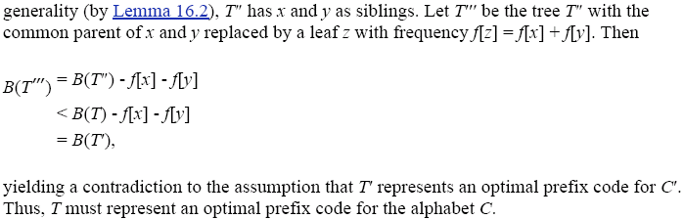
Lemma 16.3 (Cont.)

Slide 39
Dynamic Programming vs. Greedy Algorithm (1)
knapsack problemrt
  n items.
  Item i is worth $v_{i} , weighs w_{i} pounds.
  Find a most valuable subset of items with total weight ≤ W.
  0 or 1, fractional
  No duplicate items (1, k, ∞）
Variation of Knapsack Problem
Other applications

Slide 40
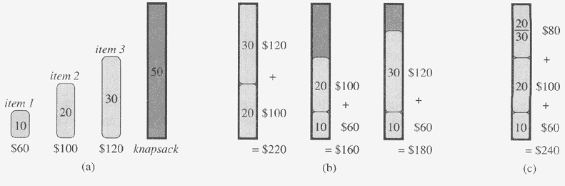
Example of knapsack Problem

Slide 41
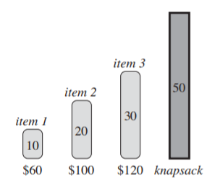
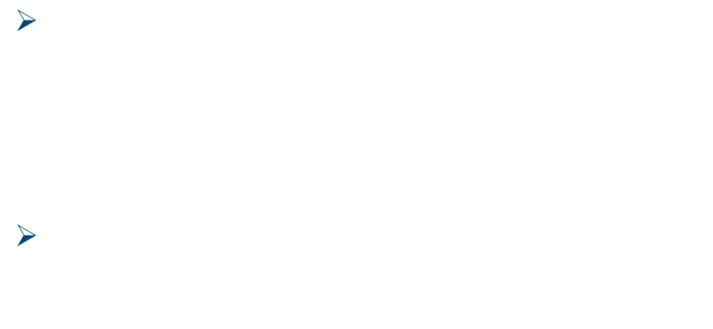

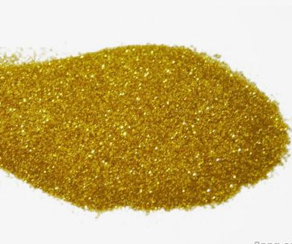
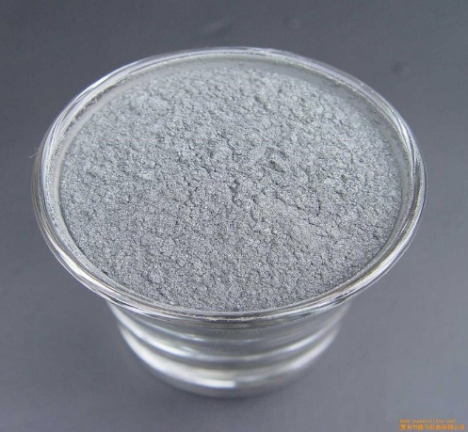
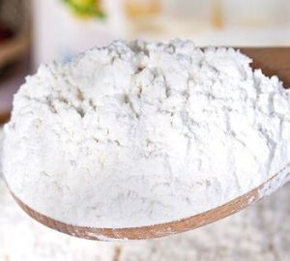
Fractional Knapsack Problem
LOGO

Slide 42
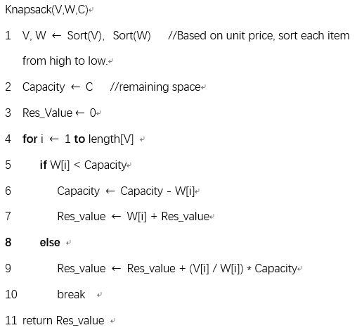
Algorithm
Time: O(nlgn)
Space: O(n)
LOGO

Slide 43

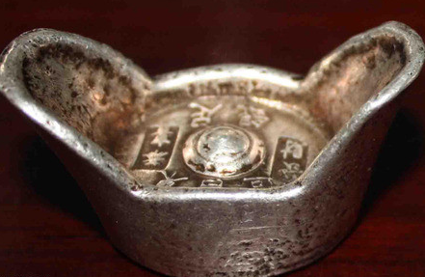
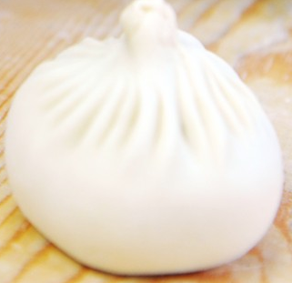
0/1 Knapsack Problem
The thief continues robbing another store. However, for each item, the thief must either take it or leave it behind. He cannot take a fractional amount of an item. Which items should he take?
He can only choose to take or not take
LOGO

Slide 44
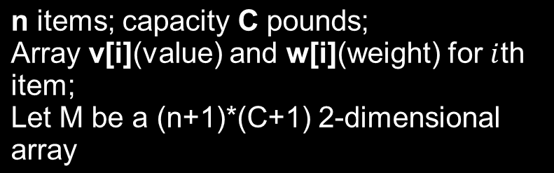
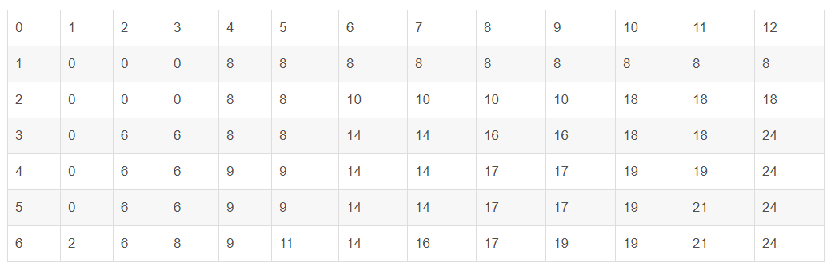
Problem Analysis
Dynamic Programming !
v = {8, 10, 6, 3, 7, 2}
w = {4, 6, 2, 2, 5, 1}
C = 12
LOGO

Slide 45
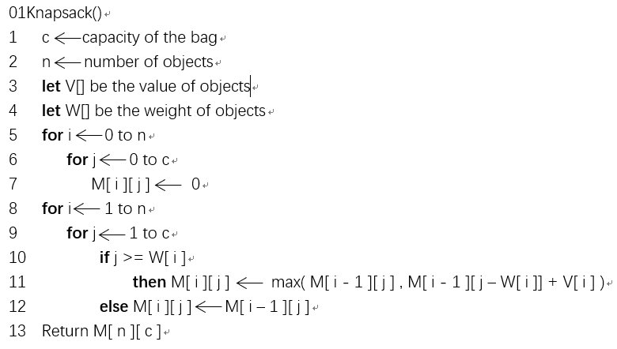
03
Algorithm Explanation
Time: O(n * c) Space: O(n * c)
LOGO

Slide 46
Greedy Algorithm vs. Dynamic Programming (2)
Interval scheduling vs. weighted interval scheduling
In weighted interval scheduling, each interval has a certain weight. (Greedy choice does not work)
Goal: we want to accept a set of maximum value
Interval scheduling Problem is simply the special case in which all weights are equal to 1.

Slide 47
Dynamic Programming vs. Greedy Algorithm (3)
Shortest Path Problem in a Graph
No negative Cycle
Only positive edge weight
  Greedy algorithm
With negative edge weight
  Dynamic Programming

