Slide 1
Interactive Wearable Healthy Habits Monitor
Devansh, Harris, Aditi and Nur
BME/CS 479
Notes:
Nur

Slide 2
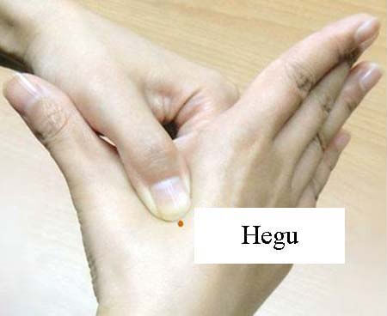
Introduction
Development of healthy habits is linked to disease prevention [1]
Improved mental and physical wellbeing
Exercise and mindful relaxation habits scientifically proven to have positive effects on individuals’ overall health [2,3]
Hegu acupoint
Proposed device: utilization of biological and user data to assist in development of healthy habits
Gamification of the process via developed android application
Adapted from [4].
Notes:
Aditi

Slide 3
Android device VS Central board
Requiring a laptop connected to the central FireBeetle board has limited usefulness
Need for a more compact, portable device vs. computer
Introducing…. Bluno Android communication!
Allows user to wear the device anywhere with a full mobile UI
Challenges
Code is 9 years old - SDK,gradle build, java compiler, bluetooth protocol, encoding and grammar update
Android development requires experiences, skills and a lot of time
Mobile UI design
Notes:
Harris

Slide 4
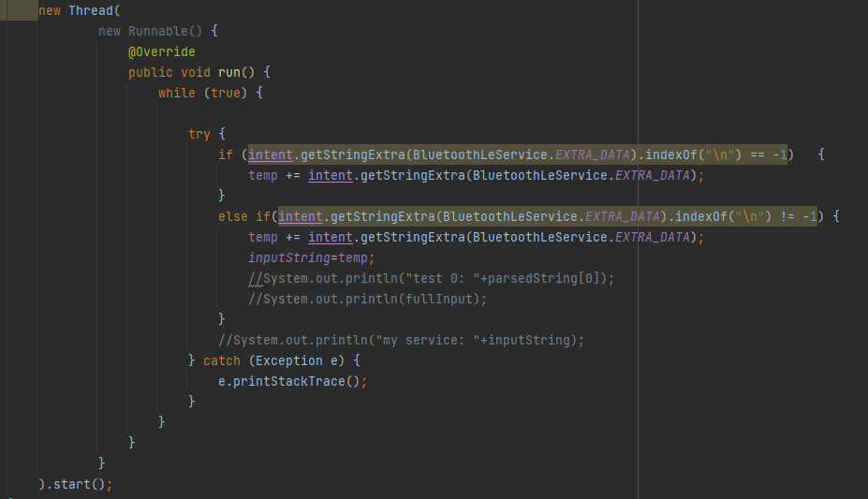
Communication Logic
Base Service BluetoothLEService - interfacing between Android and DFRobot Firebeetle
Hybrid Abstract Class - Leverage Bluetooth Service
Threading - Intent, fetch from GATT Server
Main class - Implement Abstract class unimplemented methods
Intents - Data sharing between Fragments and Activities
Utility class
Notes:
Dev

Slide 5
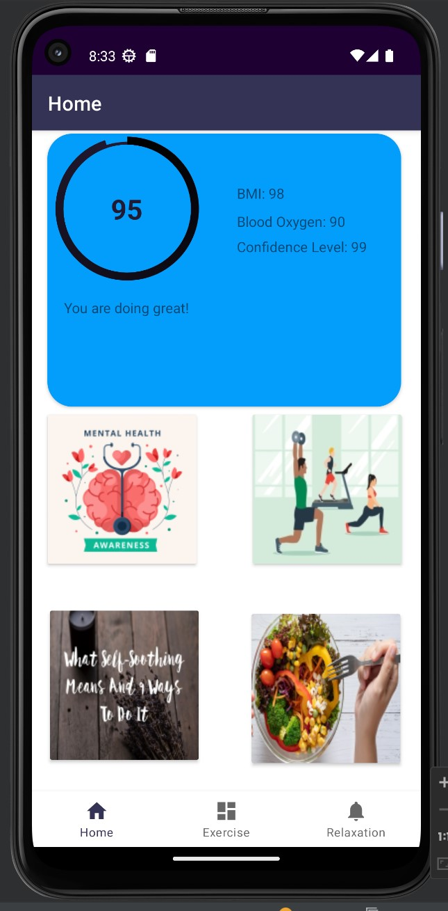
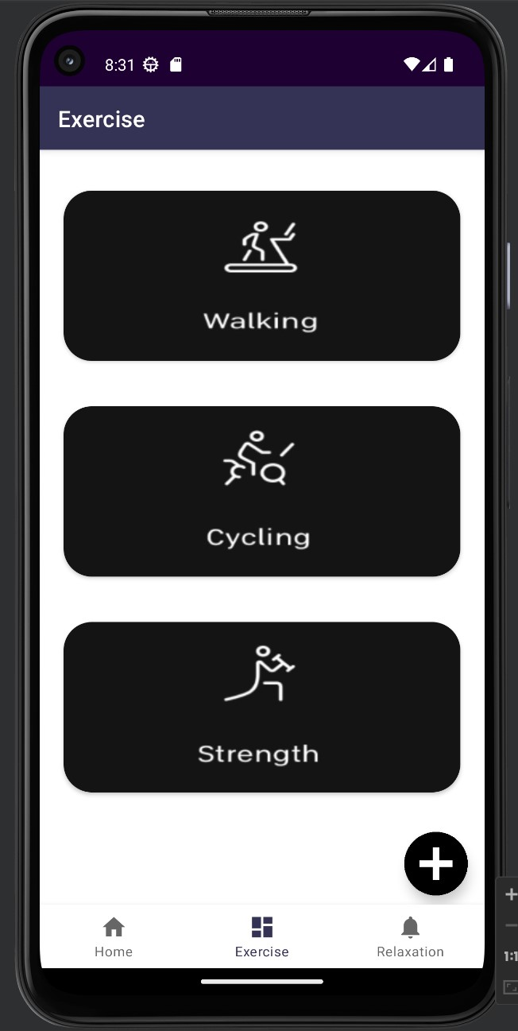
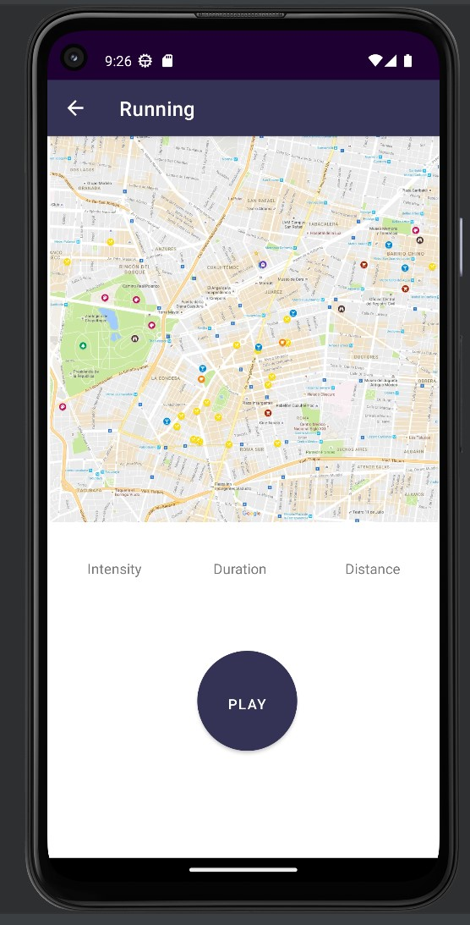
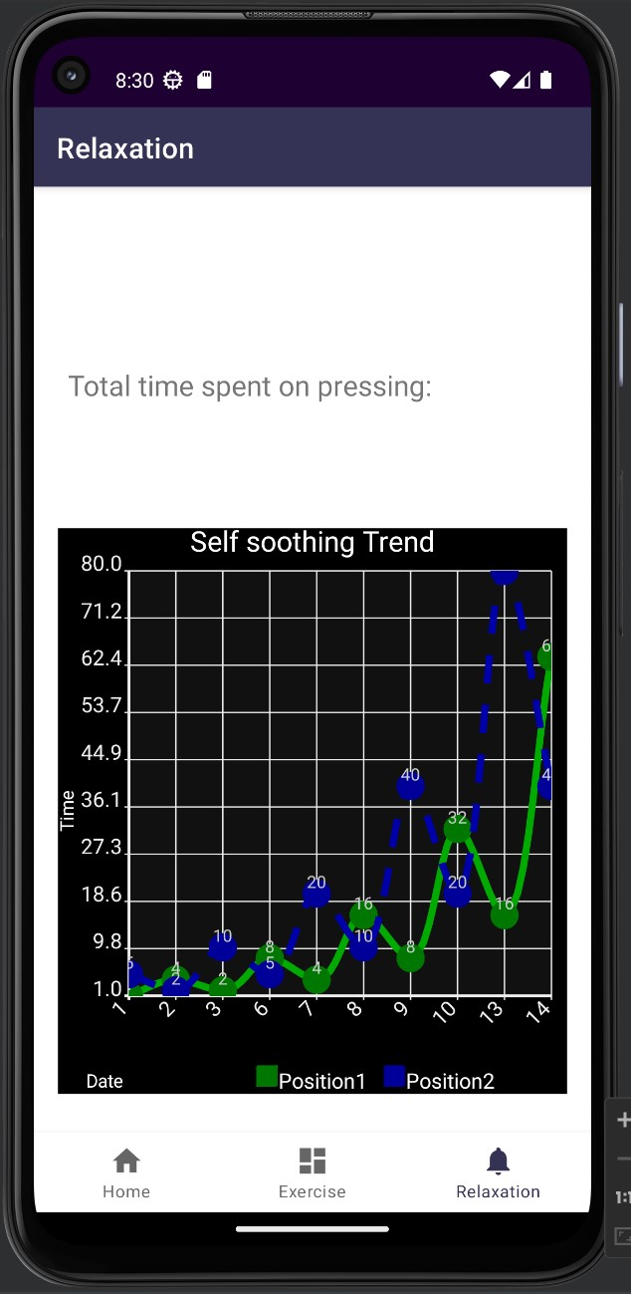
UI design
Home
Exercise
Relaxation
Dashboard
Progress bar/reward system
Cardview
Imagebutton
Graph
Notes:
harris

Slide 6
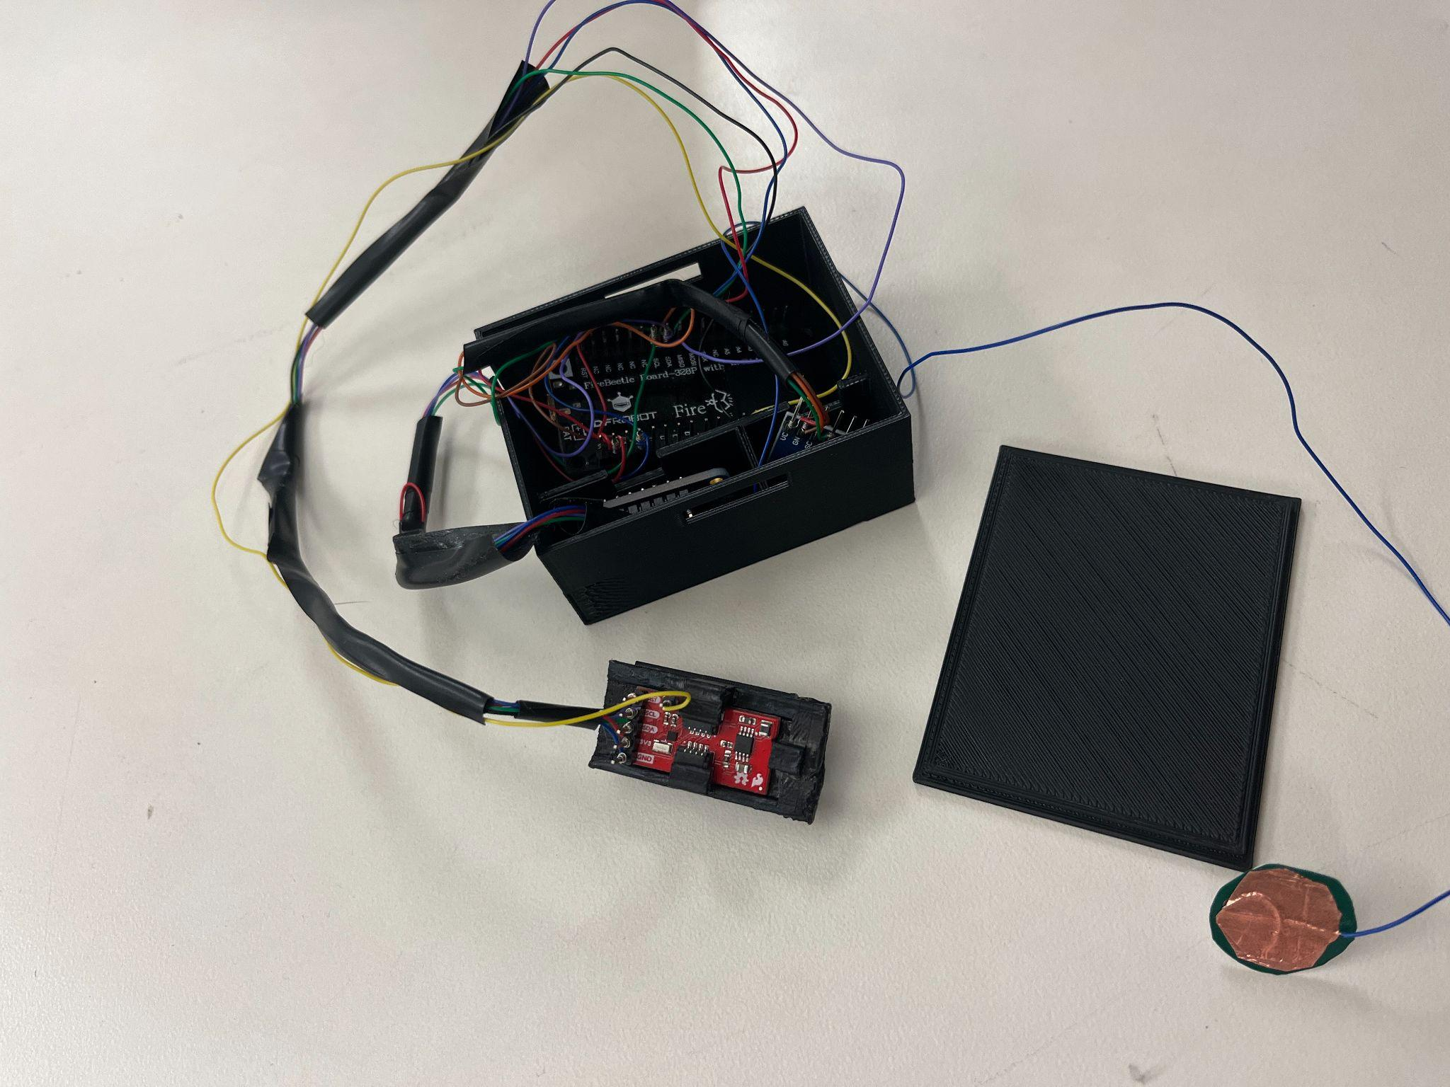
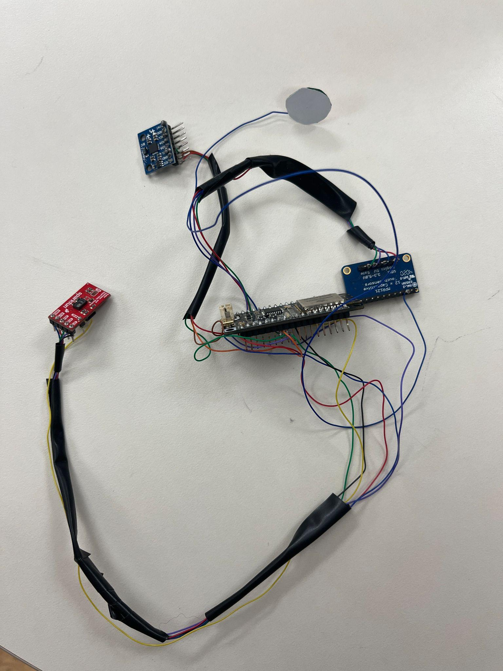
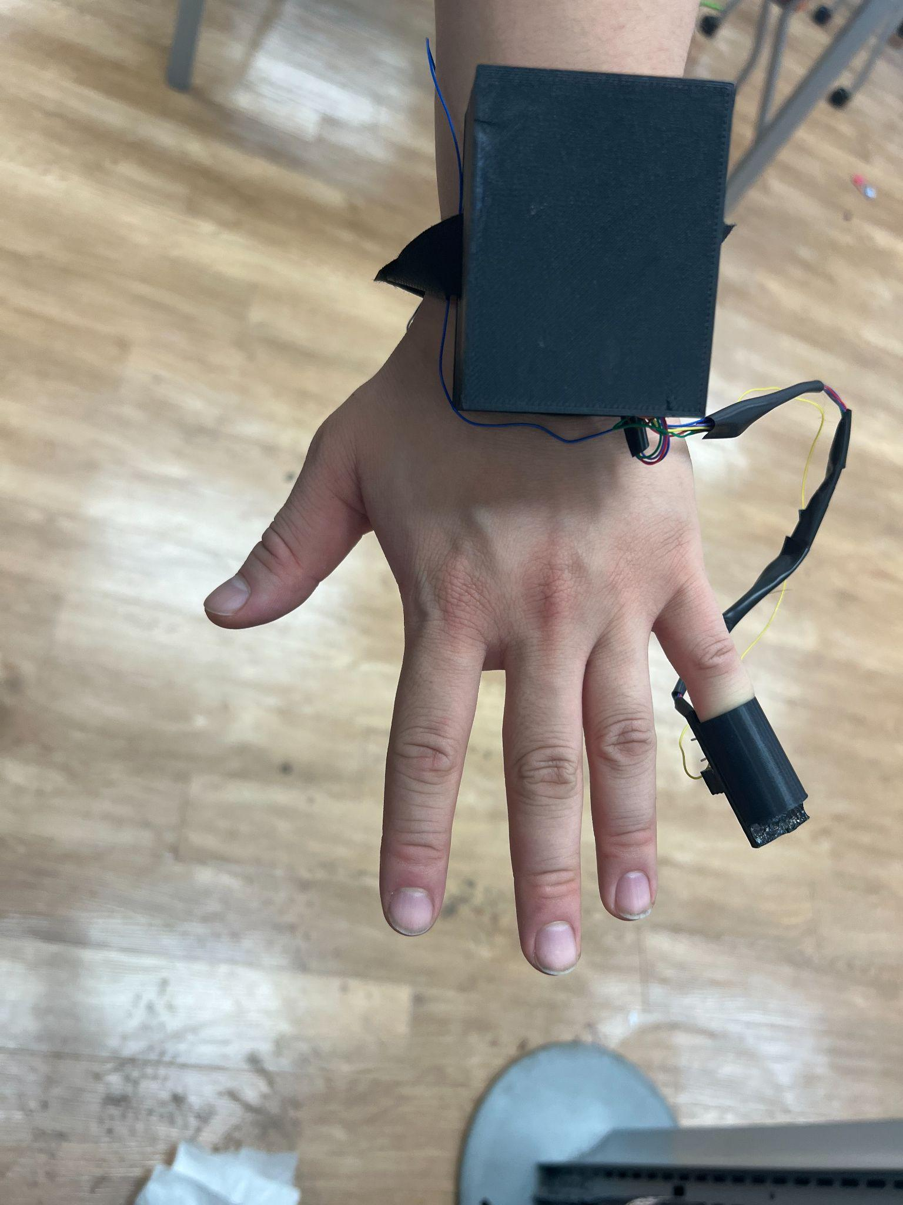
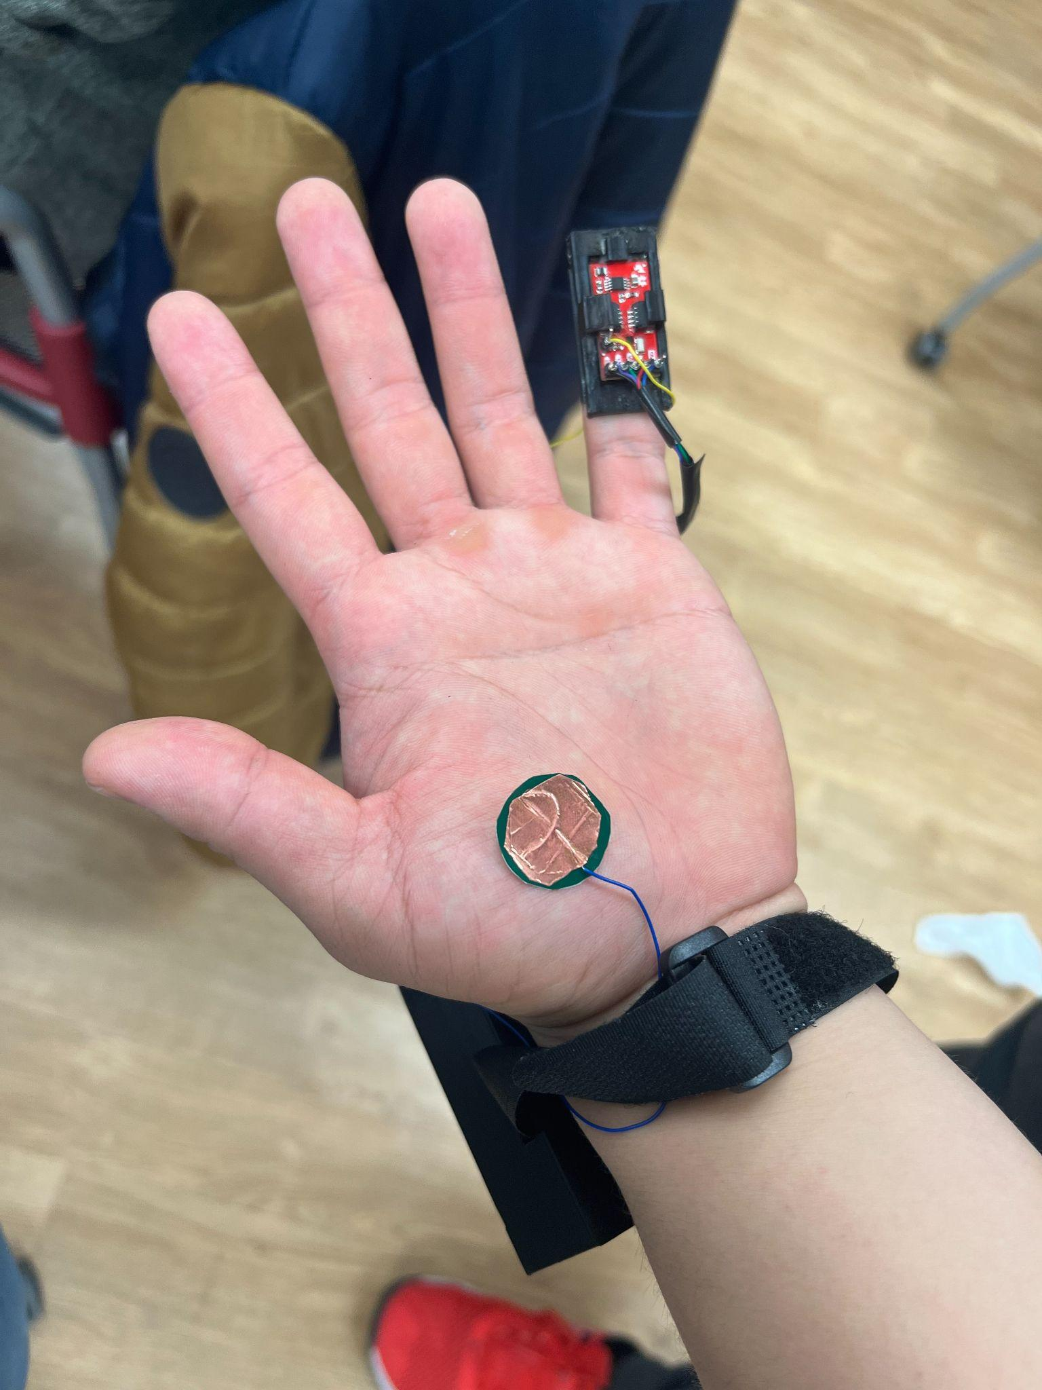
Hardware Development
Sensors: capacitive touch sensor, pulse oximeter and heart rate sensor, and accelerometer
Touch sensor at Hegu acupoint
Pulse oximeter and heart rate sensor on finger
3D-printed casing + strap to secure chosen hardware components
Wrist location (main board)
Finger (pulse ox. And heart rate)
Notes:
Aditi

Slide 7
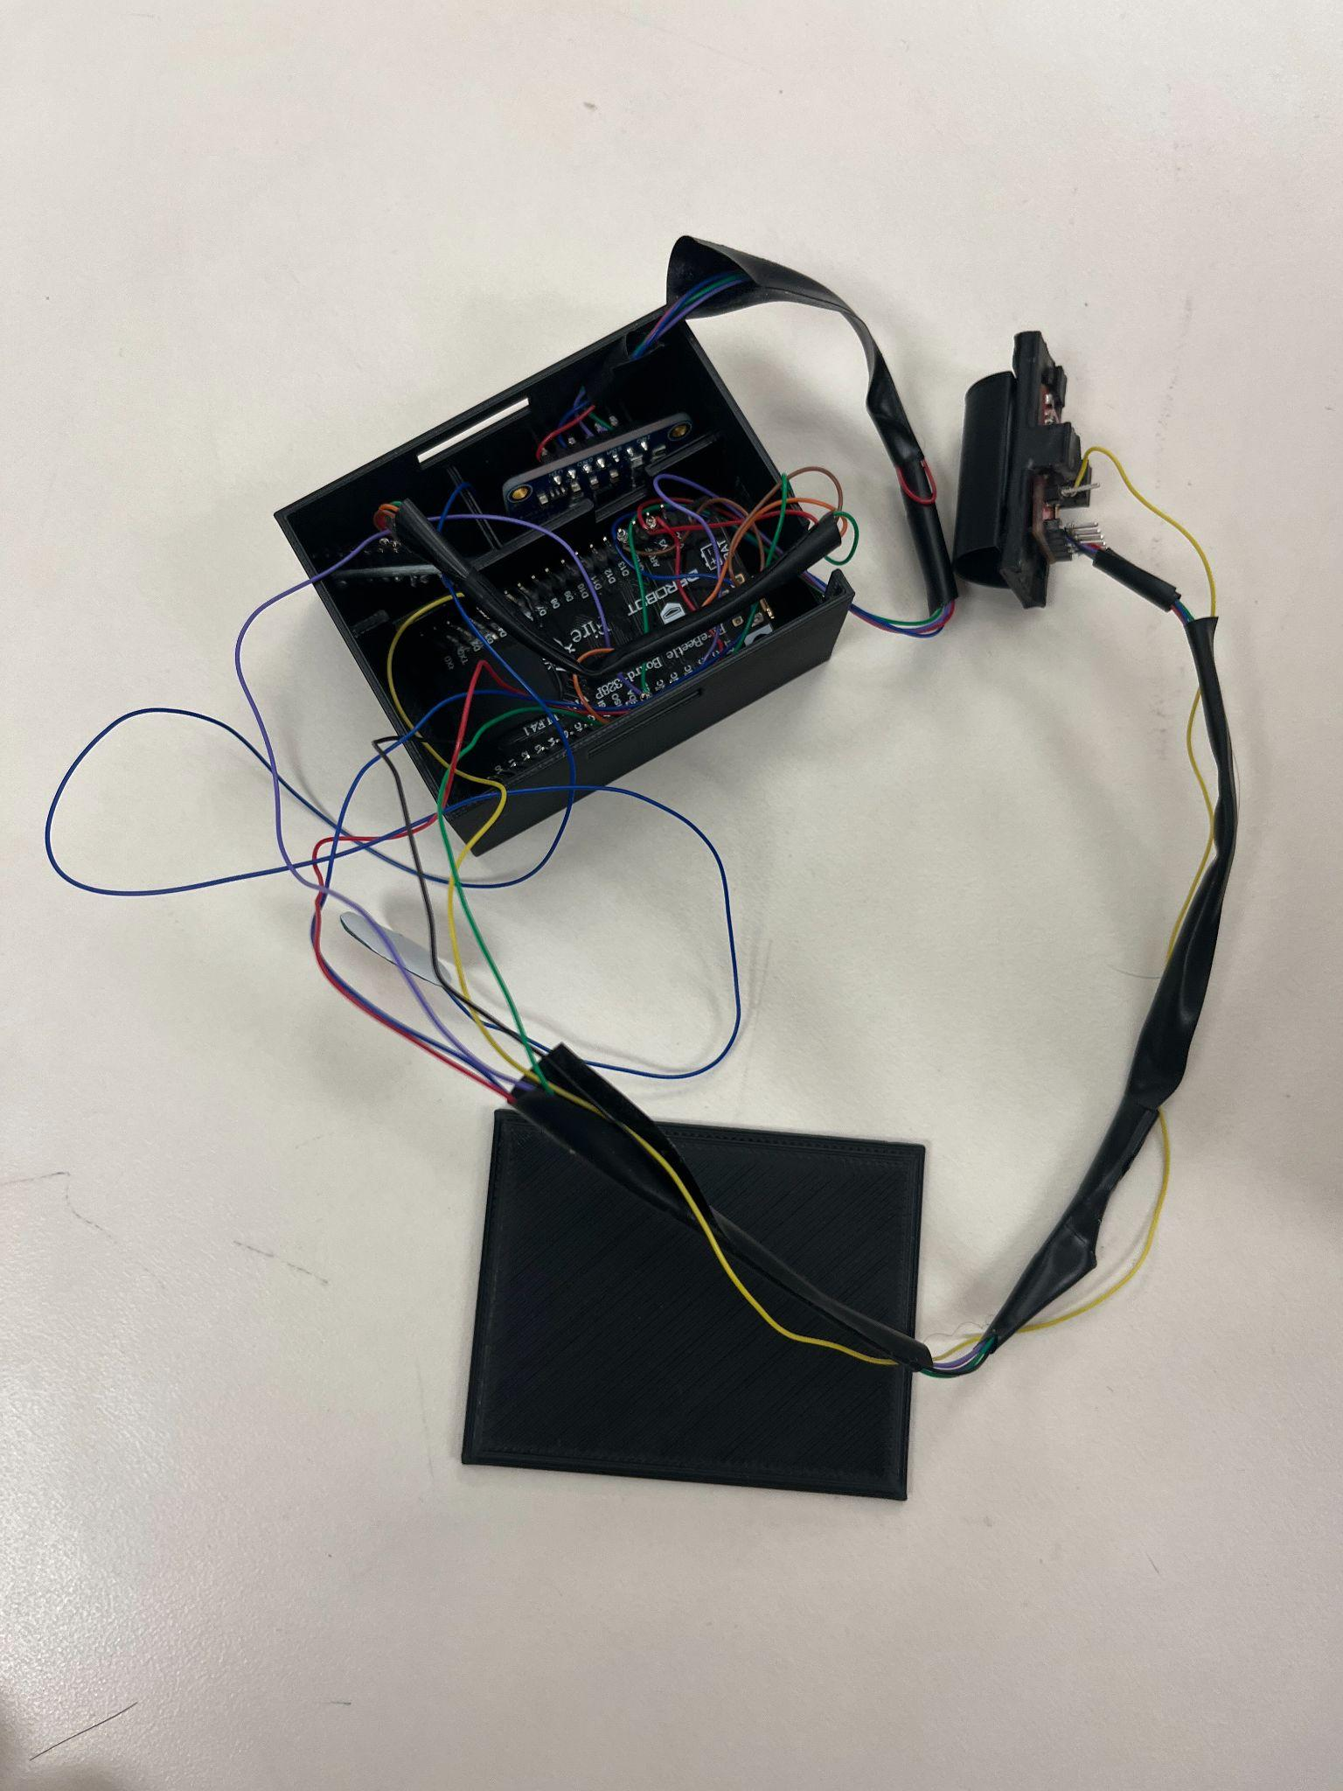
Device Photos
Notes:
Nur

Slide 8
Data collection & Results
All 3 sensor shares the same SDA/SCL pin - use different address
Arduino code combination
Organize all sensor data into one string for further parsing
Results:
Fitness mode engaged = appropriate increase in score
More engagement with relaxation mode = appropriate increase in score
Overall gamification accurately provided positive reinforcement messages and increased score
Unreliable communication rate
Parsing as simple String not enough
Data is “tagged” to parse in Android Service
Tags necessary for identification of data points
Notes:
Harris/ Dev

Slide 9
Conclusion
Constructed device assists in development of healthy habits with the use of gamification and reward-based approach
User data to gauge wellbeing score
Eliminated need for computer by utilization of bluetooth communication between FireBeetle and android device
Future direction: implementation of calendar-style system
Insight over time
Truly tracking habits
Notes:
Nur

Slide 10
References
[1]E. Chacko, “Healthy Habits to reverse cardiovascular risk,” The American Journal of Medicine, 16-Dec-2021. [Online]. Available: https://www.sciencedirect.com/science/article/pii/S0002934321002874?via%3Dihub. [Accessed: 02-Dec-2022].
[2]] Y. Y. Tang, B. Holzel, and M. Posner, “The Neuroscience of Mindfulness Meditation,” Nature reviews. Neuroscience. [Online]. Available: https://pubmed.ncbi.nlm.nih.gov/25783612/. [Accessed: 02-Dec-2022].
[3] E. Ister and Y. Altinbas, “The effect of acupressure on anxiety and pain among patients undergoing coronary angiography: A randomized controlled trial,” Holistic nursing practice, Nov-2022. [Online]. Available:https://pubmed.ncbi.nlm.nih.gov/36255344/#:~:text=Acupressure%20is%20an%20effective%20technique,among%20patients%20undergoing%20coronary%20angiography. [Accessed: 02-Dec-2022].
[4] Www.tcmsimple.com, “Acupressure points for edema in hands,” TCM Simple. [Online]. Available: https://www.tcmsimple.com/acupressure_edemahands.php. [Accessed: 02-Dec-2022].

