Slide 1



FALL 2023
DRAWING COURSE SELLING PLATFORM
E-LEARNING
SUPERVISOR: MR. LẠI ĐỨC HÙNG

Slide 2

OUR MEMBERS
SE161997
NGUYỄN MINH HIỀN
SE170242
ĐÀO XUÂN QUÝ
SE172099
TRẦN MINH NGỌC PHÚC
SE172756
NGUYỄN VĂN MINH

Slide 3
CONTENTS
01
PROJECT INTRODUCTION
02
ARCHITECTURAL OVERVIEW
03
FEATURES
04
DESMONSTRATION
05
OUTCOMES
06
Q&A

Slide 4
PROJECT INTRODUCTION
Background
Lack of focus on specific field
Provide professional course
Solve parent’s needs of art learning

Slide 5
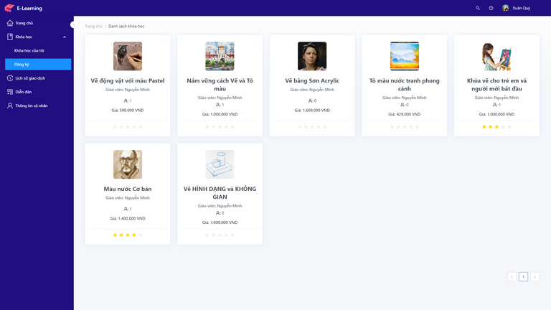

PROJECT INTRODUCTION
Proposed Solution
Staff
Manage customer,
teacher account
Manage forum content
E-Learning
Report statistics
Buy and learn
Teacher
Customer
Show course list
Create & Sell course
Revenue Management
Mange roles account
Manage website content
Admin

Slide 6


PROJECT INTRODUCTION
References
EDUMALL
Udemy is a platform that allows instructors to build online courses on their preferred topics.
UDEMY
Edumall is an online learning platform offering a diverse range of courses.

Slide 7








SYSTEM ARCHITECTURAL OVERVIEW
Tech Stack:
Front end:
Back end:
Deployment:
Mysql
Java Spring Boot
Redis
Keycloak
ReactJS
Docker

Slide 8
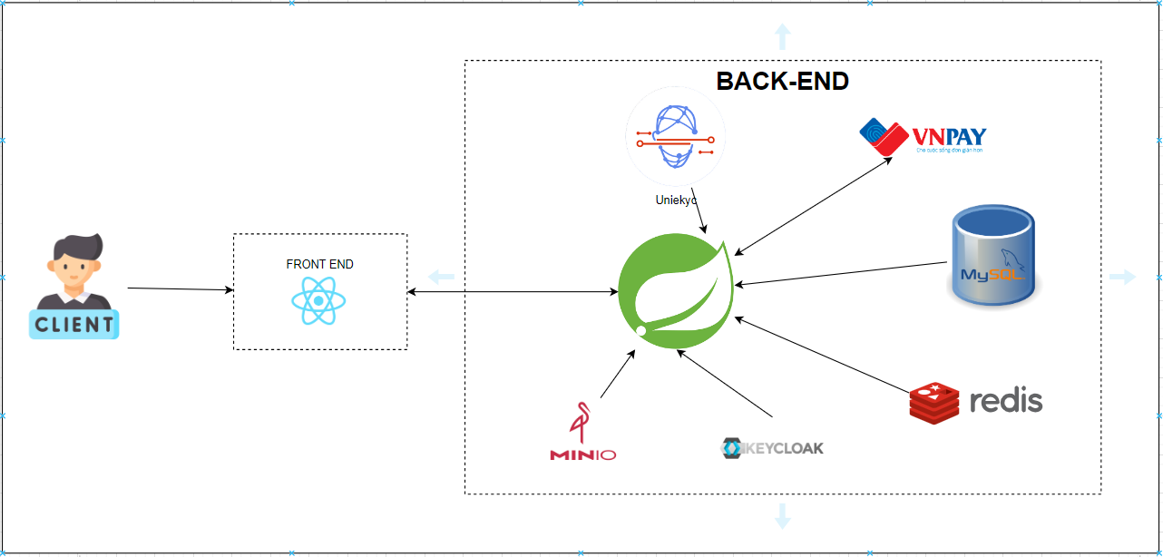
SYSTEM ARCHITECTURAL OVERVIEW

Slide 9





FEATURES
CUSTOMER
INSTRUCTOR
STAFF
ADMIN
VIEW COURSE
VIEW ORDER HISTORY
REGISTER COURSE
LEARN COURSE
FEEDBACK &
RATE COURSE
POST ON FORUM
MANAGE PROFILE
VIEW DASHBOARD
MANAGE COURSE
VIEW ORDER HISTORY
POST ON FORUM
MANAGE PROFILE
VIEW SYSTEM DASHBOARD
MANAGE INSTRUCTOR
MANAGE FORUM
VIEW SYSTEM DASHBOARD
MANAGE STAFF
MANAGE ACCOUNT
MANAGE COURSE
MANAGE FORUM
VIEW HISTORY ORDER

Slide 10


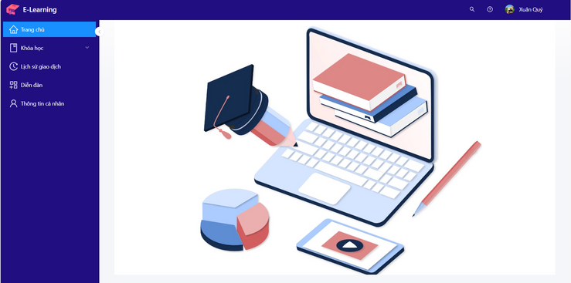


DEMONSTRATION
Scenario 1: Customer views courses
1. Login into website
2. View course list
Customer
E-Learning
Courses List
3. View course detail
4 View course trial learning
Free trial learning
Course

Slide 11


DEMONSTRATION
Scenario 2: Customer registers course
Register course
2. Choose payment method
3. View order history
Customer
Course
Payment
Order
4. View order detail
Order Detail

Slide 12

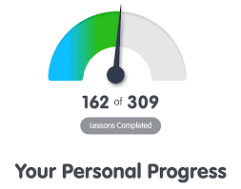

DEMONSTRATION
Scenario 3: Customer learns course
Learn course
2. Check lesson progress
3. Give feedback & rate course
Rate & Feedback
Customer
Course
4. Share personal opinion on forum
Forum

Slide 13




DEMONSTRATION
Scenario 4: Instructor creates course
Create course
2. Await for Admin's approval
Admin
Instructor
Course
3. Approve
4. Deny
3.1. Course is shown on course list
4.1. Instructor has to re-evaluate course content
Shown
Justify

Slide 14

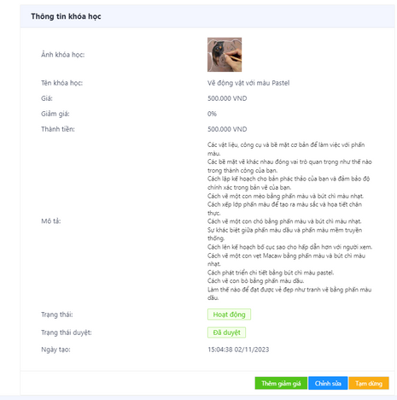
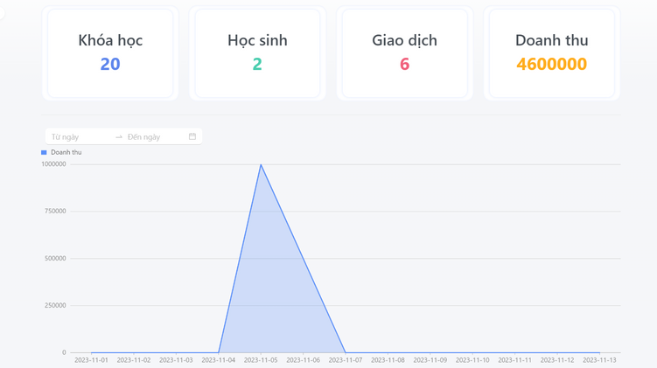
DEMONSTRATION
Scenario 5: Instructor views report & manages course
2. View self course
3. Manage course
Instructor
Course
Edit course
View business statics
4. View course after update

Slide 15



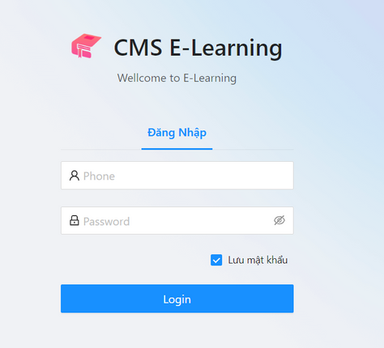




DEMONSTRATION
Scenario 6: Staff manages accounts of Instructors & Customers
View system dashboard
Manage Instructors
1. Login as
a Staff
Manage Customers
Staff
Manage forum
Login Page
View order history

Slide 16


DEMONSTRATION
View system dashboard
Scenario 7: Admin Oversees the platform
Manage Staffs
Manage Instructors
Manage Customers
1. Login as
Admin
Manage courses
Login Page
Manage forum
View system order history

Slide 17

OUTCOMES
Lessons Learned
Teamwork skills
Project management
Enhance Technological Knowlegde
App Features
Customers: Explore, purchase with trial options, pay by bank transfer, order history, rate & feedback.
Instructors: CRUD, order history, reports, dashboard.
Staff: CRUD, search/filter profiles, manage accounts, and oversee post management.
Admin: CRUD, oversee accounts, courses, and posts with a centralized dashboard, ensuring platform integrity.

Slide 18
OUTCOMES
Application Achievement
Create full basic function for Course sale platform
GitHub
Document: SRS_DrawingCourseSellingPlatform.docx
Limitations
Multiple payment gateways
Multiple languages support
Refund policy for unsatisfied customer

Slide 19

THANK YOU FOR YOUR ATTENTION!
Q & A

