Slide 1
CONCLUSION
FATİH ÇAM

Slide 2
DELIVERABLES
Equipments
Documents
Software

Slide 3
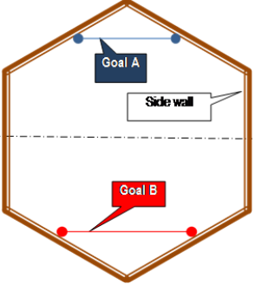
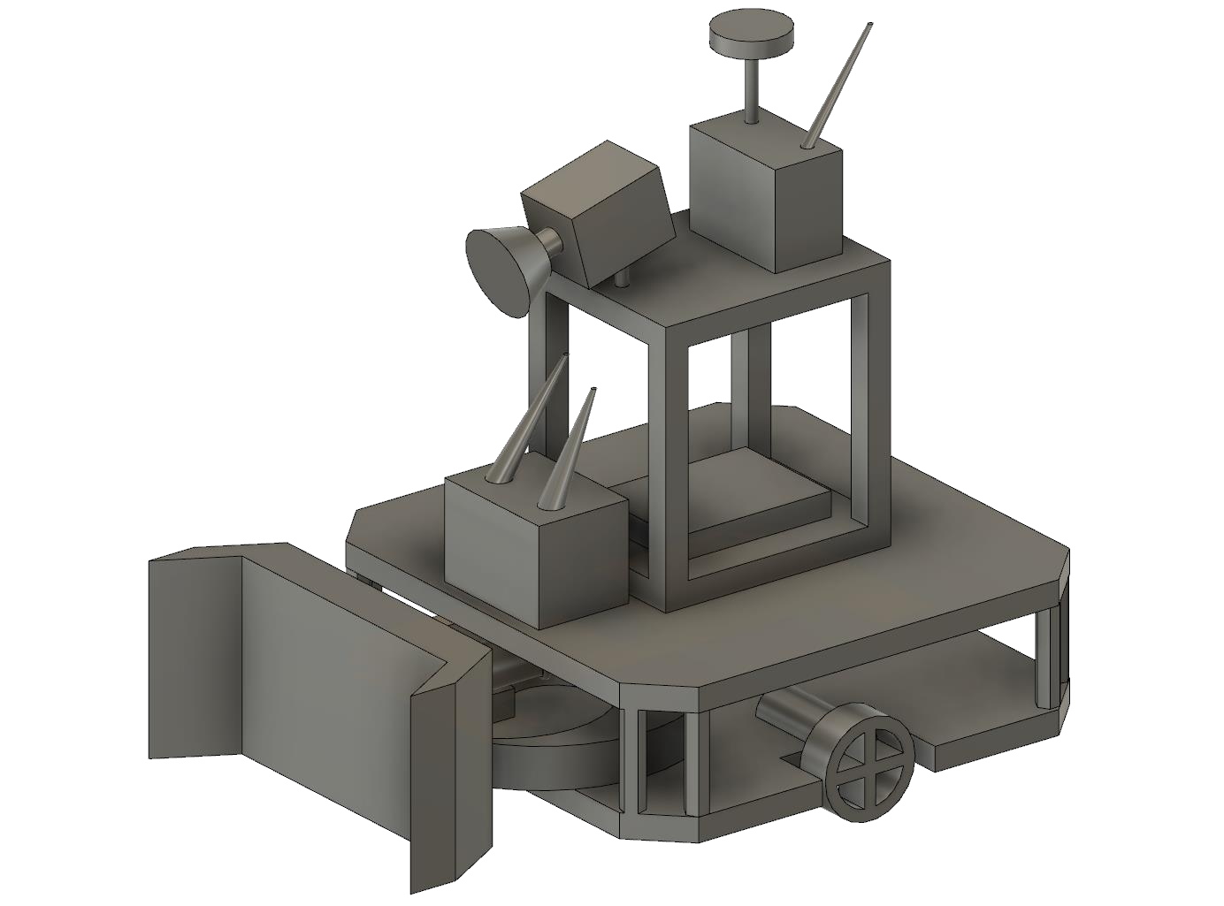

EQUIPMENTS
Vehicle(Robot)
Play Field
Ball
Goals
Control Interface

Slide 4
DOCUMENTS and SOFTWARE
Warranty
Manual
USB Flash Bellek

Slide 5
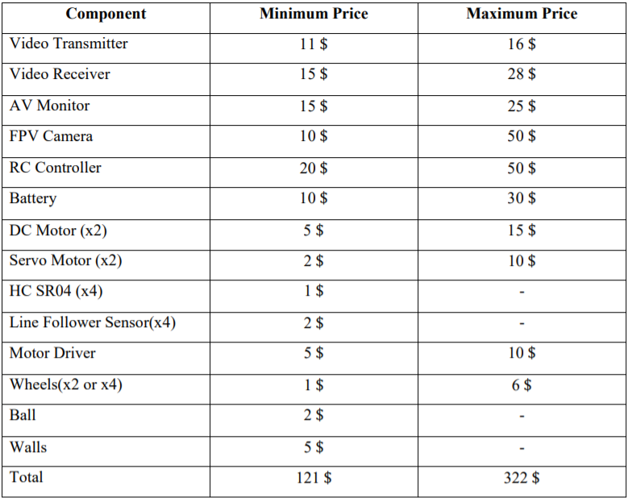
COST ANALYSIS

Slide 6
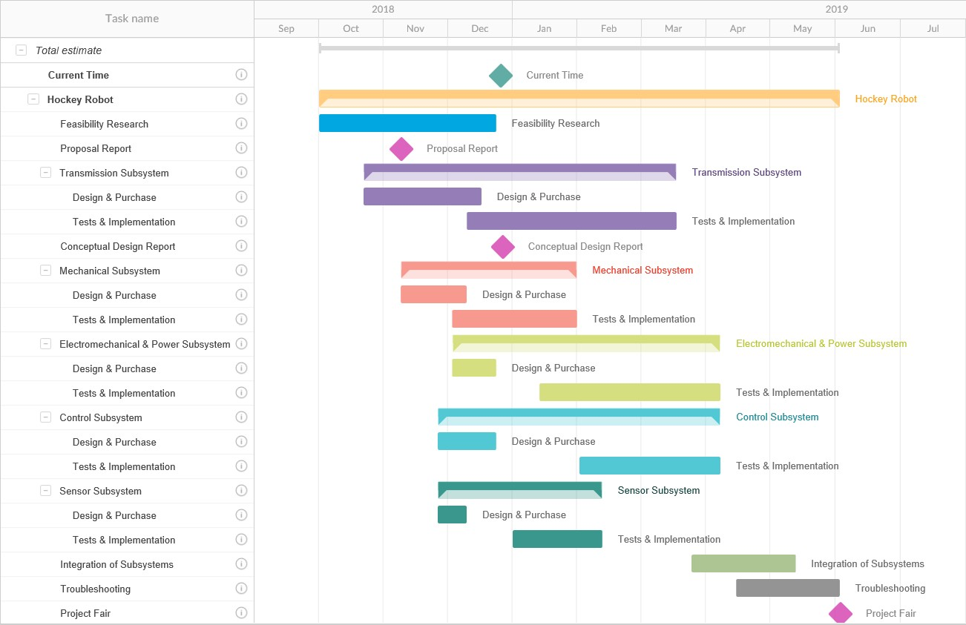
TIME PLAN

Slide 7
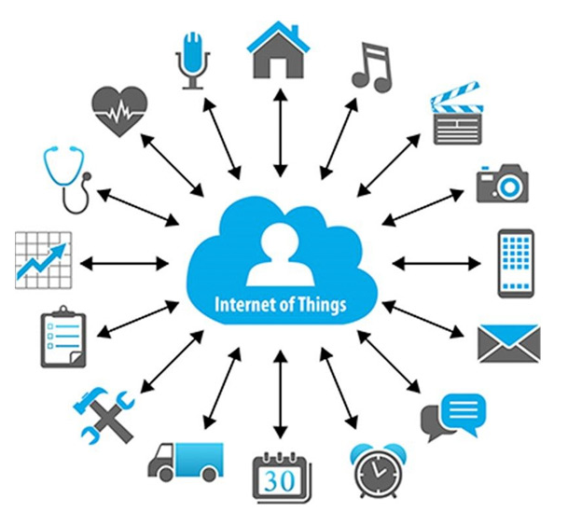
FUTURE PLAN

