Slide 1
Tokyo (residual) demand delta evaluation
2025/7/10, Hishida

Slide 2
1 degree change might hit 1 cargo for July ~ September and December ~ March

Slide 3
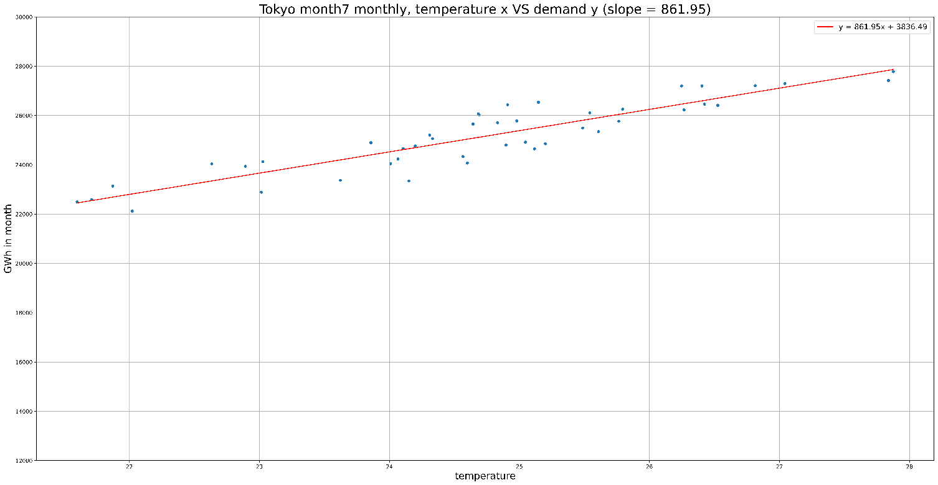
Details
Figures
Demand: Demand
Residual demand: ResidualDemand
Gits
Demand delta in July

