Slide 1
Tokyo (residual) demand delta evaluation
2025/7/10, Hishida

Slide 2
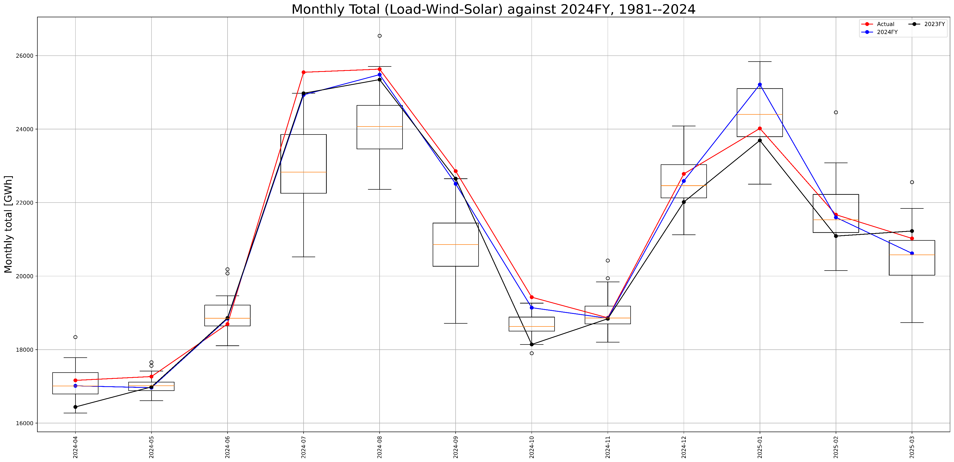
To predict 2024FY demand
Expected value: maximum error ,2,500GWh in July
2024FY weather: maximum error 1,000GWh in January, 2023FY weather : maximum error 1,500GWh in October
Calibrationで2017FY~2023FYを使っている
1,000GWh
1,500GWh

Slide 3
Sensitivity analysis in Tokyo (temperature using 2023FY)
1 degree change might hit 1 cargo in July ~ September and December ~ March
 | demand | residual demand
April | -209.198 | -187.35
May | 86.73842 | 29.66189
June | 359.653 | 262.325
July | 861.9488 | 677.427
August | 836.7706 | 647.7932
September | 667.6624 | 605.0774
October | 104.5558 | 142.3859
November | -298.976 | -272.793
December | -567.643 | -515.624
January | -558.824 | -525.594
February | -491.588 | -464.035
March | -476.025 | -481.716
これはモデルの感応度→Generationまではいった結果はモデルの出力として欲しい
Demandまでであれば、実績の感応度が欲しい（これは常にAppendixにいれておく） → 需要、残余需要 → 期間 （コロナに注意） → 学習期間が2017になっているのはなんで？→データない？最近のトレンドを捕らえたい？ → 月ではなく週ごとにみてデータ点をふやすのもありか

Slide 4
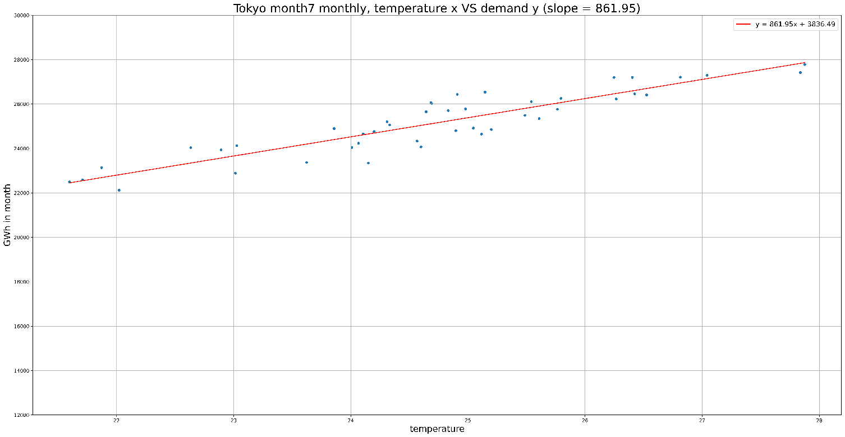
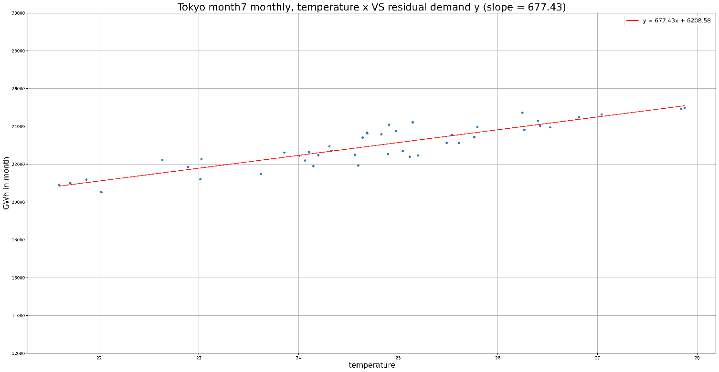
Details
Figures
Demand: Demand
Residual demand: ResidualDemand
Gits
hhishida-jera/EvaluateDelta
Note
Need discussion with Fuel Optimization Unit?
Fuel / unit is needed
Demand delta in July, delta = 861
Residual demand delta in July , delta = 677

