Slide 1
Tokyo (residual) demand delta evaluation
2025/7/10, Hishida

Slide 2
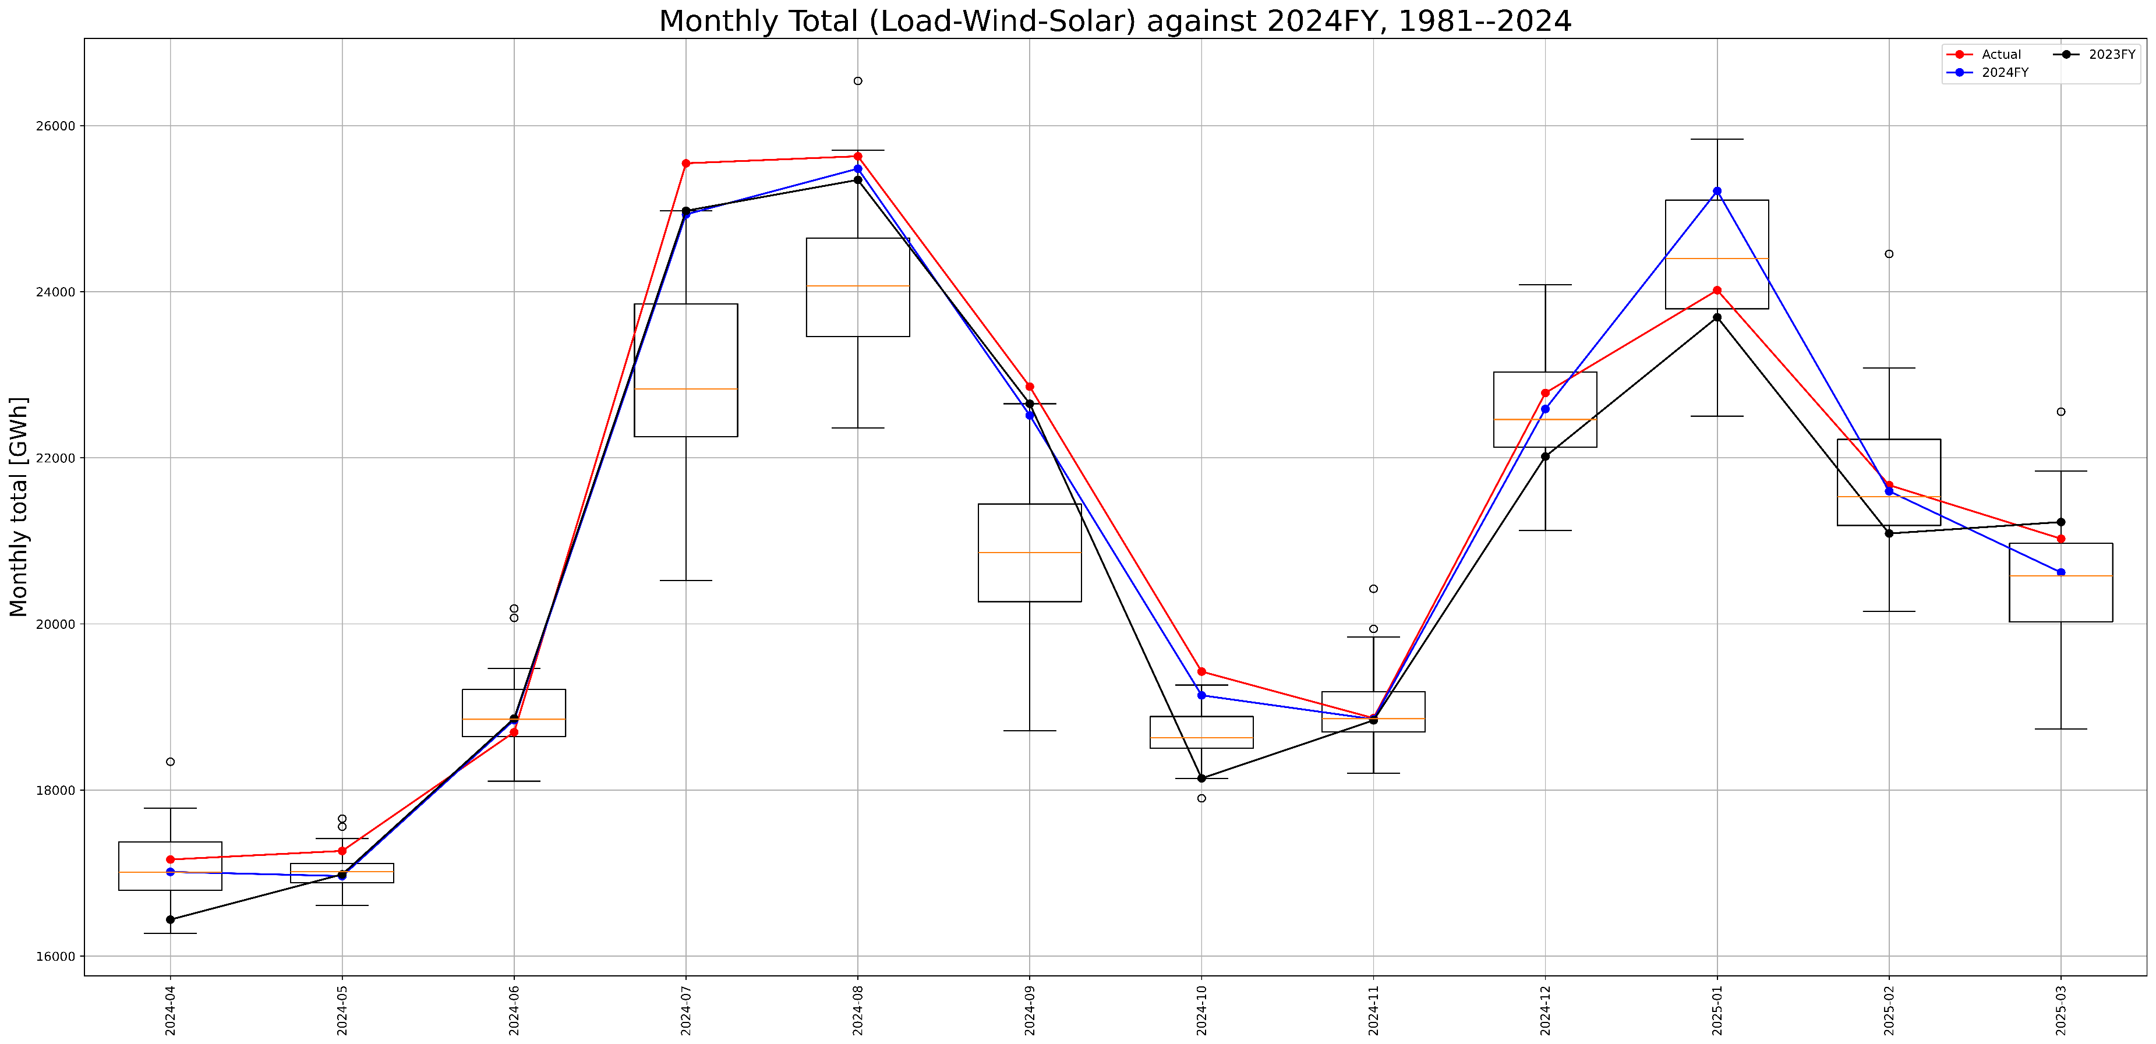
To predict 2024FY demand
Expected value: maximum error ,500GWh in July
2024FY weather: maximum error 1,000GWh in January, 2023FY weather : maximum error 1,500GWh in October
1,000GWh
1,500GWh

Slide 3
Sensitivity analysis (temperature)
1 degree change might hit 1 cargo in July ~ September and December ~ March

Slide 4
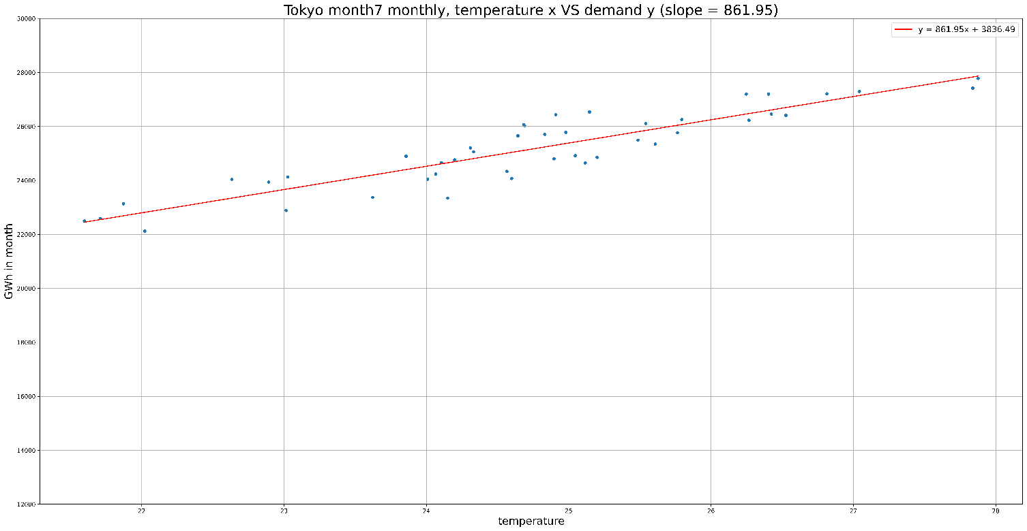
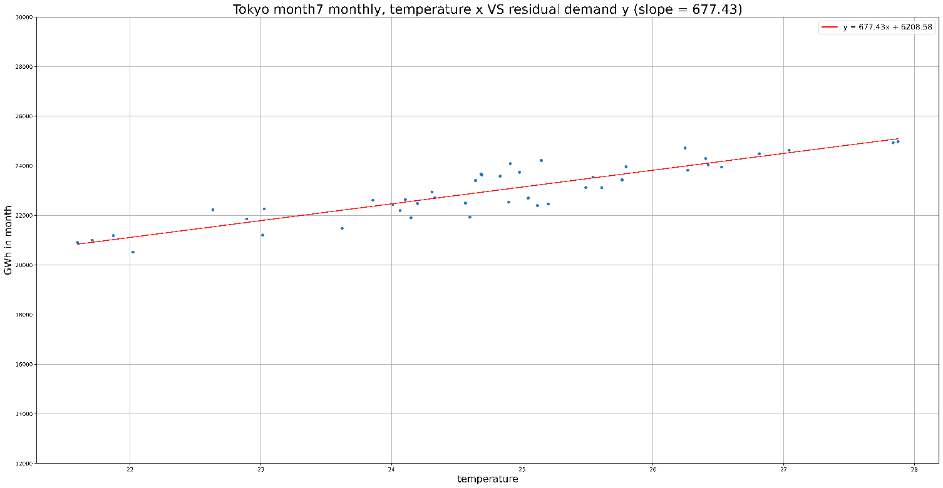
Details
Figures
Demand: Demand
Residual demand: ResidualDemand
Gits
hhishida-jera/EvaluateDelta
Note
Need discussion with Fuel Optimization Unit?
Demand delta in July, delta = 861
Residual demand delta in July , delta = 677

