Slide 1

HTML
Wedshopping.html
한정환

Slide 2
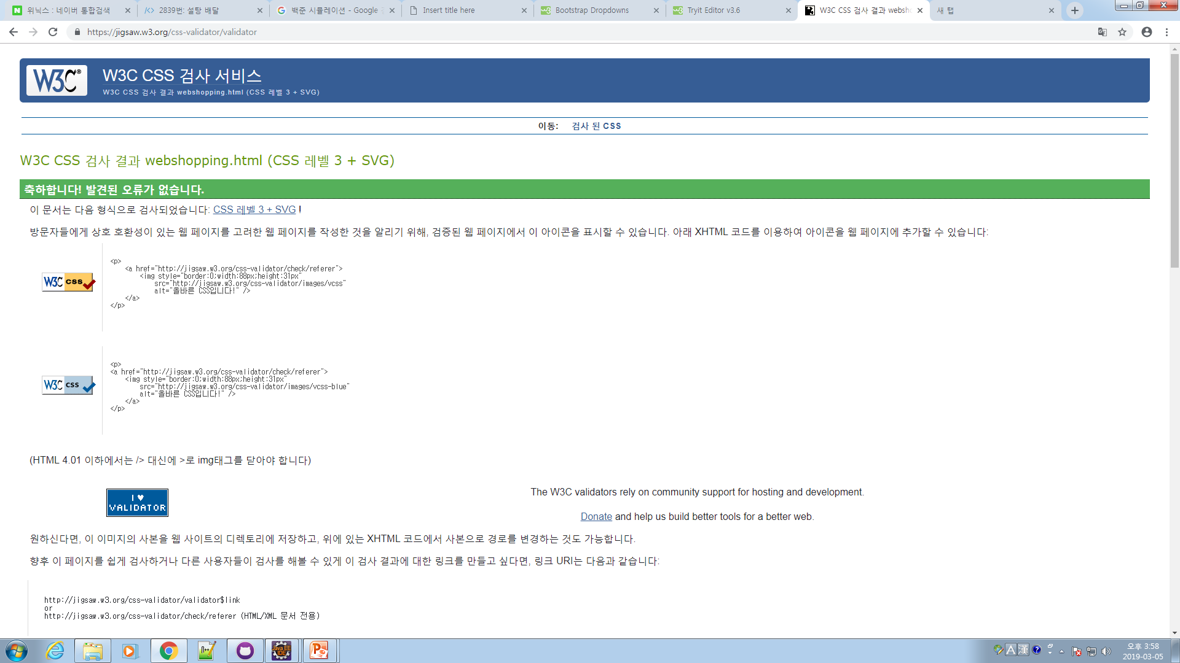

Slide 3


