Slide 1
PHILIPPINE CARABAO CENTER · TRAINING COURSE · 13–19 SEPT 2026
Reproduction in Cattle
& Water Buffalo
From Reproductive Fundamentals to Artificial Insemination,
Embryo Transfer & Smart-Farm Precision Breeding
Basics
Estrus & AI
Embryo Transfer / IVF
Smart Farm
Hyunjae Ha, DVM
Goryeo VET Clinic · L&H Institute of Biotechnology · Genetics Co. · Song Young Shin Farm — Republic of Korea

Slide 2
YOUR INSTRUCTOR · AN INTEGRATED REPRODUCTION ECOSYSTEM
25+ years bringing reproductive biotechnology from lab to farm
I am a veterinarian working across the full reproduction chain — clinical practice, a biotechnology laboratory, a genetics company, and a working dairy farm. Everything in this course is what we do every week in the field.
🏥
🔬
🧬
🐄
Goryeo VET Clinic
L&H Institute of Biotechnology
Genetics Co.
Song Young Shin Farm
Field AI, estrus synchronization & herd reproduction consulting
OPU–IVF, MOET, embryo culture & cryopreservation
Genomic selection, sexed embryos & sire evaluation
Sensor-based smart dairy — reproduction data every day
Reproduction is the engine of genetic improvement — the fastest, cheapest way to upgrade a national herd. That makes it the heart of the carabao development mission.
REPRODUCTION · CATTLE & BUFFALO
02

Slide 3
COURSE ROADMAP · WHAT THIS HOUR COVERS
Five steps, one goal: more calves, better genetics
1
2
3
4
5
Foundations
Estrus & heat detection
Artificial insemination
Embryo transfer & IVF
Smart farm
Anatomy, the estrous cycle & the hormones that drive it
Reading heat — and the buffalo “silent heat” problem
Semen, timing, technique & conception rate
Multiplying elite female genetics fast
Sensors & data for precision reproduction
Cattle principles throughout, with water-buffalo (carabao) specifics highlighted in rose.
REPRODUCTION · CATTLE & BUFFALO
03

Slide 4
01
PART ONE
Reproductive Foundations
Anatomy of the female tract · the estrous cycle · hormonal control · follicular dynamics · the male contribution. You cannot manage what you do not understand.
04

Slide 5
FOUNDATIONS · FEMALE REPRODUCTIVE ANATOMY
The female reproductive tract
Ovary — houses follicles & the corpus luteum; source of eggs & hormones
Oviduct (fallopian tube) — site of fertilization
Uterine horns — where the embryo implants & grows
Body of uterus — the AI semen deposition site
Cervix — the gateway we pass the AI gun through
Vagina — receives natural service
Recto-vaginal (“recto-cervical”) AI works by feeling the cervix through the rectum wall and guiding the gun by hand.
FOUNDATIONS
05

Slide 6
FOUNDATIONS · THE ESTROUS CYCLE
The estrous cycle — a ~21-day rhythm
Proestrus → Estrus (Day 0)
Follicle matures, estrogen peaks → standing heat. Ovulation ~24–30 h after heat onset.
21 days (18–24)
Metestrus → Diestrus (Day 1–17)
Corpus luteum (CL) forms & secretes progesterone — maintains pregnancy or holds the cycle.
Luteolysis (Day 17–18)
If not pregnant, the uterus releases PGF2α → the CL regresses → the next cycle begins.
🐃 Buffalo
Cycle ~21 d but estrus is shorter, weaker & often silent — and strongly seasonal. We will return to this.
FOUNDATIONS
06

Slide 7
FOUNDATIONS · ENDOCRINE CONTROL
The hormonal chain of command
Every reproductive tool we use — synchronization, AI timing, superovulation — works by pushing one of these four levers.
HYPOTHALAMUS
PITUITARY
OVARY
GnRH
FSH & LH
Estrogen · Progesterone
→
→
the master trigger
grow the follicle · trigger ovulation
heat & standing · maintain the CL
PGF2α (from the uterus) destroys the CL → this is the “reset button” we use to synchronize heat.
Negative feedback: high progesterone suppresses GnRH/LH — remove it, and the cow returns to heat.
FOUNDATIONS
07

Slide 8
FOUNDATIONS · FOLLICULAR DYNAMICS
Follicular waves & ovulation
follicle size →
Follicles grow in 2–3 waves per cycle (buffalo usually 1–2)
Each wave has a dominant follicle; only the last one ovulates
The LH surge triggers ovulation ~24–30 h after heat onset
The egg is viable only ~6–12 h — timing is everything
Why this matters: understanding waves is the basis of synchronization & superovulation — we manipulate which follicles grow and when they ovulate.
Wave 1 Wave 2 Wave 3 → dominant → Ovulation
FOUNDATIONS
08

Slide 9
FOUNDATIONS · THE MALE CONTRIBUTION
The sire side: one bull, thousands of daughters
♂
🔬
❄
Spermatogenesis
Semen evaluation
The power of AI
~60 days to make sperm in the testis. Heat stress or illness 2 months ago still affects today's fertility.
Volume · concentration · motility · morphology. Only quality ejaculates are processed.
One elite bull → thousands of frozen straws, shipped worldwide, used long after his lifetime.
🐃 Buffalo
River-type bulls (e.g. Murrah) are the key to upgrading native swamp buffalo — AI puts that superior sire in every village.
FOUNDATIONS
09

Slide 10
02
PART TWO
Estrus & Heat Detection
The single biggest cause of AI failure worldwide is not bad semen — it is MISSED HEAT. For buffalo, this is the central challenge.
10

Slide 11
ESTRUS · READING HEAT
Signs of estrus (heat)
The one sure sign — standing to be mounted
🐃 The buffalo problem
She stands still when mounted by another animal. This is the reference point for AI timing.
Silent / weak heat — few or no visible signs
Mostly at night — missed by day-time checks
Seasonal — poorer expression in hot months
Result: low AI conception from missed heat
SECONDARY SIGNS
Mounting others
Clear mucus
Restlessness
↓ feed & milk
Swollen vulva
Chin-resting
→ This is exactly the gap sensors & timed-AI close (Parts 3 & 5).
ESTRUS & HEAT DETECTION
11

Slide 12
ESTRUS · DETECTION METHODS
How we catch heat — low-tech to high-tech
👁 Visual observation
🎨 Tail paint / chalk
🐂 Teaser / mount detectors
3× daily, ≥20 min, quiet times. Free but labour-heavy & misses night heat.
Rubbed-off paint = she was mounted. Cheap, effective aid.
Vasectomized teaser bull or pressure patches (KaMaR).
🚶 Pedometers / activity
📡 Rumen & body sensors
🩺 Ultrasound / palpation
Heat ↑ walking 2–4×. Automated & objective — good for silent heat.
Temp + rumination + activity → alerts day or night. Best fit for buffalo.
Confirms follicle/CL & pregnancy — the vet's cross-check.
ESTRUS & HEAT DETECTION
12

Slide 13
ESTRUS · TIMING OF INSEMINATION
Timing: the AM / PM rule
Sperm need ~6 h in the tract to become fertile and live ~24 h; the egg lives only ~6–12 h. So we inseminate late in heat / just before ovulation.
6–12 h
Heat seen in the MORNING → inseminate that EVENING
egg viability window
Heat seen in the EVENING → inseminate next MORNING
~24 h
sperm survival in tract
Rule of thumb: AI about 12 hours after first standing heat; ovulation ~24–30 h after heat onset.
🐃 Buffalo
Silent heat makes “onset” hard to judge → timed AI removes the guesswork.
ESTRUS & HEAT DETECTION
13

Slide 14
ESTRUS · SYNCHRONIZATION
Estrus synchronization — scheduling the herd
Instead of waiting for each animal, we bring a whole group into heat together — enabling planned, batch AI.
PGF2α (single / double)
Progesterone device (CIDR / PRID)
Ovsynch (→ Fixed-time AI)
Destroys the CL → heat in 2–5 days. Simple & cheap; needs an active CL (cycling animals).
Intravaginal insert mimics the CL, then withdrawn. Works on non-cycling / silent buffalo & anestrus.
GnRH → PGF2α → GnRH controls ovulation itself → AI by the clock, no heat detection needed.
🐃 Buffalo
Progesterone + Ovsynch-type protocols are the practical answer to silent, seasonal heat — we detail the timeline next.
ESTRUS & HEAT DETECTION
14

Slide 15
03
PART THREE
Artificial Insemination
The most powerful, lowest-cost genetic tool ever put in a farmer's hands — and the backbone of any national herd-improvement program.
15

Slide 16
AI · THE CASE FOR ARTIFICIAL INSEMINATION
Why artificial insemination?
🧬
Rapid genetic gain
🛡
Disease control
🐃 Carabao upgrading
Access the world's proven sires — upgrade milk, growth & fertility in one generation.
No bull movement between herds = fewer venereal & transboundary diseases.
AI with Murrah / river-type semen is the engine that converts a low-yield swamp buffalo herd into a productive dairy herd — village by village, straw by straw.
💰
Low cost & safety
📋
Records & traceability
No dangerous bull to keep & feed; a straw costs a fraction of a bull.
Known sire = pedigree, genomic selection & planned matings.
This is precisely the PCC mission at national scale.
ARTIFICIAL INSEMINATION
16

Slide 17
AI · FROM BULL TO STRAW
Semen: collection → freezing → storage
1
2
3
4
5
Collection
Evaluation
Extension
Filling & freezing
Storage
Artificial vagina or electro-ejaculation from proven sires.
Motility, concentration & morphology checked immediately.
Diluted in egg-yolk / soy extender with cryoprotectant.
Into 0.25 / 0.5 mL straws; cooled, then frozen in LN₂ vapour.
Held in liquid nitrogen at −196 °C — viable for decades.
Each straw is identity-labelled: bull, breed & batch — the foundation of traceable breeding.
ARTIFICIAL INSEMINATION
17

Slide 18
AI · HANDLING & THAWING — WHERE FERTILITY IS WON OR LOST
Straw handling: the details that decide conception
Work fast in the tank neck — lift the canister no higher than the frost line, ≤10 s
Thaw in a water bath at 35–37 °C for 30–45 s — never in a pocket or by air
Dry the straw, load a pre-warmed gun, protect from cold shock & sunlight
Inseminate within ~15 minutes of thawing
One straw thawed at a time
35–37°C
thaw temperature · 30–45 s
−196°C
tank storage · never re-cool a thawed straw
Cold shock & slow thawing kill sperm — good semen fails from poor handling.
ARTIFICIAL INSEMINATION
18

Slide 19
AI · TECHNIQUE & DEPOSITION SITE
The recto-vaginal technique
Gloved hand in the rectum grips the cervix; the gun passes through the vagina
Manipulate the cervix onto the gun — thread through its rings
Deposit semen in the body of the uterus (site AI), just past the cervix
Deposit slowly; withdraw gently; minimize stress & trauma
Golden rule — “quick, clean, gentle.” A calm animal & clean pass protect the pregnancy you are trying to create.
AI gun → body of uterus
Deposition site: body of the uterus (not the vagina, not deep in a horn).
ARTIFICIAL INSEMINATION
19

Slide 20
AI · FIXED-TIME AI (THE BUFFALO GAME-CHANGER)
Ovsynch → timed AI: breeding by the calendar
Control ovulation itself, and you can inseminate every animal at a set hour — no heat detection at all.
GnRH
PGF2α
GnRH
TIMED AI
Day 0
Day 7
Day 9
Day 10 · 16–20 h
Why it transforms buffalo breeding Silent & seasonal heat no longer matters — the whole group is bred on schedule, lifting herd pregnancy rate.
Add progesterone (CIDR) For non-cycling / anestrus animals, a CIDR insert during the protocol jump-starts cyclicity.
ARTIFICIAL INSEMINATION
20

Slide 21
AI · TROUBLESHOOTING CONCEPTION RATE
Why a “good” AI still fails — the checklist
Heat / timing
Semen handling
Technician skill
Wrong timing or missed silent heat — the #1 cause.
Poor thawing, cold shock, delay after loading.
Deposition site & gentleness — training pays back fast.
Nutrition & BCS
Health & uterus
Heat stress
Thin or over-fat animals don't conceive — energy balance matters.
Retained placenta, metritis, lameness lower fertility.
Shade, water & cooling — critical for buffalo in the tropics.
Fertility is a system. Fix the weakest link — measure, don't guess (that is what Part 5 is about).
ARTIFICIAL INSEMINATION
21

Slide 22
04
PART FOUR
Embryo Transfer & IVF
If AI multiplies the sire, embryo transfer multiplies the ELITE FEMALE — turning one exceptional donor into a whole generation.
22

Slide 23
EMBRYO TRANSFER · THE CONCEPT
Why embryo transfer (MOET & IVF)?
A cow normally gives ~1 calf a year. With embryo technology, one elite donor can produce dozens of calves a year — carried by ordinary recipient females.
🐃 For scarce elite buffalo
A
MOET — superovulate the donor, AI, flush embryos ~day 7
Superior river-buffalo females are rare & valuable. ET/IVF is the fastest way to propagate them nationally — and to conserve endangered genetics.
B
OPU–IVF — aspirate eggs from live donors, fertilize in the lab
C
Transfer fresh, or freeze / vitrify for later & for export
Honest note: buffalo superovulate less predictably than cattle — OPU–IVF is often the better route.
EMBRYO TRANSFER & IVF
23

Slide 24
EMBRYO TRANSFER · MOET — DONOR SIDE
Superovulation & donor management
1
2
3
4
Select & sync donor
FSH stimulation
PGF2α & heat
Insemination
Proven, healthy, cycling elite female; synchronize the wave.
Decreasing FSH doses over ~4 days → many follicles grow at once.
Luteolysis → heat; multiple follicles ready to ovulate.
AI with elite sire (often 2×) to fertilize many eggs.
Typical yield: a handful of transferable embryos per flush in cattle — variable, and lower in buffalo.
EMBRYO TRANSFER & IVF
24

Slide 25
EMBRYO TRANSFER · RECOVERY & EVALUATION
Embryo recovery & grading
Day 7 non-surgical flush — a catheter in the uterine horn, warm media collects the embryos
Search under the microscope; identify stage: morula → blastocyst
Grade 1 (excellent) → 4 (degenerate) on shape, colour & cell compactness
Only good embryos are transferred or frozen
🥚
⚪
🔵
Morula
Blastocyst
Expanded
Grade drives outcome Grade-1 fresh embryos give the best pregnancy rates; grade-1 & 2 freeze well.
EMBRYO TRANSFER & IVF
25

Slide 26
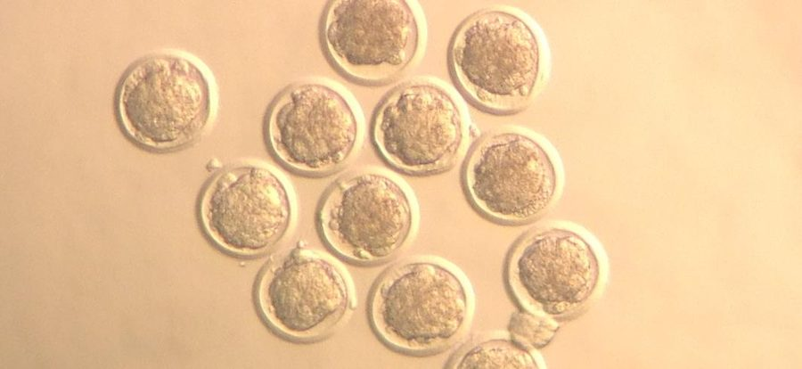
EMBRYO TRANSFER · OUR IN-VITRO PIPELINE (L&H INSTITUTE)
OPU–IVF: making embryos in the laboratory
1
OPU — ultrasound-guided egg aspiration from live donors (repeatable)
OUR IVF EMBRYOS — BLASTOCYST STAGE
2
IVM — oocyte maturation in culture (~24 h)
3
IVF — fertilize with (sexed) semen
4
IVC — culture ~7 days to blastocyst
5
Transfer fresh, or vitrify at −196 °C
Advantage for buffalo: OPU sidesteps their poor superovulation response.
EMBRYO TRANSFER & IVF
26

Slide 27
EMBRYO TRANSFER · CHOOSING THE CALF'S SEX
Sexed semen & sexed embryos
To grow a dairy or breeding herd, you want females. Flow-sorted sexed semen (~90% female) and sexed IVF embryos let you plan the sex of the calf.
~90%
Faster herd expansion — more replacement heifers
More heifers born to your best females via IVF
Fewer unwanted male calves in a dairy system
female calves with sexed semen
🐃 Buffalo dairy
Sexed genetics accelerates building a river-buffalo dairy herd from a limited elite base.
EMBRYO TRANSFER & IVF
27

Slide 28
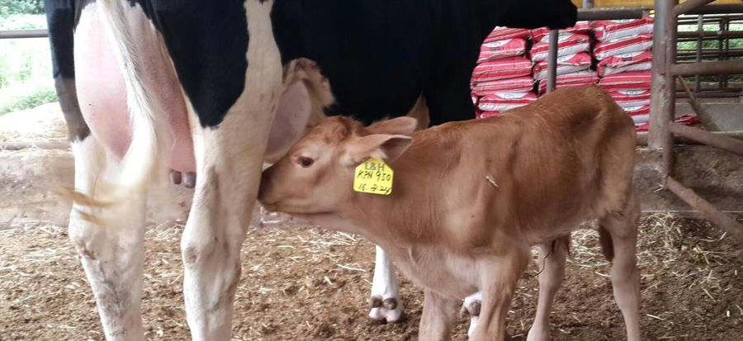
EMBRYO TRANSFER · RECIPIENT SIDE & THE RESULT
From frozen embryo to a live calf
1
Synchronize recipients — their cycle must match the embryo's age
CALF BORN FROM EMBRYO TRANSFER
2
Check the CL — transfer only to females with a good corpus luteum
3
Thaw / warm the embryo & load the transfer gun
4
Transfer non-surgically into the uterine horn on the CL side
5
Pregnancy check ~30 days by ultrasound
Elite genetics, carried by an ordinary female — this is how a nation upgrades a herd in years, not decades.
EMBRYO TRANSFER & IVF
28

Slide 29
05
PART FIVE
Smart Farming for Reproduction
Sensors and data turn reproduction from guesswork into measurement — and directly solve the buffalo SILENT-HEAT problem.
29

Slide 30
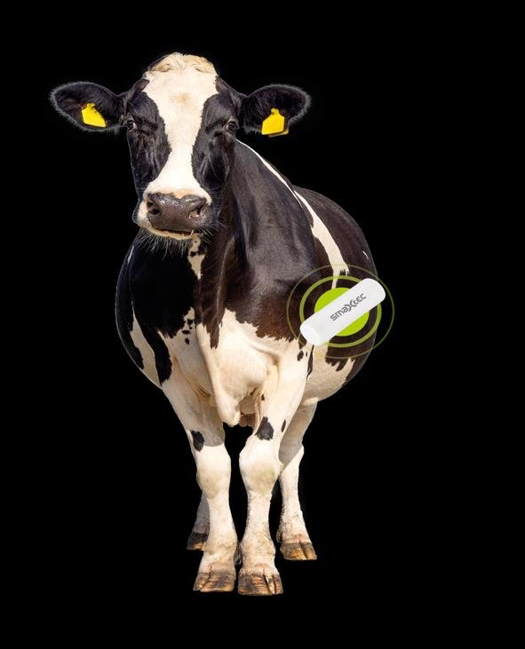
SMART FARM · SENSOR-BASED DETECTION
A sensor that never sleeps — so it catches silent heat
RUMEN BOLUS SENSOR, INSIDE THE ANIMAL
A rumen bolus continuously measures inner body temperature (±0.01 °C), rumination & activity — reading estrus and health from inside the animal, 24 hours a day.
🔥 Heat alerts, day or night
📅 Insemination window
Activity + temperature flag estrus even when signs are invisible — the buffalo breakthrough.
Tells you the ideal AI hour per animal — precision timing.
🐄 Calving prediction
❤ Early illness
Alerts ~15–30 h before calving — fewer losses.
Fever & metritis flagged days early — protects fertility.
SMART FARMING FOR REPRODUCTION
30

Slide 31
SMART FARM · DATA & DECISION SUPPORT
From alerts to action — the reproduction dashboard
Automatic heat & AI work-lists each morning
Protocol scheduling — Ovsynch / CIDR steps flagged on the right day
Pregnancy & open-day tracking per animal & per group
Herd KPIs trend over time — decisions from data, not memory
Heat-detection rate — visual vs sensor-assisted
Illustrative — sensors recover heats that eyes miss, especially at night. Higher detection → higher pregnancy rate.
SMART FARMING FOR REPRODUCTION
31

Slide 32
SMART FARM · THE INTEGRATED MODEL
Precision reproduction: three tools, one system
📡
💉
🧬
Sensors
+
Timed AI / ET
+
Genomics
Detect heat, health & calving — the eyes on every animal
Breed on schedule with elite, sexed genetics
Select the best animals to breed from — compound the gain
For the carabao program: sensors solve silent heat → timed-AI & ET spread superior genetics → genomics picks the next donors. A national herd, upgraded on data.
SMART FARMING FOR REPRODUCTION
32

Slide 33
SMART FARM · MEASURE WHAT MATTERS
The reproduction KPIs to manage by
CR
S/C
CI
PR
Conception rate
Services / conception
Calving interval
Pregnancy rate
% pregnant per AI
lower is better (≈1.5–2)
target ~12–14 mo (longer in buffalo)
detection × conception
You cannot improve what you do not measure. Track these per animal, per group, per season — and act on the trend.
SMART FARMING FOR REPRODUCTION
33

Slide 34
SUMMARY · TAKE THESE HOME
Five things to remember
1
2
3
4
5
Reproduction is the engine of genetic gain — master it and you upgrade the whole herd.
Missed heat is the #1 failure. For buffalo, plan for silent & seasonal heat.
Timed AI & synchronization beat the silent-heat problem — breed by the calendar.
ET & IVF multiply elite females — the fast track for scarce buffalo genetics.
Sensors & data make it precise, repeatable & scalable nationwide.
Practical order for a farm: detect heat well → synchronize → AI on time → measure → add ET & sensors.
SUMMARY
34

Slide 35
Thank you — Salamat po
Questions, discussion & hands-on sessions welcome. I look forward to supporting the carabao improvement mission through reproduction & smart-farm technology.
Hyunjae Ha, DVM
Goryeo VET Clinic · L&H Institute of Biotechnology · Genetics Co.
Song Young Shin Farm · Republic of Korea
AI
Embryo Transfer
IVF / OPU
Genomics
Smart Farm
35

