Slide 1
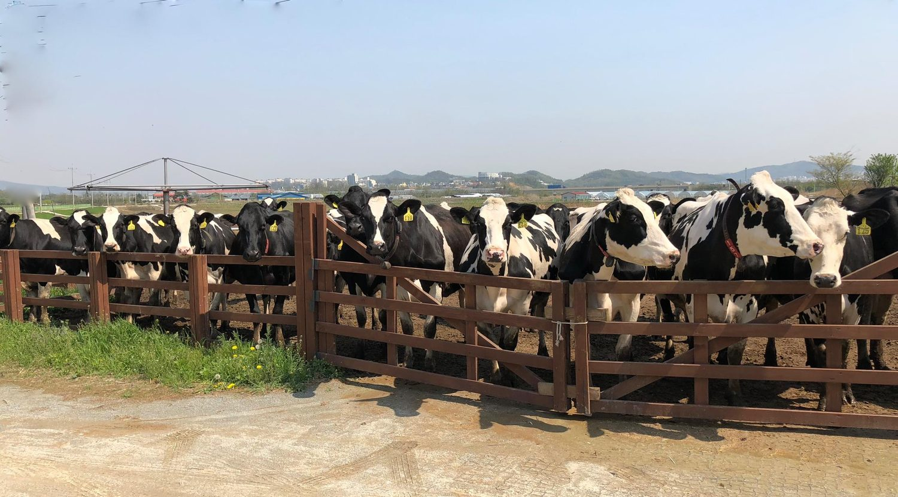
SONG YOUNG SHIN DAIRY FARM · REPUBLIC OF KOREA
Sustainable
Dairy Farming
Smart Farming (IT · BT) & Circular Agriculture
스마트팜과 순환농업으로 만드는 지속가능한 낙농
Xin chào — 베트남 대표단을 환영합니다 · Chào mừng đoàn Việt Nam
Hyunjae Ha, DVM 하현제 수의사
Goryeo VET Clinic · Song Young Shin Farm · Farm Study Visit 2026

Slide 2
WELCOME · 환영합니다 · CHÀO MỪNG
A warm welcome to our friends from Vietnam
It is an honor to host public officials of Vietnam at our farm. We share one mission — building a livestock industry that is profitable for farmers, kind to animals, and gentle on the land. Today we show how a Korean family dairy turned that mission into daily practice.
송영신목장을 찾아주신 베트남 공무원 여러분을 진심으로 환영합니다.
BUILT AROUND YOUR FOUR AREAS OF INTEREST
🌿
♻️
🥛
📡
Eco-friendly livestock
Circular agriculture
Sustainable dairy
Smart farm
친환경축산
순환농업 · Nông nghiệp tuần hoàn
지속가능한 낙농
스마트팜 · IT & BT
SUSTAINABLE DAIRY FARMING
02

Slide 3
AGENDA · 발표 순서
What we will walk through today
01
Who we are
02
Circular agriculture
The D2O ecosystem — farm, clinic, research, platform
순환농업 — the manure-to-soil nutrient loop & D2O
03
Sustainable dairy
04
Smart farming (IT · BT)
Song Young Shin Farm — welfare, low-carbon, grass-fed A2
smaXtec rumen sensors & genetics / embryo transfer
05
A model for Vietnam & Q&A
How this transfers to Vietnamese dairy — and open discussion
SUSTAINABLE DAIRY FARMING
03

Slide 4
WHO WE ARE · D2O & PARTNERS
One integrated ecosystem for smart, sustainable dairy
L&H Research Center
Goryeo VET Clinic
D2O Dung to Origin
Sexed embryo transfer (MOET)
IVF & embryo culture (BT)
ET / AI & smart vet system
Reproduction & feeding consulting
Song Young Shin Farm
D2O Co., Ltd
Animal-welfare & low-carbon certified
A2 hay milk — Jersey & Holstein
Digital platform for dairy
Smart-farming solutions (dairy & pig)
Research → Veterinary care → Farm → Platform — a single closed loop
WHO WE ARE
04

Slide 5
THE PHILOSOPHY · 지속가능한 농업
Six forces shaping sustainable agriculture
Profitability
Climate change
One Health
수익성
탄소 · 메탄 · 농업
동물 · 자연 · 인간
A farm must earn to endure.
Low-carbon livestock is now the standard.
Animal, environment & human health are one.
Smart farming
Animal welfare
Humanity
노동력 · 승계 · 삶의 질
세계적 이슈
철학 · 사명감
Technology keeps the next generation on the farm.
Comfortable cows are productive cows.
Farming as a calling, not only a business.
SUSTAINABLE AGRICULTURE
05

Slide 6
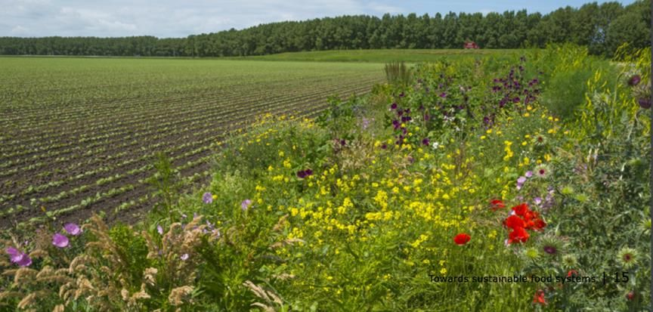
CIRCULAR AGRICULTURE · 순환농업
Waste is not waste — it is a
resource in the wrong place
순환농업이란 무엇인가?
Manure → Compost → Feed crops → Cattle feed — a closed nutrient loop
An eco-economic system that turns a cost into an input
A direct, practical response to climate change
↓ Feed costs
↓ Pollution & carbon
FIELD MARGINS RESTORED FOR BIODIVERSITY
CIRCULAR AGRICULTURE
06

Slide 7
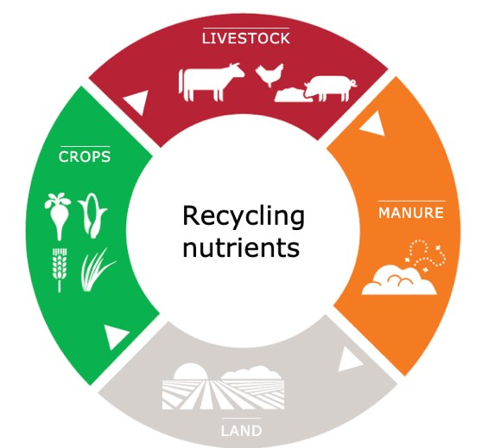
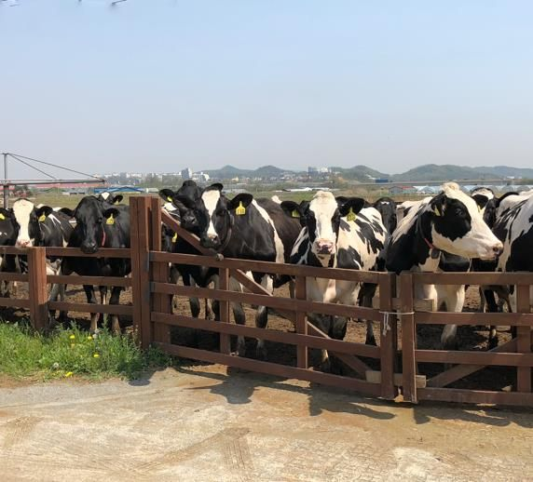
CIRCULAR DAIRY FARMING · 순환형 낙농
The livestock–crop nutrient cycle
1
Feed → Livestock → Manure
Nutrients circulate instead of leaking out of the system
2
Manure = organic fertilizer
Returned to the grassland that grows the herd's own feed
3
Low emission & sustainable
Fewer inputs bought, less pollution released
SONG YOUNG SHIN FARM — GYEONGGI, KOREA
CIRCULAR DAIRY FARMING
07

Slide 8
ECO-FRIENDLY LIVESTOCK · 친환경축산의 핵심
D2O — returning dung to its origin, the soil
The heart of eco-friendly livestock is what you do with manure. D2O is our barn-and-bedding management approach that treats manure as the starting point of the next harvest — not a disposal problem.
🌾
🦠
🌍
Odor reduction
Healthier bedding
Low-carbon compost
A cleaner barn for animals, workers and neighbours — critical near communities.
Drier, better-managed bedding supports udder health and animal comfort.
Faster, controlled composting returns stable organic matter to the grassland.
Why it matters for Vietnam: in hot, humid climates manure & odor management is the first bottleneck to scaling dairy near towns. Solve it, and welfare, environment and community acceptance all improve together.
D2O · DUNG TO ORIGIN
08

Slide 9
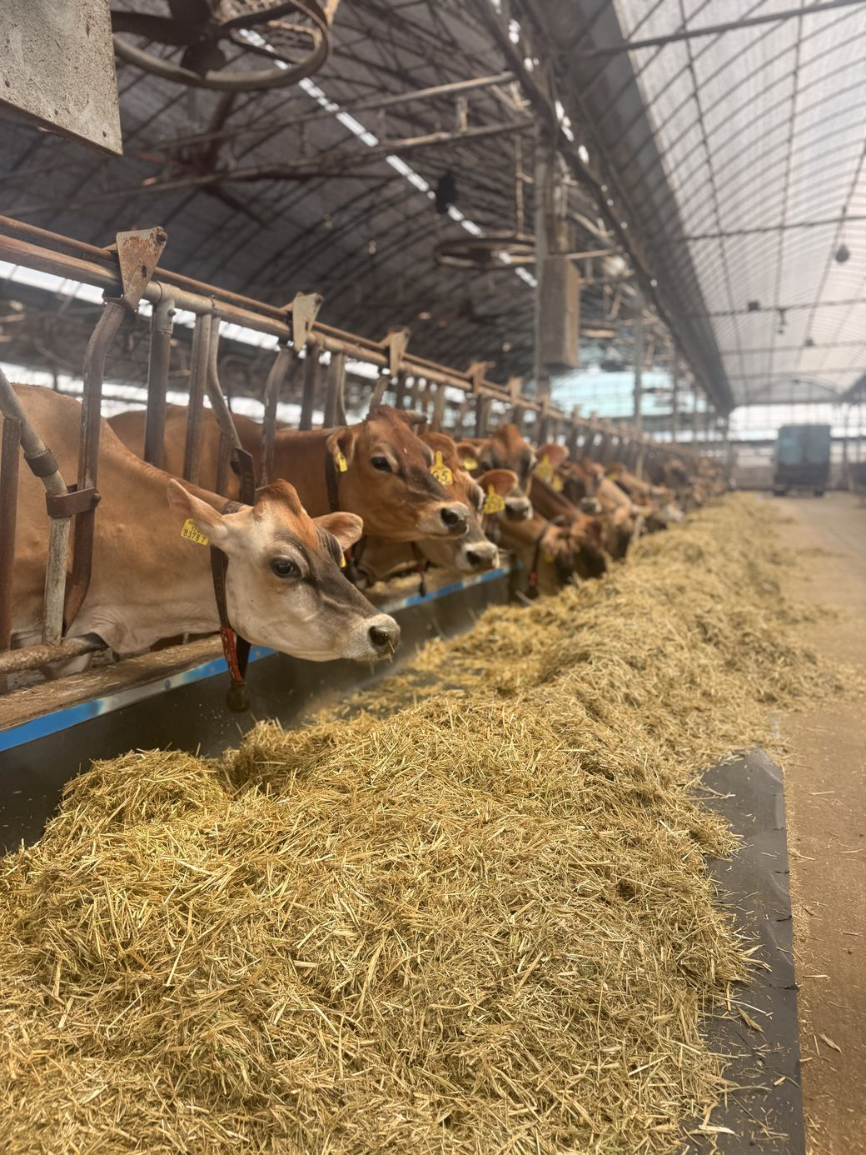
ECO-FRIENDLY LIVESTOCK · 피트모스 HBP 시스템
HBP — a peat-moss bedding that feeds the soil
PEAT-MOSS BEDDING · JERSEY BARN
The HBP system makes the barn floor the first step of the nutrient loop. A peat-moss bedding absorbs moisture and odour, keeps cows dry and healthy, then composts quickly into organic fertiliser for the grassland — closing the D2O circle.
💧 High absorption
🐄 Animal welfare
Peat moss locks in moisture & ammonia — a dry floor, far less odour.
Soft, dry bedding → cleaner udders, healthier hooves & skin.
🦠 Pathogen control
♻️ Closes the loop
A dry, low-pH bed discourages harmful bacteria in the barn.
Spent bedding + manure compost fast → back to the soil as fertiliser.
For Vietnam: in a hot, humid climate moisture & odour are the barn's first problem — HBP improves welfare and the environment together.
HBP · PEAT-MOSS BEDDING
09

Slide 10
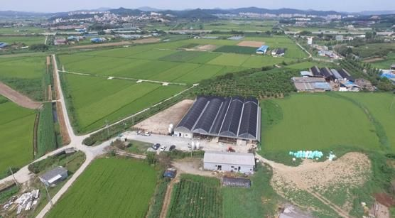
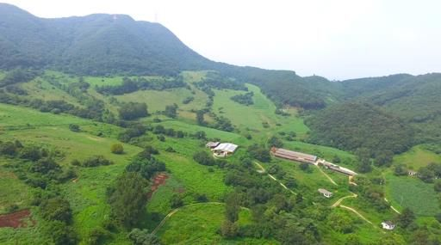
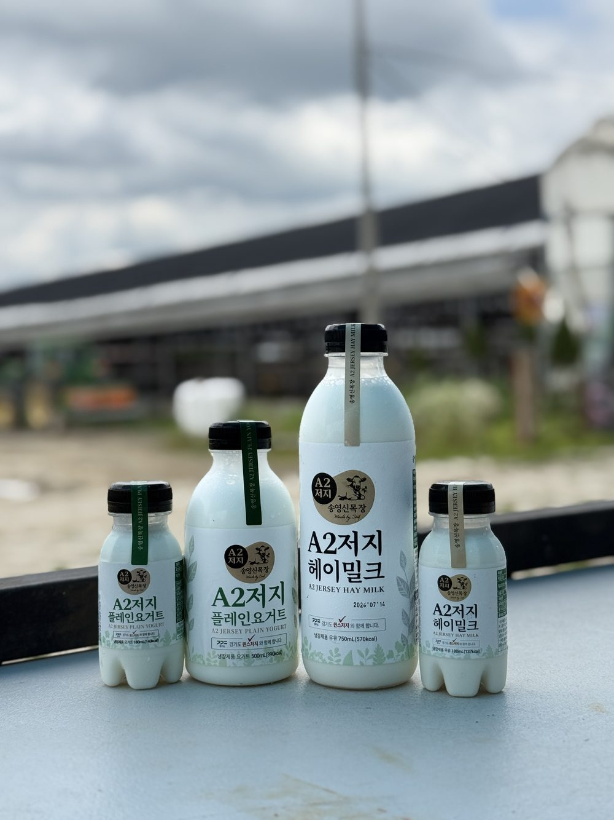
SUSTAINABLE DAIRY · 송영신목장
Song Young Shin Farm
Korea's 1st animal-welfare & low-carbon certified dairy farm
1st
Animal-welfare &
low-carbon certified
THE FARM
GRASS-FED JERSEY HERD
30ha
Own grassland for
home-grown feed
A2
Grass-fed hay milk
Jersey & Holstein
30 HA GRASSLAND
A2 HAY MILK RANGE
🤖
Robotic milking —
cows choose their time
SUSTAINABLE DAIRY
10

Slide 11
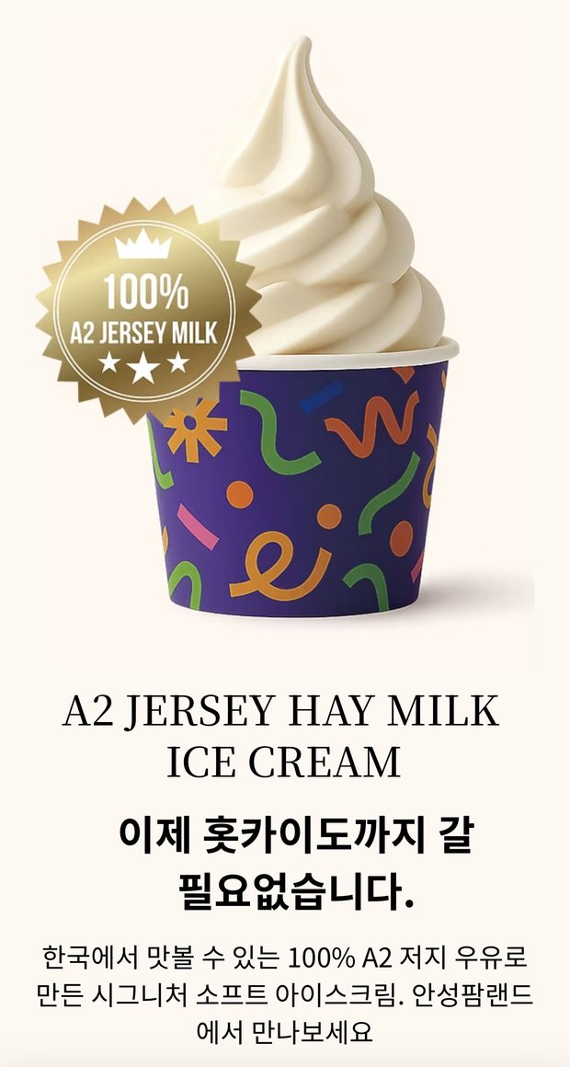
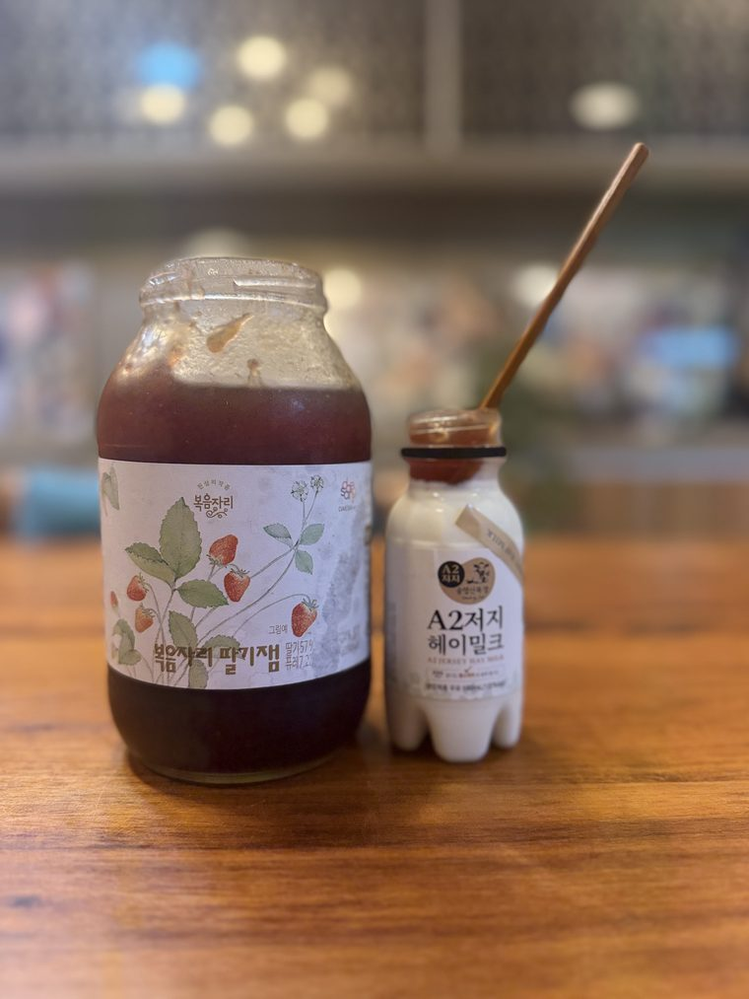
PRODUCT OF THE SYSTEM · A2 HAY MILK
No corn. No grain.
Just grass.
SONG YOUNG SHIN A2 RANGE
A sustainable farm produces a distinctive product. Cows grazed and fed on the farm's own grassland give A2 β-casein milk — sold as a premium, traceable brand that funds the farm's continued investment in welfare and technology.
100% grass-fed — no corn, no grain
A2 Jersey & Holstein hay milk
Welfare-first: robotic milking, freedom of movement
Farm-to-brand traceability that consumers trust
A2 ICE CREAM
HAY MILK
SUSTAINABLE DAIRY
Hay milk · Yogurt · Ice cream — value added on the farm
11

Slide 12
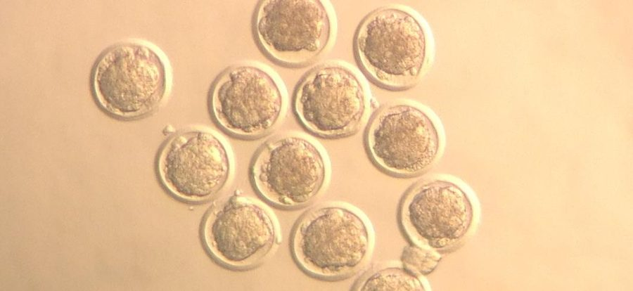
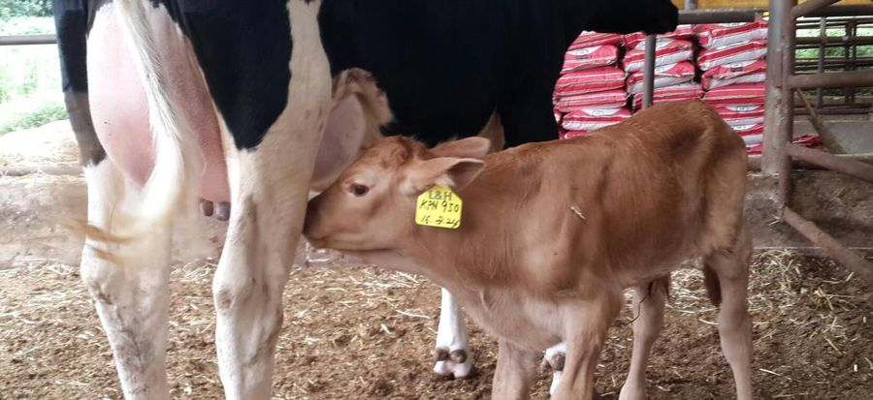
SMART FARMING · BT · 유전 · 수정란이식
Biotechnology: better cows, faster
At L&H Research Center we use embryo transfer (MOET) and IVF to multiply the best dairy genetics — cows that give more milk, breed reliably, and cope with a changing climate.
IVF EMBRYOS — BLASTOCYST STAGE
1
Oocyte recovery from selected donor cows
2
Maturation & in-vitro fertilization
3
Culture to blastocyst, quality selected
HEALTHY CALF FROM EMBRYO TRANSFER
4
Transfer to recipient — or freeze at −196 °C
Focus: Korean Holstein sexed dairy embryos — improving milk herds sustainably.
SMART FARMING · BIOTECHNOLOGY
12

Slide 13
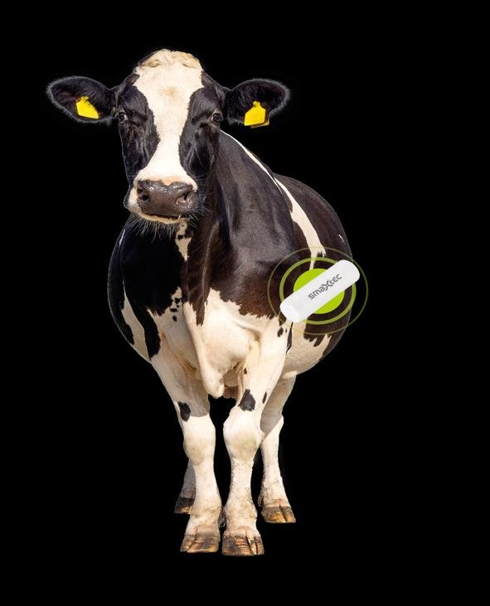
SMART FARMING · IT · SMAXTEC
One sensor. Three jobs. 24/7.
A small bolus rests in the cow's rumen and continuously measures inner body temperature (±0.01 °C), rumination and drinking — the earliest, most reliable signals of what a cow needs.
❤
🐄
🌾
Health
Reproduction
Feeding
Temperature, rumination & water intake
Heat window & calving prediction
Ration-group rumination & pH option
TruDrinking™ · TruRumi™ · TruAdvice™ — with automatic work lists & SOPs
SMART FARMING · SMAXTEC
13

Slide 14
SMART FARMING · EARLY DETECTION
Catching illness days before you could see it
Inner body temperature is the earliest health signal a cow gives. Mastitis and metritis show short fever bouts 2–5 days before any clinical sign — enough time to act before the animal is sick.
AI — TruAdvice™
The system doesn't just show data — it flags likely conditions:
Mastitis
Ketosis
Milk fever
2–5
40–70%
Act before yield, fertility or welfare are ever affected.
days early warning
potential savings via early care
SMART FARMING · EARLY DETECTION
14

Slide 15
SMART FARMING · REPRODUCTION MANAGEMENT
Every pregnancy, on time
🎯
🐮
📈
Heat detection
Calving prediction
The result
Reads activity, rumination, temperature & drinking together
Heat index shows how strong the heat is
Per-cow ideal insemination — 12-hour window
Calving alert 15–30 hours in advance
Be present for hard births — save cow & calf
Two alerts flag raised milk-fever risk
Fewer missed heats, shorter calving interval
Higher reproduction rate = more milk & calves
Less hormone use, less guesswork
SMART FARMING · REPRODUCTION
15

Slide 16
SMART FARMING · HEALTH AT A GLANCE
Four transition-period diseases, caught early
The riskiest window is right after calving. Each disease has a temperature & rumination fingerprint the sensor reads before the cow looks ill.
Mastitis
3–5 days early
Metritis / Endometritis
first 14 days
Several short temperature spikes lasting only hours — before milk yield or conductivity change.
Prolonged fever periods early in lactation, days before clinical symptoms appear.
Milk fever
around calving
Ketosis
temp + rumination
Temperature drop after calving; missed drinking & poor rumination flag cows at risk.
Temperature & rumination both fall = clinical; often avoided if the earlier disease was caught.
SMART FARMING · HEALTH
16

Slide 17
SMART FARMING · FEEDING MANAGEMENT
Feeding, judged by the cow's own rumen
Rumination time is the truest measure of whether a ration is working. The system tracks weekly rumination and daily deviation for every ration group — fresh cows, high performers, dry cows, heifers.
Weekly rumination — daily deviation by group
Spot a feeding problem the day it starts, not weeks later
Balance rations by real digestion, not by eye
Steady rumen = steady health, fertility & milk
Fresh
Elite
Low perf
Young
Dry
+10%
−1%
−2%
−1%
+4%
Illustrative of the smaXtec feeding dashboard
SMART FARMING · FEEDING
17

Slide 18
WHY IT WORKS · BENEFITS
What smart farming delivers
1
Early disease detection — lower treatment cost
Fit for Vietnamese farms 🇻🇳
Suited to 10–50 head family farms
Works in hot & humid climates
Simple smartphone monitoring
Easy bolus installation, lifetime use per bolus
Long-term return on investment
Adapted from real Korean farm experience
2
Higher reproduction rate — more productivity
3
Labor saving — 24/7 automatic monitoring
4
Data-driven decisions — scientific management
BENEFITS & VIETNAM APPLICATION
18

Slide 19
A MODEL FOR VIETNAM · HỢP TÁC
From this farm to Vietnamese dairy — a shared path
01
02
03
Pilot
Localize
Scale
A demonstration herd with sensors, welfare housing and circular manure management — proof on Vietnamese soil.
Adapt to tropical climate, local feed and herd size; train veterinarians & farmers; build the data baseline.
Extend to cooperatives and provinces — a national platform for eco-friendly, data-driven dairy.
We offer knowledge exchange, training and technology partnership — bringing eco-friendly livestock, circular agriculture, sustainable dairy and smart-farm practice together for Vietnam.
A MODEL FOR VIETNAM
19

Slide 20
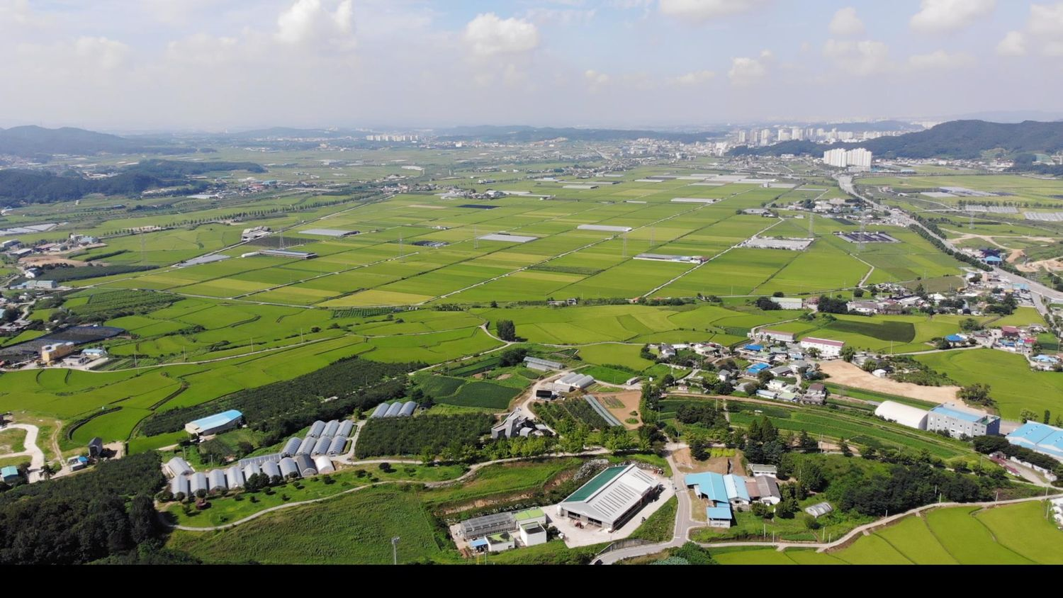
OUR PHILOSOPHY · 농민의 세상은 무궁무진합니다
"The farmer holds the key to
humanity's eternal life vault."
— Yun Bong-gil, The Farmer's Reader, 1927
건강한 흙
→
행복한 소
→
좋은 우유
Soil to Soul
20

Slide 21
감사합니다
Cảm ơn quý vị · Thank you
It is an honor to share our work with you. May our farms grow together.
Hyunjae Ha, DVM 하현제 수의사
Goryeo VET Clinic · L&H Institute of Biotechnology
Song Young Shin Farm · D2O = Dung to Origin
21

