Slide 1
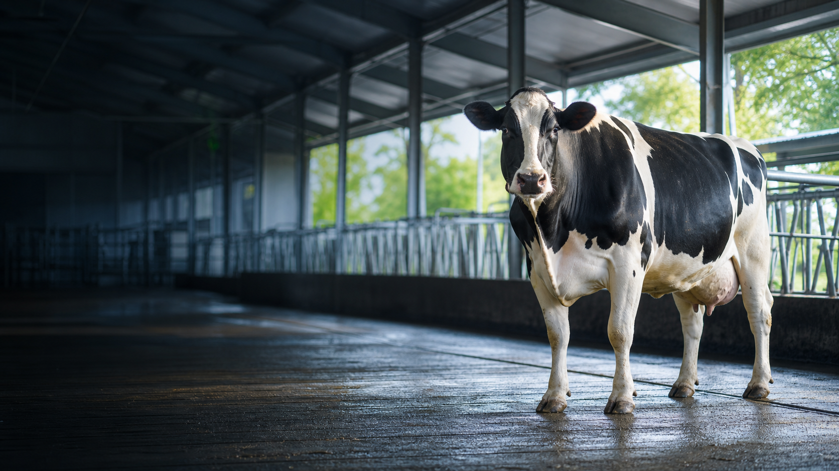
UNIVERSAL TRAINING
Better decisions
from inside the cow
Practical smaXtec / CowTalk training
Health • Reproduction • Feeding
16:9 | English | Speaker notes included
Notes:
Opening: This course turns sensor data into routine management decisions. Ask how health, breeding and feeding decisions are made today. The system supports early checks and prioritization; it does not replace veterinary diagnosis.
[Sources]
- Cover image: OpenAI image generation, 2026-08-20

Slide 2
LEARNING GOALS
Turn sensor signals into practical action
01
Internal measurement
Why reticulum signals are more stable
02
Reading graphs
Interpret temperature, drinking, rumination, activity and pH together
03
Workflow
Alert → check → record → follow up → close
04
Management
Groups, rations, worklists and performance indicators
smaXtec × CowTalk | Universal training material
02
Notes:
Emphasize that the course is about taking the right action at the right time, not simply viewing more graphs. At the end of each section, ask participants to write one SOP step they can apply.

Slide 3
THE BIG PICTURE
One system, three management questions
HEALTH
REPRODUCTION
FEEDING
Which cow needs checking now?
When should we inseminate or prepare for calving?
Which group or ration changed?
The same internal data → different decisions → one daily workflow
smaXtec × CowTalk | Universal training material
03
Notes:
Present Health–Reproduction–Feeding as one connected management system. A rumination decline may be both a health and feeding signal; context determines the action.

Slide 4

01
Measuring from within
The reticulum provides continuous physiological monitoring with less external noise.
smaXtec × CowTalk | Universal training material
04
Notes:
Explain that the reticulum is the second stomach compartment. The next slide compares the practical difference between internal and external measurement.
[Sources]
- https://smaxtec.com/en/smaxtec-system-in-detail/1000/
[Sources] - Product image: https://www.smaxtec.com/wp-content/uploads/2024/07/20240708_devices_pH.svg - https://www.smaxtec.com/en/technical-components/

Slide 5
RETICULUM
The advantage of internal measurement: stable context
What affects external sensors?
What does an internal bolus provide?
• Dirt, friction and placement
• Environmental and mechanical noise
• Risk of detachment or displacement
• Often measures behavior indirectly
• Continuous core-temperature trend
• Drinking cycles and water intake
• Rumination from reticulum contractions
• Activity and optional pH
• Comparison with each cow’s baseline
smaXtec × CowTalk | Universal training material
05
Notes:
The point is not that all external sensors are poor. The internal position continuously measures unique information such as core temperature, drinking and rumen pH. Official materials describe a maintenance-free bolus after administration.
[Sources]
- https://smaxtec.com/en/smaxtec-system-in-detail/1000/
- https://smaxtec.com/en/technical-components/

Slide 6
SYSTEM ARCHITECTURE
Data flows automatically; people make the decision
1
2
3
4
5
BOLUS
BASE STATION
CLOUD TruD®
MESSENGER / APP
TEAM
Internal signals
Automatic reception
Algorithms and analysis
Alerts and graphs
Check and record
The sensor provides the signal. The SOP turns it into an outcome.
smaXtec × CowTalk | Universal training material
06
Notes:
The base station transfers data automatically, and a climate sensor can add ambient temperature, humidity and pressure. TruD® Cloud performs analysis, while field professionals make the final check and treatment decision.
[Sources]
- https://smaxtec.com/us/

Slide 7
SIGNALS
Five signals tell the cow’s story together
°C
H₂O
R
A
pH
Core temperature
Drinking
Rumination
Activity
Rumen pH
Inflammation, calving, heat stress
Changes in drinking frequency and volume
Response to health and ration
Heat, lameness, abrupt behavior change
Fermentation stability and SARA risk
Trend > single point | Combination > single signal | Check > assumption
smaXtec × CowTalk | Universal training material
07
Notes:
Stress three rules: trend over a single value, combined signals over one signal, and checking over guessing. pH is used in selected representative cows fitted with a pH bolus.
[Sources]
- https://smaxtec.com/en/technical-components/

Slide 8
CORE TEMPERATURE
Temperature is a powerful internal signal for early checks
±0.01 °C
Watch deviations from the cow’s own baseline
Manufacturer-stated relative measurement accuracy
A rise may be consistent with inflammation
A drop matters with other signs in a calving context
For heat stress, read it with climate, drinking and rumination
An alert is not a diagnosis. Observe, measure and check history and SOP first.
smaXtec × CowTalk | Universal training material
08
Notes:
The cow’s baseline and the duration of change matter more than one absolute temperature. Check appearance, rectal temperature, udder, discharge, manure, intake and days post-calving. ±0.01°C is relative device accuracy, not diagnostic accuracy.
[Sources]
- https://smaxtec.com/en/smaxtec-system-in-detail/1000/

Slide 9
WATER & DRINKING
Drinking signals can reveal a problem before milk changes
What do we look for?
QUICK QUESTION
Number of drinking cycles
One cow
or the whole group?
Individual water intake
Deviation from the daily baseline
One cow → health or individual access
Group → water line, pressure, heat stress, feed
Simultaneous group-level change
smaXtec × CowTalk | Universal training material
09
Notes:
Do not stop at ‘she drank less.’ If several cows change together, inspect the water line, pressure, cleanliness, heat stress and group movement.
[Sources]
- https://smaxtec.com/en/

Slide 10
RUMINATION
Rumination connects health and feeding
Decline
Recovery
May relate to disease, pain, lower intake, stress or a group change.
Helps track response after treatment, calving recovery or ration correction.
INDIVIDUAL TREND
GROUP TREND
smaXtec × CowTalk | Universal training material
10
Notes:
Rumination alone cannot identify a disease. A simultaneous temperature change raises the priority of a health check. A turning point in the group average should trigger review of ration, mixing, delivery and sorting.
[Sources]
- https://smaxtec.com/en/

Slide 11
ACTIVITY
Activity supports reproduction decisions, but needs context
Increased
Possible heat
ACTIVITY
Decreased
Lameness / disease
Changed
Movement / stress
smaXtec × CowTalk | Universal training material
11
Notes:
Activity is central to heat detection but is not sufficient alone. Check reproductive status and insemination history; with declining activity, also check health and gait.
[Sources]
- https://smaxtec.com/us/

Slide 12
RUMEN pH
pH shows the ration’s actual effect in the rumen
150 days
INTERPRETATION CHAIN
pH measurement period; other signals for the battery lifetime
Ration / mixing
pH profile
Rumination and drinking
Group outcome
pH is a feeding-verification tool in selected representative cows
smaXtec × CowTalk | Universal training material
12
Notes:
Official specifications state a 150-day pH measurement period, with relative accuracy of ±0.2 for days 1–90 and ±0.4 for days 90–150. Review the daily profile and time spent low, not one point.
[Sources]
- https://smaxtec.com/en/smaxtec-system-in-detail/1000/

Slide 13
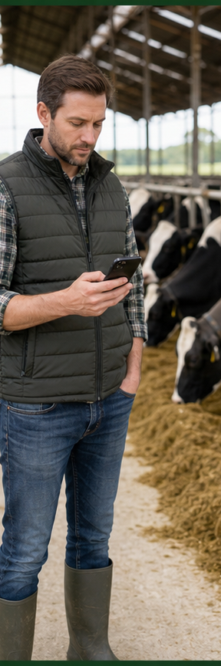
02
Messenger and app graphs
Use graphs to validate an alert, understand the timeline and choose the next check.
smaXtec × CowTalk | Universal training material
13
Notes:
The next graph is a training example that teaches a reading method; it is not a reproduction of the official app interface.
[Sources] - Section image: OpenAI image generation, 2026-08-20 (generic training context; no product UI reproduced).

Slide 14
TRAINING GRAPH EXAMPLE
Training example—not the official UI
Read the graph left to right—from event to decision
1
Find the baseline
2
Find the turning point
3
Combine signals
4
Record the event and action
smaXtec × CowTalk | Universal training material
14
Notes:
Find the normal range, then locate the turning point. In this example, rising temperature with falling rumination and activity increases health-check priority. Values are synthetic training data, not clinical thresholds.
[Sources]
- Training example data, author-created.

Slide 15
VIEW LEVEL
Individual and group views answer different questions
INDIVIDUAL
GROUP
• Which cow changed?
• How far from her baseline?
• What happened before the alert?
• Did she recover after the check or treatment?
• How many cows changed together?
• Was there a ration, water or climate event?
• Which ration group was most affected?
• How long did the change last?
smaXtec × CowTalk | Universal training material
15
Notes:
Individual view is strong for clinical follow-up; group view is strong for feeding, environment and operating issues. Distinguish a one-cow problem from a group problem.

Slide 16
ALERT TRIAGE
The goal is correct triage—not simply closing the alert
1
2
3
4
5
OPEN
CONTEXT
CHECK
RECORD
FOLLOW UP
Signal, time, duration
Lactation, calving, group
Cow, environment, equipment
Finding and action
Did the trend recover?
Critical alert → responsible person now | Unclear alert → recheck and follow up
smaXtec × CowTalk | Universal training material
16
Notes:
Each farm should define critical alert types, target response times and owners in advance. Marking an alert as viewed is not closure; record the outcome and schedule a recheck.

Slide 17
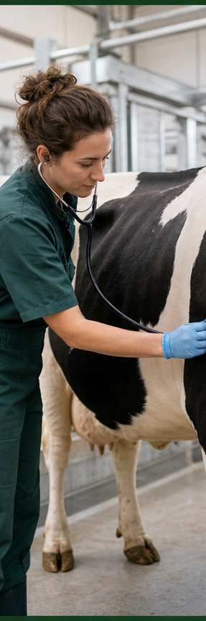
03
Early health management
The value of an early signal is moving the check earlier—not naming the disease.
smaXtec × CowTalk | Universal training material
17
Notes:
Manufacturer materials present case-based figures of up to five days earlier disease detection and up to 70% lower antibiotic use. These are not guarantees and vary by disease, farm and SOP.
[Sources]
- https://smaxtec.com/en/
[Sources] - Section image: OpenAI image generation, 2026-08-20 (generic training context; no product UI reproduced).

Slide 18
EARLY DETECTION
Detect the deviation early—not the diagnosis
Invisible stage
Subclinical stage
Clinical stage
Recovery
Internal trend changes
Alert + check
Visible symptoms
Trend monitoring
Goal: check and begin targeted action before clinical deterioration
smaXtec × CowTalk | Universal training material
18
Notes:
Physiological changes may precede visible signs in conditions such as mastitis, metritis, pneumonia, ketosis or milk fever. Even if the system suggests a condition, veterinary confirmation is required.
[Sources]
- https://smaxtec.com/en/

Slide 19
PRACTICAL SOP
The health SOP should work the same way for every alert
0–15 min
Receive alert
Animal ID, location, risk level
15–60 min
Physical check
Temperature, udder, discharge, manure, gait
Same shift
Decision and record
Monitor / separate / specialist / treat
Next 24 hours
Trend monitoring
Temperature, rumination, drinking, clinical response
Close
Confirm outcome
Cause, action, recurrence prevention
smaXtec × CowTalk | Universal training material
19
Notes:
The times shown are training examples. Adapt them to farm risk and veterinary protocols. Record quality matters for performance analysis and customer-support troubleshooting.

Slide 20
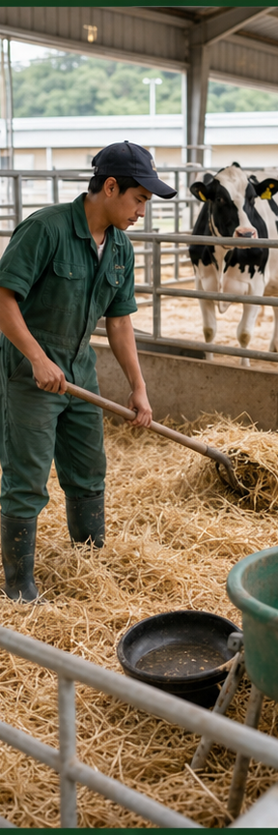
04
Reproduction
Activity, temperature and history sharpen heat, insemination and calving decisions.
smaXtec × CowTalk | Universal training material
20
Notes:
Interpret reproduction signals within the voluntary waiting period and the farm’s breeding strategy.
[Sources] - Section image: OpenAI image generation, 2026-08-20 (generic training context; no product UI reproduced).

Slide 21
HEAT
A heat alert is a tool for managing the insemination window
1
2
3
4
Activity rises
Algorithm produces a heat index
Recommended insemination window
Record the result
Check status and days in milk
Confirm observed signs
Choose timing for conventional or sexed semen
Enter insemination in the app immediately
smaXtec × CowTalk | Universal training material
21
Notes:
The official system supports recommended insemination timing, including timing for sexed semen. Farm breeding protocols and veterinary judgment take priority.
[Sources]
- https://smaxtec.com/us/

Slide 22
CALVING
A calving alert creates preparation time
≈15 hours
SEPARATE
PREPARE
Average advance notice stated by the manufacturer
Clean, safe calving area
Staff, equipment, calcium and records
MONITOR
AFTER
Temperature, activity and calving progress
Placenta, drinking, rumination and recovery
smaXtec × CowTalk | Universal training material
22
Notes:
About 15 hours is an average, not a guarantee. Monitoring rumination, drinking and temperature recovery after calving can support earlier checks for retained placenta, metritis and metabolic problems.
[Sources]
- https://smaxtec.com/en/smaxtec-system-in-detail/1000/

Slide 23
ABORTION / PREGNANCY LOSS
An abortion alert requires a high-priority check
IMMEDIATELY
What do we check on the graph?
• Locate the cow and check her condition
• Notify the veterinarian and responsible person
• Follow biosafety and sampling SOPs
• Record the event time and findings
Temperature change and duration
Abrupt activity change
Combined drop in rumination and drinking
Previous reproduction and health events
smaXtec × CowTalk | Universal training material
23
Notes:
Abortion detection is included in official product descriptions. Treat it as a high-priority check, follow biosafety procedures and comply with local veterinary requirements.
[Sources]
- https://smaxtec.com/us/

Slide 24
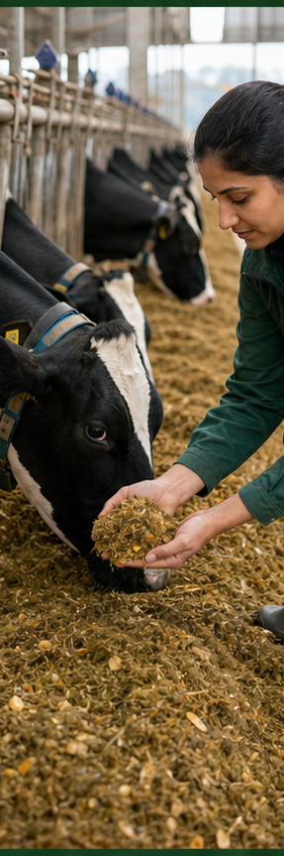
05
Feeding
The Feeding Tool turns individual noise into group signals and ration decisions.
smaXtec × CowTalk | Universal training material
24
Notes:
The most useful unit of feeding analysis is often the ration group and the period before and after a change—not the individual cow.
[Sources] - Section image: OpenAI image generation, 2026-08-20 (generic training context; no product UI reproduced).

Slide 25
FEEDING TOOL
Ration groups create a clean context for comparison
Fresh cows
High production
Late lactation
Dry / transition
0–21 DIM
22–150 DIM
>150 DIM
Around calving
A group should share the same ration, similar physiological stage and clear dates.
DIM examples—adapt to the farm protocol
smaXtec × CowTalk | Universal training material
25
Notes:
Group names and DIM ranges are training examples. Adapt them to farm rations and operating rules, and always record movement and ration-change dates.

Slide 26
RATION ANALYSIS
Evaluate a ration change in four layers
1. INPUT
Recipe, DM, ingredient lot, mixing
2. DELIVERY
Timing, push-up, sorting, bunk space
3. COW RESPONSE
pH, rumination, drinking, activity
4. OUTCOME
Milk, components, health events
smaXtec × CowTalk | Universal training material
26
Notes:
Sensors show the cow’s response, but identifying the cause also requires checking ingredient input and feed delivery.

Slide 27
pH + FEEDING
The pH profile shows ration stability
Training example
Focus on time spent low—not only the lowest point
Connect feeding time to the graph
Add rumination and drinking trends
Compare before and after a ration change
smaXtec × CowTalk | Universal training material
27
Notes:
The graph is educational and does not define a universal clinical threshold. Review DM, NDF, sorting and mixing quality with the nutritionist.
[Sources]
- Training example data, author-created.
- https://smaxtec.com/en/smaxtec-system-in-detail/1000/

Slide 28
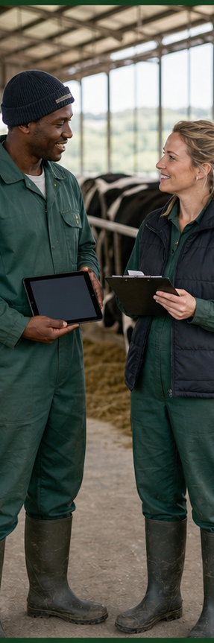
06
Assistant, worklists and SOPs
A strong system asks the same questions in the same order every shift—and leaves none unanswered.
smaXtec × CowTalk | Universal training material
28
Notes:
Assistant and worklists do not replace people; they create priorities and consistency.
[Sources] - Section image: OpenAI image generation, 2026-08-20 (generic training context; no product UI reproduced).

Slide 29
ASSISTANT
Digital Assistant directs attention where it is needed
ALERT
PRIORITY
OWNER
ACTION
OUTCOME
What happened?
When?
Who?
What was done?
Closed?
Push notification → worklist → check → event record → follow-up
smaXtec × CowTalk | Universal training material
29
Notes:
The official app description includes worklists, animal lists, observation lists, offline event entry and bulk actions. Define an official closure point so alerts do not disappear in personal messages.
[Sources]
- https://play.google.com/store/apps/details?id=com.smaxtec.cow
- https://smaxtec.com/us/software/

Slide 30
WORKLIST RHYTHM
A daily rhythm turns data into habit
1
SHIFT START
New critical and overdue tasks
2
MORNING ROUND
Health and calving checks
3
INSEMINATION
Confirm window and status
4
FEEDING
Group trend and ration events
5
SHIFT END
Open tasks and handover
smaXtec × CowTalk | Universal training material
30
Notes:
Adapt the operating rhythm to the farm’s shifts. What matters is opening and closing the list at defined times every day.

Slide 31
PERFORMANCE OVERVIEW
Performance overview measures process as well as outcomes
RESPONSE
CLOSURE
HEALTH
Time from alert to check
Tasks completed according to SOP
Early checks and repeat cases
REPRO
FEEDING
DATA
Heat → insemination → result
Group trends and ration events
Bolus, base station and event-record quality
Measure the baseline → set a target → review weekly
smaXtec × CowTalk | Universal training material
31
Notes:
Include leading indicators such as response time, completion rate and data quality—not only production outcomes. Distinguish manufacturer figures from the farm’s own baseline.
[Sources] - Stygar AH et al. (2021), Frontiers in Veterinary Science 8:634338. https://doi.org/10.3389/fvets.2021.634338 - Adams AE et al. (2013), Journal of Dairy Science 96(3):1549–1555. https://pubmed.ncbi.nlm.nih.gov/23332847/ - Liu N et al. (2023), Agriculture. https://agris.fao.org/search/en/providers/122436/records/67598043c7a957febdf958cc

Slide 32
CUSTOMER SERVICE
Evidence helps customer service solve problems faster
1
FARM
Issue, time, animal/group ID
2
FIRST CHECK
Power, connection, base station, app
3
EVIDENCE PACKAGE
Screenshot, graph range, event record
4
ESCALATION
Local partner / smaXtec Support
5
CLOSURE
Cause, correction, prevention, confirmation
smaXtec × CowTalk | Universal training material
32
Notes:
For support, provide the time of the issue, cow or group ID, equipment status, screenshots, graph range and checks already completed.

Slide 33
IMPLEMENTATION
Embed the system into daily management in 30 days
WEEK 1
WEEK 2
WEEK 3
WEEK 4
Set up
Train
Observe
Improve
Groups, roles, alerts, basic SOP
Graphs, triage, records, handover
Response time, open tasks, data quality
Review unnecessary alerts, roles, thresholds and SOPs
Ask weekly: which alerts became actions—and which did not?
smaXtec × CowTalk | Universal training material
33
Notes:
Do not try to perfect every feature at once. Establish roles and task closure first. After 30 days, audit one workflow each for health, reproduction and feeding.

Slide 34
KEY TAKEAWAYS
Three habits connect every function
1
2
3
See the trend
Add context
Close the task
Not a single point
Cow + group + event
Check + record + follow-up
Internal data → earlier insight → organized action → a healthier herd
smaXtec × CowTalk | Universal training material
34
Notes:
Repeat the three habits together: see the trend, add context and close the task. Finish by asking which worklist and SOP participants will check first tomorrow.

Slide 35
SOURCES
Sources and limits of educational use
Official + global references
Important note
smaxtec.com/en/technical-components/
smaxtec.com/us/software/
smaxtec.com/en/profit-in-dairy-farming…
Stygar et al. (2021), Front. Vet. Sci.
Adams et al. (2013), J. Dairy Sci.
Liu et al. (2023), Agriculture
Manufacturer claims and customer case results are context-specific. Independent reviews support continuous monitoring, while also showing that commercial sensors differ in external validation. Use alerts to prioritize checks; local veterinary protocols remain decisive.
Version: 2026-08 | Global evidence & visual upgrade | Country-neutral
smaXtec × CowTalk | Universal training material
35
Notes:
Return to official sources for complex questions. Local veterinary law, medicine-use rules and biosafety requirements always take priority.
[Sources]
- https://smaxtec.com/en/
- https://smaxtec.com/en/smaxtec-system-in-detail/1000/
- https://smaxtec.com/en/technical-components/
- https://smaxtec.com/us/software/
[Sources] - https://www.smaxtec.com/en/smaxtec-system-in-detail/1000/ - https://www.smaxtec.com/en/technical-components/ - https://www.smaxtec.com/us/software/ - https://www.smaxtec.com/en/profit-in-dairy-farming-why-smaxtec-truly-pays-off/ - https://www.smaxtec.com/en/success-stories/testimonial-bill-jewell-2/ - https://doi.org/10.3389/fvets.2021.634338 - https://pubmed.ncbi.nlm.nih.gov/23332847/ - https://agris.fao.org/search/en/providers/122436/records/67598043c7a957febdf958cc

Slide 36
FROM SENSOR TO SYSTEM
The alert is where smaXtec ends and CowTalk begins
WHAT THE SENSOR GIVES YOU
WHAT STILL HAS TO HAPPEN
A reliable event
A decision, by a person
A physiological deviation, detected inside the cow
Which cow do I check first, out of eleven alerts?
Time-stamped and validated by the manufacturer
What is her history — treatments, parity, days in milk?
The same quality on every farm, every day
Who acts, and with what? Was it actually done?
The gap between an alert and an action is where most of the value is lost.
smaXtec × CowTalk | Universal training material
36
Notes:
This slide is the hinge of the whole programme. The first half of this training covered the sensor. Everything that follows covers the layer that turns a sensor event into a decision, an action and a record. Do not present CowTalk as a better sensor — it is a different layer.

Slide 37
07
The layer above the sensor
CowTalk adds context, interpretation and role-based action on top of the sensor event. It does not re-judge the event itself.
smaXtec × CowTalk | Universal training material
37
Notes:
Say the boundary out loud: the manufacturer validated the event, so we trust it. Re-scoring a validated event would only reduce accuracy. Our job starts after the event.

Slide 38
ARCHITECTURE
Four layers turn a signal into a decision
LAYER 4
Learning loop
Expert labels, alarm statistics and treatment outcomes improve the next judgement
LAYER 3
Role-based serving
The same data reaches farmer, veterinarian, biosecurity officer and administration differently
LAYER 2
Interpretation
Context is added to the event; every judgement carries its reasoning and its sources
LAYER 1
Data integration
Sensor events, national records, farm history and weather are joined onto one animal
The sensor event is trusted, not re-judged. CowTalk adds what the sensor cannot know.
smaXtec × CowTalk | Universal training material
38
Notes:
Read the stack from the bottom up. Layer 1 is the only place data enters. Layer 2 never bypasses it — the assistant cannot answer from memory alone, it has to query the data. That constraint is what makes the answers auditable.

Slide 39
CONTEXT
One cow carries four numbers that used to live apart
NATIONAL ID
FARM TAG
PEDIGREE ID
DEVICE SERIAL
Traceability number
Management number
Breeding registry
Sensor identity
Issued by the state within two weeks of birth. The key that unlocks national records.
What the farm actually calls her. The number used in every conversation on the yard.
Ancestry and genetic merit. Needed for inbreeding checks and semen selection.
The bolus inside her. Links the physiological stream to everything above.
Joining these four is what turns “this cow has a fever” into a priority and a cost.
smaXtec × CowTalk | Universal training material
39
Notes:
In most countries these four numbers live in four systems that never meet. Ask the room how long it takes today to look up a treatment history for one animal. That answer is the value of this slide.

Slide 40
BOUNDARIES
What the assistant does and does not do
IT DOES
IT DOES NOT
Organise and evidence
Decide or prescribe
Gather the animal’s full context in one place
It does not diagnose — it presents candidates
Rank candidate explanations with the evidence for each
It does not prescribe — that stays with the veterinarian
Propose the next check and the expected timing
It does not act without approval — no silent execution
Write the record once the person has acted
It does not answer without data — “no data” is a valid answer
Every output records its sources. An answer without evidence is treated as a failure, not a result.
smaXtec × CowTalk | Universal training material
40
Notes:
Give this slide time. In every audience there is someone who has decided in advance that AI is a liability. The right-hand column is for that person. Say plainly: the final judgement belongs to a human, and the system is built so that this cannot be bypassed.

Slide 41
08
The assistant
Ask in plain language. The system answers from your own farm data — and shows where every number came from.
smaXtec × CowTalk | Universal training material
41
Notes:
Demonstrate live if the network allows. If not, use the screenshots in the appendix. The point to land is that it answers from the farm’s own data, not from general knowledge.

Slide 42
TOOLS
The assistant works only through a fixed set of permitted tools
SENSOR
FARM
REPRODUCTION
PUBLIC DATA
VETERINARY
Animal & signal
Herd & records
Breeding cycle
National records
Clinical support
Profile, event history, temperature and activity series, weather and heat index
Herd summary, key indicators, treatment and milk yield entry
Breeding statistics, insemination window, semen advice, sync protocols
Traceability, carcass grading, auction prices, regional disease status
Differential candidates, treatment outcome confirmation, expert labelling
Every tool call is written to an audit log — who asked, when, and what was returned.
smaXtec × CowTalk | Universal training material
42
Notes:
The assistant cannot invent a capability. If a question needs a tool that does not exist, it says so. Access differs by role — a farmer and a biosecurity officer do not have the same tool set. Mention that the log is per-call, not per-session; that level of detail is what auditors ask for.

Slide 43
EVIDENCE
Every answer shows where the number came from
1
2
3
4
A question in plain language
Permitted tools are called
Data is read from the record
The answer carries citations
“How is 423 doing?” — typed or spoken, in the user’s own language
Only tools this role may use, only for animals in this scope
Live values from the database — never a recollection or an estimate
Each figure is tied to its source, its timestamp and its confidence
If the data is missing, the correct answer is “no data” — not a plausible guess.
smaXtec × CowTalk | Universal training material
43
Notes:
Step 4 is the one that matters for professional users. A veterinarian will not act on a number whose origin is unclear. Point out that when a value is estimated rather than measured, the answer says so.

Slide 44
ROLES
One dataset, four different questions
FARMER
VETERINARIAN
BIOSECURITY OFFICER
ADMINISTRATION
What do I do today?
Who do I visit first?
Is anything spreading?
What is the regional picture?
Today’s tasks, heat and calving alerts, the margin each cow returns.
Case queue across all client farms, differential evidence, route and records.
Cluster detection, contact tracing, spread scenarios, investigation records.
Coverage, performance indicators, policy briefing and budget evidence.
Permission is enforced on the server. Data outside your scope is not hidden — it is refused.
smaXtec × CowTalk | Universal training material
44
Notes:
The distinction between hiding and refusing matters in procurement reviews. Hiding is a user-interface choice; refusing is an architectural guarantee. The same rule applies to the assistant’s long-term memory — it only recalls within the account’s permissions.

Slide 45
09
Veterinary intelligence
The system organises candidates and the evidence behind them. Diagnosis and prescription remain with the veterinarian.
smaXtec × CowTalk | Universal training material
45
Notes:
If veterinarians are in the room, this is the section that decides whether they trust the product. Lead with the limits, then show the evidence table. Never say “the AI diagnoses”.

Slide 46
DIFFERENTIAL
A probability is useless without the evidence behind it
6
Each candidate shows which findings support it and which argue against it
Candidate conditions ranked for each case, with the evidence listed for every one
Where data is absent, the item is marked absent — not counted as negative
A weakly evidenced single candidate is not allowed to reach high confidence
The next confirmatory check is proposed, with an urgency level
Uncertainty is displayed, not hidden. A confident-looking number with thin evidence is a defect.
smaXtec × CowTalk | Universal training material
46
Notes:
Explain the correction we made: an early version let a single weakly supported candidate reach near-certainty. That artefact was removed by adding an uncertainty prior. Being open about a fixed defect earns more clinical trust than any accuracy claim.

Slide 47
RECORD
The record writes itself — including the withdrawal date
PRESCRIPTION
WITHDRAWAL
OUTCOME
Written at the chairside
Calculated automatically
Verified by the sensor
Diagnosis, drug, dose, route and duration captured once, on the spot, and issued as a document.
The end date is derived from the product and shown against milk and slaughter — no mental arithmetic.
Days later the system re-reads the animal and reports recovery, relapse or continued monitoring.
Withdrawal control is food safety — and food safety is a trade issue before it is a farm issue.
smaXtec × CowTalk | Universal training material
47
Notes:
For a government audience, the withdrawal card is the strongest slide in the veterinary section. Residue control is usually managed on paper and memory. Here it becomes a system property, and it produces the evidence an export market asks for.

Slide 48
LEARNING
The veterinarian’s judgement becomes the system’s memory
1
2
3
4
A judgement is spoken
One confirmation
Stored and aggregated
The next judgement improves
During the case review — “this looks like ketosis”
The assistant asks once whether to record it as a label
Kept as ground truth and tracked per alert type over time
Guidance is rebuilt by fixed rules — never by the model itself
Only expert judgements become labels. Farmer and administrator guesses are excluded to protect data quality.
smaXtec × CowTalk | Universal training material
48
Notes:
Step 5 is deliberately conservative: the model does not edit its own instructions. Guidance is generated by deterministic rules from the label statistics, so every change is reviewable. This is the answer to “how do you stop the AI drifting?”

Slide 49
10
The reproduction loop
From heat alert to insemination decision to pregnancy result — and back into the next recommendation.
smaXtec × CowTalk | Universal training material
49
Notes:
This is where the farm sees money fastest. Open days are the most expensive number on a dairy, and they are the number a sensor plus a decision layer moves first.

Slide 50
HEAT
The recommendation carries the farm’s own settings
The insemination window is calculated from this farm’s parameters, not a global default
Semen is proposed on inbreeding coefficient, genetic merit and the farm’s stated breeding goal
A pre-check runs first — recent treatment, withdrawal status, repeated failed services
The recommendation names who acts and by when, and the technician receives it directly
Ranking uses inbreeding, genetic merit and farm goals. Supplier weighting does not exist in the algorithm.
smaXtec × CowTalk | Universal training material
50
Notes:
Every farm keeps different breeding settings — return interval, pregnancy check timing, gestation length, dry-off lead time. Using a global default here is the single most common way an advisory tool loses credibility. The callout is a procurement answer: read it verbatim if anyone asks about supplier bias.

Slide 51
PROTOCOL & FEEDBACK
Protocols become schedules, and results become learning
SYNCHRONISATION
THE CLOSING LOOP
A protocol becomes a calendar
Results teach the next cycle
Four standard protocols are supported as prescriptions
Insemination is recorded with sire and technician
Each becomes dated hormone and insemination tasks
The pregnancy result returns as ground truth
Today’s due treatments appear on the daily worklist
Conception rates are tracked by sire and by cow
Approval rules still apply before anything is scheduled
The next recommendation is adjusted accordingly
A conception result that never comes back is a loop that never closes — and a system that never improves.
smaXtec × CowTalk | Universal training material
51
Notes:
The failure mode to warn about: farms that record inseminations but not pregnancy results. Without the result the model cannot learn, and the recommendation quality plateaus. Make recording the result part of the routine from week one.

Slide 52
11
From one farm to a national picture
The same signal that helps one farm, aggregated across many, becomes an early-warning layer for disease control.
smaXtec × CowTalk | Universal training material
52
Notes:
Shift the frame here. Until now every slide was about one farm. From here the audience should be thinking about a region and a country.

Slide 53
DRILL-DOWN
Four levels, one continuous view
1
2
3
4
National
Province
Farm
Animal
Risk grade and fever rate by province, on one map
Farms in the province with coordinates, herd size and alert counts
Herd status, recent alerts, movement history and contacts
The temperature curve and the interpretation behind the alert
Four clicks from a national map to the temperature curve of a single cow — without changing systems.
smaXtec × CowTalk | Universal training material
53
Notes:
Demonstrate this as one continuous motion rather than four screens. The impression to leave is that the national number and the individual animal are the same data, not two reports that have to be reconciled.

Slide 54
SPREAD
Contact tracing and a spread model — not an illustration
CONTACT NETWORK
SPREAD SIMULATION
Built from movement records
A differential-equation model
Animal movements are traced from recorded transfers
An SEIR model with disease-specific parameters
Where movement data is absent, proximity is used and flagged as such
Movement-restriction scenarios are compared numerically
Radius analysis lists the farms and head count inside a given distance
Outputs a curve and a farm count, not a qualitative impression
The model informs a decision. It does not make one, and it does not predict a specific outbreak.
smaXtec × CowTalk | Universal training material
54
Notes:
Be precise about what a model is. It uses published epidemiological parameters for the disease in question; it is not a forecast of whether an outbreak will occur. Overselling this is how credibility is lost with veterinary authorities.

Slide 55
REPORTING
The gap before notification is where this layer sits
—
—
1
2
3
Biological deviation
Clinical signs
Notification
Confirmation
Response
Detectable inside the animal. Empty in today’s systems
Visible to the farmer. Still empty in today’s systems
Where the national system begins today
Sampling and laboratory confirmation
Movement control and disease management
This does not replace the national system. It fills the two boxes in front of it and hands over.
smaXtec × CowTalk | Universal training material
55
Notes:
Say the replacement sentence early and clearly. Any suggestion of competing with the official notification system will end the conversation with a veterinary authority. We are an input to it.

Slide 56
12
Learning, and staying accountable
Four loops improve the system over time. All four are auditable, and none of them lets the model rewrite its own rules.
smaXtec × CowTalk | Universal training material
56
Notes:
The two halves of this title are equally important. A system that learns but cannot be audited is not deployable in a regulated sector.

Slide 57
LOOPS
Four loops, all of them auditable
EXPERT LABELS
ALERT STATISTICS
TREATMENT OUTCOME
CONVERSATION MEMORY
Clinical ground truth
Self-correcting guidance
Did it actually work?
Standing farm facts
Veterinary judgements become labelled cases. Non-expert guesses are excluded by design.
Confirmation and false-positive rates are turned into written guidance by fixed rules.
The sensor re-reads the animal after treatment and reports recovery or relapse.
Durable facts a user states — equipment, protocols, constraints — held within permission limits.
Statistics built on fewer than ten labels never change behaviour. A small sample is not evidence.
smaXtec × CowTalk | Universal training material
57
Notes:
The ten-label floor is worth naming explicitly. It is the difference between a system that learns and a system that overreacts to noise. Auditors and researchers both ask about this threshold.

Slide 58
GOVERNANCE
Data sovereignty is proven by structure, not by promise
Every value passes through the database — the model cannot bypass the pipeline and answer on its own
Every tool call is logged — who asked, when, on which animal, and what was returned
Requests outside a user’s scope are refused at the gateway, not filtered in the interface
Even the assistant’s long-term memory is recalled only within the account’s permission boundary
Export boundary — raw sensor data, animal identifiers and clinical records never leave the national instance.
Code crosses borders. Data does not.
smaXtec × CowTalk | Universal training material
58
Notes:
For international audiences this is the slide that decides the deal. Raise sovereignty before they do — answered on request it reads as defence, offered first it reads as design. Each country runs its own instance; only approved anonymised aggregates ever cross the boundary.

Slide 59
13
Putting it to work
A system only pays for itself when it changes what actually happens at half past seven in the morning.
smaXtec × CowTalk | Universal training material
59
Notes:
The last section is about habit, not technology. Most failed deployments had working software and no routine.

Slide 60
RHYTHM
The same three questions, every morning
1
2
3
Read the overnight list
Open the decision card
Record what was done
What changed while nobody was watching — sorted by urgency, not by time
Everything about that animal in one place: history, context, recommendation
Done, or not done and why. One second — and it is the step that closes the loop
If the action is never recorded, the loop never closes and the system never gets better.
smaXtec × CowTalk | Universal training material
60
Notes:
Teach only these three actions to farm users. Every additional feature taught in week one reduces adoption. Step three is the one people skip, and it is the one that determines whether the product improves.

Slide 61
MEASUREMENT
Measure the process, not only the outcome
Action-record rate — the share of alerts that ended in a recorded decision
Detection lead time — how many days earlier the check happened than it would have
Open days and conception rate — the reproductive result the farm actually feels
Treatment success and relapse — did the intervention hold, verified by the sensor
Margin per cow per day — where the whole exercise finally lands
Action-record rate is the single indicator that predicts whether all the others will move.
smaXtec × CowTalk | Universal training material
61
Notes:
Agree these indicators before the pilot starts, not at the end. A pilot without an agreed baseline cannot prove anything at day ninety, however well it went.

Slide 62
IMPLEMENTATION
Thirty days to turn a system into a habit
W1
W2
W3
W4
Install and connect
Measure the baseline
Run the three touches
Review and adjust
Sensors in, gateway live, accounts and permissions set for every role
Record where the farm stands today — the step most teams skip
Daily rhythm with support on hand; only the three core actions
Read the indicators together, tune alert settings, agree the routine
Week 2 is the one people skip. Without a baseline there is nothing to prove at day ninety.
smaXtec × CowTalk | Universal training material
62
Notes:
Push back hard on skipping week two. Every farm wants to start using the alerts immediately. A week of baseline measurement is what makes the day-90 review a result rather than an opinion.

Slide 63
KEY TAKEAWAYS
Three sentences to carry out of this room
1
The sensor tells you something changed. This layer tells you what to do about it.
2
An alert is not a diagnosis, and an AI answer is not a decision. Both are inputs to a person.
3
The loop only closes when the action is recorded — and nothing improves until it does.
smaXtec × CowTalk | Universal training material
63
Notes:
Close on the third sentence and stop talking. Do not add a summary of the summary. If there is time, ask the room which of the three is hardest on their farm — the answer is always the third.

