Slide 1
Understanding United States Presidential Elections
Group Presentation with:
Stephen Allen | Jace Barton | Leon Chen
Andrew Reuben | Samruddhi Somani

Slide 2
Predictive Analytics
Predicting Attributes of Presidential Elections from Available Data

Slide 3
Partial Least Squares Regression
Similar to Linear Discriminant Analysis but with a float target variable
Creates a linear regression based on attributes found similar to PCA
However while PCA is unsupervised , PLSR uses a target variable against which to maximize variance
Used because we had far more predictors than data points for the target.

Slide 4
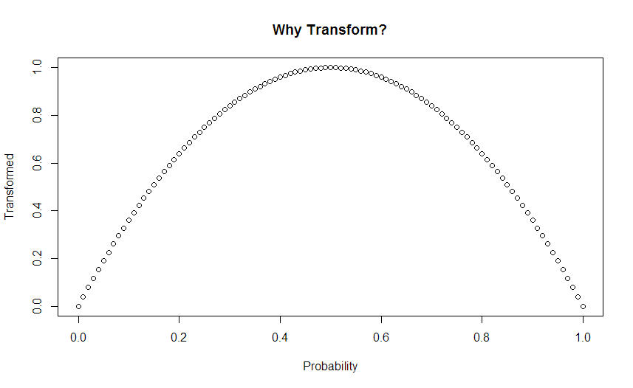
Data Transformation

Slide 5
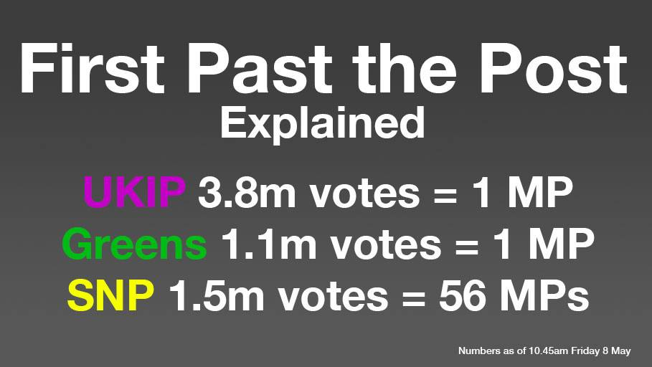
Competitiveness
Competitiveness – accounts for our “First Past The Post” Winner Take All Elections

Slide 6
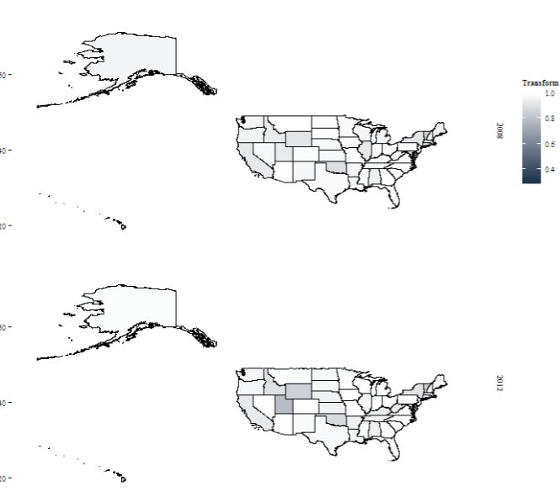
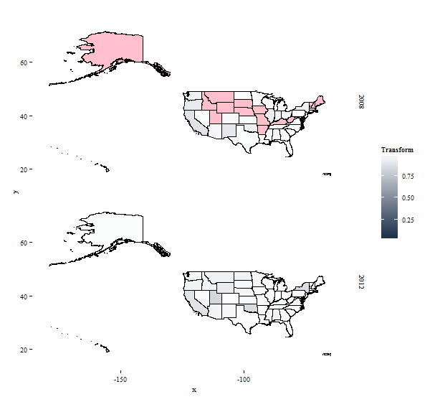
Competiveness
Actual
Predicted - ACS

Slide 7
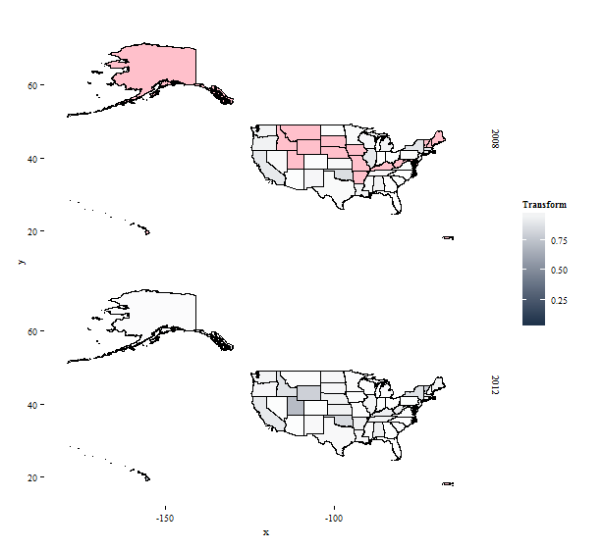
Competiveness
Actual
Predicted - ANES

Slide 8
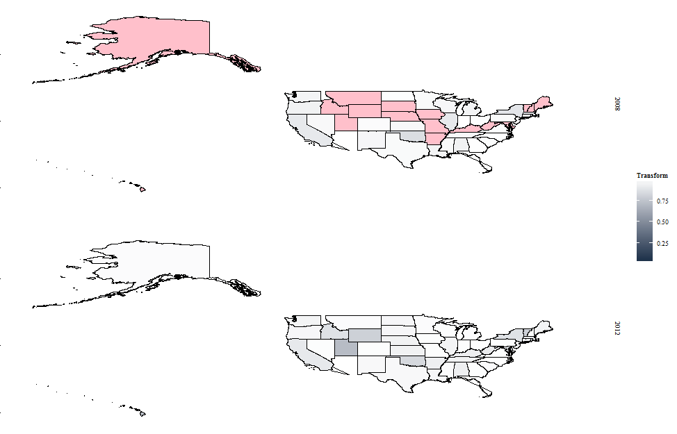
Competiveness
Actual
Predicted - Everything

Slide 9
Descriptive Analytics
Voter Insights from Attitudinal Data

Slide 10
Popularity and Homogeneity
Compared means of people’s opinions of groups. Those groups who’s average deviated a sigma from the overall average were designated most popular or least popular (depending on the direction of the deviation.
Compared the standard deviations of people’s opinions to the mean of those standard deviations. Following the patter above noted the most agreed upon (smallest standard deviations) and most divisive (largest standard deviations)

Slide 11
Most Popular Least Popular Groups
Most Popular
Least Popular
Military
Middle Class
Young
White
Southern
Poor
Republican Party
Illegal Aliens
Congress
Federal Government

Slide 12
Most Agreed Upon and Contentious Groups
Agreed Upon
Contentious
Middle Class
Young People
White People
Military
Southerners
Poor
Illegal Immigrants
LGBT
Christian Fundamentalists
Republican Party
Unions
Democratic Party

Slide 13
Interpretation?
Speaking positively about helping the middle class, young, poor and the military is probably safe political speech.
If one seeks to appeal to those who have low opinions of illegal immigrants one might build up support from those who agree but risk alienating those who feel strongly in the opposite manner.
Negative speech about the Federal Government and Congress is an easy way to score political points without stepping on too many toes.

Slide 14
Demographic Breakdowns
Found mean opinions of certain groups split by the racial profile of the survey respondent.
Adjusted for overall trends between racial groups (both in homogeneity and positivity)
African American respondents gave more favorable opinions of groups on average than the overall average and also more diverse answers. Asian respondents gave more negative opinions of groups overall as well as more uniform answers.
Both these had to be accounted for.
Found the groups where each racial group deviated from the norm.

Slide 15
White Respondents
Liked More Than Average
Liked Less Than Average
Jewish People
Poor
White People
Liberals
LGBT
Women’s Libbers (but not feminists)
Labor Unions
Conservatives

Slide 16
African American Respondents
Liked More Than Average
Liked Less Than Average
Conservatives
Unions
People on Welfare
Women’s Libbers (but not feminists)
Congress
Poor People
Democratic Party
White People

Slide 17
Asian Respondents
Liked More Than Average
Liked Less Than Average
Unions
Military
Congress
Environmentalists
Protestants
Jews
Christian Fundamentalists
LGBT

Slide 18
Correlation Matrix Takeaways
Put all of the data through a correlation matrix.
Nearly every relationship was significant.
Nearly every relationship was positive.
Seems that positive people are just positive
Excluding correlations involving a political party (Republican or Democrat), only one relationship was negative.
Opinions of LGBT and Political Parties overall negatively correlated but was not significantly correlated
Partisan people had many negative correlations.

Slide 19
High Opinion of the Democratic Party Correlates to a low opinion of…
Big Business
Conservatives
Military
Republican Party

Slide 20
High Opinion of the Republican Party Correlates to a low opinion of…
Hispanics
Illegal Aliens
People on Welfare
The Poor
Feminists
Women’s Libbers
Environmentalists
LGBT
African Americans
Labor Unions
Liberals
The Democratic Party

Slide 21
Other Noteworthy Correlations
High opinion of one minority group (African American, Hispanic, Asian, or Jewish) correlates to high opinions of all other minority groups.
High opinions of one Judeo-Christian group (Jews, Catholics, Protestants) correlates to a higher opinion of the others (and to a lesser extent Christian Fundamentalists)
Higher opinions of the Federal Government correlate to higher opinions of Congress
Higher opinions of Women’s libbers correlates to higher opinions of Feminists. This may seem obvious but similar correlations between Liberal/Democrats, Conservatives/Republicans, Welfare/Poor are much weaker

Slide 22
Takeaways?
Phrasing matters a lot
Opinions of Conservatives and Republicans differ. Same with Liberals and Democrats, Women’s Libbers and Feminists. Even notably, African American respondents held above average opinions of those one welfare but below average opinions of the poor.
Primary pandering may lead to General Election Problems
For the group of respondents who spoke unfavorably of illegal immigrants, some candidate who’s name we could put on a tower might be very appealing, but alienate many others by striking hard on a hot button issue.
Being partisan makes you negative. Avoid politics?

