Slide 1
More Data Wrangling

Slide 2
Agenda
Pandas
Finance
Group Assignment
Missing Values
Input / Output

Slide 3
Pandas

Slide 4
Series : pandas 1-D vectors
Index: array([0,1,2,3])
Series([4, 7, -5, 3])
Values: array([ 4, 7, -5, 3])
Name

Slide 5
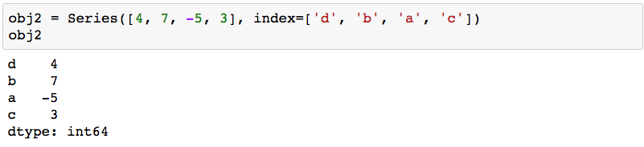
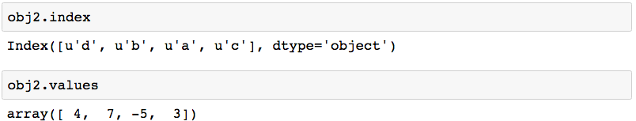
Series: Index, Values
2 main Series attribues: Index, Values

Slide 6
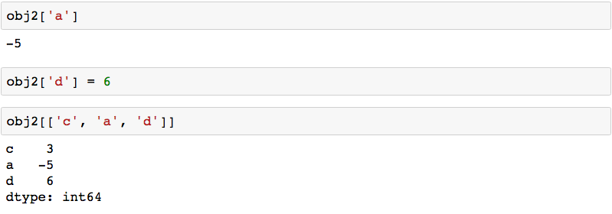
Series: element selection

Slide 7
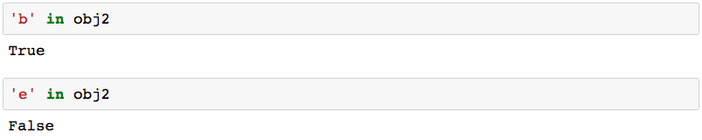
Series: membership

Slide 8
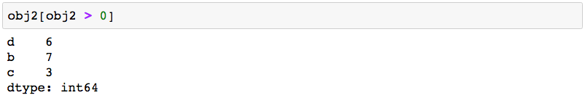
Series: element filtering

Slide 9
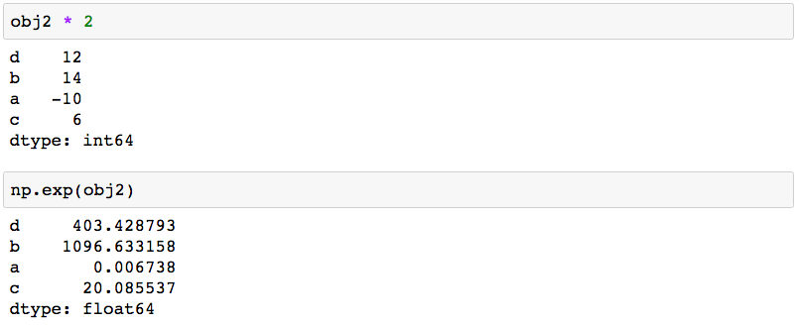
Series: scalar operations

Slide 10
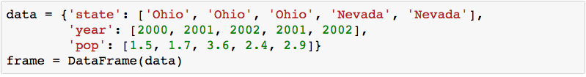
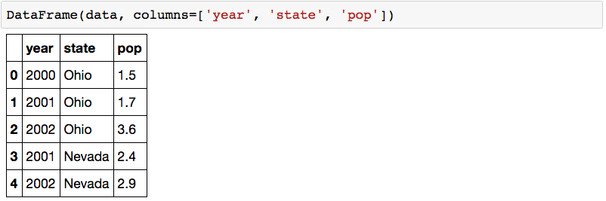
DataFrame: table in pandas

Slide 11
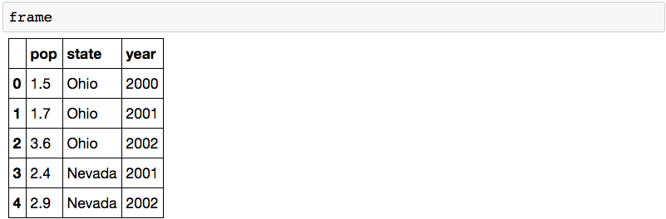
DataFrame: table in pandas

Slide 12
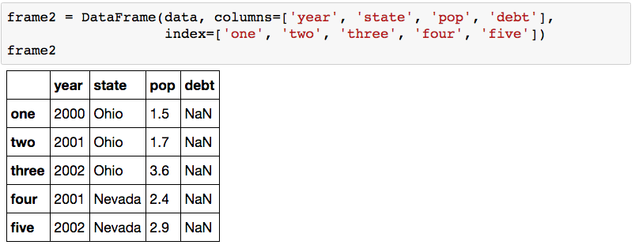
DataFrame: columns of lists with indices

Slide 13
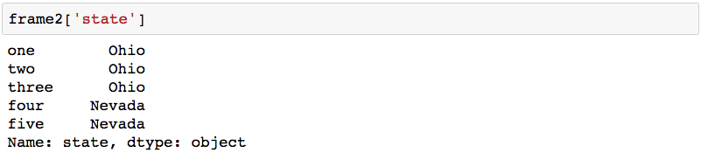
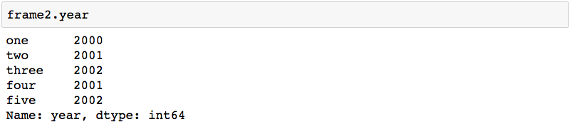
DataFrame: columns

Slide 14
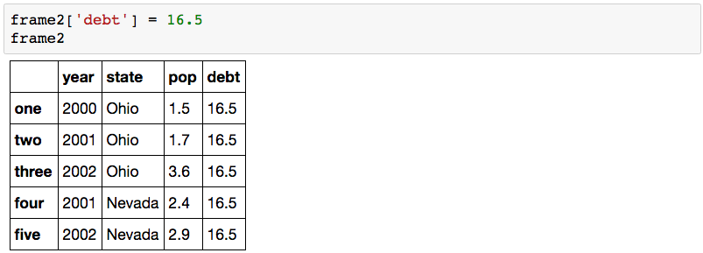
DataFrame: inserting data

Slide 15
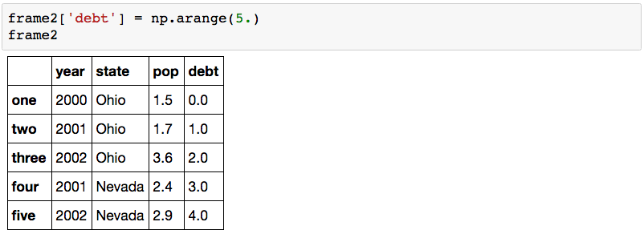
DataFrame: inserting data

Slide 16
Agenda
Pandas
Finance
Group Assignment
Missing Values
Input / Output

Slide 17
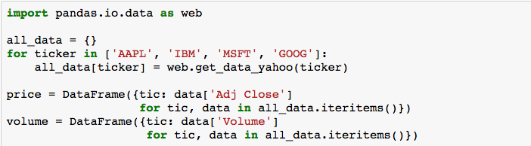
Getting Yahoo Finance Data

Slide 18
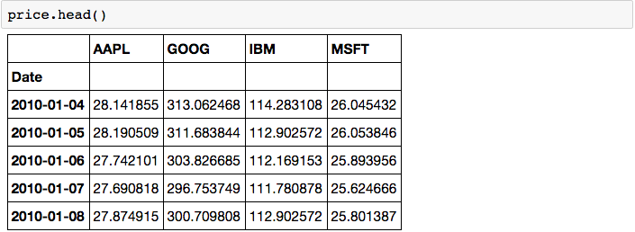
Stock data as DataFrame

Slide 19
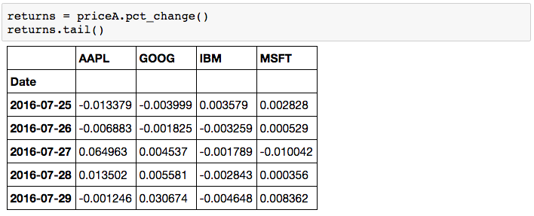
Stock data as DataFrame

Slide 20
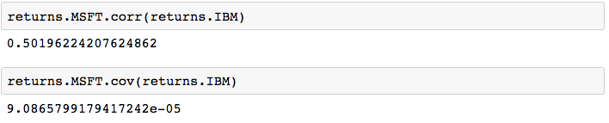
Correlation among stocks

Slide 21
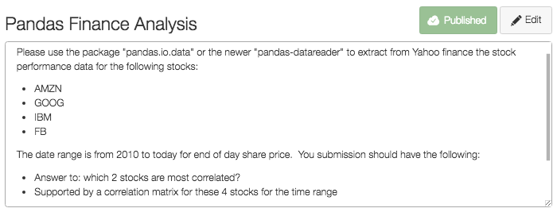
Assignment: Correlated Stocks

Slide 22
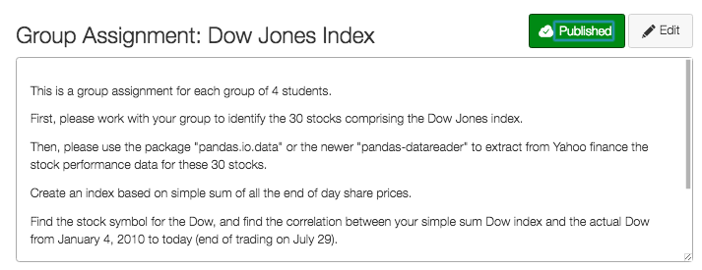
Group Assignment: Dow Jones

Slide 23
Agenda
Pandas
Finance
Group Assignment
Missing Values
Input / Output

Slide 24
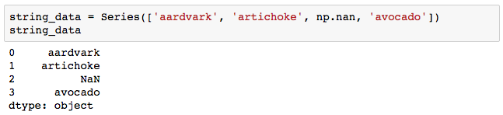
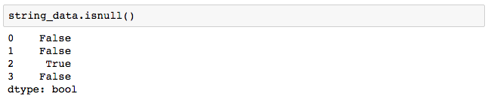
Missing Values: NaN

Slide 25
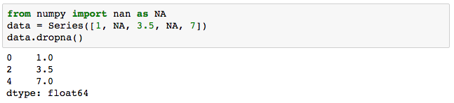
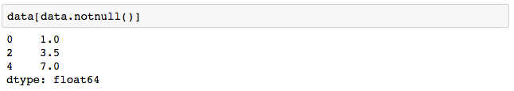
Strategy 1: filtering out missing values

Slide 26
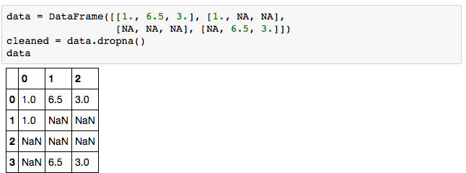
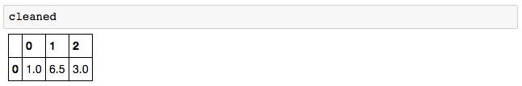
Strategy 1: filtering out missing values

Slide 27
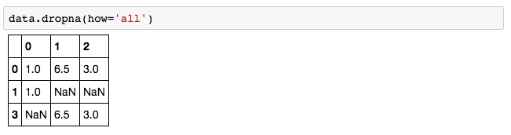
Strategy 2: filtering out some missing values

Slide 28
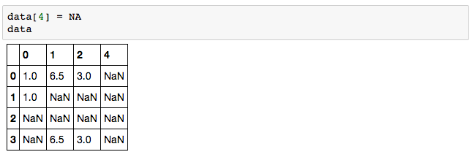
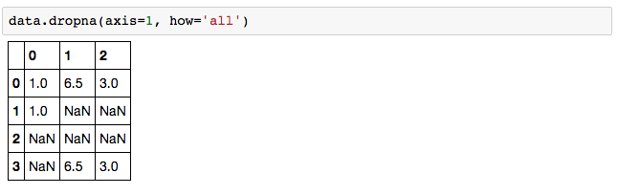
Strategy 2: filtering out some missing values

Slide 29
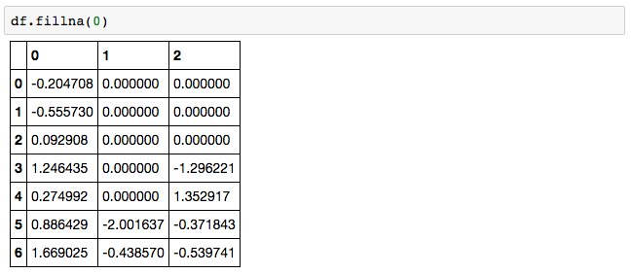
Strategy 3.1: filling in missing values

Slide 30
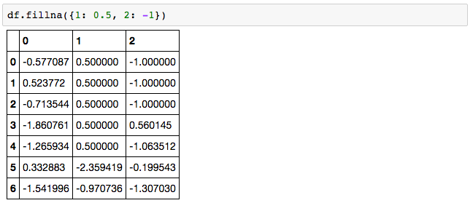
Strategy 3.2: filling in missing values

Slide 31
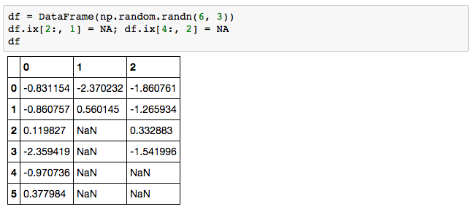
Strategy 3.3 forward filling missing values

Slide 32
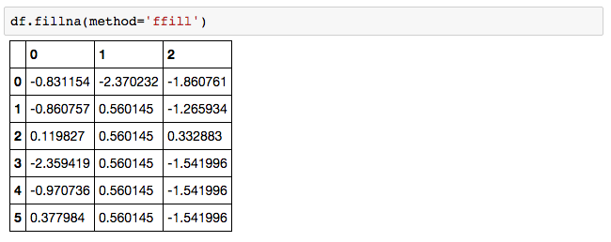
Strategy 3.3 forward filling missing values

Slide 33
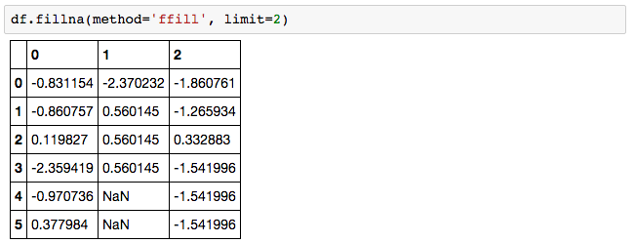
Strategy 3.3 forward filling missing values

Slide 34
Agenda
Pandas
Finance
Group Assignment
Missing Values
Input / Output

Slide 35
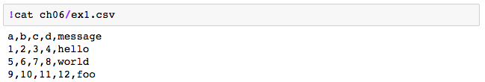
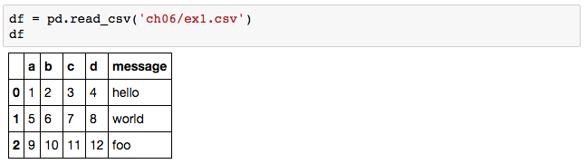
Reading CSV into DataFrame

Slide 36
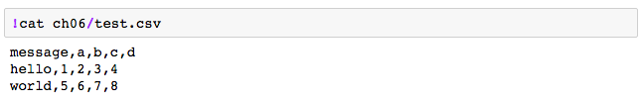
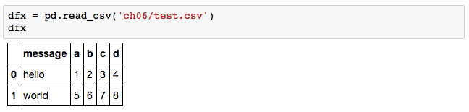
Reading CSV into DataFrame

Slide 37
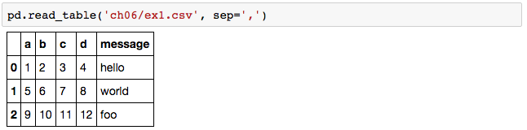
Reading CSV into DataFrame

Slide 38

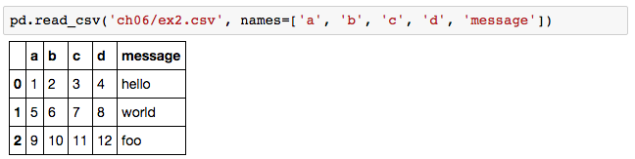
Reading CSV into DataFrame

Slide 39
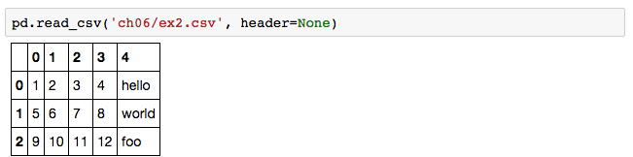
Reading CSV into DataFrame

Slide 40
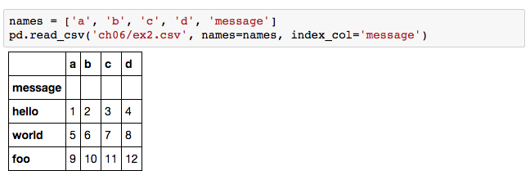
Reading CSV into DataFrame

Slide 41
Reminder: mid-term next week!

