Slide 1
Data Science & Big Data

Slide 2
Agenda
Data Cleaning, Profiling, Performance
String Processing
Trends & Outliers
Big Data Processing with Spark
Final Project

Slide 3
lecture07.1.clean.data.ipynb

Slide 4
Agenda
Data Cleaning, Profiling, Performance
String Processing
Trends & Outliers
Big Data Processing with Spark
Final Project

Slide 5
lecture07.2.strings.ipynb

Slide 6
Agenda
Data Cleaning, Profiling, Performance
String Processing
Trends & Outliers
Big Data Processing with Spark
Final Project

Slide 7
lecture07.3.trends.ipynb

Slide 8
Agenda
Data Cleaning, Profiling, Performance
String Processing
Trends & Outliers
Big Data Processing with Spark
Final Project

Slide 9
Big Data Processing with

Slide 10
https://databricks.com/ce

Slide 11
Apache Spark
Spark SQL
Spark Streaming
MLlib &
ML
GraphFrame (or GraphX)
Apache Spark Core

Slide 12
Map-Reduce
Commodity clusters have become an important computing platform for a variety of applications
Current popular programming models for clusters transform data flowing from stable storage to stable storage
Great for “acyclic” data flow
Map
Reduce
Input
Map
Output
Reduce
Map

Slide 13
Map-Reduce
Commodity clusters have become an important computing platform for a variety of applications
Current popular programming models for clusters transform data flowing from stable storage to stable storage
Great for “acyclic” data flow
Map
Reduce
Benefits of Map-Reduce: runtime can decide where to run tasks and can automatically recover from failures
Input
Map
Output
Reduce
Map

Slide 14
Why Spark?
Acyclic data flow is not efficient for applications that repeatedly reuse a working set of data:
Iterative algorithms (many in machine learning)
Interactive data mining tools (R, Excel, Python)
Spark makes working sets a first-class concept to efficiently support these apps

Slide 15
Spark Goals
Provide distributed memory abstractions for clusters to support apps with working sets
Retain the attractive properties of MapReduce:
Fault tolerance (for crashes & stragglers)
Data locality
Scalability
Solution: augment data flow model with “resilient distributed datasets” (RDDs)

Slide 16
RDDs
The primary data abstraction in Spark
An immutable, partitioned, logical collection of records
Need not be materialized, but rather contains information to rebuild a dataset from stable storage
Track lineage information to efficiently recompute lost data
Built using bulk transformations on other RDDs
Can be cached for future reuse

Slide 17
RDDs : 3 ways to construct
by parallelizing existing Python collections (lists)
by transforming an existing RDDs
from files in HDFS or any other storage system

Slide 18
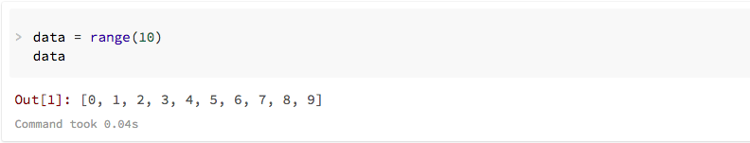
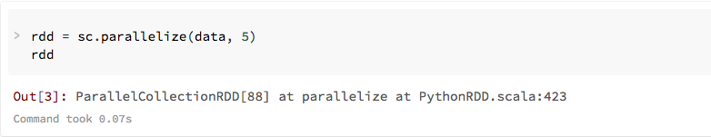
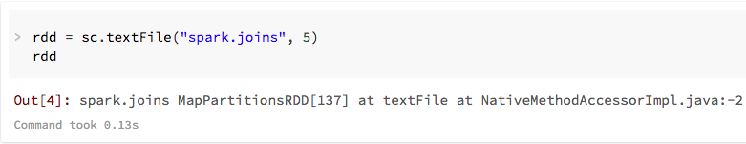
RDDs : examples

Slide 19
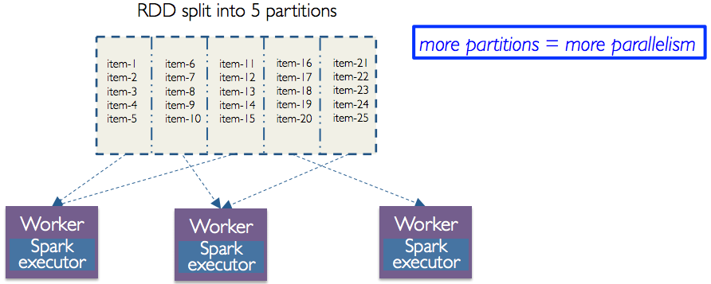
RDDs : partitions
User specified number of partitions
More partitions = more parallelism

Slide 20
RDD vs. Shared Memory Model
Concern | RDDs | Distr. Shared Mem.
Reads | Fine-grained | Fine-grained
Writes | Bulk transformations | Fine-grained
Consistency | Guaranteed (immutable) | Up to app / runtime
Fault recovery | Fine-grained and low-overhead using lineage | Requires checkpoints and program rollback
Straggler mitigation | Possible using speculative execution | Difficult
Work placement | Automatic based on data locality | Up to app (but runtime aims for transparency)

Slide 21
Spark Driver & Workers
Driver Program
SparkContext
Cluster Manager
Local
Threads
Worker
(executor)
Worker
(executor)
Storage

Slide 22
2 types of operations
Transformations
Transformations are lazy (not computed immediately)
Transformed DF is executed when action runs on it
Persist (cache) DFs in memory or disk
Actions : collect, show, reduce, …
DataFrame
Filtered DataFrame
Filtered DataFrame
DataFrame
Filtered DataFrame
Filtered DataFrame
<list>
DataFrame
Filtered DataFrame
Transformed DataFrame
results
createDF
filter
transform
show
http://spark.apache.org/docs/1.6.2/api/python/pyspark.sql.html#module-pyspark.sql.functions

Slide 23
RDD: Operations
Transformations (define a new RDD)
map filter sample union groupByKey reduceByKey join cache …
Parallel operations (return a result to driver)
reduce collect count save lookupKey …

Slide 24
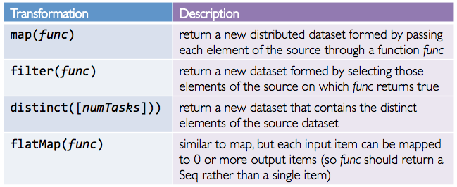
Transformations

Slide 25
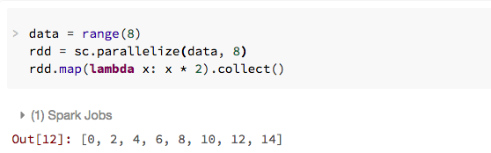
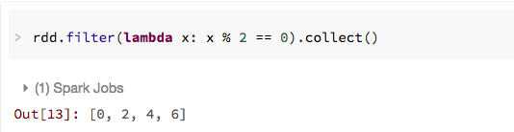
Transformation: map & filter

Slide 26
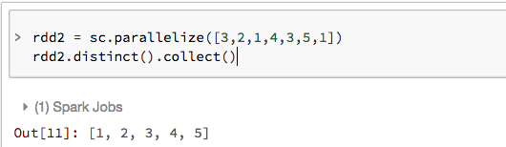
Transformation: distinct

Slide 27
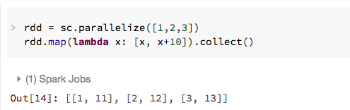
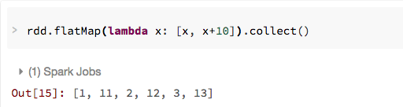
Transformation: map & flatMap

Slide 28
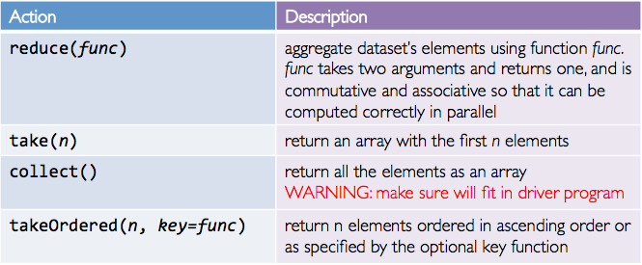
Actions
Cause Spark to execute recipe to transform source
Mechanism for getting results out of Spark

Slide 29
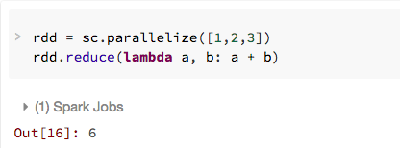
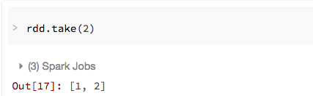
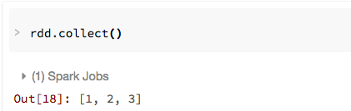
Action: reduce, take, collect

Slide 30
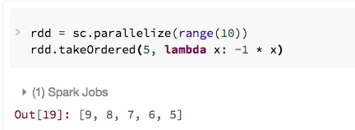
Action: takeOrdered

Slide 31
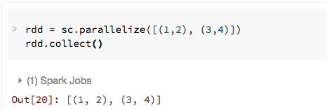
Spark: Key-Value RDD
Similar to Map Reduce, Spark supports Key-Value pairs
Each element of a Pair RDD is a pair tuple

Slide 32
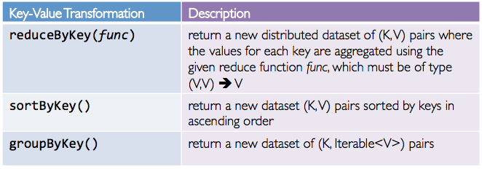
Key-Value Transformations

Slide 33
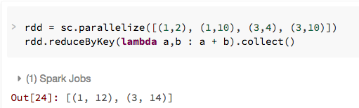
Key-Value Transformation: reduceByKey

Slide 34
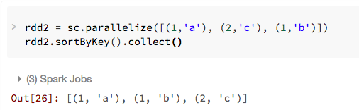
Key-Value Transformation: sortByKey

Slide 35
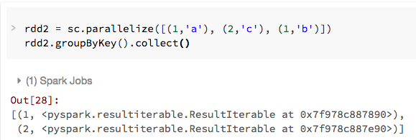
Key-Value Transformation: groupByKey

Slide 36
Python: lambda & closure
Spark creates “closure” with lambda function to each worker
Closure contains:
Functions that run on RDDs at workers
Any global variables used by those workers
One closure per worker
Sent for every task
No communication between workers
Changes to global variables at workers are not sent to driver
Driver Program
SparkContext
Functions + Globals
Functions + Globals
Worker
(executor)
Worker
(executor)

Slide 37


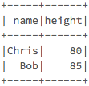
Joining Datasets
Joining Datasets in Spark!
A
B

Slide 38
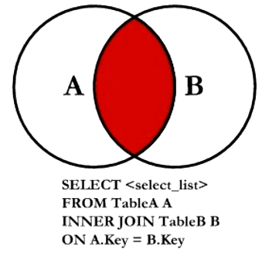
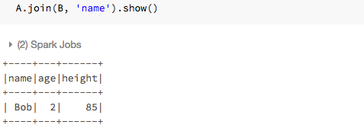
Joining Spark Datasets : Inner Join

Slide 39
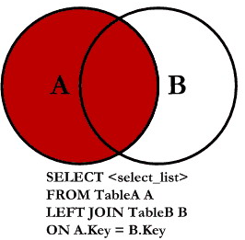
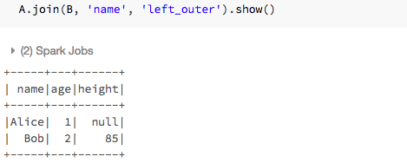
Joining Spark Datasets : Left Outer Join

Slide 40
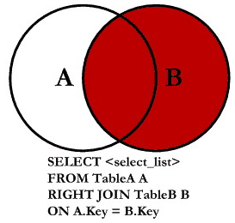
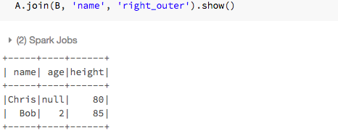
Joining Spark Datasets : Right Outer Join

Slide 41
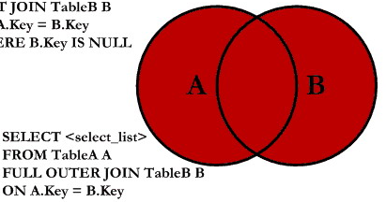
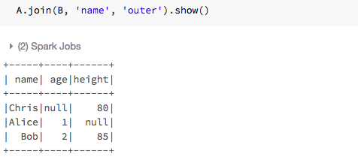
Joining Spark Datasets : Full Outer Join

Slide 42
Exercise: Shakespeare Complete Work
ShakespeareStart.dbc
Your exercise project to examine Shakespeare’s complete work
ShakespeareSolution.dbc
Solution file containing a possible solution

Slide 43
Agenda
Data Cleaning, Profiling, Performance
String Processing
Trends & Outliers
Big Data Processing with Spark
Final Project

Slide 44
Your final project : guidelines
Goal: apply what you have learned in this class to a realistic data science challenge + exercise your creativity + have fun!
This is meant to be a significant individual effort to learn by practicing what you are learning to a real-world data science problem.
The writeup of your final project is in the form of a Jupyter notebook and associated data – to be uploaded to the final project assignment in Camino.
You are to submit your final notebook by September 3 @ 11:59pm.

Slide 45
Your final project : topic selection
Goal: apply what you have learned in this class to a realistic data science challenge + exercise your creativity + have fun!
You can choose any ”significant” data set via downloadable sites, APIs, or use any of the datasets from the class.
You need to propose an interesting data insight investigation that you would like to explore, analyze the data, visualize the data, and finally write up your conclusion on what insights you have reached.
Grading of your final project will be based on the following rubric.

Slide 46
Your final project : grading rubric
Area | Details | Grading %
Topic Selection | Did you create a reasonably interesting data insight hypothesis for your investigation? | 10%
Packaging | Did you create a Jupyter project packaging that looks professional and understandable? | 10%
Analysis Competence | Does your notebook show competence in using the data science tools we learned in class? | 40%
Insight | Does your project show useful or interesting insights from the data analysis you have done? | 40%

Slide 47
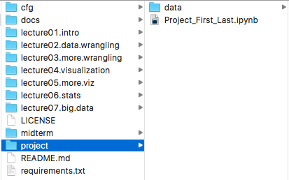
Submitting your notebook to github
In the “datascience” folder, there is now a “project” subfolder:
Your notebook needs to be submitted to this “project” folder

Slide 48
Submitting your notebook to github
Your notebook should be named: “Project_First_Last.ipynb” where:
First : your first name
Last : your last name
Any dataset that you are using should be submitted to:
datascience/project/data

Slide 49
Submitting your notebook to github
When you are in the folder “datascience” in the console, your first check-in should look like:
git add project/Project_First_Last.ipynb
git add project/data/Project_First_Last_data.txt
git commit –m “Checking in my awesome project”
git push

Slide 50
Submitting your notebook to github
After your first check, and you modified your notebook or data,
git add project/Project_First_Last.ipynb
git add project/data/Project_First_Last_data.txt
git commit –m “Checking in my awesome project”
git push

Slide 51
See you on September 10!

