Slide 1
visualizations

Slide 2
Agenda
Matplotlib
Bokeh
Tableau
Final Project

Slide 3
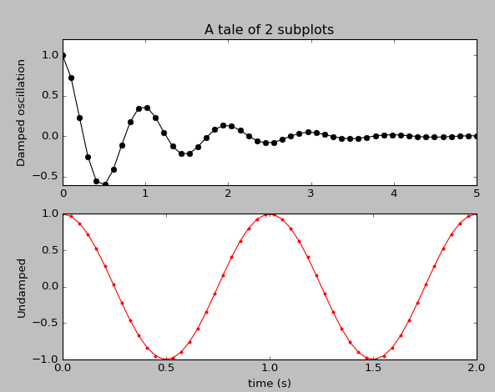
Anatomy of a matplotlib plot

Slide 4
Anatomy of a matplotlib plot
import numpy as np
import matplotlib.pyplot as plt
x1 = np.linspace(0.0, 5.0)
x2 = np.linspace(0.0, 2.0)
y1 = np.cos(2 * np.pi * x1) * np.exp(-x1)
y2 = np.cos(2 * np.pi * x2)
plt.subplot(2, 1, 1)
plt.plot(x1, y1, 'ko-')
plt.title('A tale of 2 subplots')
plt.ylabel('Damped oscillation')
plt.subplot(2, 1, 2)
plt.plot(x2, y2, 'r.-')
plt.xlabel('time (s)')
plt.ylabel('Undamped')
plt.show()

Slide 5
Import libraries
import numpy as np
import matplotlib.pyplot as plt
x1 = np.linspace(0.0, 5.0)
x2 = np.linspace(0.0, 2.0)
y1 = np.cos(2 * np.pi * x1) * np.exp(-x1)
y2 = np.cos(2 * np.pi * x2)
plt.subplot(2, 1, 1)
plt.plot(x1, y1, 'ko-')
plt.title('A tale of 2 subplots')
plt.ylabel('Damped oscillation')
plt.subplot(2, 1, 2)
plt.plot(x2, y2, 'r.-')
plt.xlabel('time (s)')
plt.ylabel('Undamped')
plt.show()

Slide 6
Anatomy of a matplotlib plot
import numpy as np
import matplotlib.pyplot as plt
x1 = np.linspace(0.0, 5.0)
x2 = np.linspace(0.0, 2.0)
y1 = np.cos(2 * np.pi * x1) * np.exp(-x1)
y2 = np.cos(2 * np.pi * x2)
plt.subplot(2, 1, 1)
plt.plot(x1, y1, 'ko-')
plt.title('A tale of 2 subplots')
plt.ylabel('Damped oscillation')
plt.subplot(2, 1, 2)
plt.plot(x2, y2, 'r.-')
plt.xlabel('time (s)')
plt.ylabel('Undamped')
plt.show()

Slide 7
Define 2 x-axis ranges in linear space
import numpy as np
import matplotlib.pyplot as plt
x1 = np.linspace(0.0, 5.0)
x2 = np.linspace(0.0, 2.0)
y1 = np.cos(2 * np.pi * x1) * np.exp(-x1)
y2 = np.cos(2 * np.pi * x2)
plt.subplot(2, 1, 1)
plt.plot(x1, y1, 'ko-')
plt.title('A tale of 2 subplots')
plt.ylabel('Damped oscillation')
plt.subplot(2, 1, 2)
plt.plot(x2, y2, 'r.-')
plt.xlabel('time (s)')
plt.ylabel('Undamped')
plt.show()

Slide 8
Create 2 sinusoidal functions
import numpy as np
import matplotlib.pyplot as plt
x1 = np.linspace(0.0, 5.0)
x2 = np.linspace(0.0, 2.0)
y1 = np.cos(2 * np.pi * x1) * np.exp(-x1)
y2 = np.cos(2 * np.pi * x2)
plt.subplot(2, 1, 1)
plt.plot(x1, y1, 'ko-')
plt.title('A tale of 2 subplots')
plt.ylabel('Damped oscillation')
plt.subplot(2, 1, 2)
plt.plot(x2, y2, 'r.-')
plt.xlabel('time (s)')
plt.ylabel('Undamped')
plt.show()

Slide 9
Plot subplot #1
import numpy as np
import matplotlib.pyplot as plt
x1 = np.linspace(0.0, 5.0)
x2 = np.linspace(0.0, 2.0)
y1 = np.cos(2 * np.pi * x1) * np.exp(-x1)
y2 = np.cos(2 * np.pi * x2)
plt.subplot(2, 1, 1)
plt.plot(x1, y1, 'ko-')
plt.title('A tale of 2 subplots')
plt.ylabel('Damped oscillation')
plt.subplot(2, 1, 2)
plt.plot(x2, y2, 'r.-')
plt.xlabel('time (s)')
plt.ylabel('Undamped')
plt.show()

Slide 10
Plot subplot #2
import numpy as np
import matplotlib.pyplot as plt
x1 = np.linspace(0.0, 5.0)
x2 = np.linspace(0.0, 2.0)
y1 = np.cos(2 * np.pi * x1) * np.exp(-x1)
y2 = np.cos(2 * np.pi * x2)
plt.subplot(2, 1, 1)
plt.plot(x1, y1, 'ko-')
plt.title('A tale of 2 subplots')
plt.ylabel('Damped oscillation')
plt.subplot(2, 1, 2)
plt.plot(x2, y2, 'r.-')
plt.xlabel('time (s)')
plt.ylabel('Undamped')
plt.show()

Slide 11
Finally: show it!
import numpy as np
import matplotlib.pyplot as plt
x1 = np.linspace(0.0, 5.0)
x2 = np.linspace(0.0, 2.0)
y1 = np.cos(2 * np.pi * x1) * np.exp(-x1)
y2 = np.cos(2 * np.pi * x2)
plt.subplot(2, 1, 1)
plt.plot(x1, y1, 'ko-')
plt.title('A tale of 2 subplots')
plt.ylabel('Damped oscillation')
plt.subplot(2, 1, 2)
plt.plot(x2, y2, 'r.-')
plt.xlabel('time (s)')
plt.ylabel('Undamped')
plt.show()

Slide 12
Anatomy of a matplotlib plot

Slide 13
Agenda
Matplotlib
Bokeh
Tableau
Final Project

Slide 14
Bokeh: web interactive display
Creates interactive visualization for web presentation.
In the style of D3.js
High-performance interactivity over very large or streaming datasets
Quick creation of plots, dashboards, data apps

Slide 15
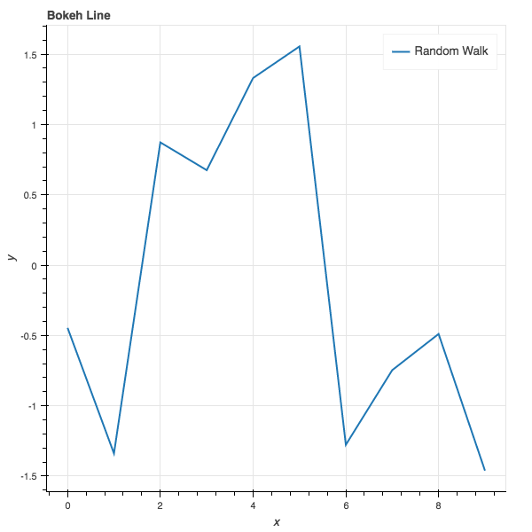
Anatomy of a Simple Bokeh App

Slide 16
Anatomy of a Simple Bokeh App
import numpy as np
from bokeh.plotting import figure, output_file, show
a = np.arange(10)
b = np.random.randn(10)
output_file("lines.html")
p = figure(title="Bokeh Line", x_axis_label='x', y_axis_label='y')
p.line(a, b, legend="Random Walk", line_width=2)
show(p)

Slide 17
Import the libraries
import numpy as np
from bokeh.plotting import figure, output_file, show
a = np.arange(10)
b = np.random.randn(10)
output_file("lines.html")
p = figure(title="Bokeh Line", x_axis_label='x', y_axis_label='y')
p.line(a, b, legend="Random Walk", line_width=2)
show(p)

Slide 18
Define the x and y ranges
import numpy as np
from bokeh.plotting import figure, output_file, show
a = np.arange(10)
b = np.random.randn(10)
output_file("lines.html")
p = figure(title="Bokeh Line", x_axis_label='x', y_axis_label='y')
p.line(a, b, legend="Random Walk", line_width=2)
show(p)

Slide 19
Define name of the HTML file
import numpy as np
from bokeh.plotting import figure, output_file, show
a = np.arange(10)
b = np.random.randn(10)
output_file("lines.html")
p = figure(title="Bokeh Line", x_axis_label='x', y_axis_label='y')
p.line(a, b, legend="Random Walk", line_width=2)
show(p)

Slide 20
Create the actual figure
import numpy as np
from bokeh.plotting import figure, output_file, show
a = np.arange(10)
b = np.random.randn(10)
output_file("lines.html")
p = figure(title="Bokeh Line", x_axis_label='x', y_axis_label='y')
p.line(a, b, legend="Random Walk", line_width=2)
show(p)

Slide 21
Finally, show it!
import numpy as np
from bokeh.plotting import figure, output_file, show
a = np.arange(10)
b = np.random.randn(10)
output_file("lines.html")
p = figure(title="Bokeh Line", x_axis_label='x', y_axis_label='y')
p.line(a, b, legend="Random Walk", line_width=2)
show(p)

Slide 22
Anatomy of a Simple Bokeh App

Slide 23
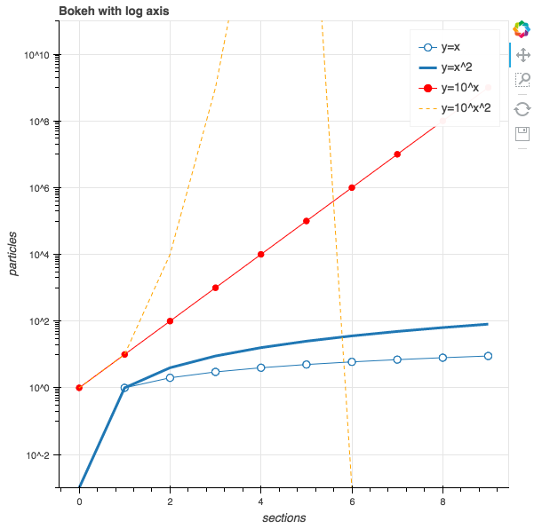
Anatomy of an Interactive Bokeh App

Slide 24
Anatomy of an Interactive Bokeh App
x = np.arange(10)
y0 = [i**2 for i in x]
y1 = [10**i for i in x]
y2 = [10**(i**2) for i in x]
output_file("loglines.html")
p = figure(tools="pan,box_zoom,reset,save", y_axis_type="log",
y_range=[0.001, 10**11], title="Bokeh with log axis",
x_axis_label='sections', y_axis_label='particles')
p.line(x, x, legend="y=x")
p.circle(x, x, legend="y=x", fill_color="white", size=8)
p.line(x, y0, legend="y=x^2", line_width=3)
p.line(x, y1, legend="y=10^x", line_color="red")
p.circle(x, y1, legend="y=10^x",
fill_color="red", line_color="red", size=6)
p.line(x, y2, legend="y=10^x^2",
line_color="orange", line_dash="4 4")
show(p)

Slide 25
Define x-range
x = np.arange(10)
y0 = [i**2 for i in x]
y1 = [10**i for i in x]
y2 = [10**(i**2) for i in x]
output_file("loglines.html")
p = figure(tools="pan,box_zoom,reset,save", y_axis_type="log",
y_range=[0.001, 10**11], title="Bokeh with log axis",
x_axis_label='sections', y_axis_label='particles')
p.line(x, x, legend="y=x")
p.circle(x, x, legend="y=x", fill_color="white", size=8)
p.line(x, y0, legend="y=x^2", line_width=3)
p.line(x, y1, legend="y=10^x", line_color="red")
p.circle(x, y1, legend="y=10^x",
fill_color="red", line_color="red", size=6)
p.line(x, y2, legend="y=10^x^2",
line_color="orange", line_dash="4 4")
show(p)

Slide 26
Define 3 separate functions in terms of x
x = np.arange(10)
y0 = [i**2 for i in x]
y1 = [10**i for i in x]
y2 = [10**(i**2) for i in x]
output_file("loglines.html")
p = figure(tools="pan,box_zoom,reset,save", y_axis_type="log",
y_range=[0.001, 10**11], title="Bokeh with log axis",
x_axis_label='sections', y_axis_label='particles')
p.line(x, x, legend="y=x")
p.circle(x, x, legend="y=x", fill_color="white", size=8)
p.line(x, y0, legend="y=x^2", line_width=3)
p.line(x, y1, legend="y=10^x", line_color="red")
p.circle(x, y1, legend="y=10^x",
fill_color="red", line_color="red", size=6)
p.line(x, y2, legend="y=10^x^2",
line_color="orange", line_dash="4 4")
show(p)

Slide 27
Specify name of output HTML file
x = np.arange(10)
y0 = [i**2 for i in x]
y1 = [10**i for i in x]
y2 = [10**(i**2) for i in x]
output_file("loglines.html")
p = figure(tools="pan,box_zoom,reset,save", y_axis_type="log",
y_range=[0.001, 10**11], title="Bokeh with log axis",
x_axis_label='sections', y_axis_label='particles')
p.line(x, x, legend="y=x")
p.circle(x, x, legend="y=x", fill_color="white", size=8)
p.line(x, y0, legend="y=x^2", line_width=3)
p.line(x, y1, legend="y=10^x", line_color="red")
p.circle(x, y1, legend="y=10^x",
fill_color="red", line_color="red", size=6)
p.line(x, y2, legend="y=10^x^2",
line_color="orange", line_dash="4 4")
show(p)

Slide 28
Specify the exact set of “tools” on graph
x = np.arange(10)
y0 = [i**2 for i in x]
y1 = [10**i for i in x]
y2 = [10**(i**2) for i in x]
output_file("loglines.html")
p = figure(tools="pan,box_zoom,reset,save", y_axis_type="log",
y_range=[0.001, 10**11], title="Bokeh with log axis",
x_axis_label='sections', y_axis_label='particles')
p.line(x, x, legend="y=x")
p.circle(x, x, legend="y=x", fill_color="white", size=8)
p.line(x, y0, legend="y=x^2", line_width=3)
p.line(x, y1, legend="y=10^x", line_color="red")
p.circle(x, y1, legend="y=10^x",
fill_color="red", line_color="red", size=6)
p.line(x, y2, legend="y=10^x^2",
line_color="orange", line_dash="4 4")
show(p)

Slide 29
Actually creating the 3 separate graphs
x = np.arange(10)
y0 = [i**2 for i in x]
y1 = [10**i for i in x]
y2 = [10**(i**2) for i in x]
output_file("loglines.html")
p = figure(tools="pan,box_zoom,reset,save", y_axis_type="log",
y_range=[0.001, 10**11], title="Bokeh with log axis",
x_axis_label='sections', y_axis_label='particles')
p.line(x, x, legend="y=x")
p.circle(x, x, legend="y=x", fill_color="white", size=8)
p.line(x, y0, legend="y=x^2", line_width=3)
p.line(x, y1, legend="y=10^x", line_color="red")
p.circle(x, y1, legend="y=10^x",
fill_color="red", line_color="red", size=6)
p.line(x, y2, legend="y=10^x^2",
line_color="orange", line_dash="4 4")
show(p)

Slide 30
Finally, show it!
x = np.arange(10)
y0 = [i**2 for i in x]
y1 = [10**i for i in x]
y2 = [10**(i**2) for i in x]
output_file("loglines.html")
p = figure(tools="pan,box_zoom,reset,save", y_axis_type="log",
y_range=[0.001, 10**11], title="Bokeh with log axis",
x_axis_label='sections', y_axis_label='particles')
p.line(x, x, legend="y=x")
p.circle(x, x, legend="y=x", fill_color="white", size=8)
p.line(x, y0, legend="y=x^2", line_width=3)
p.line(x, y1, legend="y=10^x", line_color="red")
p.circle(x, y1, legend="y=10^x",
fill_color="red", line_color="red", size=6)
p.line(x, y2, legend="y=10^x^2",
line_color="orange", line_dash="4 4")
show(p)

Slide 31
Anatomy of an Interactive Bokeh App

Slide 32
Agenda
Matplotlib
Bokeh
Tableau
Final Project

Slide 33
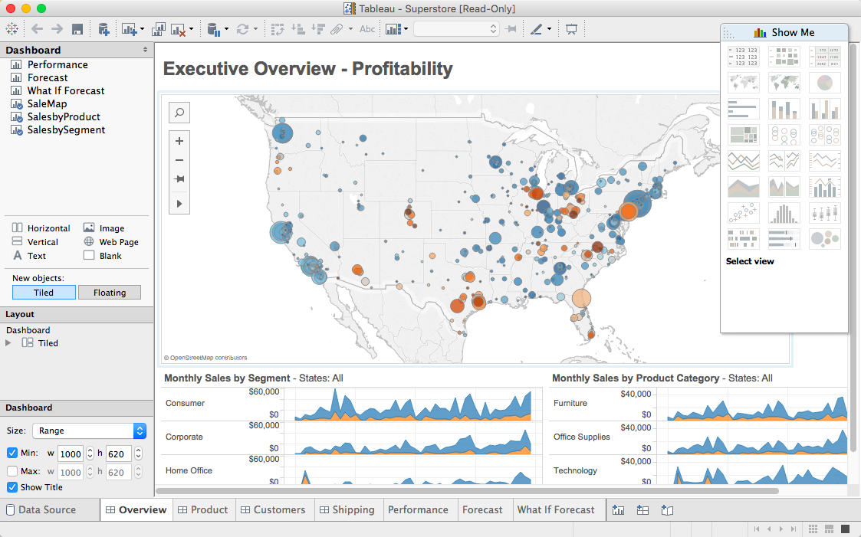

Slide 34

Data Ingestion
Joins: inner, left, right, full
Extract – Transform – Load (ETL)
Field Transformation
Live / Extract
Filtering
Large dataset & role of Tableau

Slide 35
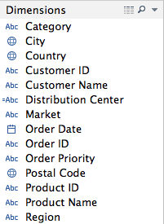
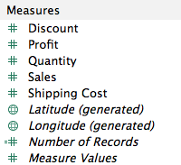
Dimensions & Measures
Dimensions : categorical
Measures : numerical

Slide 36
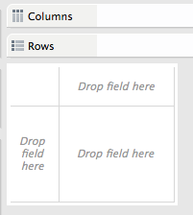
Rows & Columns

Slide 37
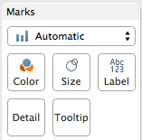
Marks

Slide 38
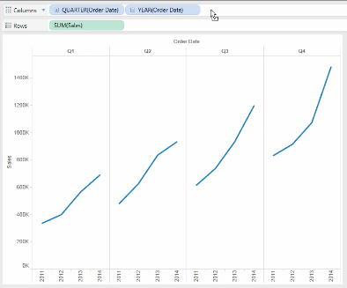
Multi-level Analysis

Slide 39
Group Exercise
Load the “global_superstore.xls” dataset into Tableau
Answer the following questions:
Which region has the highest sales?
For (1), which product segment for that region has the highest sales?
Regardless of region, which product segment in a given region has the highest sales?
Take 15 min in your group to decide on extracting an interesting insight from this dataset to present to the class.

Slide 40
Agenda
Matplotlib
Bokeh
Tableau
Final Project

Slide 41
Your final project : guidelines
Goal: apply what you have learned in this class to a realistic data science challenge + exercise your creativity + have fun!
This is meant to be a significant individual effort to learn by practicing what you are learning to a real-world data science problem.
The writeup of your final project is in the form of a Jupyter notebook and associated data – to be uploaded to the final project assignment in Camino.
You are to submit your final notebook by September 3 @ 11:59pm.

Slide 42
Your final project : topic selection
Goal: apply what you have learned in this class to a realistic data science challenge + exercise your creativity + have fun!
You can choose any ”significant” data set via downloadable sites, APIs, or use any of the datasets from the class.
You need to propose an interesting data insight investigation that you would like to explore, analyze the data, visualize the data, and finally write up your conclusion on what insights you have reached.
Grading of your final project will be based on the following rubric.

Slide 43
Your final project : grading rubric
Area | Details | Grading %
Topic Selection | Did you create a reasonably interesting data insight hypothesis for your investigation? | 10%
Packaging | Did you create a Jupyter project packaging that looks professional and understandable? | 10%
Analysis Competence | Does your notebook show competence in using the data science tools we learned in class? | 40%
Insight | Does your project show useful or interesting insights from the data analysis you have done? | 40%

