Slide 1
Data Wrangling

Slide 2
Agenda
Python Review
Jupyter / IPython
Web Scraping
NumPy
Pandas

Slide 3
Python Review

Slide 4
Review
Integers
Floating Point
Dynamic Typing – no declarations
x = 5
y = 6.3
Names start with a letter, cAsE SeNsiTiVe.
Long names OK.

Slide 5
Review Character Strings
Dynamic typing – no declaration
No memory allocation
Immutable
s = “Good Afternoon”
len(s) # length of string

Slide 6
Review String Slicing
s = “Good Afternoon”
s[0] evaluates to “G”
s[5:10] selects “After” # string slicing
s[:10] selects “Good After”
s[5:] selects “Afternoon”
s[-4:] selects “noon” # last 4 characters
Notes:
String slicing is very useful when you start thinking about strings: beginning, end, first character, last character, etc.

Slide 7
String Methods
String is a Class with data & subroutines:
t = s.upper()
pos = s.find(“A”)
first = “George”
last = “Washington”
name = first + “ “ + last
# string concatenation
Notes:
Can also use single quotes to surround a string

Slide 8
Review Lists
Ordered sequence of items
Can be floats, ints, strings, Lists
a = [16, 25.3, “hello”, 45]
a[0] contains 16
a[-1] contains 45
a[0:2] is a list containing [16, 25.3]
Notes:
Very flexible but not high performance

Slide 9
Create a List
days = [ ]
days.append(“Monday”)
days.append(“Tuesday”)
years = range(2000, 2014)
Notes:
ranges from the number you want to the first number you don’t want
You can define your own irange function to include the last number
You can define your own frange function to return a list containing floating point numbers
9

Slide 10
List Methods
List is a Class with data & subroutines:
d.insert( )
d.remove( )
d.sort( )
Can concatenate lists with +

Slide 11
String split
s = “Princeton Plasma Physics Lab”
myList = s.split() # returns a list of strings
print myList
[ “Princeton”, “Plasma”, “Physics”, “Lab” ]
help(str.split) # delimiters, etc.
Notes:
Now that we have reviewed lists, we can add the string split method
First step in parsing
11

Slide 12
Tuple
Designated by ( ) parenthesis
A List that can not be changed. Immutable.
No append.
Good for returning multiple values from a subroutine function.
Can extract slices.

Slide 13
Review math module
import math
dir(math)
math.sqrt(x)
math.sin(x)
math.cos(x)
from math import *
dir()
sqrt(x)
from math import pi
dir()
print pi
Notes:
A python source code file of classes is a module.
import a module or some classes from a module
13

Slide 14
import a module
import math # knows where to find it
___________________________________
import sys
sys.path.append(“/u/efeibush/python”)
import cubic.py # import your own code
_____________________________________
if task == 3:
import math # imports can be anywhere
Notes:
Something new about imports
It’s not on the test.
14

Slide 15
Review Defining a Function
Block of code separate from main.
Define the function before calling it.
def myAdd(a, b): # define before calling
return a + b
p = 25 # main section of code
q = 30
r = myAdd(p, q)
Notes:
if p = “hello” and q = “goodbye” it will return “hellogoodbye”
15

Slide 16
Keyword Arguments
Provide default values for optional arguments.
def setLineAttributes(color=“black”, style=“solid”, thickness=1):
...
# Call function from main program
setLineAttributes(style=“dotted”)
setLineAttributes(“red”, thickness=2)
Notes:
For methods that have many arguments
Need this technique for graphing later today.

Slide 17
Looping with the range() function
for i in range(10): # i gets 0 - 9
range() is limited to integers
numpy provides a range of floats
Notes:
xrange() – generates number as needed instead of creating all numbers initially
First homework assignment is to write frange that returns a list of floats.
17

Slide 18
Summary
Integer, Float
String
List
Tuple
def function
Keywords: if elif else
while for in
import print
Indenting counts :
Notes:
An indent always starts after a colon.
Outdent does not have a specific character or symbol.

Slide 19
Run python as Interpreter
type()
dir()
help()

Slide 20
Jupyter / IPython

Slide 21
lecture02.jupyter.ipynb

Slide 22
Web Scraping

Slide 23
lecture02.web.scraping.ipynb

Slide 24
NumPy

Slide 25
numpy module
Items are all the same type.
Contiguous data storage in memory of items.
Considerably faster than lists.
Class with data and methods (subroutines).
Notes:
Guess what nd stands for? N-dimensional
spell checker on numpy: bumpy, dumpy, & lumpy. Just need Grumpy and you have the 7 Dwarves.
25

Slide 26
numpy module
import numpy
dir()
dir(numpy)
help(numpy)
help(numpy.ndarray) # class
help(numpy.array) # built-in function
Notes:
Guess what nd stands for? N-dimensional module can be referred to as a package site-packages directory
spell checker on numpy: bumpy, dumpy, & lumpy. Just need Grumpy and you have the 7 Dwarves.
26

Slide 27
numpy module
import numpy
dir(numpy)
help(numpy.zeros) tuple
a = numpy.zeros( (3,5) )
# create 3 rows, 5 columns
[ [ 0., 0., 0., 0., 0. ],
[ 0., 0., 0., 0., 0. ],
[ 0., 0., 0., 0., 0. ] ]
# default type is float64
Notes:
Store in memory as C or Fortran ordering
Try to match your accessing order
27

Slide 28
numpy Array Access
Access order corresponding to printed order:
[row] [column] index starts with 0
a[0][2] = 5
[ [ 0., 0., 5., 0., 0. ],
[ 0., 0., 0., 0., 0. ],
[ 0., 0., 0., 0., 0. ] ]
Notes:
Store in memory as C or Fortran ordering
Try to match your accessing order
28

Slide 29
NumPy arrays versus Python lists
Python lists: Very general
a = [1,2]
b = [[1,2],[3,4]]
c = [[1,2, ’duh’],[3,[4]]]
NumPy arrays:
x = array([1,2])
y = array([[1,2],[3,4]])
All rows must have same length, etc.
All entries must have same data-type, e.g. all real or all complex

Slide 30
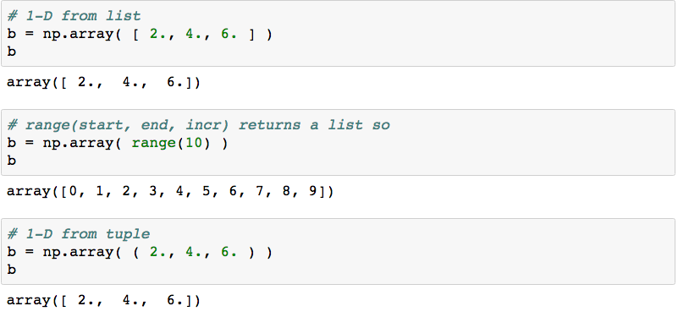
Create 1-D Array

Slide 31
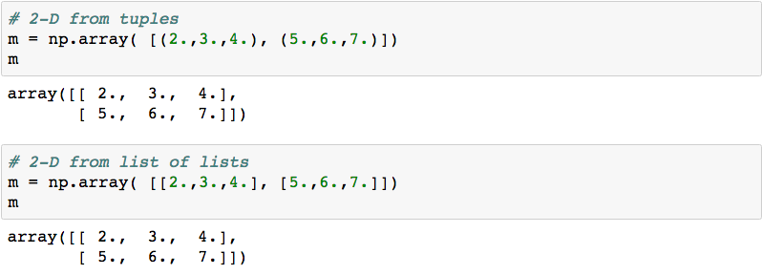
Create 2-D Matrix

Slide 32
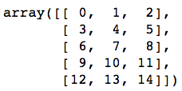
EXERCISE
Create a (5, 3) 2-d array / matrix with Numpy that looks like the following:
Challenge: do it in 1 line
Notes:
m = np.arange(15).reshape((5,3))

Slide 33
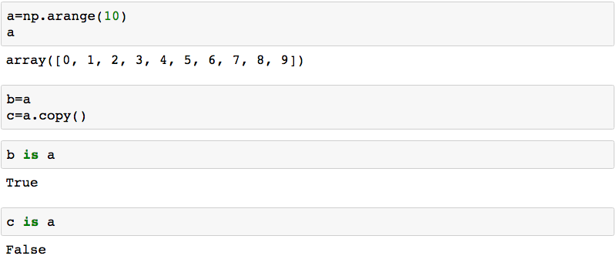
Pointer vs. Deep Copy

Slide 34
Pointer vs. Deep Copy
a = numpy.zeros( (3, 3) )
b = a # b is a pointer to a
c = a.copy() # c is a new array
b is a # True
c is a # False
Views
base

Slide 35
Array Arithmetic
a = numpy.array( range(10, 20) )
a + 5
a – 3
a * 5
a / 3.14
a.sum()
a > 15
(a > 15).sum()

Slide 36
Array Arithmetic by Index
a = numpy.array( range(10) )
b = numpy.array( range(0, 1000, 100) )
a + b # a[0] + b[0], a[1] + b[1] ...
a – b
a * b # not row, column matrix product
a / b
The 2 arrays must be the same shape.
Notes:
If a and b are not the same shape:
operands could not be broadcast together with shapes ...

Slide 37
Row, Column Matrix Product
c = numpy.dot(a, b)
Dot product of 2 arrays.
Matrix multiplication for 2D arrays.

Slide 38
Cross Product
zA = numpy.cross(xA, yA)
Note: we have been using numpy. functions

Slide 39
Array Shape
a = numpy.linspace(2, 32, 16)
a = a.reshape(4, 4) # ndarray . method
a.shape # ndarray attribute tuple (4, 4)
a = numpy.linspace(2,32,16).reshape(8,2)
Notes:
Python golf
len(a) or a.size

Slide 40
Array Diagonals
a = numpy.linspace(1, 64, 64)
a = a.reshape(8, 8)
numpy.triu(a) # upper triangle
numpy.tril(a) # lower triangle
numpy.diag(a) # main diagonal
numpy.diag(a, 1) # 1 above
numpy.diag(a, -1) # 1 below

Slide 41
Array Data Types
numpy.float64 is the default type
float32
int8, int16, int32, int64, uint8, uint16, uint32, uint64
complex64, complex128
bool - True or False
a.dtype shows type of data in array
>>> help(numpy.ndarray) # Parameters Attributes
Notes:
int8 is a byte
signed or unsigned ints
Correspond to C language implementation
41

Slide 42
Multi-Dimensional Indexing
a = numpy.array( range(12) )
a = a.reshape(2,6) # 2 rows, 6 columns
a[1][5] contains 11
a[1, 5] is equivalent, more efficient

Slide 43
Array Slicing
a = numpy.array(range(0, 100, 10))
Array([ 0, 10, 20, 30, 40, 50, 60, 70, 80, 90])
a[2:4] contains 20, 30
a[-4 : -1] contains 60, 70, 80
Slicing returns ndarray

Slide 44
Array Slicing
a = numpy.array(range(64)).reshape(8,8)
a[3, 4] contains 28
asub = a[3:5, 4:6]
Very useful for looking at data & debugging.
a[:,2] # all rows, column 2
a[3, 2:5] # row 3, columns 2 and 3 and 4
Notes:
Python was written by people who have done a lot of programming & debugging

Slide 45
Array Stuff
a.T
a.min()
a.max()
a.round()
a.var()
a.std()

Slide 46
Organize Arrays
Make a list of arrays named a, b, and c:
w = [ a, b, c]
len(w) # length of list is 3
w[1].max() # use array method

Slide 47
EXERCISE

Slide 48
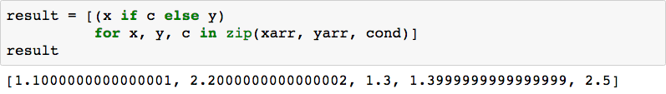
Conditional Logic with NumPy
Consider these arrays:
Use native “list comprehension” from Python:

Slide 49

Conditional Logic with NumPy
Consider these arrays:
Use NumPy conditional logic:

Slide 50
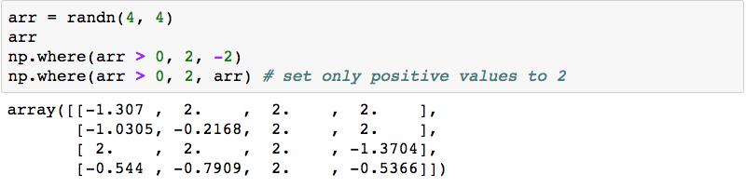
Why Conditional Logic with NumPy?
Consider these arrays:
Works with vectors / arrays / list by default
Fast

Slide 51
Pandas

Slide 52
Series : pandas 1-D vectors
Index: array([0,1,2,3])
Series([4, 7, -5, 3])
Values: array([ 4, 7, -5, 3])
Name

Slide 53
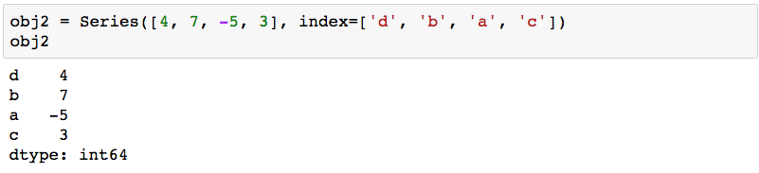
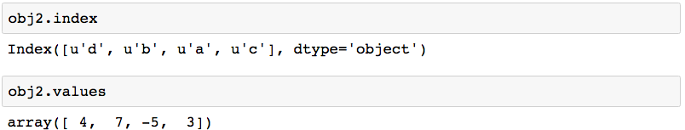
Series: Index, Values
2 main Series attribues: Index, Values

Slide 54
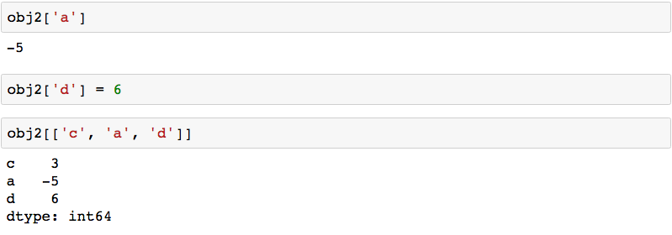
Series: element selection

Slide 55
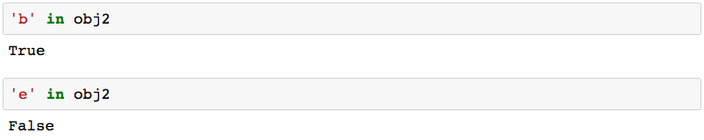
Series: membership

Slide 56
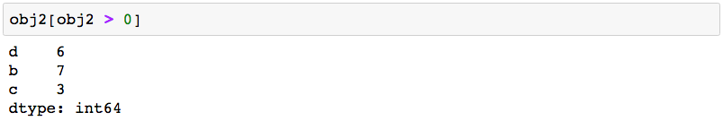
Series: element filtering

Slide 57
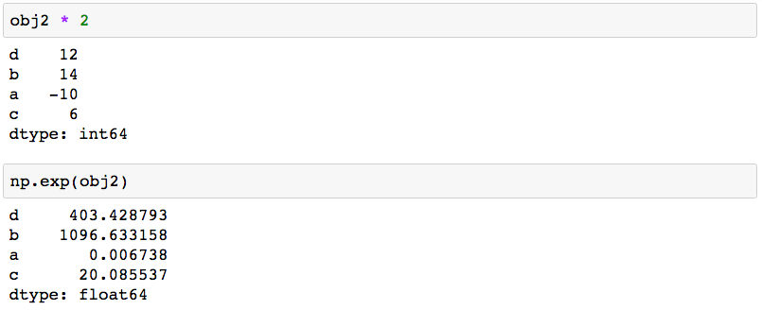
Series: scalar operations

Slide 58
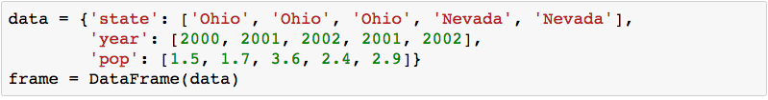
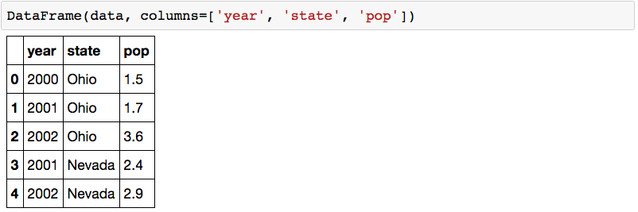
DataFrame: table in pandas

Slide 59
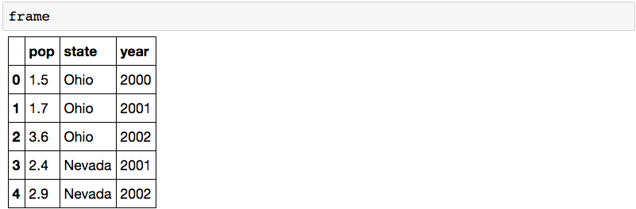
DataFrame: table in pandas

Slide 60
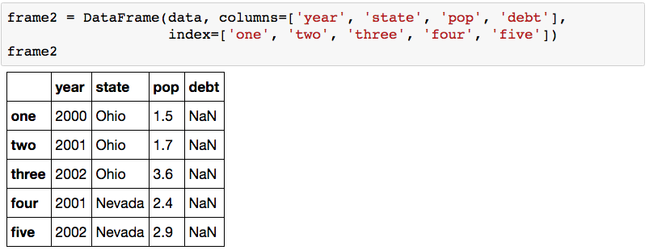
DataFrame: columns of lists with indices

Slide 61
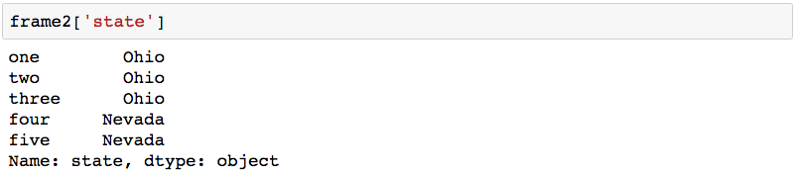
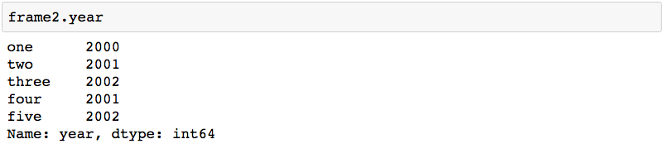
DataFrame: columns

Slide 62
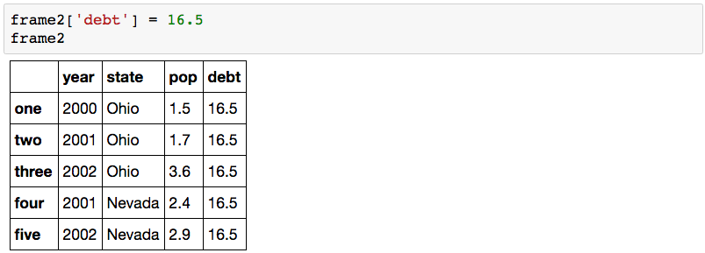
DataFrame: inserting data

Slide 63
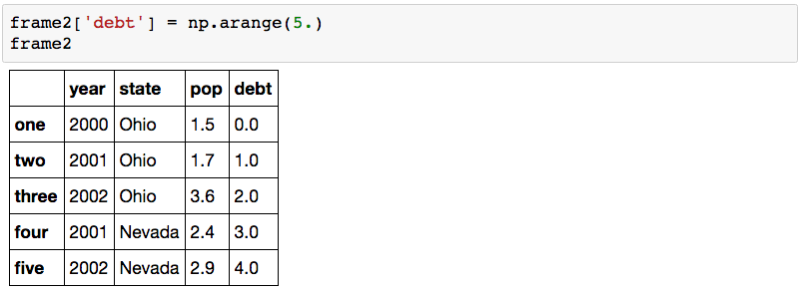
DataFrame: inserting data

