Slide 1
Database & Data Visualization

Slide 2
Agenda
Databases
Midterm
Matplotlib
Tableau

Slide 3
A Model: Entity Relations
Household
Person
Address
A “Household” has one or more “Person”
A “Household” has exactly 1 ”Address”
An “Address” belongs to exactly 1 “Household”

Slide 4
Creating a database
import sqlite3
query = """ CREATE TABLE test (a VARCHAR(20), b VARCHAR(20),
c REAL, d INTEGER );"""
con = sqlite3.connect(':memory:') con.execute(query) con.commit()

Slide 5
Inserting data to a database
data = [('Atlanta', 'Georgia', 1.25, 6), ('Tallahassee', 'Florida', 2.6, 3), ('Sacramento', 'California', 1.7, 5)]
stmt = "INSERT INTO test VALUES(?, ?, ?, ?)"
con.executemany(stmt, data) con.commit()

Slide 6
Finding data in a database
cursor = con.execute('select * from test')
rows = cursor.fetchall()
In [580]: rows Out[580]: [(u'Atlanta', u'Georgia', 1.25, 6),
(u'Tallahassee', u'Florida', 2.6, 3), (u'Sacramento', u'California', 1.7, 5)]

Slide 7
Creating a DataFrame
rows = cursor.fetchall()
In [580]: rows Out[580]: [(u'Atlanta', u'Georgia', 1.25, 6),
(u'Tallahassee', u'Florida', 2.6, 3), (u'Sacramento', u'California', 1.7, 5)]

Slide 8
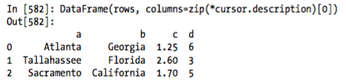
Finding data in a database
DataFrame(rows, columns=zip(*cursor.description)[0])

Slide 9
Agenda
Databases
Midterm
Matplotlib
Tableau

Slide 10
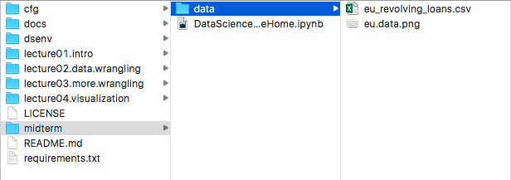
Midterm – 2 parts
In-class (20 questions, 1 hour)
Take-home (1 dataset)

Slide 11
Agenda
Databases
Midterm
Matplotlib
Tableau

Slide 12
Matplotlib
Matplotlib is a python 2D plotting library which produces publication quality figures in a variety of hardcopy formats and interactive environments across platforms.
Matplotlib is the whole package; pylab is a module in matplotlib that gets installed alongside matplotlib; and matplotlib.pyplot is a module in matplotlib
Pyplot provides the state-machine interface to the underlying plotting library in matplotlib.

Slide 13
Subplot
Subplot divides the current figure into rectangular panes that are numbered row wise.
Each pane contains an axes object. Subsequent plots are output to the current pane.

Slide 14
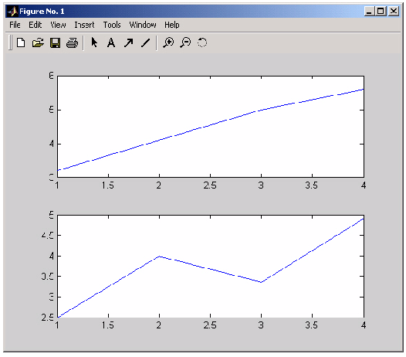
Subplot grid 2X1

Slide 15
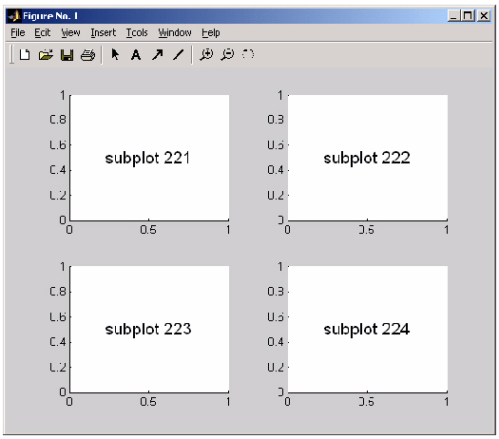
Subplot grid 2x2

Slide 16
Matplotlib Gallery
http://matplotlib.org/examples/index.html

Slide 17
Agenda
Databases
Midterm
Matplotlib
Tableau

Slide 18
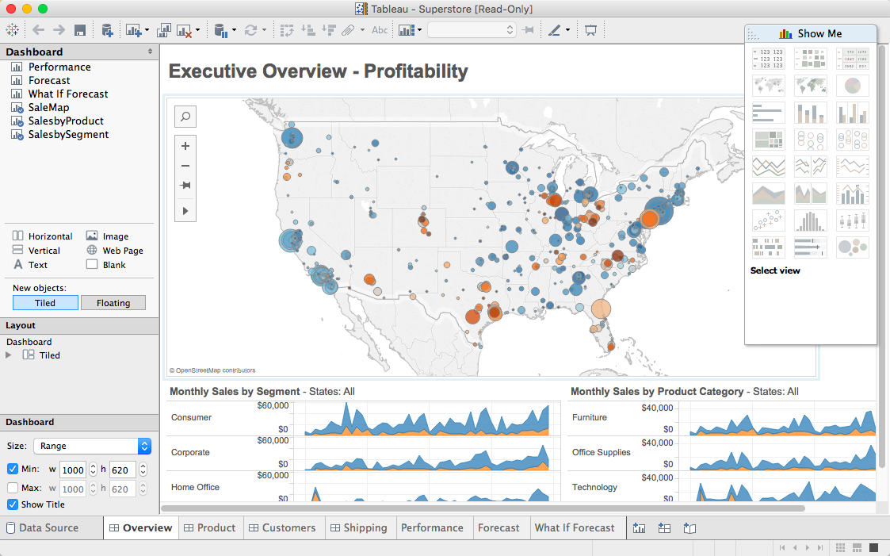

Slide 19
1 Year Tableau License
http://tableau.com/students

