Slide 1
Database & Data Visualization

Slide 2
Agenda
Databases
Matplotlib
Tableau

Slide 3
Databases

Slide 4
A Model: Entity Relations
Household
Person
Address
A “Household” has one or more “Person”
A “Household” has exactly 1 ”Address”
An “Address” belongs to exactly 1 “Household”

Slide 5
Creating a database
import sqlite3
query = """ CREATE TABLE test (a VARCHAR(20), b VARCHAR(20),
c REAL, d INTEGER );"""
con = sqlite3.connect(':memory:') con.execute(query) con.commit()

Slide 6
Inserting data to a database
data = [('Atlanta', 'Georgia', 1.25, 6), ('Tallahassee', 'Florida', 2.6, 3), ('Sacramento', 'California', 1.7, 5)]
stmt = "INSERT INTO test VALUES(?, ?, ?, ?)"
con.executemany(stmt, data) con.commit()

Slide 7
Finding data in a database
cursor = con.execute('select * from test')
rows = cursor.fetchall()
In [580]: rows Out[580]: [(u'Atlanta', u'Georgia', 1.25, 6),
(u'Tallahassee', u'Florida', 2.6, 3), (u'Sacramento', u'California', 1.7, 5)]

Slide 8
Creating a DataFrame
rows = cursor.fetchall()
In [580]: rows Out[580]: [(u'Atlanta', u'Georgia', 1.25, 6),
(u'Tallahassee', u'Florida', 2.6, 3), (u'Sacramento', u'California', 1.7, 5)]

Slide 9
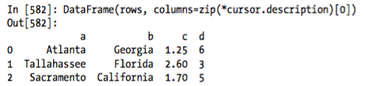
Finding data in a database
DataFrame(rows, columns=zip(*cursor.description)[0])

Slide 10
Agenda
Databases
Matplotlib
Tableau

Slide 11
Agenda
Databases
Matplotlib
Tableau

Slide 12
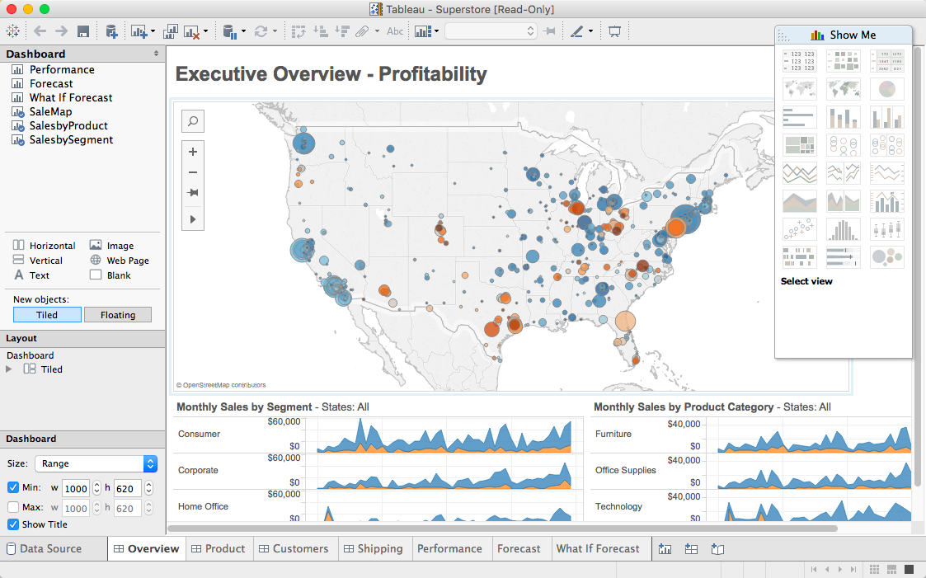

Slide 13
1 Year Tableau License
http://tableau.com/students

