Slide 1
TF Speech Recognition Challenge
Dongbo Wang, Kexin Hui, Zhaoheng Hu
ECE544 Final Presentation

Slide 2
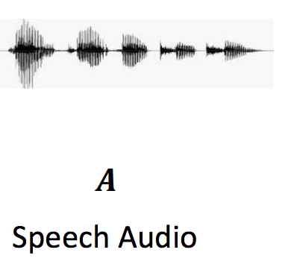
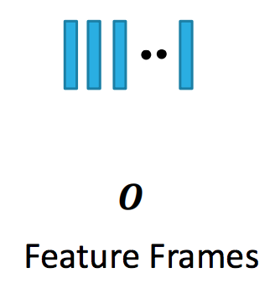
Introduction
Tensorflow Speech Commands Dataset
Preprocess + LSTM + Cross Entropy Loss
Phonemes
Feature
Extraction
LSTM
Word
Speech
Audio
Feature
Frames

Slide 3
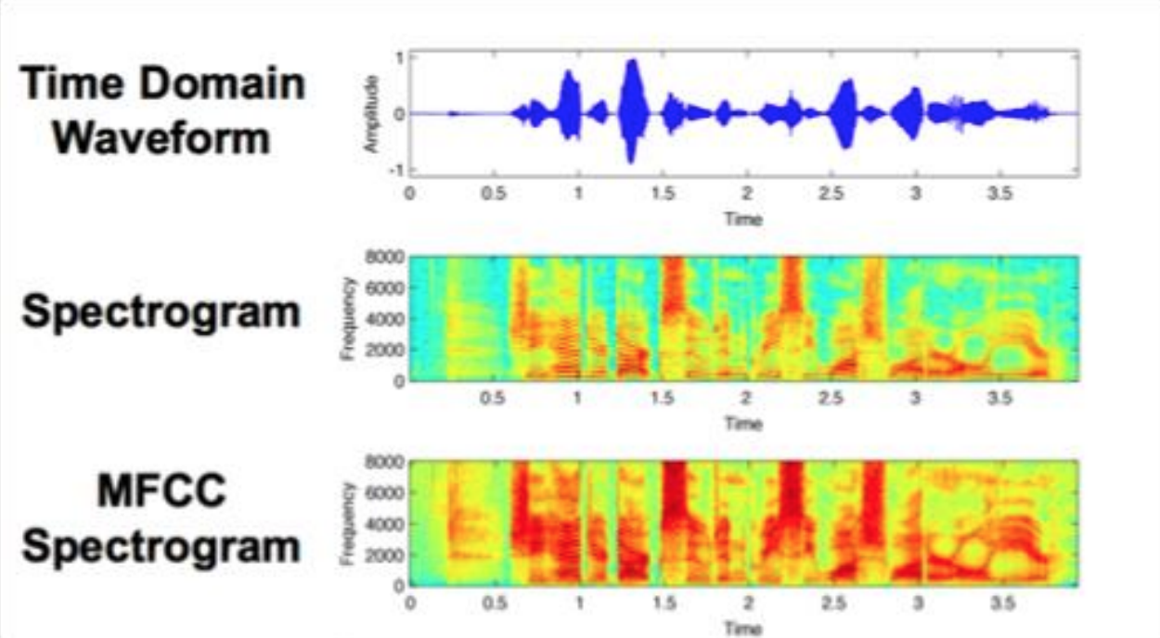
Feature Extraction
No Extraction
Short Time Fourier
Transform (STFT)
Filter Banks (FBanks)
Mel-frequency Cepstral
Coefficients (MFCC)

Slide 4
Results
Unweighted vs. Weighted Loss Function
None vs. STFT vs. FBanks vs. MFCC
64 vs. 128 vs. 256 Hidden Units

Slide 5

Results
Overall accuracy: 73.101%
>>> class yes: 84.551%
>>> class no: 65.602%
>>> class up: 64.777%
>>> class down: 69.0%
>>> class left: 78.0%
>>> class right: 72.937%
>>> class on: 69.945%
>>> class off: 74.592%
>>> class stop: 67.539%
>>> class go: 54.0%
>>> class silence: 99.559%
>>> class unknown: 76.713%

Slide 6
Thank you!

