Slide 1
도메인 주도 설계 with 클린 아키텍처
고형호
hyungho.ko@gmail.com
https://github.com/hhko

Slide 2
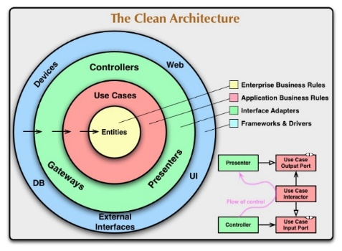
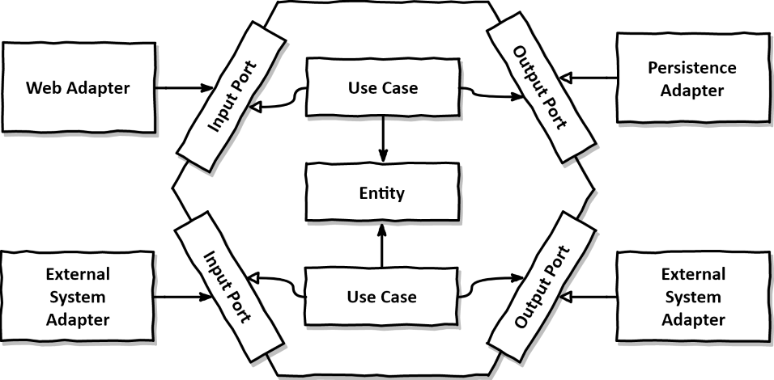
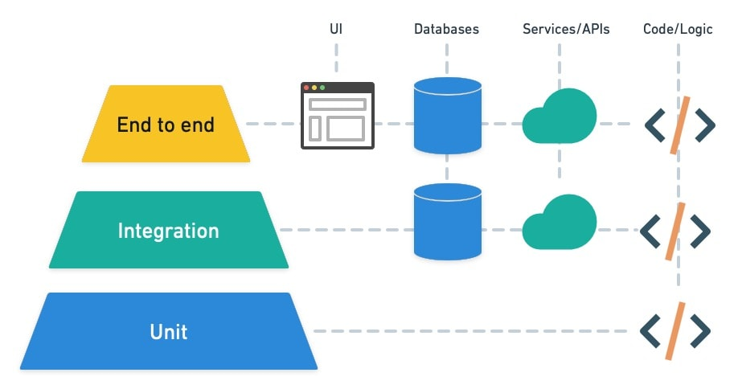
Separation of Concerns
Layer(Tier), Entity
Three-tier Architecture > Three-layered Architecture
by John J. Donovan
Entity-Control-Boundary(ECB)
by lvar Jacobson
Tech.
Pattern
Domain-Driven Design
by Eric Evans
Onion Architecture
by Jeffrey Palermo
Clean Architecture
by Robert C. Martin
Agile Manifesto
1992
2001
2003
2008
2012
1999
2002
2005
2009
Extreme Programming(XP) book published
by Kent Beck
Test-Driven Development by Example
by Kent Beck
Hexagonal Architecture / Ports & Adapters
by Alistair Cockburn
Test Pyramid
by Mike Cohn at Succeeding with Agile Book
Test

Slide 3
관심사의 분리
Separation of Concerns
Three-tier Architecture > Three-layered Architecture
by John J. Donovan
Entity-Control-Boundary(ECB)
by lvar Jacobson
설계 기술
설계 패턴
Domain-Driven Design
by Eric Evans
Onion Architecture
by Jeffrey Palermo
Clean Architecture
by Robert C. Martin
Agile Manifesto
1992
2001
2003
2008
2012
1999
2002
2005
2009
Extreme Programming(XP) book published
by Kent Beck
Test-Driven Development by Example
by Kent Beck
Hexagonal Architecture / Ports & Adapters
by Alistair Cockburn
Test Pyramid
by Mike Cohn at Succeeding with Agile Book
설계 테스트

Slide 4
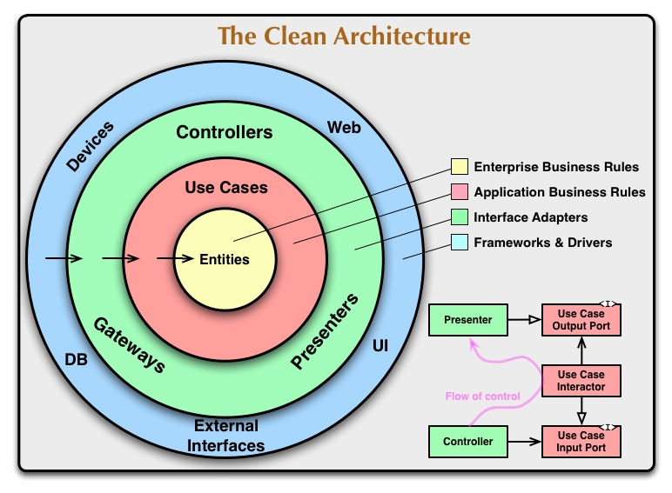
Layers
T1.T2.T3
Domain
Application
Adapter
Host
src
CleanDdd.Domain
CleanDdd.Application
CleanDdd.Adapters.Infrastructure
CleanDdd.Adapters.Persistence
CleanDdd.Adapters.Presentation
CleanDdd.Host

Slide 5
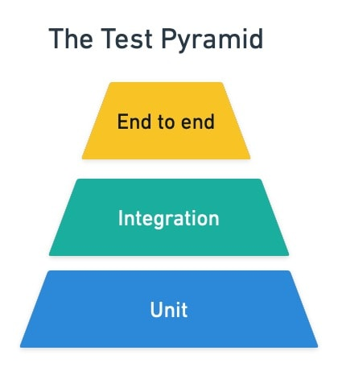
Features
T1.T2.T3
E2E
Integration
Unit
tests
CleanDdd.Tests.E2E
CleanDdd.Tests.Integration
CleanDdd.Tests.Unit

Slide 6
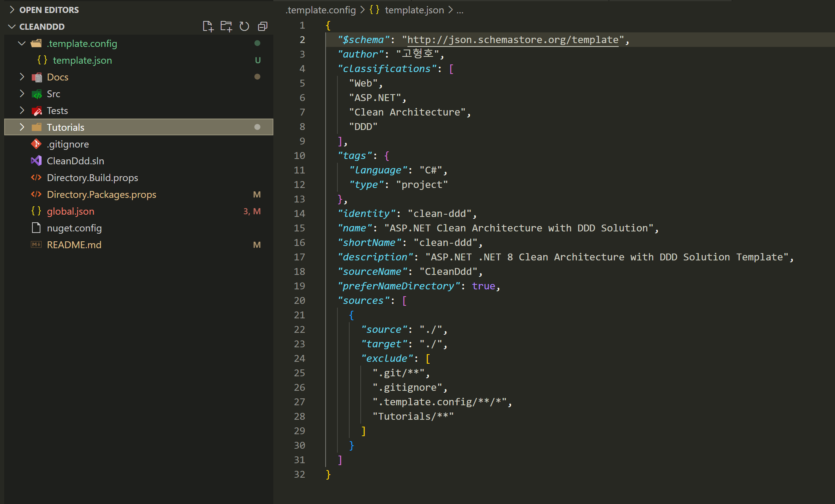
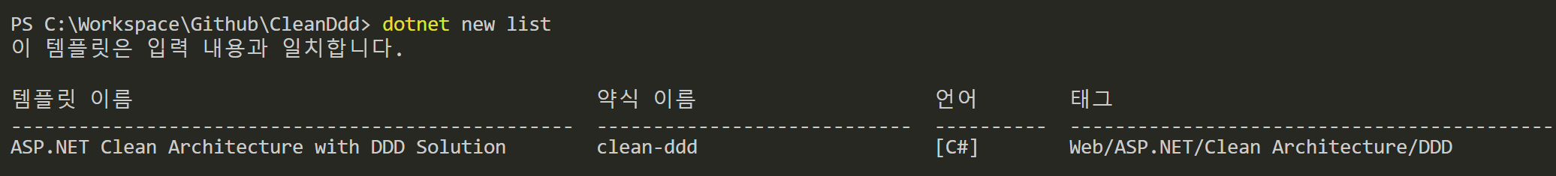
템플릿 대상에서 제외 시킨다.

Slide 7
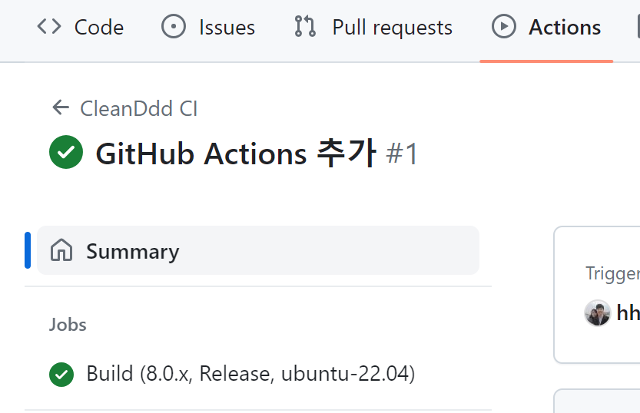
Matrix에서 조합되는 N개 Job을 실행합니다.
name
runs-on: ${{ matrix.os }}

Slide 8
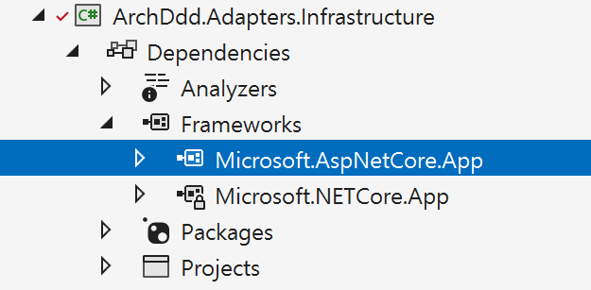
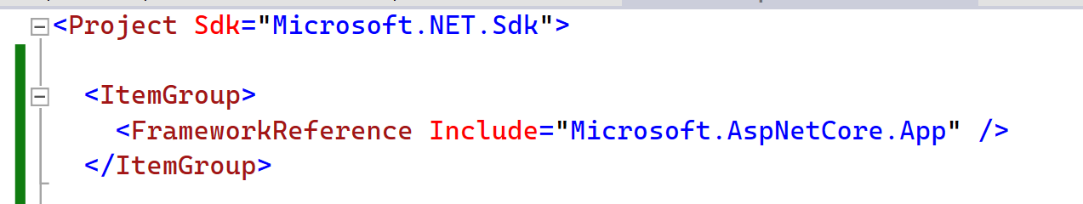

Slide 9
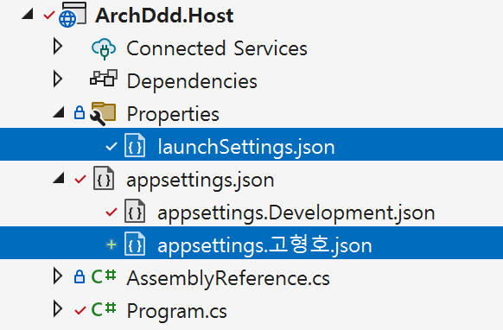
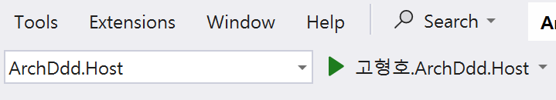
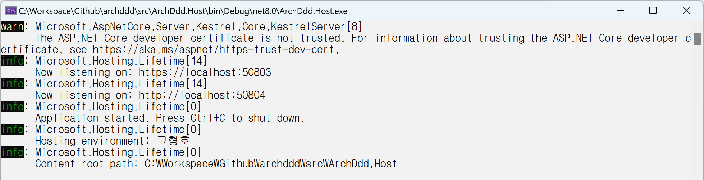
launchSettings.json
1
{
"profiles": {
"고형호.ArchDdd.Host": {
"commandName": "Project",
"launchBrowser": true,
"environmentVariables": {
"ASPNETCORE_ENVIRONMENT": "고형호"
},
"applicationUrl": "https://localhost:50803;http://localhost:50804"
}
}
}
2
3
4

