Slide 2
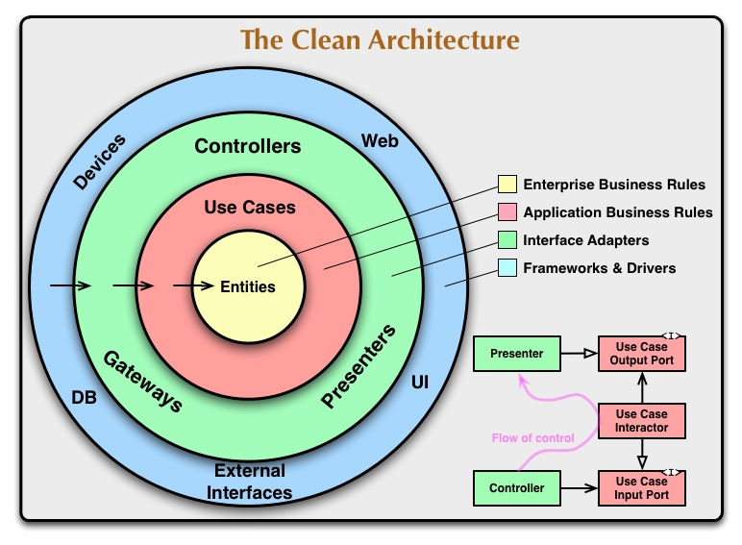
Layers
T1.T2.T3
Domain
Application
Adapter
Host
src
CleanDdd.Domain
CleanDdd.Application
CleanDdd.Adapters.Infrastructure
CleanDdd.Adapters.Persistence
CleanDdd.Adapters.Presentation
CleanDdd.Host

Slide 3
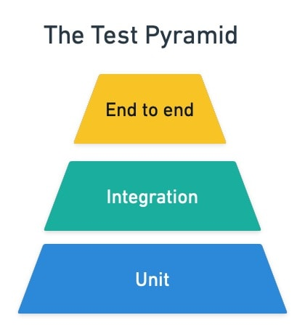
Features
T1.T2.T3
E2E
Integration
Unit
tests
CleanDdd.Tests.E2E
CleanDdd.Tests.Integration
CleanDdd.Tests.Unit

Slide 4
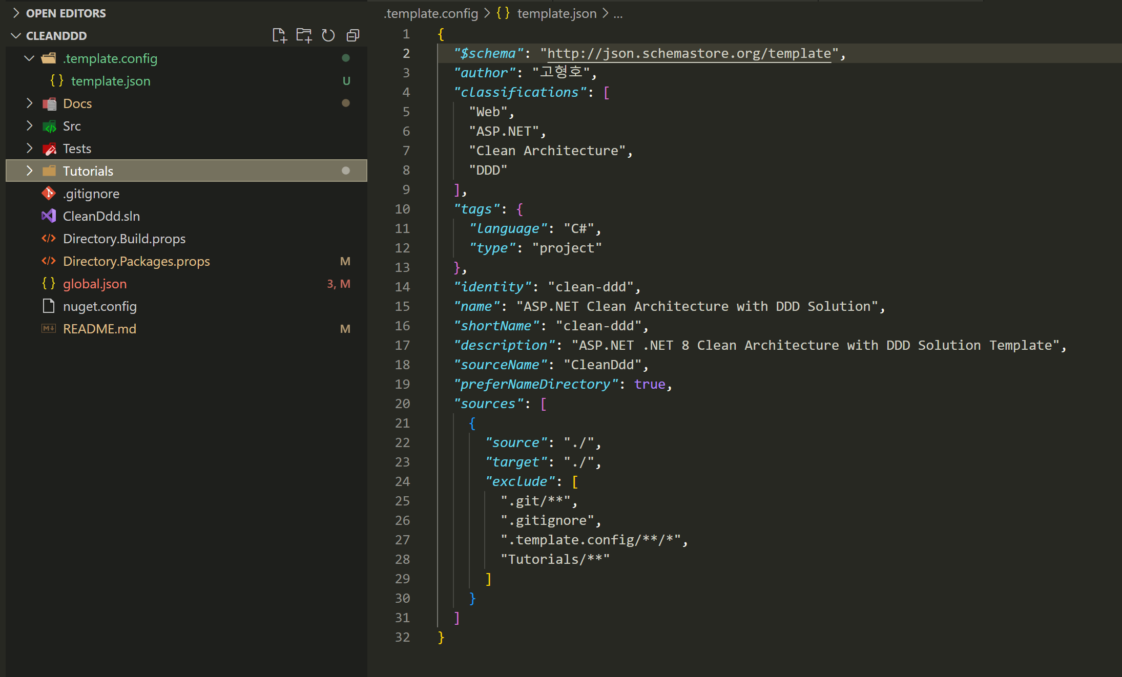
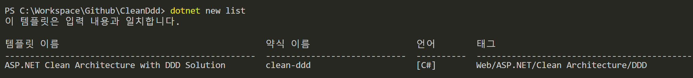
템플릿 대상에서 제외 시킨다.

