Slide 1
better CODE with doamin-driven design
고형호
hyungho.ko@gmail.com
https://github.com/hhko/better-code-with-ddd

Slide 2
MSA
Microservices Architecture
DevOps
CNA
Cloud Native Application

Slide 3
Sustainable Code
Infrastructure Automation
Measurable Code
DEV
development
OPS
operations
CI/CD
Unit Test
Integration Test
Performance Test
End to End Test
Infrastructure as Code
Container
Cluster
Distributed
Test Pyramid
Container Orchestration
Logs
Metrics
Traces
Heal Check
Domain-Driven Desgin
Observability
Feedback
Refactoring
Strategic Design
Sub-Domain
Bounded Context
Context Map
Tactical Design
Functional Architecture
Model-Driven Design
Static Site Generator
ADR(Architecture Decision Record)
SOP(Standard Operating Procedure)

Slide 4
Known
Known
Command Input Message
Adapter Layer
Output Message
Adapter Layer
Query Input Message
Mediator
Tech.
Tech.
Known
Input & Output Interface
Implementation
Unknown
Unknown
Adapter Layer
Application Layer
Adapter Layer
Tech.
Unknown
Input Interface
Use
Biz. Flow
Unknown
Output Interface
Use
Tech.
Domain Layer
Biz. Unit

Slide 5
INPUT
OPERATION
OUTPUT
Tech.
CONCERN
Biz.
CONCERN
Tech.
CONCERN
Dependency
Isolation
Dependency
Known
Known
Command Input Message
Adapter Layer
Output Message
Adapter Layer
Query Input Message
Mediator
Tech.
Tech.
Known
Input & Output Interface
Implementation
Unknown
Unknown
Adapter Layer
Application Layer
Adapter Layer
Tech.
Unknown
Input Interface
Use
Biz. Flow
Unknown
Output Interface
Use
Tech.
Domain Layer
Biz. Unit

Slide 6
프로젝트 참여자 모두가 이해하고 있어야 하는 것
shared understanding
핵심 가치, 바꾸기 어렵고, 가능한 바꾸어서는 안되는 것
hard to change
지속 가능한 성장을 위해 중요한 모든 것, 그것이 무엇이든 간에
the important stuff whatever that is.

Slide 7
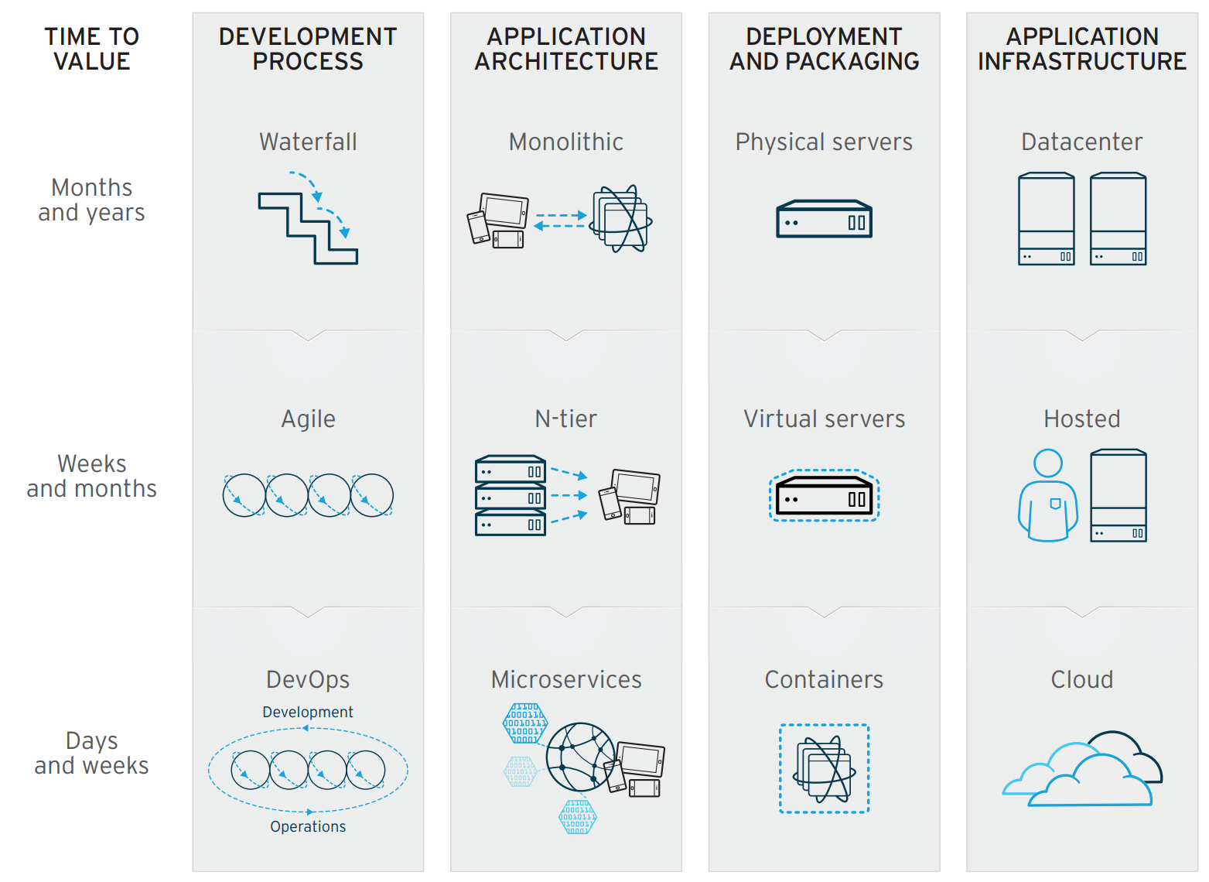

Slide 8
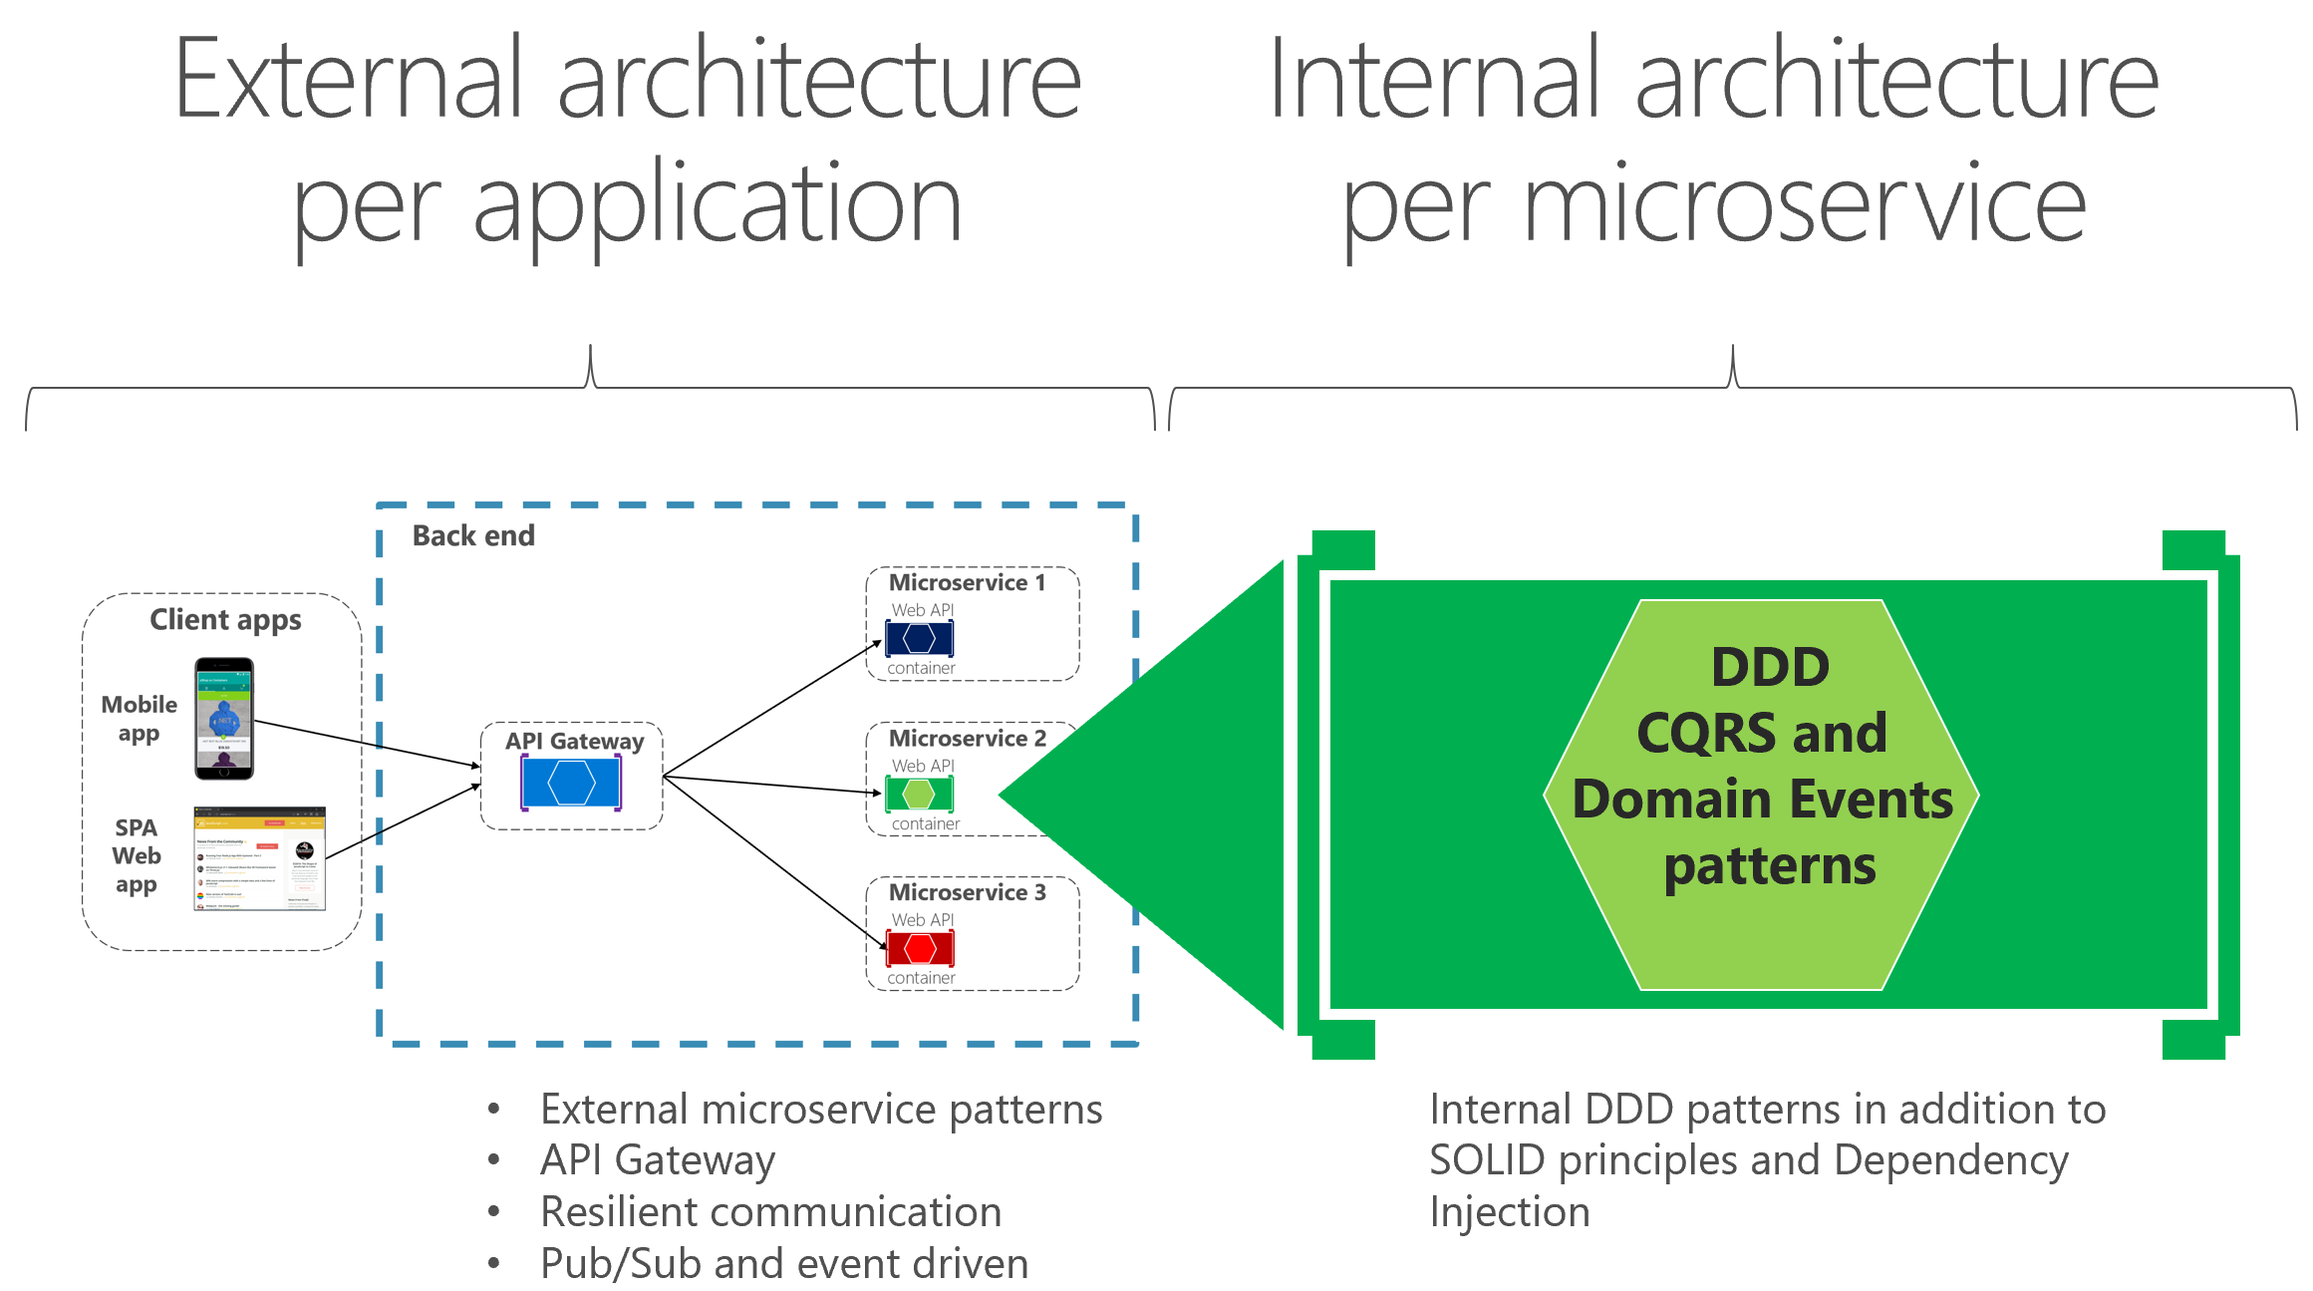

Slide 9
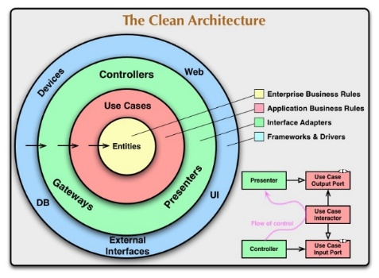
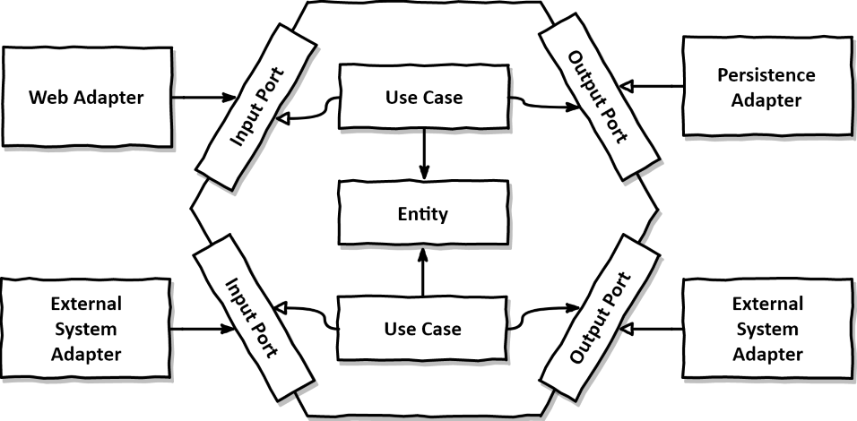
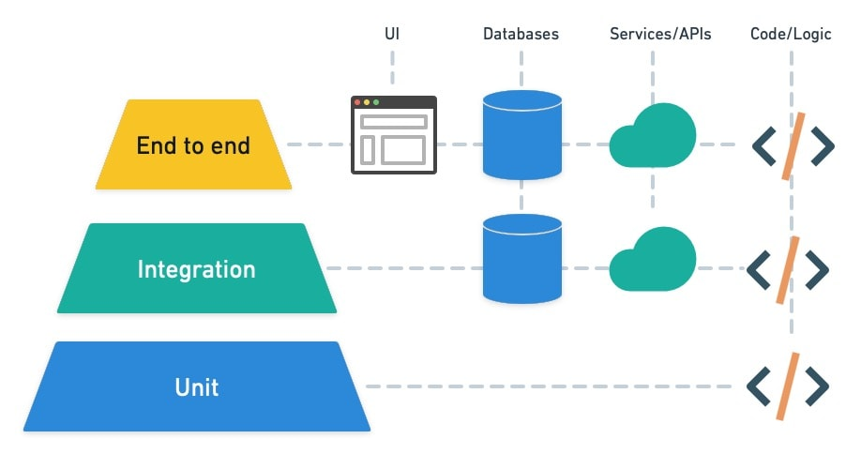
관심사의 분리
Separation of Concerns
Three-tier Architecture > Three-layered Architecture
by John J. Donovan
Entity-Control-Boundary(ECB)
by lvar Jacobson
설계 기술
아키텍처 패턴
Domain-Driven Design
by Eric Evans
Onion Architecture
by Jeffrey Palermo
Clean Architecture
by Robert C. Martin
Agile Manifesto
1992
2001
2003
2008
2012
1999
2002
2005
2009
Extreme Programming(XP) book published
by Kent Beck
Test-Driven Development by Example
by Kent Beck
Hexagonal Architecture / Ports & Adapters
by Alistair Cockburn
Test Pyramid
by Mike Cohn at Succeeding with Agile Book
설계 테스트

Slide 10
Biz.
CONCERN
DEV
Development
Voice
of
the Customer
CODE
OPS
Operations
Logs
Tech.
CONCERN

Slide 11
DEV
Development
CODE
OPS
Operations
Biz.
CONCERN
Biz. Flow
Application Layer
Biz. Flow
Biz.
Biz.
Biz. Unit
Domain Layer
Biz. Unit
Voice
of
the Customer
decomposition
distinguish
Logs
※ Requirement
Tech.
CONCERN
Known Input/OUtput
Tech.
Adapter Layer
Tech.
Unknown Output
※ Side Effectss

Slide 12
INPUT
OPERATION
OUTPUT
Tech.
CONCERN
Biz.
CONCERN
Tech.
CONCERN
Known
Known
Adapter Layer
Application Layer
Adapter Layer
Tech.
Biz. Flow
Tech.
Domain Layer
Biz. Unit

Slide 13
INPUT
OPERATION
OUTPUT
Tech.
CONCERN
Biz.
CONCERN
Tech.
CONCERN
Known
Known
Adapter Layer
Application Layer
Adapter Layer
Tech.
Biz. Flow
Tech.
Unknown
Unknown
Adapter Layer
Adapter Layer
Tech.
Tech.
Domain Layer
Biz. Unit

Slide 14
INPUT
OPERATION
OUTPUT
Tech.
CONCERN
Biz.
CONCERN
Tech.
CONCERN
Dependency
Known
Known
Adapter Layer
Application Layer
Adapter Layer
Tech.
Biz. Flow
Tech.
Unknown
Unknown
Adapter Layer
Adapter Layer
Tech.
Tech.
Domain Layer
Biz. Unit

Slide 15
INPUT
OPERATION
OUTPUT
Tech.
CONCERN
Biz.
CONCERN
Tech.
CONCERN
Dependency
Isolation
Dependency
Known
Input Interface
Implementation
Known
Output Interface
Use
Known
Known
Adapter Layer
Application Layer
Adapter Layer
Tech.
Biz. Flow
Tech.
Unknown
Unknown
Adapter Layer
Adapter Layer
Tech.
Tech.
Unknown
Input Interface
Use
Unknown
Output Interface
Use
Domain Layer
Biz. Unit

Slide 16
Deterministic
Integration Test
Deterministic
Unit Tests
Non-deterministic
Non-deterministic
Tech.
CONCERN
Biz.
CONCERN
Tech.
CONCERN
Dependency
Isolation
Dependency
Known
Known
Input Interface
Use
Known
Output Interface
Use
Known
Adapter Layer
Application Layer
Adapter Layer
Tech.
Biz. Flow
Tech.
Unknown
Unknown
Adapter Layer
Adapter Layer
Tech.
Unknown
Input Interface
Use
Unknown
Output Interface
Use
Tech.
Domain Layer
Biz. Unit

Slide 17
INPUT
OPERATION
OUTPUT
Tech.
CONCERN
Biz.
CONCERN
Tech.
CONCERN
Dependency
Isolation
Dependency
Known
Known
Input Interface
Use
Known
Output Interface
Use
Known
Adapter Layer
Application Layer
Adapter Layer
Tech.
Biz. Flow
Tech.
Unknown
Unknown
Adapter Layer
Adapter Layer
Tech.
Unknown
Input Interface
Use
Unknown
Output Interface
Use
Tech.
Domain Layer
Biz. Unit

Slide 18
INPUT
OPERATION
OUTPUT
Tech.
CONCERN
Biz.
CONCERN
Tech.
CONCERN
Dependency
Isolation
Dependency
Known
Known
Adapter Layer
Input Message
Output Message
Adapter Layer
Mediator
Tech.
Tech.
Known
Input & Output Interface
Implementation
Unknown
Unknown
Adapter Layer
Application Layer
Adapter Layer
Tech.
Biz. Flow
Tech.
Unknown
Input Interface
Use
Unknown
Output Interface
Use
Domain Layer
Biz. Unit

Slide 19
INPUT
OPERATION
OUTPUT
Tech.
CONCERN
Biz.
CONCERN
Tech.
CONCERN
Dependency
Isolation
Dependency
Known
Known
Adapter Layer
Input Message
Output Message
Adapter Layer
Mediator
Tech.
Tech.
Known
Input & Output Interface
Implementation
Unknown
Unknown
Adapter Layer
Application Layer
Adapter Layer
Tech.
Biz. Flow
Tech.
Unknown
Input Interface
Use
Unknown
Output Interface
Use
Domain Layer
Biz. Unit

Slide 20
INPUT
OPERATION
OUTPUT
Tech.
CONCERN
Biz.
CONCERN
Tech.
CONCERN
Dependency
Isolation
Dependency
Known
Known
Adapter Layer
Input Message
Output Message
Adapter Layer
Mediator
Tech.
Tech.
Known
Input & Output Interface
Implementation
Unknown
Unknown
Adapter Layer
Application Layer
Adapter Layer
Tech.
Biz. Flow
Tech.
Unknown
Input Interface
Use
Unknown
Output Interface
Use
Domain Layer
Biz. Unit

Slide 21
INPUT
OPERATION
OUTPUT
Tech.
CONCERN
Biz.
CONCERN
Tech.
CONCERN
Dependency
Isolation
Dependency
Known
Known
Command Input Message
Adapter Layer
Output Message
Adapter Layer
Query Input Message
Mediator
Tech.
Tech.
Known
Input & Output Interface
Implementation
Unknown
Unknown
Adapter Layer
Application Layer
Adapter Layer
Tech.
Biz. Flow
Tech.
Unknown
Input Interface
Use
Unknown
Output Interface
Use
Domain Layer
Biz. Unit

Slide 22
Write Request
Read Request
API
Adapter Layer
1. Command
1. Query
4. Result
Command handler using ORM
Query handler using SQL
Application Layer
2. Get Entities
5. Entities
6. Invoke Aggregate Method
7. Save Changes
2. SQL
3. Result
Domain
Domain Layer
Repositories
Adapter Layer
3. SQL
4. Result
8. SQL
Database

Slide 23
INPUT
OPERATION
OUTPUT
Known
Known
Command Input Message
Adapter Layer
Output Message
Adapter Layer
Query Input Message
Mediator
Tech.
Tech.
Known
Input & Output Interface
Implementation
Unknown
Unknown
Adapter Layer
Application Layer
Adapter Layer
Tech.
Biz. Flow
Tech.
Unknown
Input Interface
Use
Unknown
Output Interface
Use
Domain Layer
Biz. Unit

Slide 24
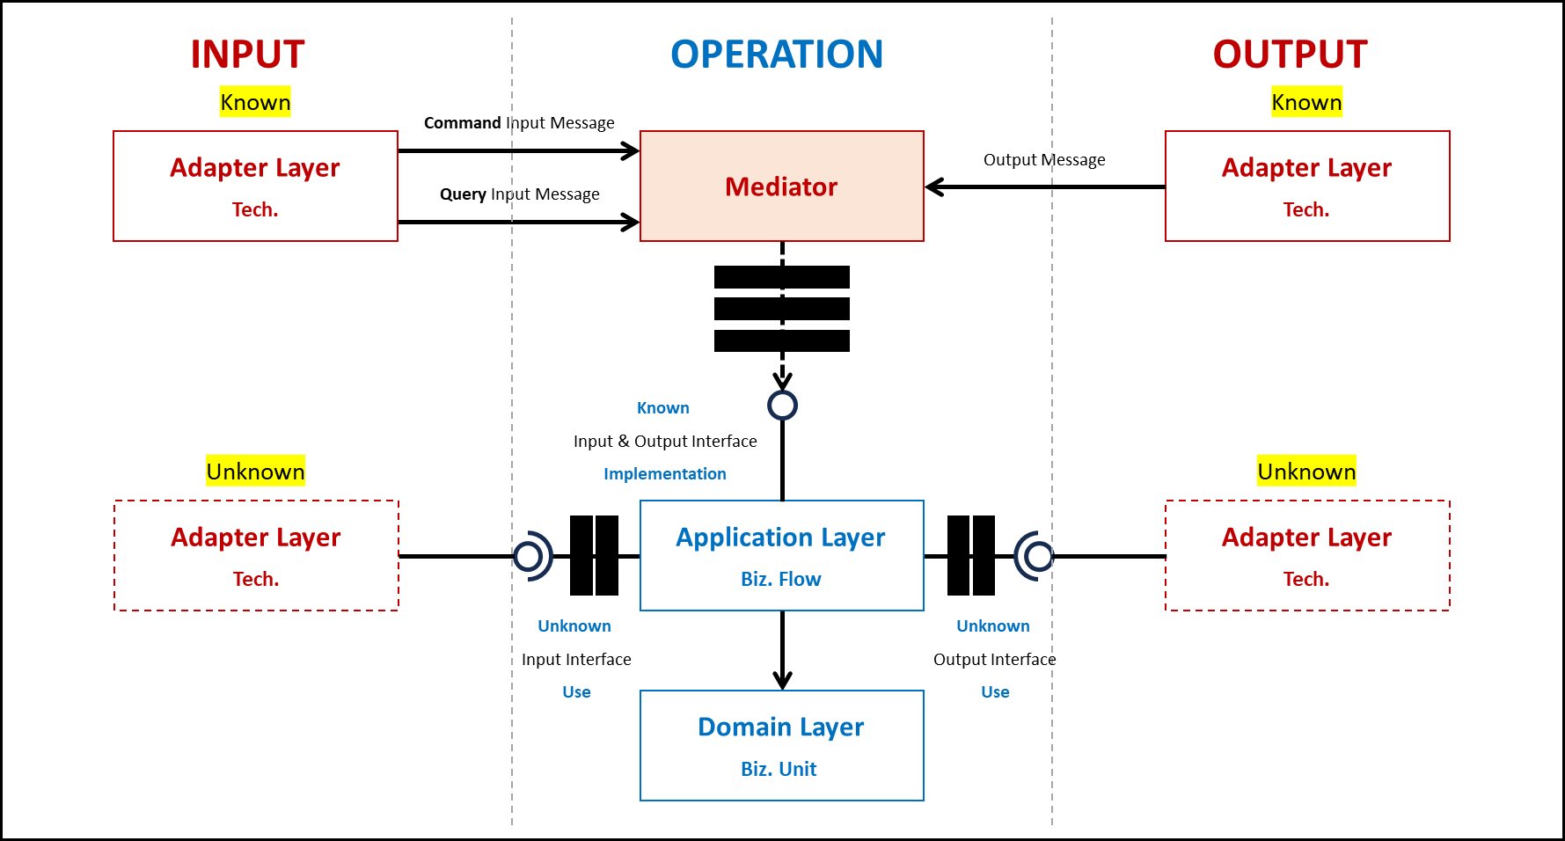
Service 1.
Service 3.
Service 2.

Slide 25
Known
Known
Command Input Message
Adapter Layer
Output Message
Adapter Layer
Query Input Message
Mediator
Tech.
Tech.
Known
Input & Output Interface
Implementation
Unknown
Unknown
Adapter Layer
Application Layer
Adapter Layer
Tech.
Biz. Flow
Tech.
Unknown
Input Interface
Use
Unknown
Output Interface
Use
Domain Layer
Biz. Unit

Slide 26
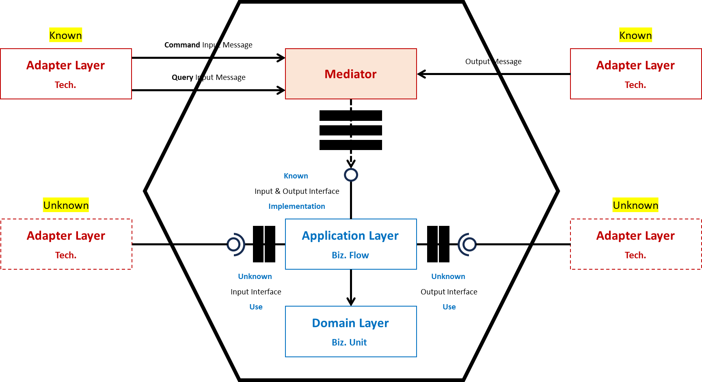
Port
Vs.
Known
Known & Unknown Input/Output Port
Unknown

Slide 27
Adapter
Vs.
Known
Known & Unknown Input/Output Adapter
Unknown

Slide 28
CQRS
Message
none
Decorator
Vs.

Slide 29
Application
Vs.

Slide 30
Domain
Vs.

Slide 31
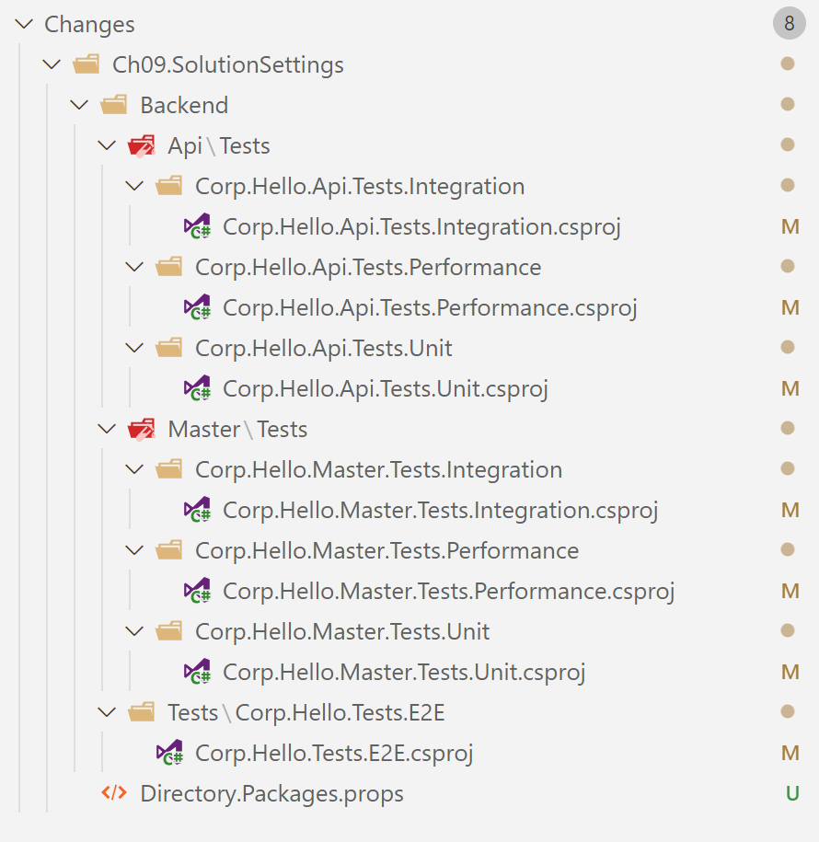
`
<PackageReference Include="xunit"
<PackageVersion Include="xunit" Version="2.4.2" />

Slide 32
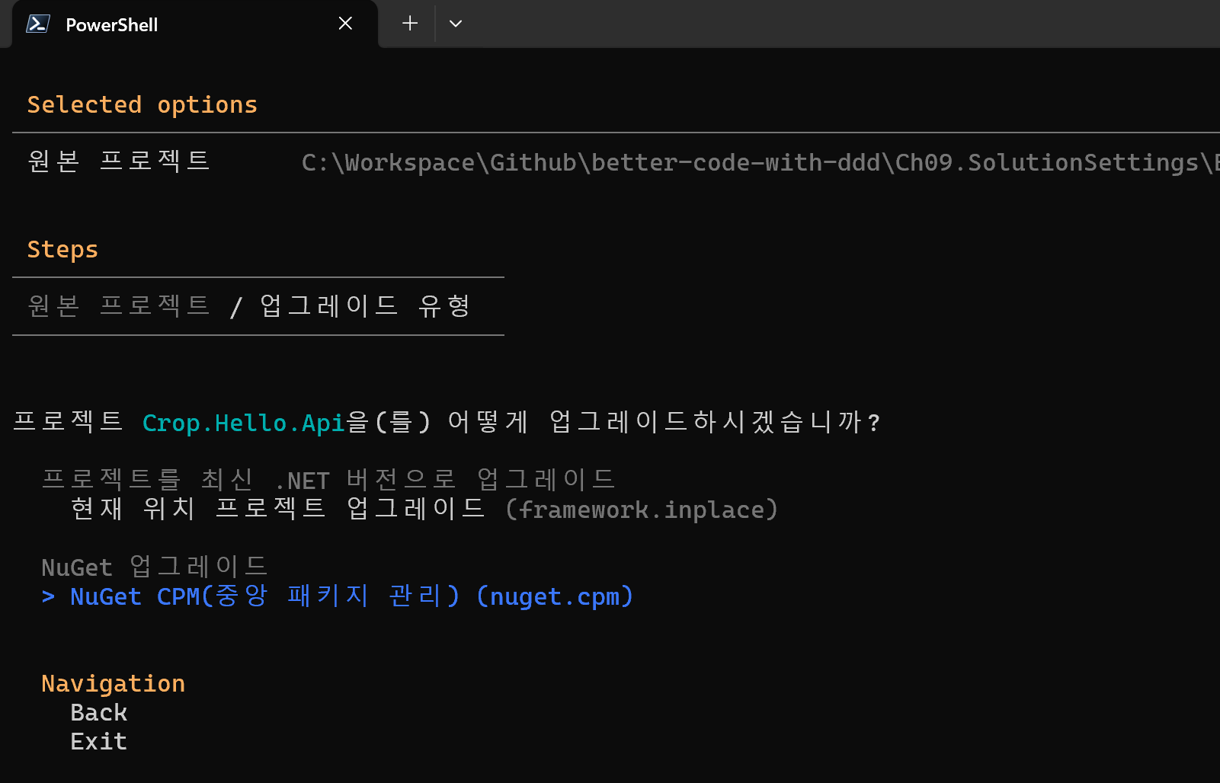
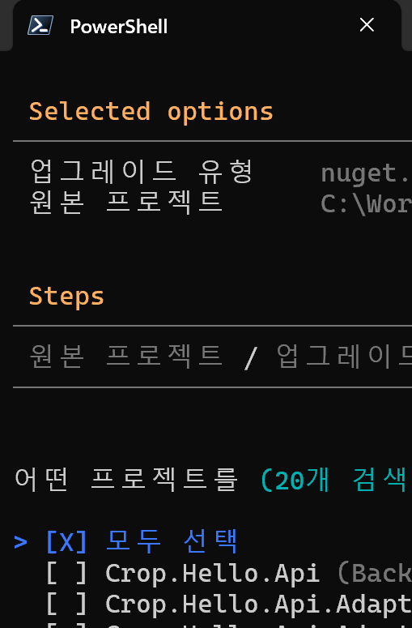

Slide 33
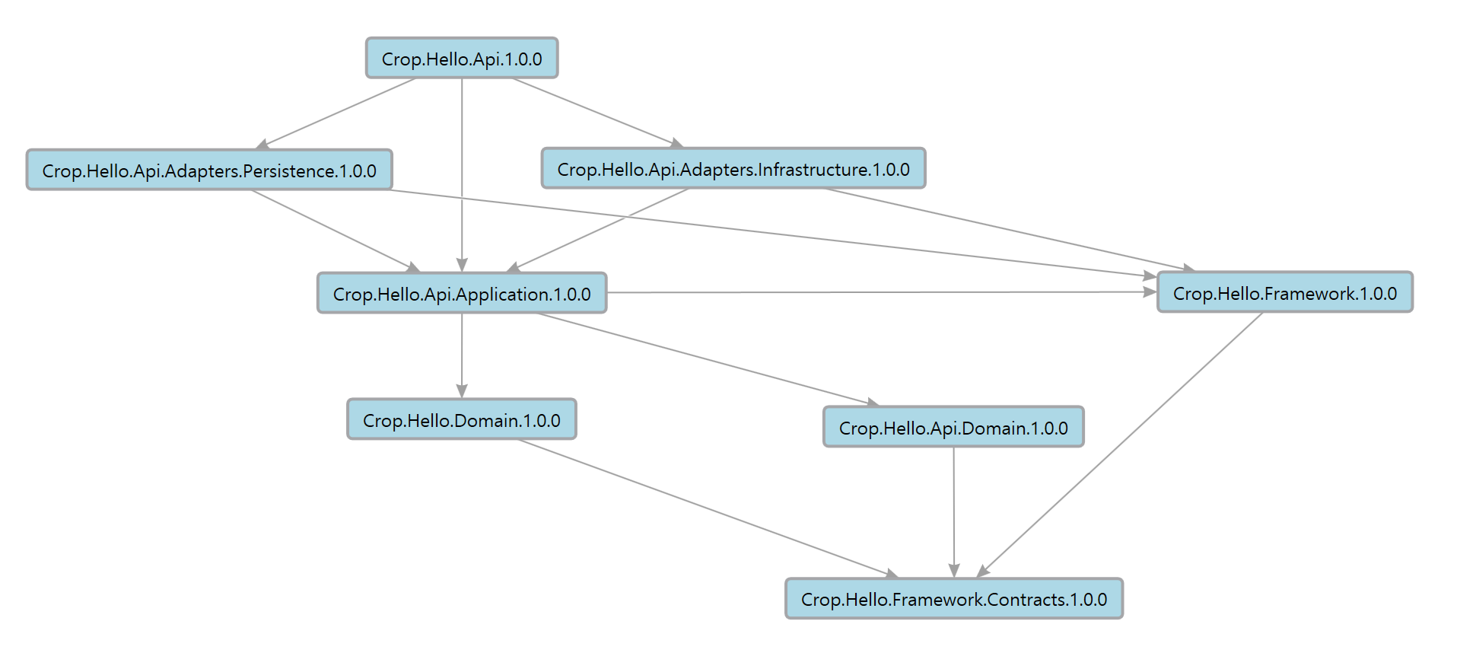
`
Layers
Assets

Slide 34
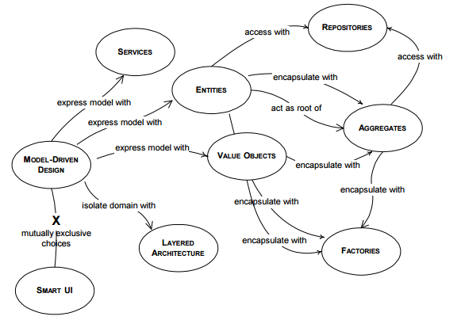
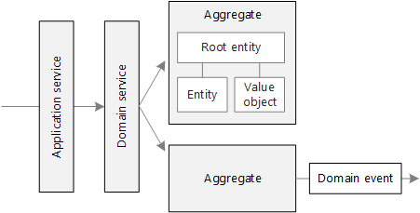
Tactical Design Compile-time
Vs.
Tactical Design Runtime

Slide 35
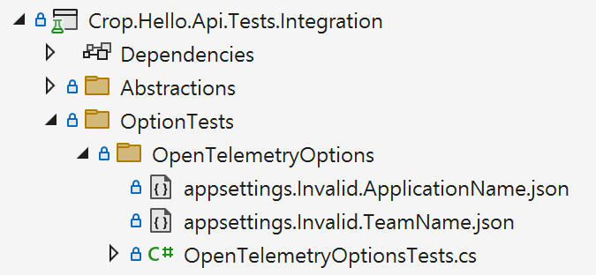
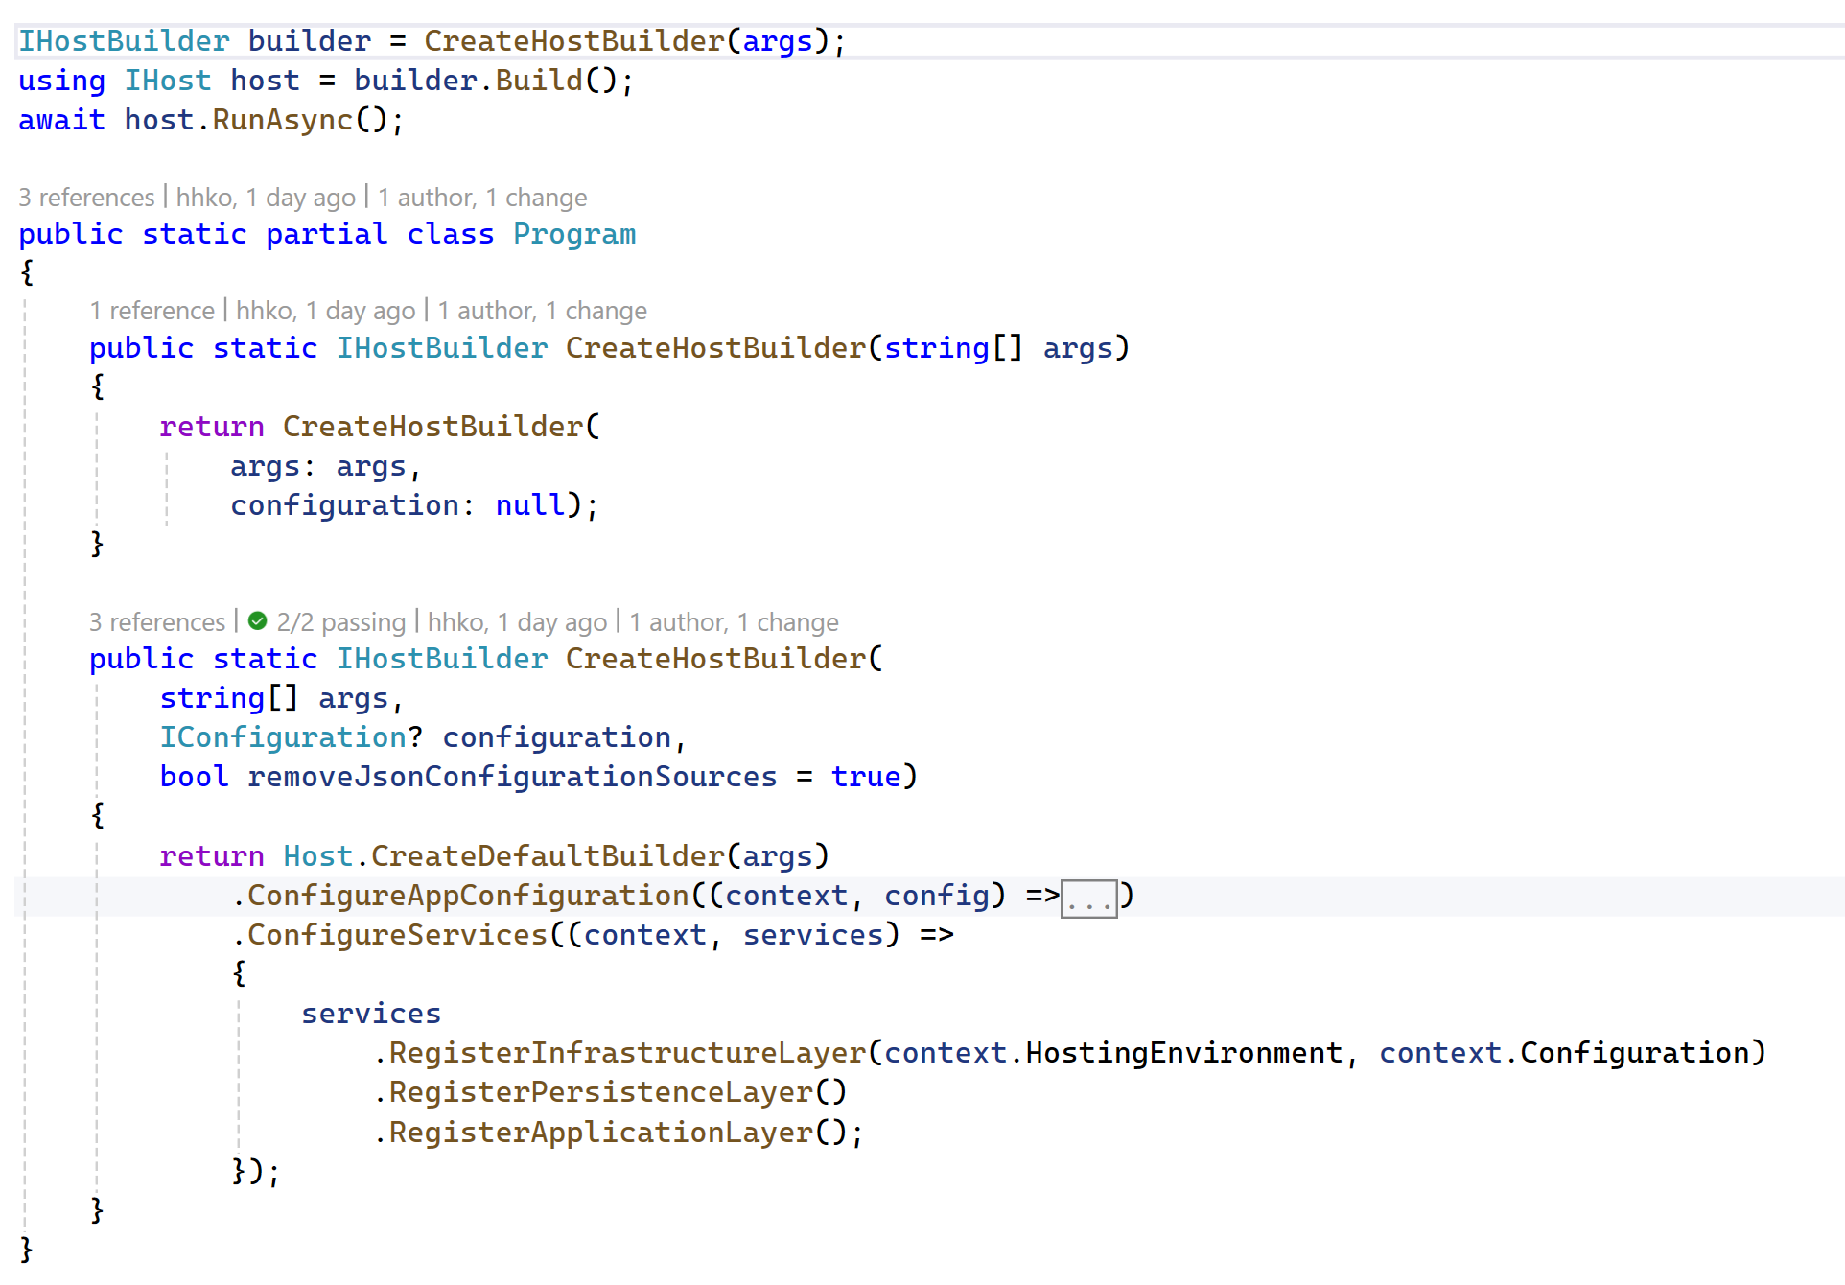
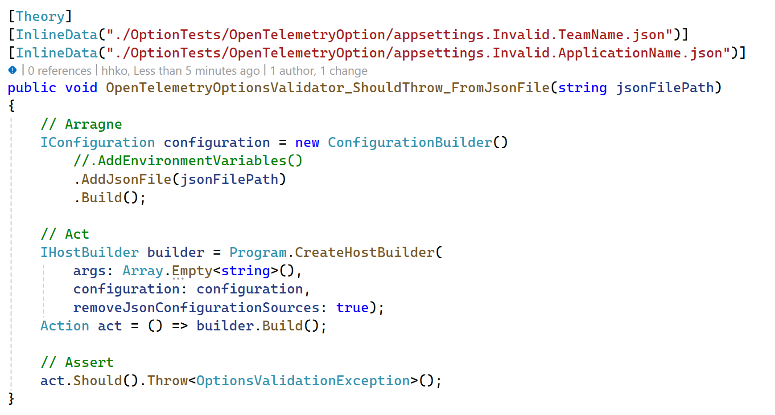

Slide 36
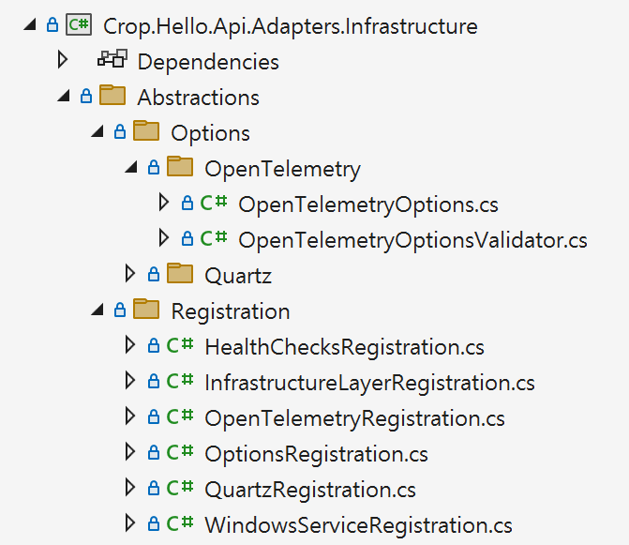
Options
Options Validator

Slide 37
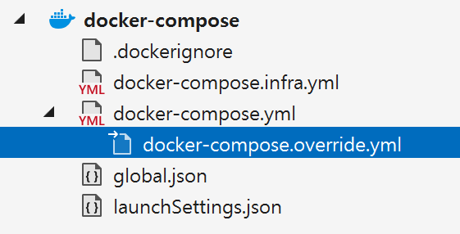
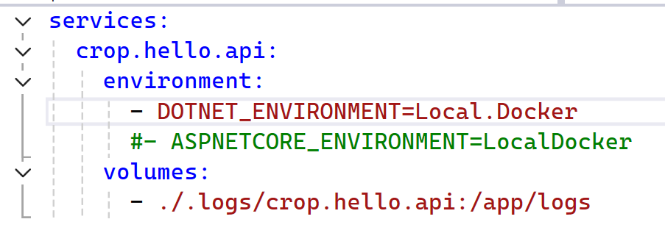
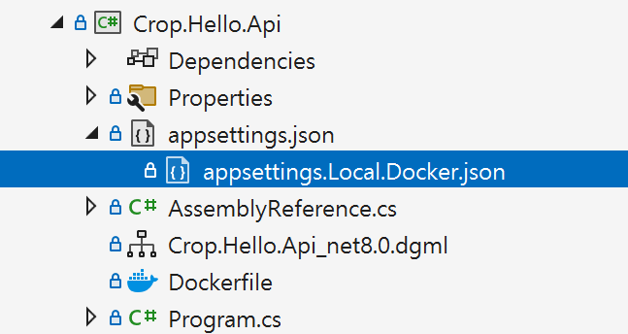
docker-compose.override.yml
appsettings.{DOTNET_ENVIRONMENT}.json

Slide 38
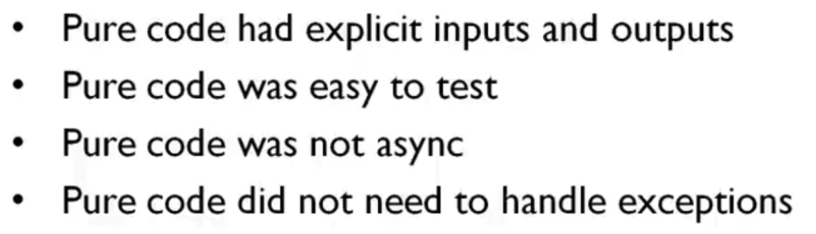
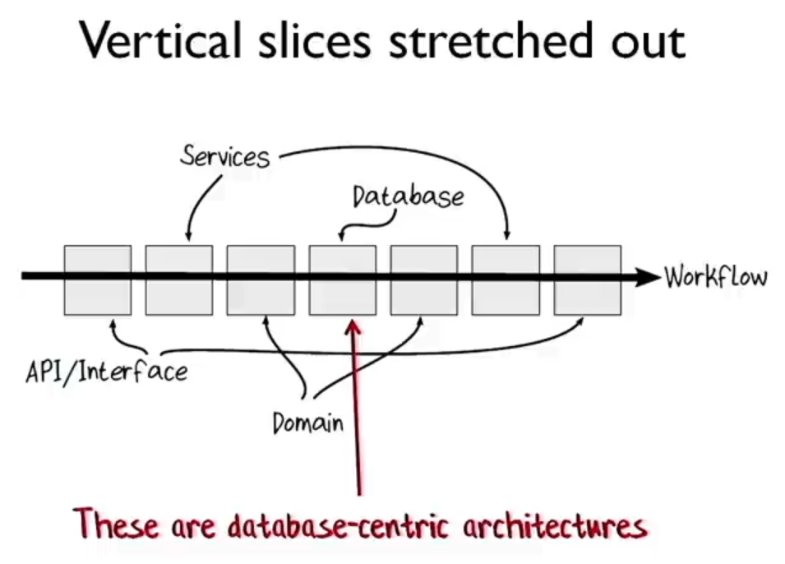
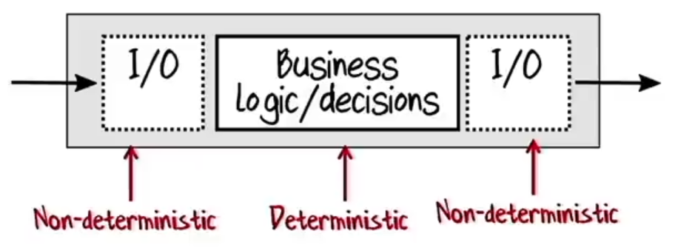
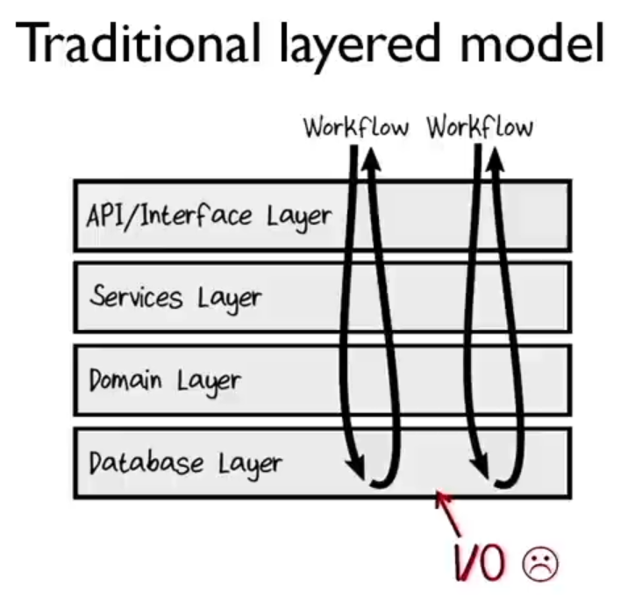
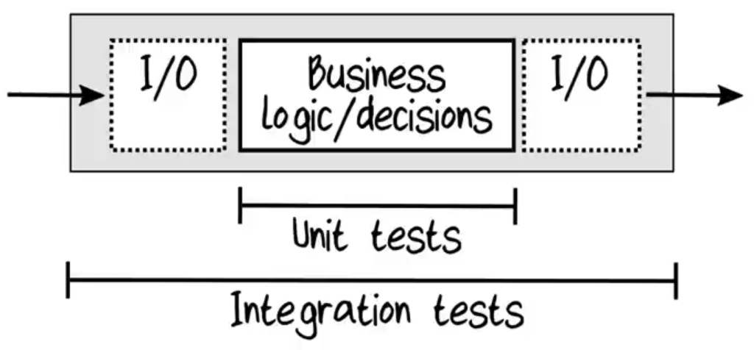
Application Layer
Vs.
Adapter Layer
Domain Layer
Adapter Layer

Slide 39
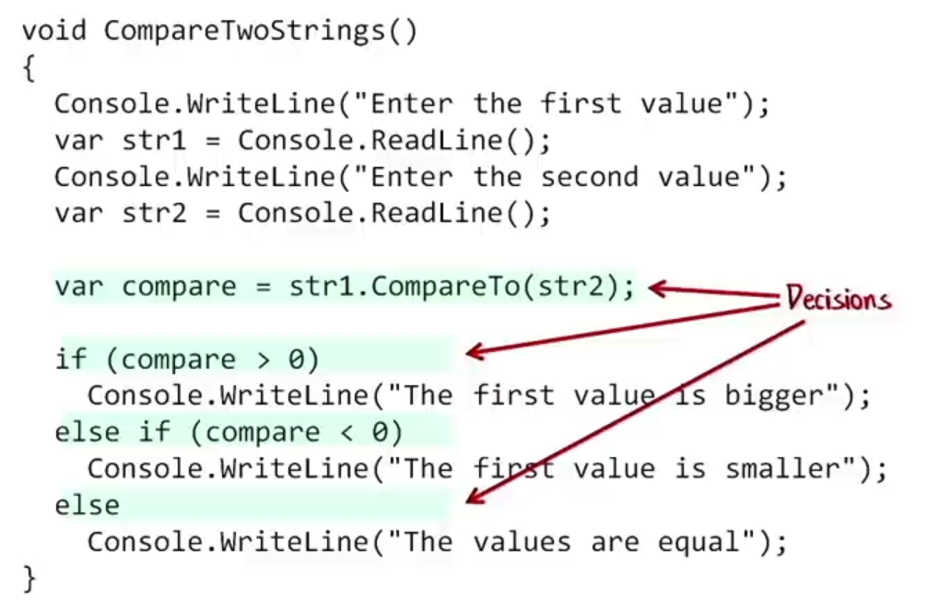
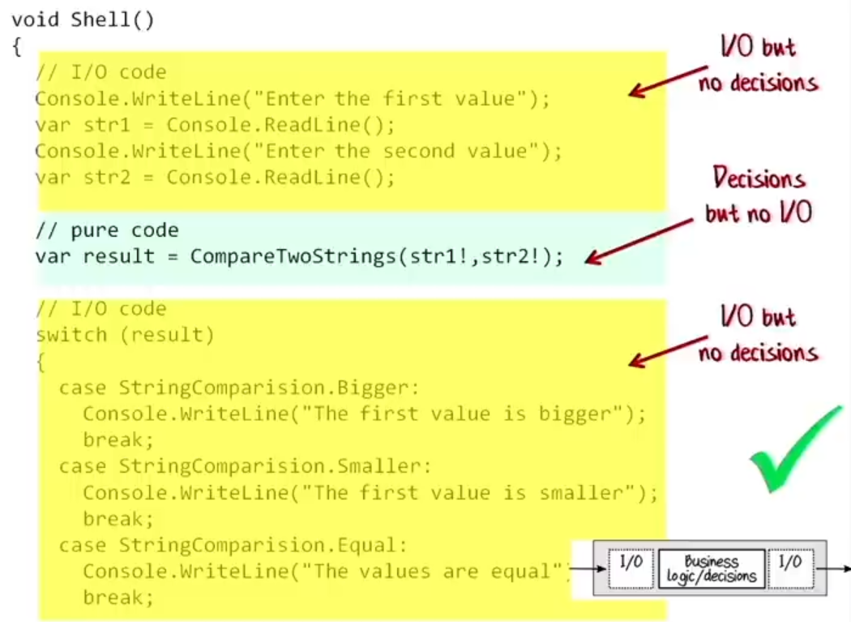
리팩토링 전
VS.
리팩토링 후

Slide 40
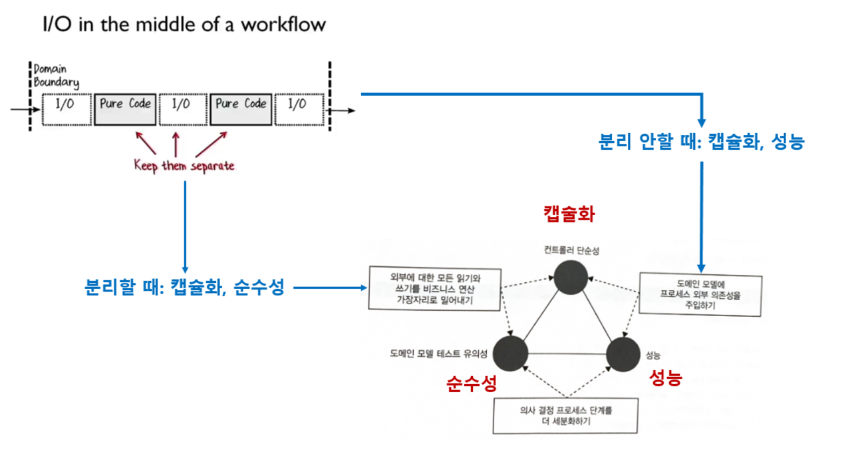

Slide 41
Korean

Slide 42
지속 가능한 코드
인프라 자동화
측정 가능한 코드
DEV
development
OPS
operations
CI/CD
Unit Test
Integration Test
Performance Test
End to End Test
Infrastructure as Code
컨테이너
오케스트레이션
테스트 피라미드
Logs
Metrics
Traces
Heal Check
도메인 주도 설계
관찰 가능성
Feedback
Refactoring
Strategic Design
Sub-Domain
Bounded Context
Context Map
Tactical Design
Functional Architecture
Model-Driven Design
사이트 정적 생성기
ADR(Architecture Decision Record)
SOP(Standard Operating Procedure)

Slide 43
DEV
development
CODE
OPS
operations
Biz.
관심사
Biz. 흐름
Application Layer
Biz. 흐름
Biz.
Biz.
Biz. 단위
Domain Layer
Biz. 단위
Voice of Customer
Logs
decomposition
분해
식별
distinguish
※ Requirement
Tech.
관심사
Known 입출력
Tech.
Adapter Layer
Tech.
Unknown 출력
※ 부수 효과(Side Effects)

Slide 44
입력
연산
출력
Tech.
관심사
Biz.
관심사
Tech.
관심사
Known
Known
Adapter Layer
Application Layer
Adapter Layer
Tech.
Biz. 흐름
Tech.
Unknown
Adapter Layer
Tech.
Domain Layer
Biz. 단위

Slide 45
입력
연산
출력
Tech.
관심사
Biz.
관심사
Tech.
관심사
의존성
Known
Known
Adapter Layer
Application Layer
Adapter Layer
Tech.
Biz. 흐름
Tech.
Unknown
Adapter Layer
Tech.
Domain Layer
Biz. 단위

Slide 46
입력
연산
출력
의존성
Tech.
관심사
Biz.
관심사
Tech.
관심사
의존성
Isolation
Known
입력
인터페이스
구현
출력
인터페이스
사용
Known
Adapter Layer
Application Layer
Adapter Layer
Tech.
Biz. 흐름
Tech.
Unknown
Adapter Layer
Tech.
Domain Layer
Biz. 단위

Slide 47
Deterministic
통합 테스트
Integration Tests
Deterministic
유닛 테스트
Unit Tests
Non-deterministic
Non-deterministic
의존성
Tech.
관심사
Biz.
관심사
Tech.
관심사
의존성
Isolation
Known
입력
인터페이스
구현
출력
인터페이스
사용
Known
Adapter Layer
Application Layer
Adapter Layer
Tech.
Biz. 흐름
Tech.
Unknown
Adapter Layer
Tech.
Domain Layer
Biz. 단위

Slide 48
입력
연산
출력
의존성
Tech.
관심사
Biz.
관심사
Tech.
관심사
의존성
Isolation
Known
입력
메시지
출력
메시지
Known
Adapter Layer
Mediator
Adapter Layer
Tech.
Tech.
Known
입출력 인터페이스
구현
Unknown
출력 인터페이스
사용
Unknown
Application Layer
Adapter Layer
Biz. 흐름
Tech.
Domain Layer
Biz. 단위

Slide 49
입력
연산
출력
의존성
Tech.
관심사
Biz.
관심사
Tech.
관심사
의존성
Isolation
Known
입력
메시지
출력
메시지
Known
Adapter Layer
Mediator
Adapter Layer
Tech.
Tech.
Known
입출력 인터페이스
구현
Unknown
출력 인터페이스
사용
Unknown
Decorator
Application Layer
Adapter Layer
Biz. 흐름
Tech.
Domain Layer
Biz. 단위

Slide 50
입력
연산
출력
의존성
Tech.
관심사
Biz.
관심사
Tech.
관심사
의존성
Isolation
Known
출력
메시지
Known
Command 입력 메시지
Adapter Layer
Mediator
Adapter Layer
Query 입력 메시지
Tech.
Tech.
Known
입출력 인터페이스
구현
Unknown
출력 인터페이스
사용
Unknown
Decorator
Application Layer
Adapter Layer
Biz. 흐름
Tech.
Domain Layer
Biz. 단위

Slide 51
설계 컴파일 타임
Vs.
설계 런타임

Slide 52
Backup

Slide 53
DEV
development
CODE
OPS
operations
Biz.
관심사
Biz. 흐름
Application Layer
Biz. 흐름
Biz.
Biz.
Biz. 단위
Domain Layer
Biz. 단위
Voice of Customer
Logs
decomposition
분해
식별
distinguish
※ Requirement
Tech.
관심사
Tech.
Adapter Layer
Tech.

Slide 54
DEV
development
CODE
OPS
operations
Biz.
Concern
Biz. Flow
Application Layer
Biz. Flow
Biz.
Biz.
Biz. Unit
Domain Layer
Biz. Unit
Voice of Customer
Logs
decomposition
분해
식별
distinguish
※ Requirement
Tech.
Concern
Tech.
Adapter Layer
Tech.

Slide 55
DEV
Development
CODE
OPS
Operations
Biz.
CONCERN
Biz. Flow
Application Layer
Biz. Flow
Biz.
Biz.
Biz. Unit
Domain Layer
Biz. Unit
Voice of Customer
Logs
decomposition
distinguish
※ Requirement
Tech.
CONCERN
Known Input/OUtput
Tech.
Adapter Layer
Tech.
Unknown Output
※ Side Effectss

Slide 56
입력
연산
출력
Tech.
관심사
Biz.
관심사
Tech.
관심사
Adapter Layer
Application Layer
Adapter Layer
Tech.
Biz. Flow
Tech.
Domain Layer
Biz. Unit

Slide 57
입력
연산
출력
Tech.
관심사
Biz.
관심사
Tech.
관심사
Known
Known
Adapter Layer
Application Layer
Adapter Layer
Tech.
Biz. 흐름
Tech.
Unknown
Adapter Layer
Tech.
Domain Layer
Biz. 단위

Slide 58
입력
연산
출력
Tech.
관심사
Biz.
관심사
Tech.
관심사
Known
Known
Adapter Layer
Application Layer
Adapter Layer
Tech.
Biz. 흐름
Tech.
Unknown
Adapter Layer
Tech.
Domain Layer
Biz. 단위

Slide 59
입력
연산
출력
Tech.
관심사
Biz.
관심사
Tech.
관심사
변화
영향
Known
Known
Adapter Layer
Application Layer
Adapter Layer
Tech.
Biz. 흐름
Tech.
Unknown
Adapter Layer
Tech.
Domain Layer
Biz. 단위

Slide 60
입력
연산
출력
변화
영향
Tech.
관심사
Biz.
관심사
Tech.
관심사
변화
영향
Isolation
Known
입력
인터페이스
구현
출력
인터페이스
사용
Known
Adapter Layer
Application Layer
Adapter Layer
Tech.
Biz. 흐름
Tech.
Unknown
Adapter Layer
Tech.
Domain Layer
Biz. 단위

Slide 61
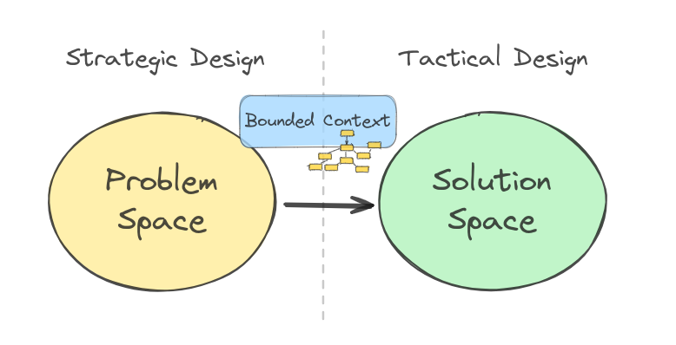

Slide 62
입력
연산
출력
변화
영향
Tech.
관심사
Biz.
관심사
Tech.
관심사
변화
영향
Isolation
Known
입력
메시지
출력
메시지
Known
Adapter Layer
Mediator
Adapter Layer
Tech.
Tech.
Known
입출력 인터페이스
구현
Unknown
출력 인터페이스
사용
Unknown
Application Layer
Adapter Layer
Biz. 흐름
Tech.
Domain Layer
Biz. 단위

Slide 63
입력
연산
출력
변화
영향
Tech.
관심사
Biz.
관심사
Tech.
관심사
변화
영향
Isolation
Known
입력
메시지
출력
메시지
Known
Adapter Layer
Mediator
Adapter Layer
Tech.
Tech.
Known
입출력 인터페이스
구현
Unknown
출력 인터페이스
사용
Unknown
Decorator
Application Layer
Adapter Layer
Biz. 흐름
Tech.
Domain Layer
Biz. 단위

Slide 64
INPUT
OPERATION
OUTPUT
Tech.
CONCERN
Biz.
CONCERN
Tech.
CONCERN
Dependency
Isolation
Dependency
Known
Output
Message
Known
Command Input Message
Adapter Layer
Mediator
Adapter Layer
Query Input Message
Tech.
Tech.
Known
Input/Output Interface
Implementation
Unknown
Output Interface
Use
Unknown
Application Layer
Adapter Layer
Biz. Flow
Tech.
Domain Layer
Biz. Unit

Slide 65
INPUT
OPERATION
OUTPUT
Tech.
CONCERN
Biz.
CONCERN
Tech.
CONCERN
Known
Known
Adapter Layer
Application Layer
Adapter Layer
Tech.
Biz. Flow
Tech.
Unknown
Adapter Layer
Tech.
Domain Layer
Biz. Unit

Slide 66
INPUT
OPERATION
OUTPUT
Tech.
CONCERN
Biz.
CONCERN
Tech.
CONCERN
Dependency
Known
Known
Adapter Layer
Application Layer
Adapter Layer
Tech.
Biz. Flow
Tech.
Unknown
Adapter Layer
Tech.
Domain Layer
Biz. Unit

Slide 67
INPUT
OPERATION
OUTPUT
Tech.
CONCERN
Biz.
CONCERN
Tech.
CONCERN
Dependency
Isolation
Dependency
Known
Input
Interface
Implementation
Output
Interface
Use
Known
Adapter Layer
Application Layer
Adapter Layer
Tech.
Biz. Flow
Tech.
Unknown
Adapter Layer
Tech.
Domain Layer
Biz. Unit

Slide 68
INPUT
OPERATION
OUTPUT
Tech.
CONCERN
Biz.
CONCERN
Tech.
CONCERN
Known
Known
Adapter Layer
Application Layer
Adapter Layer
Tech.
Biz. Flow
Tech.
Domain Layer
Biz. Unit

Slide 69
INPUT
OPERATION
OUTPUT
Tech.
CONCERN
Biz.
CONCERN
Tech.
CONCERN
Known
Known
Adapter Layer
Application Layer
Adapter Layer
Tech.
Biz. Flow
Tech.
Unknown
Unknown
Adapter Layer
Adapter Layer
Tech.
Tech.
Domain Layer
Biz. Unit

Slide 70
INPUT
OPERATION
OUTPUT
Tech.
CONCERN
Biz.
CONCERN
Tech.
CONCERN
Dependency
Known
Known
Adapter Layer
Application Layer
Adapter Layer
Tech.
Biz. Flow
Tech.
Unknown
Unknown
Adapter Layer
Adapter Layer
Tech.
Tech.
Domain Layer
Biz. Unit

Slide 71
INPUT
OPERATION
OUTPUT
Tech.
CONCERN
Biz.
CONCERN
Tech.
CONCERN
Dependency
Isolation
Dependency
Known
Input
Interface
Implementation
Output
Interface
Use
Known
Adapter Layer
Application Layer
Adapter Layer
Tech.
Biz. Flow
Tech.
Unknown
Unknown
Adapter Layer
Adapter Layer
Tech.
Tech.
Domain Layer
Biz. Unit

Slide 72
Deterministic
Integration Test
Deterministic
Unit Tests
Non-deterministic
Non-deterministic
Tech.
CONCERN
Biz.
CONCERN
Tech.
CONCERN
Dependency
Isolation
Dependency
Known
Input
Interface
Implementation
Output
Interface
Use
Known
Adapter Layer
Application Layer
Adapter Layer
Tech.
Biz. Flow
Tech.
Unknown
Adapter Layer
Tech.
Domain Layer
Biz. Unit

Slide 73
INPUT
OPERATION
OUTPUT
Tech.
CONCERN
Biz.
CONCERN
Tech.
CONCERN
Dependency
Isolation
Dependency
Known
Input
Message
Output
Message
Known
Adapter Layer
Mediator
Adapter Layer
Tech.
Tech.
Known
Input/Output Interface
Implementation
Unknown
Output Interface
Use
Unknown
Application Layer
Adapter Layer
Biz. Flow
Tech.
Domain Layer
Biz. Unit

Slide 74
INPUT
OPERATION
OUTPUT
Tech.
CONCERN
Biz.
CONCERN
Tech.
CONCERN
Dependency
Isolation
Dependency
Known
Input
Message
Output
Message
Known
Adapter Layer
Mediator
Adapter Layer
Tech.
Tech.
Known
Input/Output Interface
Implementation
Unknown
Output Interface
Use
Unknown
Decorator
Application Layer
Adapter Layer
Biz. Flow
Tech.
Domain Layer
Biz. Unit

Slide 75
INPUT
OPERATION
OUTPUT
Tech.
CONCERN
Biz.
CONCERN
Tech.
CONCERN
Dependency
Isolation
Dependency
Known
Output
Message
Known
Command Input Message
Adapter Layer
Mediator
Adapter Layer
Query Input Message
Tech.
Tech.
Known
Input/Output Interface
Implementation
Unknown
Output Interface
Use
Unknown
Application Layer
Adapter Layer
Biz. Flow
Tech.
Domain Layer
Biz. Unit

Slide 76
Known
Known
Command Input Message
Adapter Layer
Output Message
Adapter Layer
Query Input Message
Mediator
Tech.
Tech.
Known
Input & Output Interface
Implementation
Unknown
Unknown
Adapter Layer
Application Layer
Adapter Layer
Tech.
Biz. Flow
Tech.
Unknown
Input Interface
Use
Unknown
Output Interface
Use
Domain Layer
Biz. Unit

Slide 77
INPUT
OPERATION
OUTPUT
Tech.
CONCERN
Biz.
CONCERN
Tech.
CONCERN
Dependency
Isolation
Dependency
Known
Known
Command Input Message
Adapter Layer
Output Message
Adapter Layer
Query Input Message
Mediator
Tech.
Tech.
Known
Input & Output Interface
Implementation
Unknown
Unknown
Adapter Layer
Application Layer
Adapter Layer
Tech.
Biz. Flow
Tech.
Unknown
Input Interface
Use
Unknown
Output Interface
Use
Domain Layer
Biz. Unit

Slide 78
Known
Known
Command Input Message
Adapter Layer
Output Message
Adapter Layer
Query Input Message
Mediator
Tech.
Tech.
Known
Input & Output Interface
Implementation
Unknown
Unknown
Adapter Layer
Application Layer
Adapter Layer
Tech.
Biz. Flow
Tech.
Unknown
Input Interface
Use
Unknown
Output Interface
Use
Domain Layer
Biz. Unit

Slide 79
INPUT
OPERATION
OUTPUT
Tech.
CONCERN
Biz.
CONCERN
Tech.
CONCERN
Dependency
Isolation
Dependency
Known
Known
Command Input Message
Adapter Layer
Output Message
Adapter Layer
Query Input Message
Mediator
Tech.
Tech.
Known
Input & Output Interface
Implementation
Unknown
Unknown
Adapter Layer
Application Layer
Adapter Layer
Tech.
Biz. Flow
Tech.
Unknown
Input Interface
Use
Unknown
Output Interface
Use
Domain Layer
Biz. Unit

