Slide 1
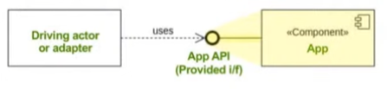

Adapter Layer
Application Layer
(Use Case)
Adapter Layer
Structured Error
ErrorCodeExpected
ErrorCodeExceptional
ManyErrors
Observability Pipeline
Dependency Registration
CQRS
ICommandRequest<TInput>, ICommandUsecase<TInput, TOutput>
IQueryRequest<TInput>, IQueryUsecase<TInput, TOutput>
IFinResponse<T>
Observability CQRS Pipeline
FinT<IO, T> LINQ
IAdatper
Observability Source Generator
FinT<IO, T>
Fin<T>
Validation<Error, T>
Domain
Domain Layer
(Aggregate Root)

Slide 2
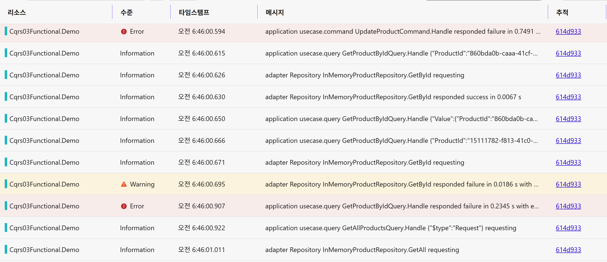
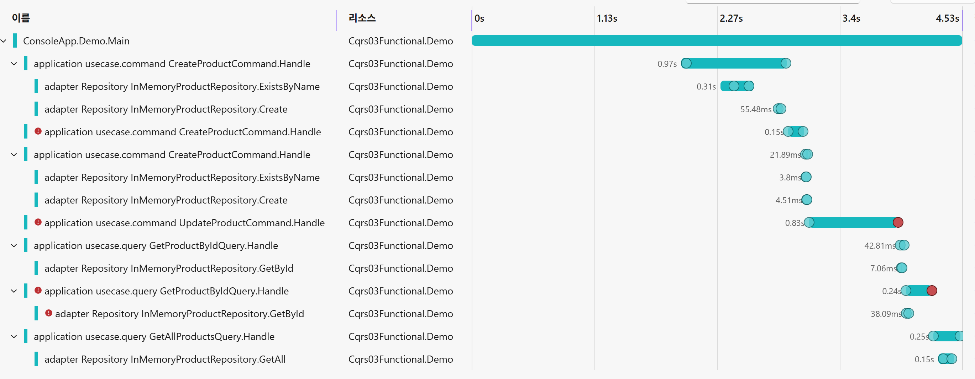
application usecase.query
{Layer} {CQRS}

