Slide 1
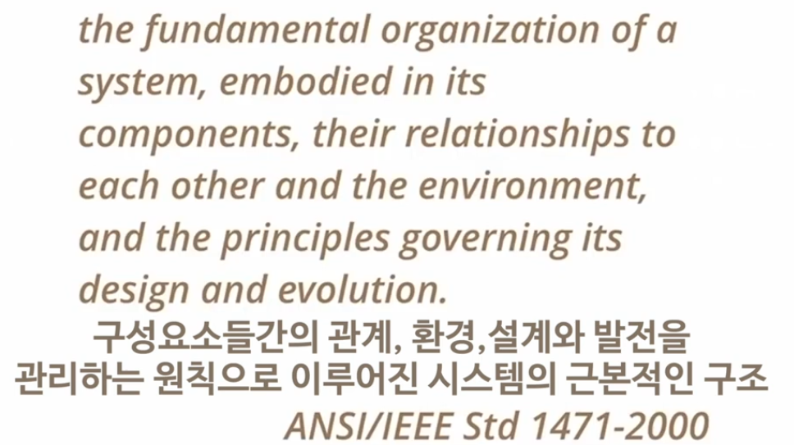
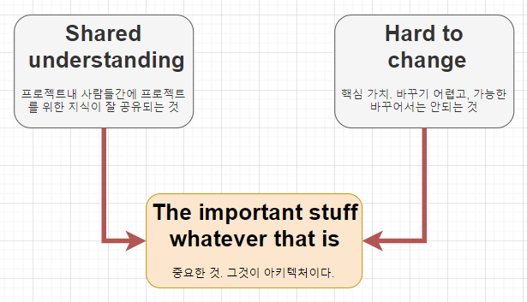
Vs.

Slide 2
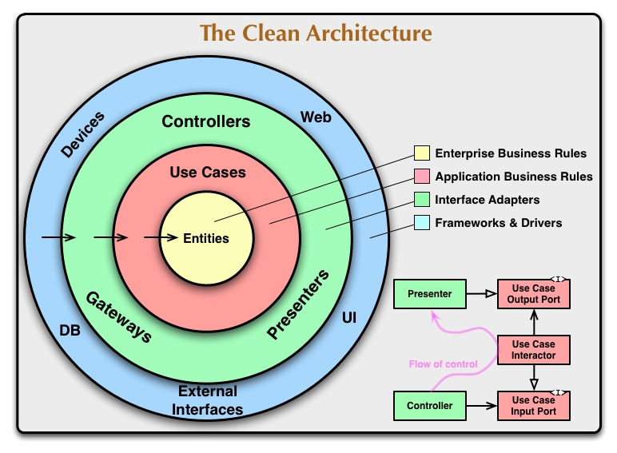
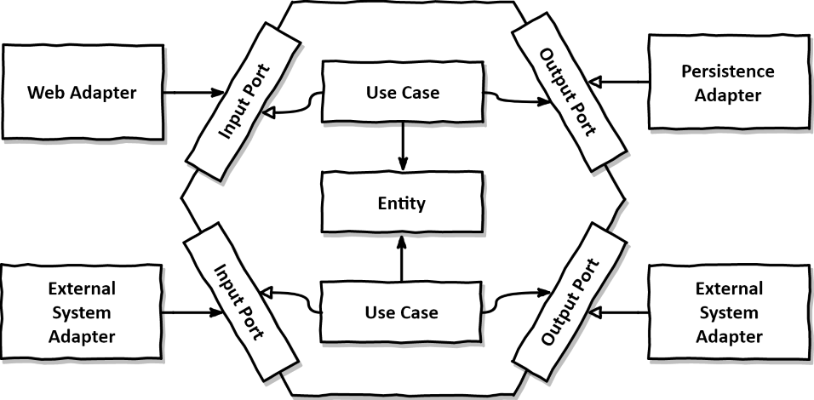
Layers
Adapter
Application
Domain

Slide 3
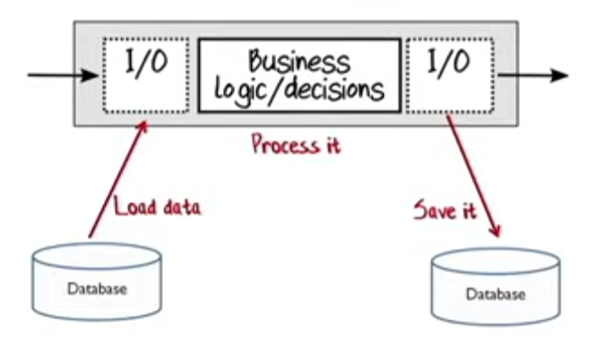
Adapter Layer
Application Layer
Adapter Layer
Input
Request
Process
Output
Response

Slide 4
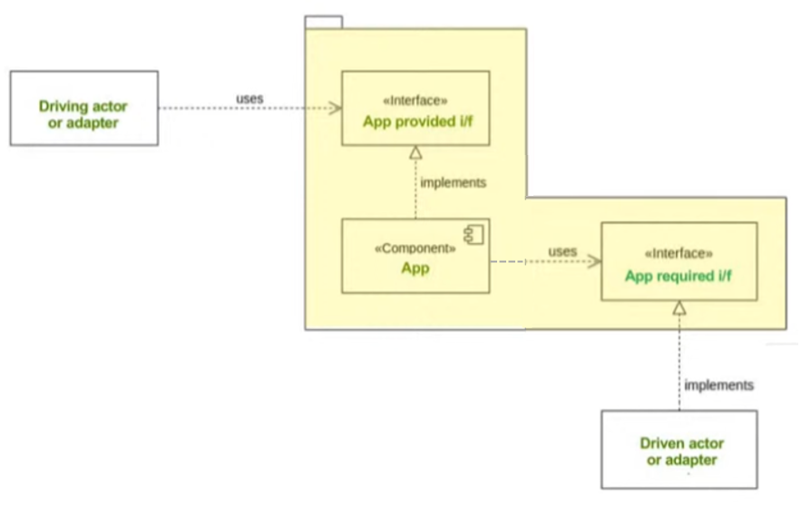
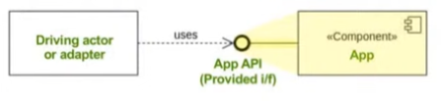

Interface

Slide 5
Input
Request
Process
Output
Response
Adapter Layer
Application Layer
Adapter Layer

Slide 6
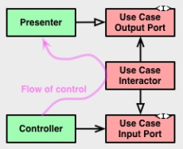
Vs.

Slide 8
Input
Request
Process
Output
Response
Adapter Layer
Application Layer
Adapter Layer
CQRS-based Mediator Pattern
IRequest/IResponse
- ICommandRequest
- IQueryRequest
Strategy Pattern
IAdatper
Result Pattern
T/Error
Functional
IFinT<IO, T>
Functional
IFin<T>
Domain
Domain Layer

Slide 9
Adapter Layer
Application Layer
Adapter Layer
CQRS
ICommandRequest<TInput>, ICommandUsecase<TInput, TOutput>
IQueryRequest<TInput>, IQueryUsecase<TInput, TOutput>
IFinResponse<T>
Observability CQRS Pipeline
FinT<IO, T> LINQ
Structured Error
Observability Pipeline
Dependency Registration
IAdatper
Observability Source Generator
FinT<IO, T>
Fin<T>
Validation<Error, T>
Domain
Domain Layer

Slide 10
Observability
No implementation required: provided by the package
implementation required
Domain
No implementation required: Functional
Domain Layer

Slide 11
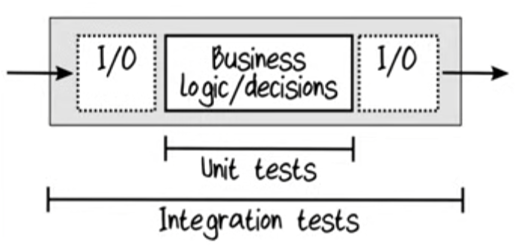
Integration Tests
Unit Tests
Domain

Slide 13
