Slide 1
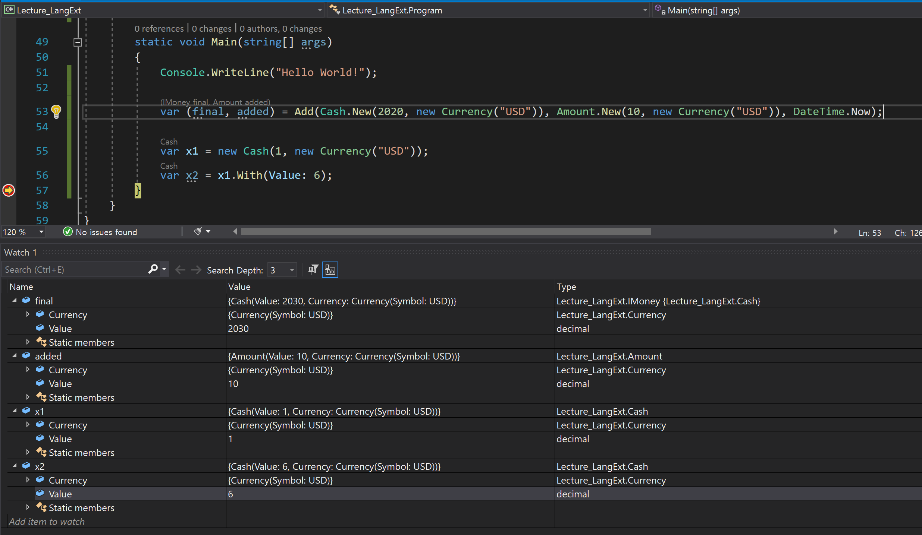
Immutable
Immutable

