Slide 1
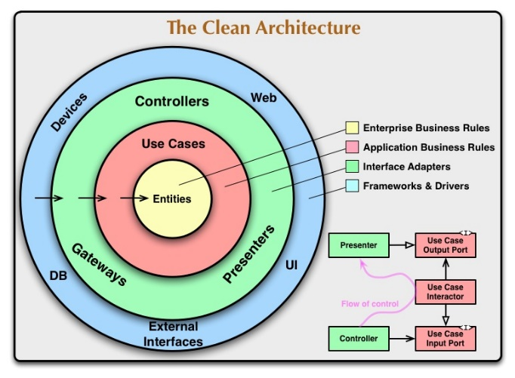
Architectural Principles
Explicit Dependency
Dependency inversion
Business
Voice of Customer
Storage
Ex. DB
Dependency
Single
Responsibility
Single
Responsibility
Persistence ignorance
Dependencies should be pointed to abstractions.
Abstraction
Encapsulation
Isolation
Separation of concerns
Dependency
Bounded Context
Class
Module
Process
…
Single responsibility

