Slide 1
External World
Vs.
Internal World
Subset
Superset
Invalid
Valid and Invalid
Subset
Validation
Valid
Subset
Valid
Always-valid domain model

Slide 2
External World
Vs.
Internal World
Subset
Superset
Invalid
Valid and Invalid
Subset
Validation
Valid
Subset
Valid
Always-valid domain model
edges.Length == 3
Invariants
= Validation Rules
a condition that your domain model must uphold at all times
Invariants

Slide 3
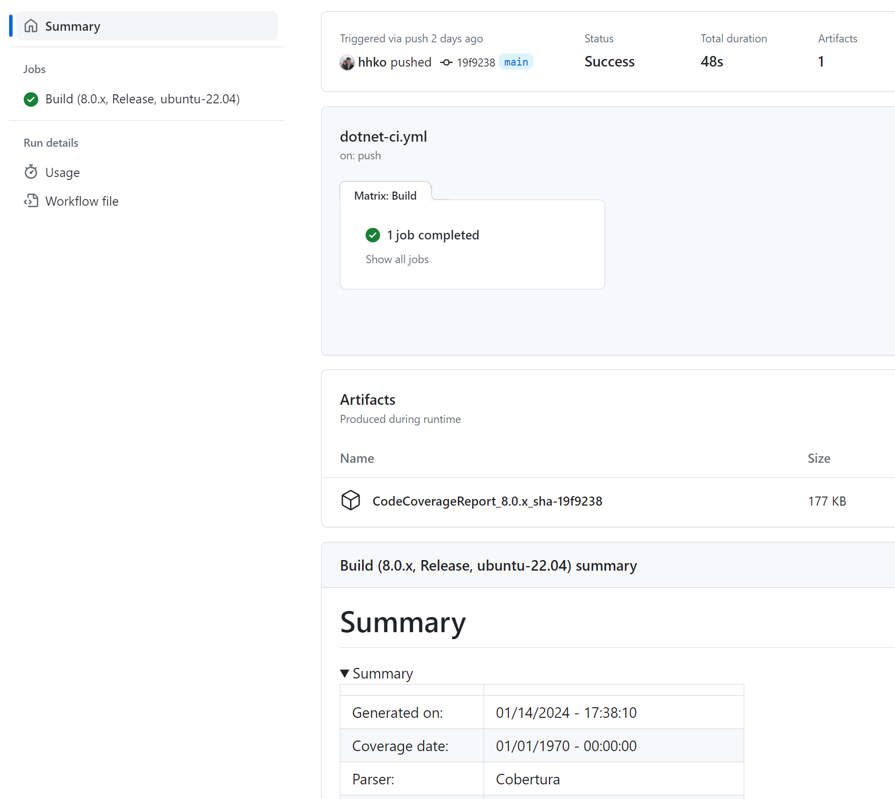
matrix
Job 이름
actions/upload-artifact@v3
$GITHUB_STEP_SUMMARY

