Slide 1
Part 1.
https://www.youtube.com/watch?v=fhM0V2N1GpY

Slide 2
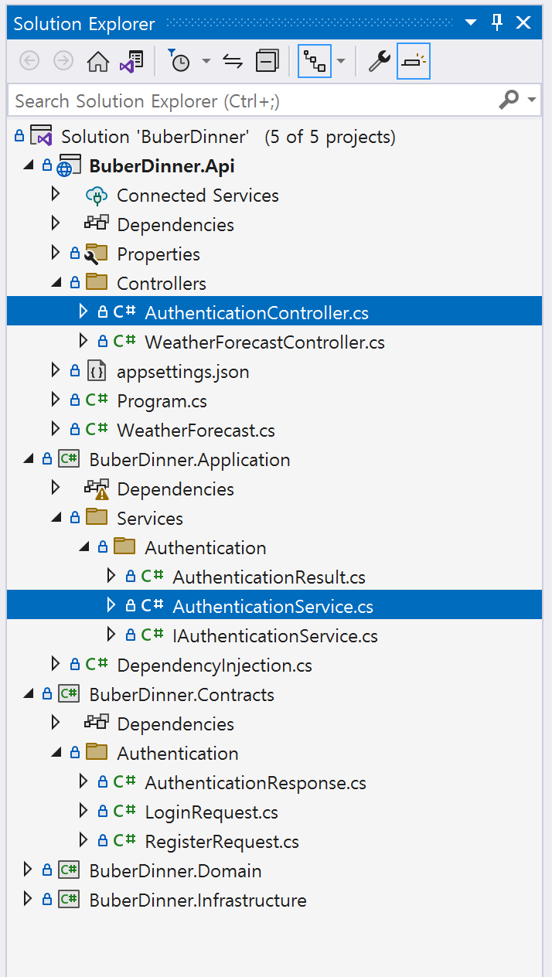
Presentation Layer API
Application Layer API
Presentation Layer API 입/출력 데이터 타입

