Slide 1
Part 1.
https://www.youtube.com/watch?v=fhM0V2N1GpY

Slide 2
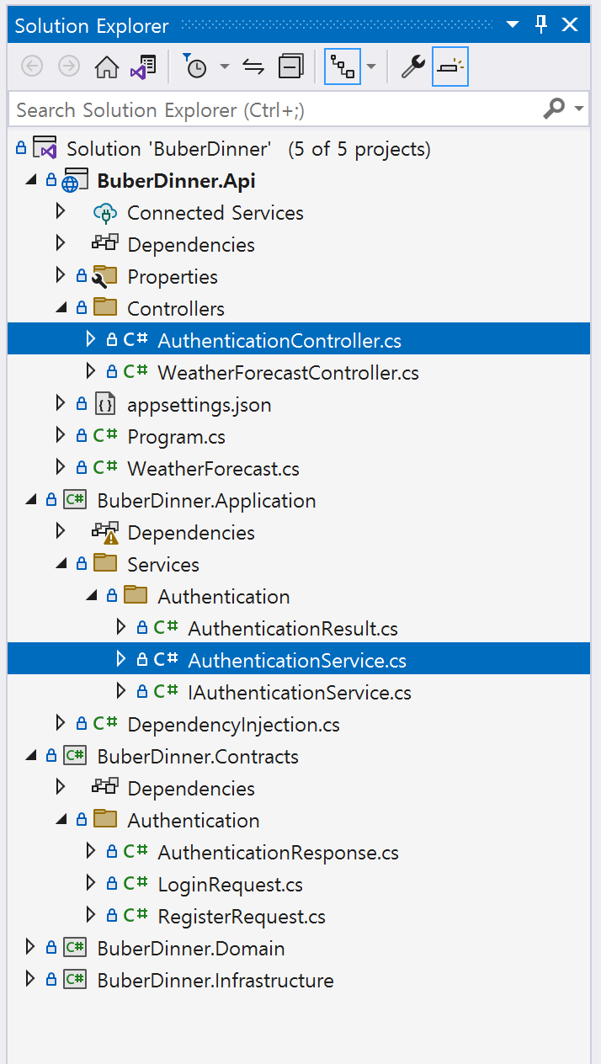
Presentation Layer API
Application Layer API
Presentation Layer API 입/출력 데이터 타입

Slide 3
Part 2.

Slide 4
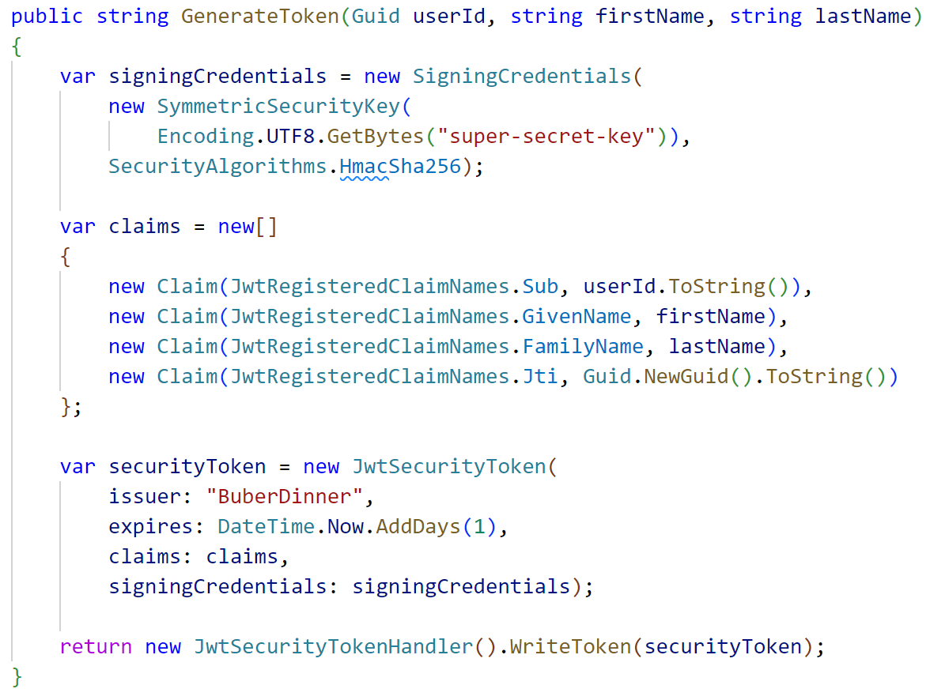
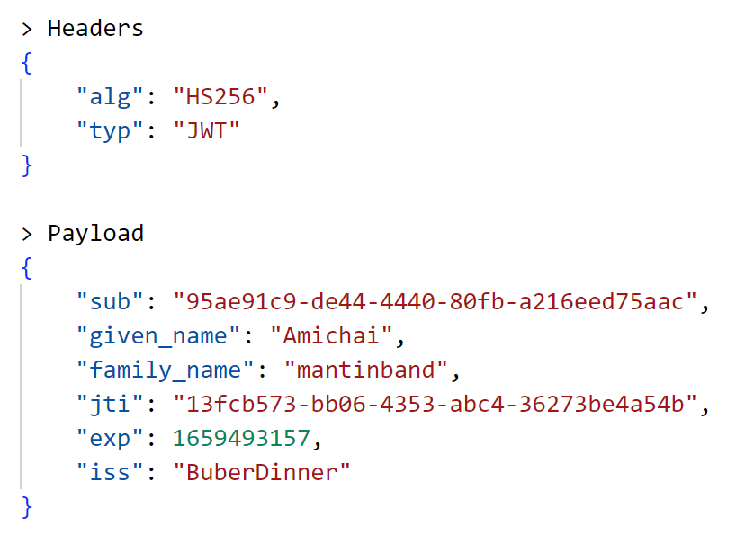
POST http://localhost:5024/auth/register
Content-Type: application/json
{
"firstName": "Amichai",
"lastName": "mantinband",
"email": "amichai@mantinband.com",
"password": "Amiko1232"
}

Slide 5
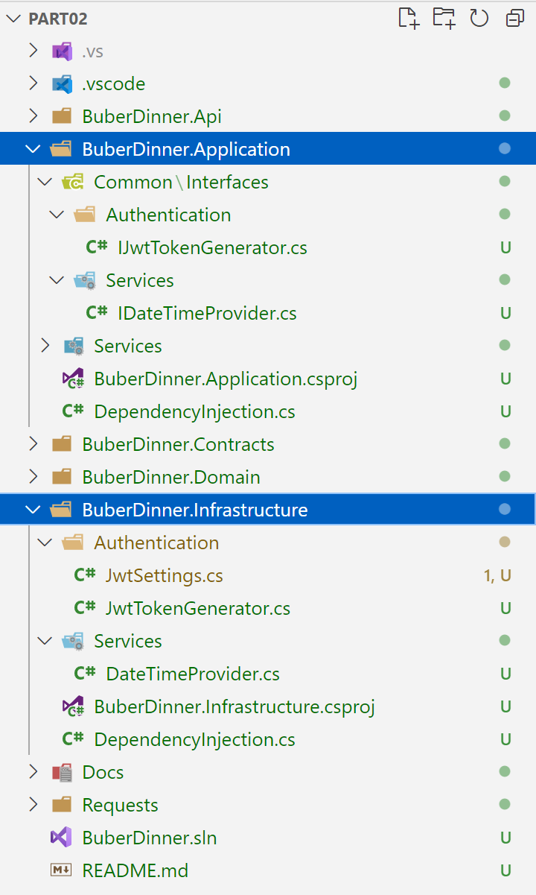
1. 인터페이스 정의
2. 인터페이스 사용
BuberDinner.Application.Common.Interfaces.Authentication
BuberDinner.Application.Common.Interfaces.Services
3. 인터페이스 구현
BuberDinner.Infrastructure.Authentication
BuberDinner.Infrastructure.Services

