Slide 1

‹#›

Slide 2
AQM – Gaps August 2017 AQM Seminar
‹#›

Slide 3
Agenda
1. AQM Program Introduction (Dustin) [20 min] 2. Natural Language Processing (NLP) (Haihan) [25 min]
2a. Introduction to Elements of NLP
2b. TDF-IF Clustering
2c. Word Vectorization and Embedding with Word2vec
2d. Word Mover’s Distance and Document Search application
3. Code Demo (Haihan) [10 min]
4. Q&A [10 min]
‹#›

Slide 4
What is AQM?
AQM is a highly quantitative, rigorous 10-month data science training program designed for graduates, postgraduates and experienced professionals interested in making the transition to the lucrative field of Data Science.
4 months of training in all areas of Data Science expected in the field from cloud computing, data storage and processing to computational statistics, machine learning, and visualization
6 months focused on a real-world project for a large firm
Supported by the Faculty of Operations Research at UBC
Led and taught by experienced graduates and professionals
A network of students and industry professionals advancing the data science presence in Vancouver

Slide 5
Why AQM?
Immediately immersed into handling complex, real-world data while undergoing training in all aspects of Data Science
Collaborative environment of graduates, post graduates and professionals with diverse backgrounds working together to solve problems
Unconstrained curriculum; free to explore bleeding edge topics
Hands-on workshops with instructors in relevant fields
Personalized letter of recommendation from AQM and a leading firm
Career opportunities with some of Canada’s largest companies

Slide 6

Topics Covered
Data Processing
Machine Learning
Computational Statistics
Visualization

Slide 7





Program Structure
Weekly 2 hour meetings @ UBC. Bi-weekly mini-projects. Online collaboration with Github and Slack.
September - December: The AQM candidates delve into exploratory data analysis, statistical computing, data pipelines and machine learning with real, complex data sets to explain and model real-world phenomena. During this stage, the value of data management and the ETL process will be enforced.
January - May: The AQM team begins the well anticipated project upon a meeting with the partnered firm of that particular year. More advanced topics related to machine learning and probability are introduced relating to the the given project. Students spend this period developing a methodology to best serve the purpose of the project. At the end of the project, the team presents its findings at the company’s headquarters and receives feedback. If accepted, the method with be deployed within the company and further development may be undertaken.

Slide 8

2017 Capstone Project
Working with BestBuy Canada’s Service Analytics team to analyze social media content that will add insights to buyer behavior and sentiment
A four month project starting approximately in January focusing on text mining and Natural Language Processing (NLP)
3GB of social media data and counting with a soon-to-be deployed “listener” retrieving up to a 1GB a day.

Slide 9

2017 Capstone Project
Working with TransLink’s forecasting department to analyse 5GB of bus data
A four month project starting approximately in January focusing on exploratory and modelling projects addressing the core problem posed by TransLink
Learning additional theory, reading research papers and exploring tools necessary to answer
Final presentations at TransLink headquarters followed by research-grade papers

Slide 10
Building a Community
Have held Google Hangouts with Hadley Wickham (Chief Scientist, R Studio) and Peter Norvig (Director of Research, Google)
Going to be holding panel talks with speakers from BCCDC, PHEMI etc
Holding individual speaker series just for AQM team
Hands-on learning sessions with firms
Hackathons

Slide 11
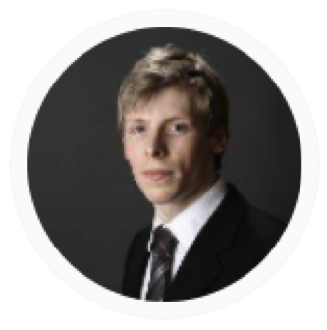
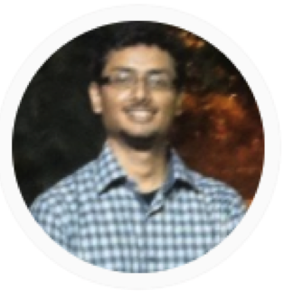
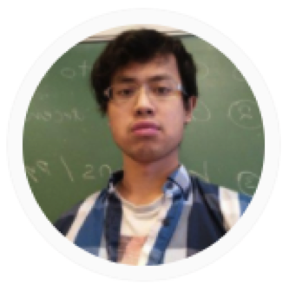
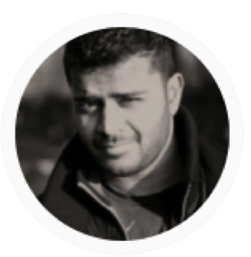

Leadership Team
Dustin
MSc. Statistics, UBC
Sanjith
PhD. Operations Research, UBC
Haihan
BASc. Electrical Engineering, UBC
Dharu
BCom. Operations Research, UBC
Mirko
PhD. Theoretical Nuclear Physics, UBC

Slide 12
Program Investment
$700 CAD
What does this pay for?
Supporting Teaching Assistants who will be responsible for running lectures, marking assignments, evaluating students and coordinating the capstone project
Paying for a variety of third-party software licenses used for large scale computing
Holding panel talks and hosting industry speakers
Scaling AQM into the best data science program
What do I get?
A strong skill-set in data science (data exploration, data pipelines, large scale ML development, algorithm deployment)
An extensive portfolio on GitHub
A certificate of completion from AQM signed by the managers and faculty program sponsor
A letter of recommendation outlining the accomplishments on the project from the firm
Possible career opportunities

Slide 13
How to Apply
Visit aqm.io to get a better idea of the program
Navigate to the Fees & Registration section and fill out your details + attach your resume and CV in one file
Wait for an email from us outlining the interview process
Resume
Project
Interview

Slide 14
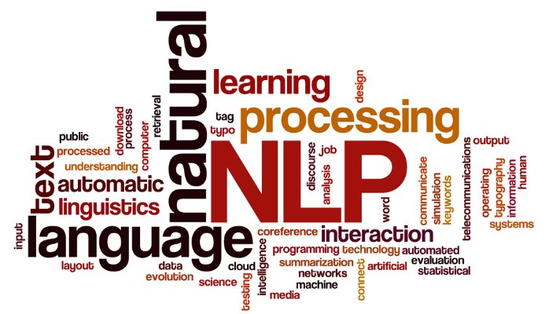
Introduction to Elements of NLP
‹#›

Slide 15
Introduction to Elements of NLP
Natural Language Processing (NLP):
1. Interaction between human (natural) language and computing machines
2. Models and algorithms for representing and processing natural language
Semantics, Syntax, Discourse, Speech
NLP historically used hand-programmed rules, now Machine Learning and Probabilistic Models
Applications of NLP include:
Sentiment Analysis (Twitter, Product reviews, Feedback forms)
Natural language understanding/speech recognition (Siri, Cortana)
Machine Translation (Google Translate)
Document search (Word Mover’s Distance, TDF-IF)
Visualization (Word clouds, Word2vec Distance/t-SNE)
Plagiarism Detection
‹#›

Slide 16




Introduction to Elements of NLP
Python 3 has many excellent libraries for NLP such as NLTK and Gensim
More so, Python has both general purpose and Deep-Learning specific packages such as Scikit-Learn and Keras/Tensorflow respectively to easily connect NLP to shallow/deep machine learning and visualizations
‹#›

Slide 17
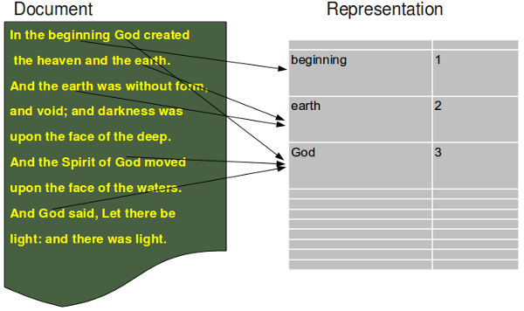
Introduction to Elements of NLP
Bag of Words (BoW) model:
A multiset (bag) of words from a phrase, sentence or document
Starting point for classification (Neural Net, Bayesian), Clustering and Word Mover’s Distance
Simple and fast but ignores sequence correlated information in word sequences
Terminology:
Term: a single word
Document: a collection
of terms
Corpus: a collection of
documents
‹#›

Slide 18
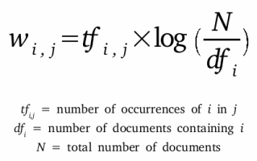
TF-IDF Clustering
Frequencies of words in documents give valuable information for inferring content or comparing similarity
Count Frequency and Term Frequency – Inverse Document Frequency (TF-IDF)
TF-IDF is a measure of the relative ‘importance’ of a term
It balances the frequency of occurrence of a term in a document and it’s specificity or rareness in a corpus
‹#›

Slide 19
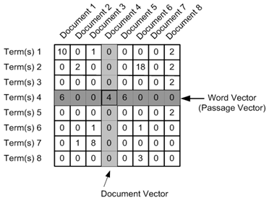
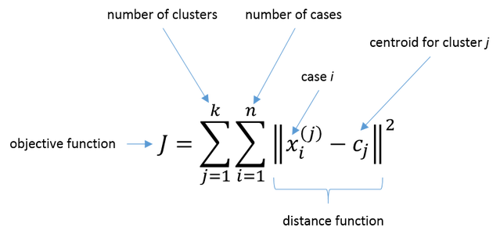
TF-IDF Clustering
Applications of TDF-IF include document searching and clustering
We can apply a classic unsupervised ML technique called K-Means clustering using TF–IDF
K–means assigns K random centroids and updates the centroids iteratively to have minimal Within Cluster Sum of Squares (WCSS)
Each document is converted to a BoW and vectorized into a TF-IDF vector and the vectors are compared using a metric (usually Cosine distance)
‹#›

Slide 20
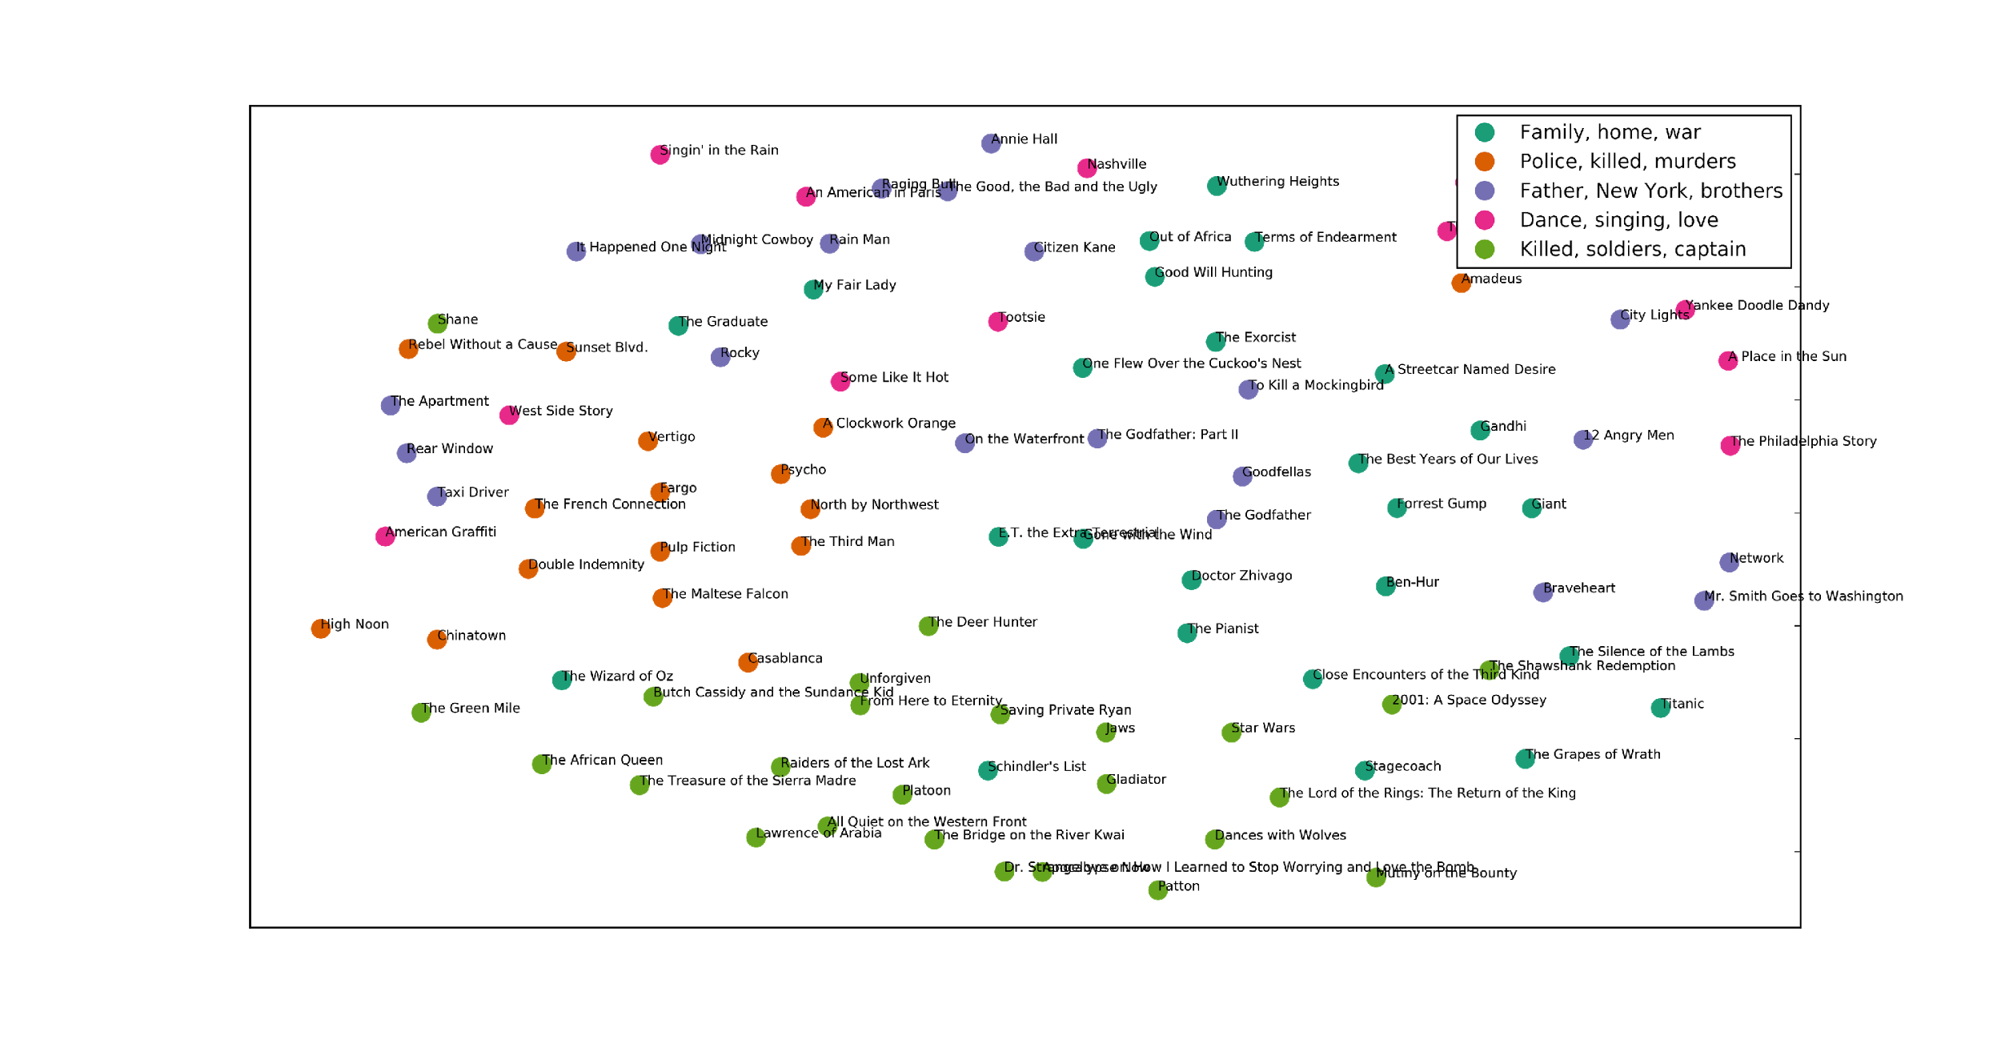
TF-IDF Clustering
Code Demo. [cluster_analysis.ipynb]
Source: [https://github.com/brandomr/document_cluster/blob/master/cluster_analysis.ipynb]
‹#›

Slide 21
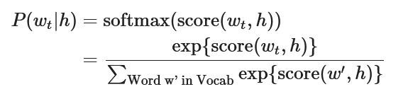
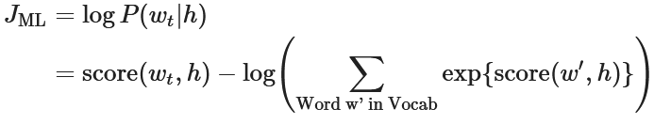
Word vectorization and embedding with Word2vec
Words have semantic meaning, but it's hard to assign without regard to context of other words
Word2vec (Mikolov et al.) maps a word or token to a real vector of dim n
Probabilistic language model: Maximum Likelihood Estimation (MLE) to maximize probability of a word w_{t} given its adjacent words h in sentence or document
Word2vec uses a variation of this principle and operates unsupervised
‹#›

Slide 22
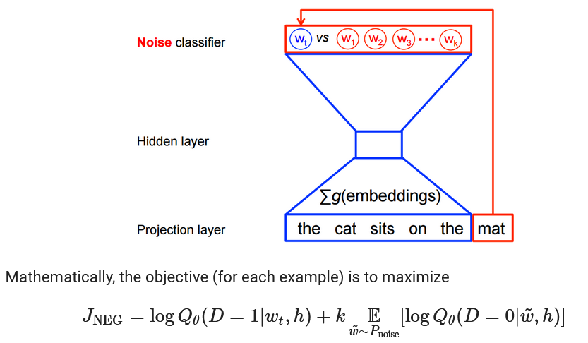
Word vectorization and embedding with Word2vec
The Word2vec model is a shallow, 2-layer Neural Net and can be trained a few ways, Skip-gram with negative sampling is one
Skip-gram inverts contexts and targets, and tries to predict each context word from its target word
‹#›

Slide 23
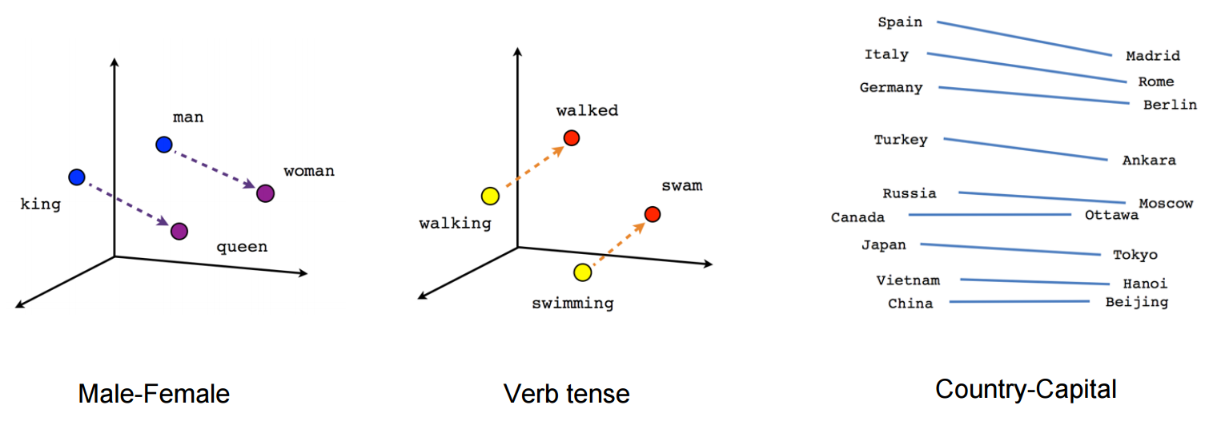
Word vectorization and embedding with Word2vec
Once the training is complete, Word2vec learns the contexts of individual words with relation to other words. The neural net itself returns a real vector of dim n for a word or token
The semantic distance between words is defined as the Euclidean distance between each word vector
The embeddings produced by Word2vec can be visualized using the t-SNE dimensionality reduction technique
‹#›

Slide 24
Word vectorization and embedding with Word2vec
In practice Data Scientists can use a pretrained Word2vec dictionary (native Python type) that contains the mapping from single words to n-dim real vectors
The Google News Word2vec dictionary is a good example: https://github.com/mmihaltz/word2vec-GoogleNews-vectors
Each word vector in the Google News dictionary is 300 dimensional, there are about 3 million words in the dictionary
Word2vec can be used as a preprocessor step for deep learning applications
‹#›

Slide 25
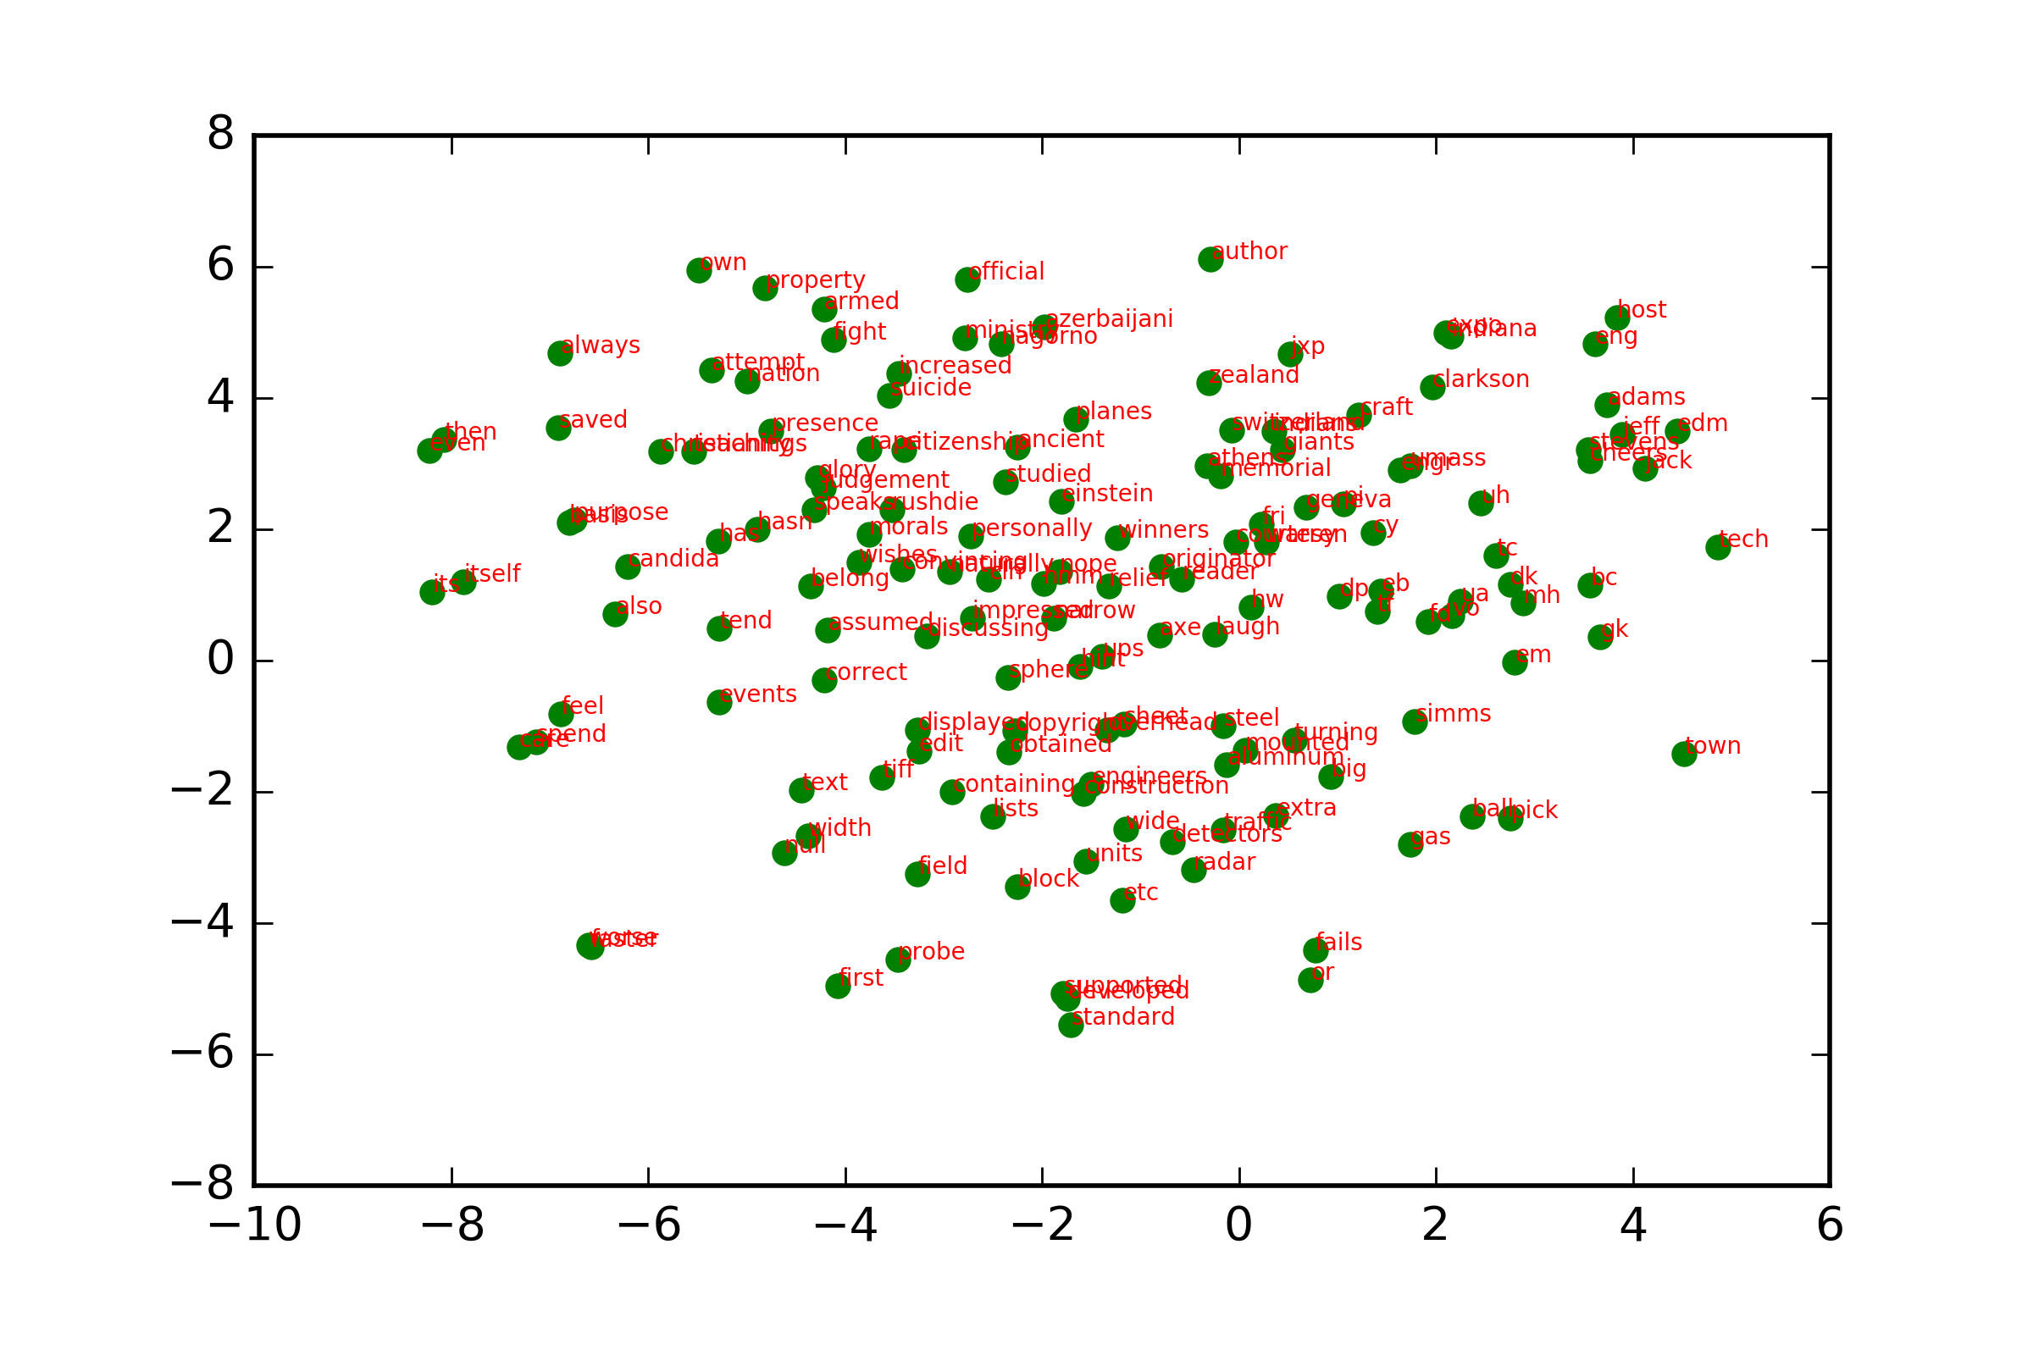
Word vectorization and embedding with Word2vec
Code Demo. [word2vec.ipynb]
‹#›

Slide 26
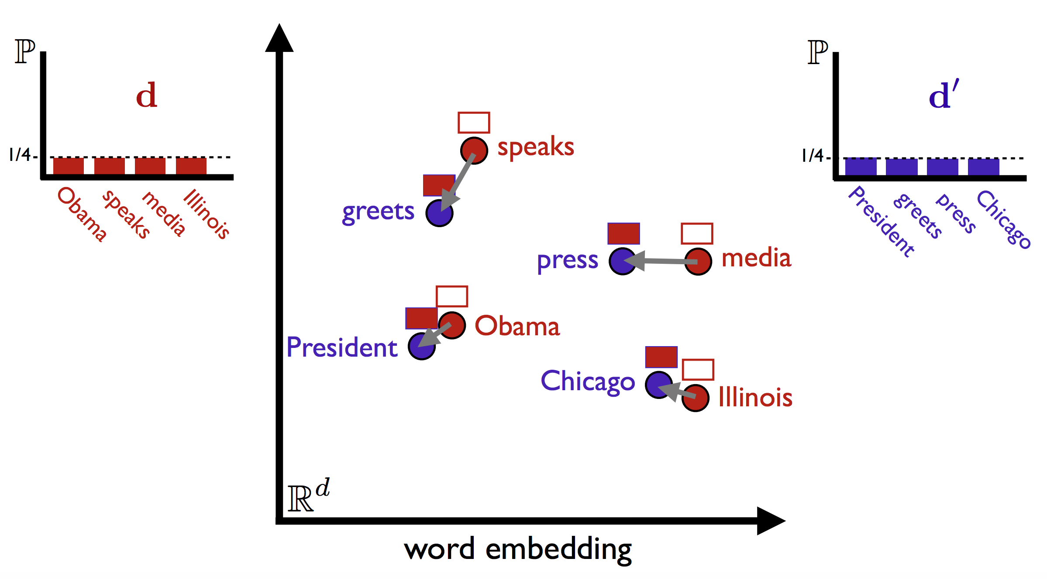
Word Mover’s Distance
The semantic distances between words can be generalized to the distance between collections of words (or documents, so to speak)
One way to accomplish this generalization is with the Word Mover’s Distance (WMD)
WMD is an extension of the Earth Mover’s Distance algorithm utilizing Word2vec
‹#›

Slide 27
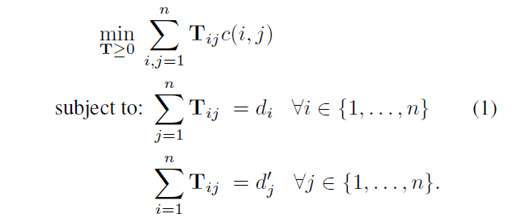
Word Mover’s Distance
WMD assigns a ‘mass’ to each word proportional to it’s word2vec magnitude and minimizes the aggregate mass-distance product of each document
For a detailed derivation the WMD model refer to http://proceedings.mlr.press/v37/kusnerb15.html
‹#›

Slide 28
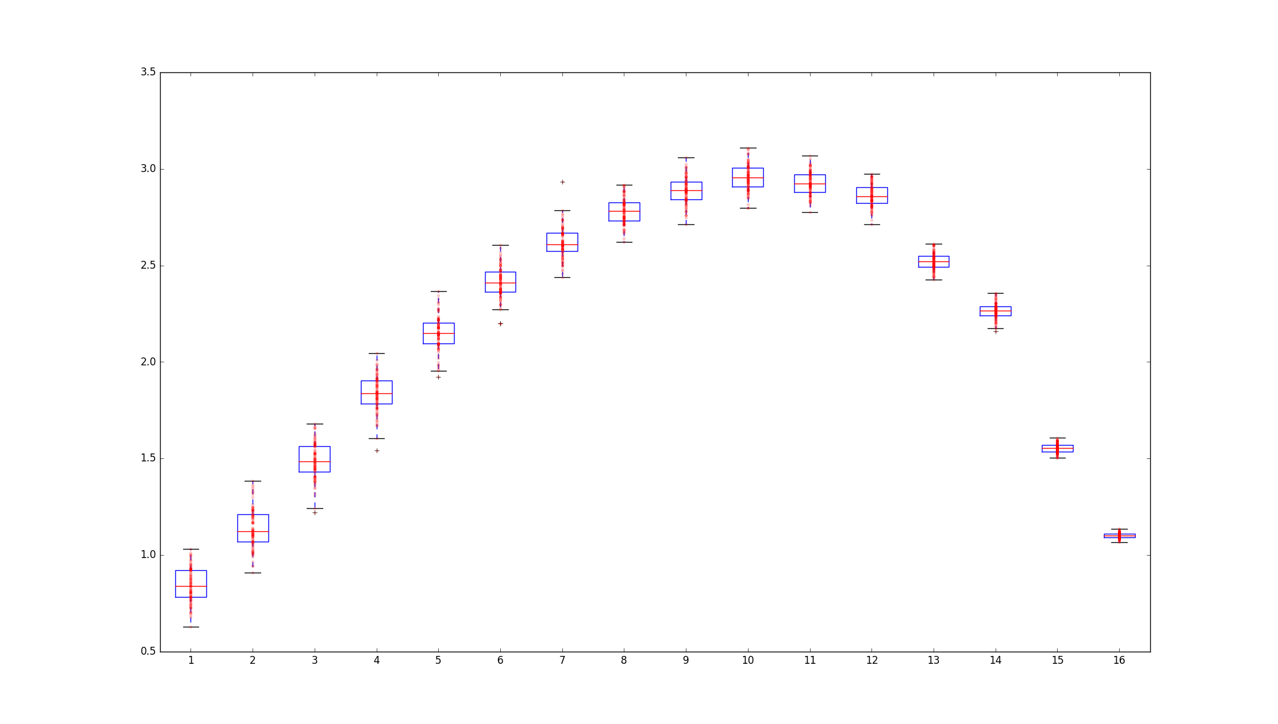
Word Mover’s Distance
Applications of WMD involve document search and clustering
‹#›

Slide 29
Word Mover’s Distance
Code Demo. [wmd.ipynb]
Source: [https://www.kernix.com/blog/similarity-measure-of-textual-documents_p12]
Original Snippet:
['manufacture', 'manufacturer', 'directory', 'directory', 'china', 'taiwan', 'products', 'manufacturers', 'directory-', 'taiwan', 'china', 'products', 'manufacturer', 'directory', 'exporter', 'directory', 'supplier', 'directory', 'suppliers']
Snippet match, WMD 0.603294929296
['allproducts', 'allproducts', 'com', 'manufacturers', 'directory', 'products', 'database', 'global', 'marketplace', 'manufacture', 'directory', 'exporters', 'importers', 'wholesalers', 'volume', 'buyers', 'suppliers', 'product', 'directory']
Snippet match, WMD 0.528627233402
['wand', 'wand', 'com', 'directory', 'suppliers', 'traders', 'products', 'wand', 'com', 'directory', 'suppliers', 'traders', 'providers', 'products', 'services', 'buyers', 'wand', 'com', 'source', 'commodities']
Snippet match, WMD 0.52601643645
['dfma', 'truecost', 'paper', 'true', 'cost', 'overseas', 'manufacture', 'product', 'design', 'costs', 'manufacturing', 'products', 'china', 'manufacturing', 'redesigned', 'product', 'china', 'save']
Snippet match, WMD 0.523237602248
['erealdeal', 'erealdeal', 'marketplace-', 'trade', 'export', 'import', 'directory', 'auction', 'international', 'business', 'trade', 'import', 'export', 'portal', 'consumers', 'companies', 'manufacturers', 'suppliers', 'products', 'export', 'import']
‹#›

Slide 30
Q&A
Question and Answer session

Slide 31
For Further Information
AQM Program website: www.aqm.io
Gensim’s Word2Vec functionality: https://radimrehurek.com/gensim/models/word2vec.html
NLTK website: http://www.nltk.org/
Short Article on the Word2vec model and training: https://www.tensorflow.org/tutorials/word2vec

Slide 32
‹#›

