Slide 1
Presenting to you ExerciseBuddy - your workout partner
Creators:
Harsha Hiremagalur
Narayan
Himanshu
Dagdi
Ikesh V

Slide 2
ExerciseBuddy is a ML powered Web Application which facilitates & performs necessary task similar to that of our Gym partner. Like, Helping us not to miss out rep count while doing workout session or probably assisting us in the exercise so that exercise is performed in the way it should be otherwise which may cause injury and having such a buddy is luck by chance.
Next few slides will take us through ExerciseBuddy ☺

Slide 3
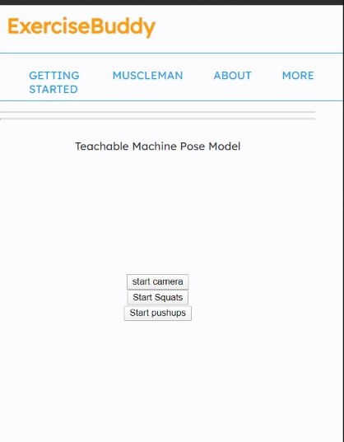
1. Homepage This is where a User lands as soon as ExerciseBuddy is accessed by the user.

Slide 4
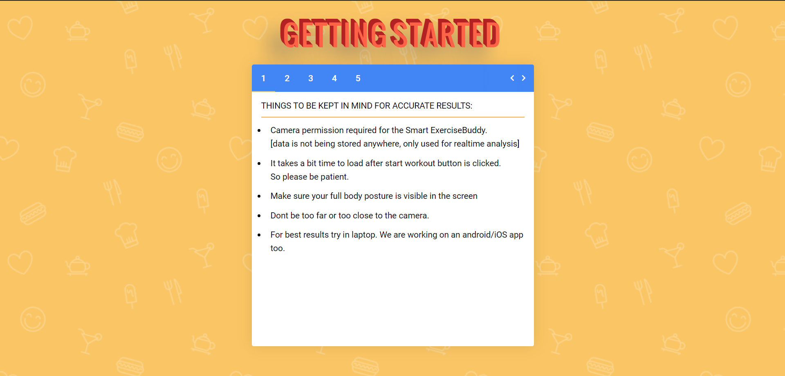
2.Getting Started Helps the new user with instructions on how one can use the app efficiently. It can be accessed by “GETTING STARTED” Tab on the homepage.

Slide 5
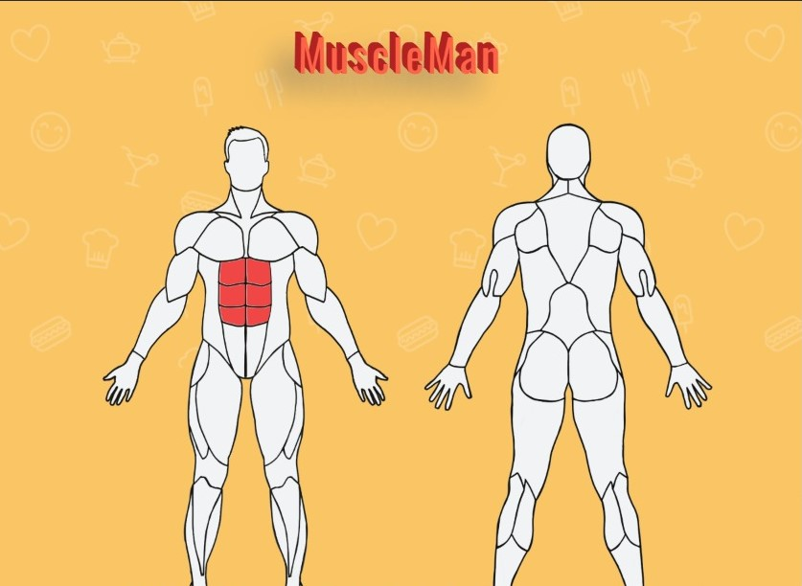
3.MuscleMan This helps the user to know and understand which muscle can be trained with what exercise. Just we need to click on the muscle. Simple. This can be excessed through “MUSCLEMAN” tab on the homepage. Note: We are redirecting to MuscleWiki for exercise details.

Slide 6
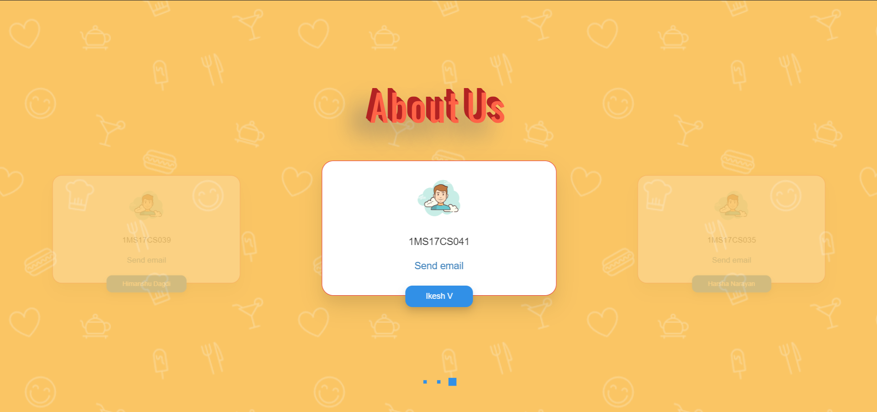
4.About Us As the name suggest, this gives some details of the creators of this app and can be accessed by “ABOUT US” tab on homepage.

Slide 7
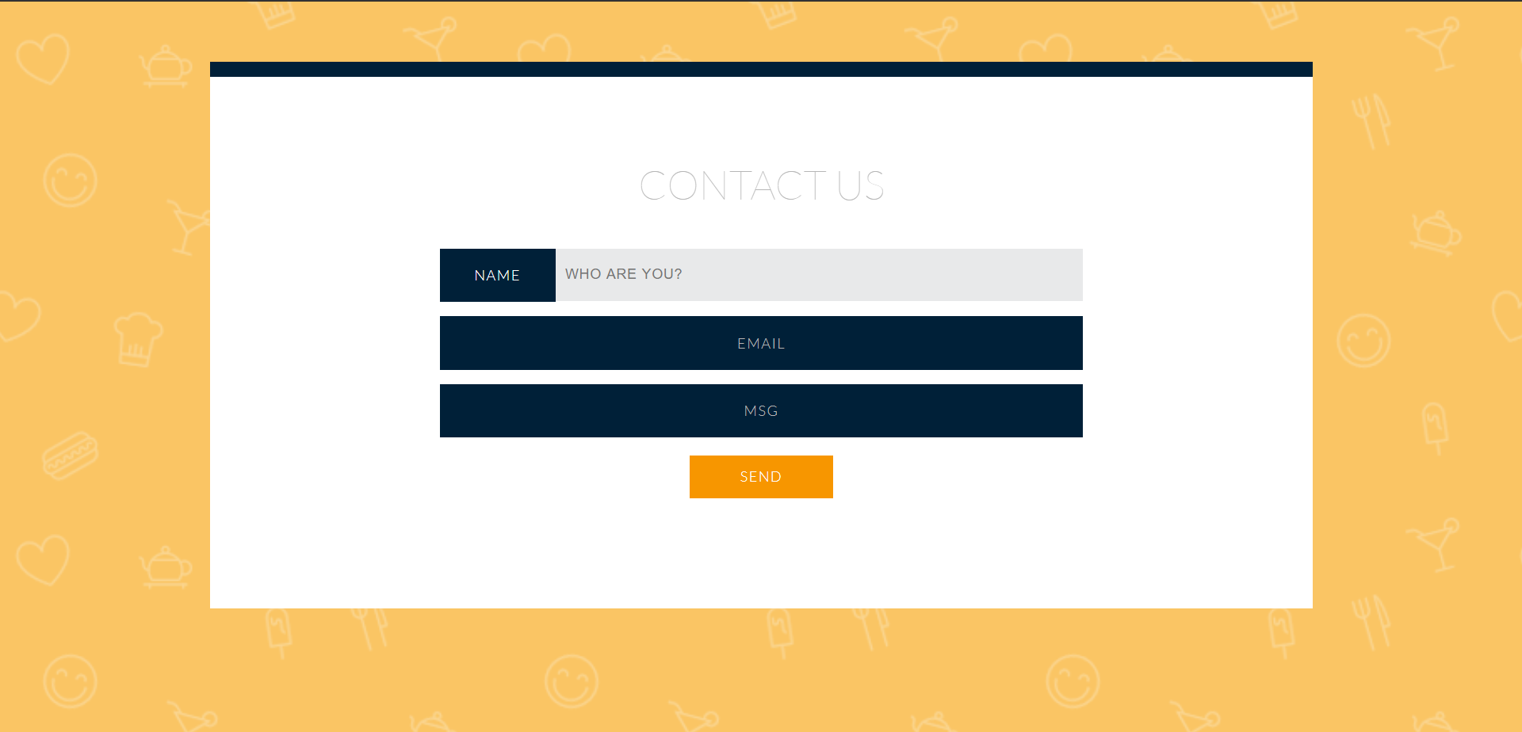
5.Contact Us This functionality can be used, If any user wants to send us feedback or want to seek any help with respect to the app. It can be accessed through “CONTACT US” on the homepage.

Slide 8
Thank you, ExerciseBuddy Team ☺
To have a quick round of workout session with your ExerciseBuddy, please help yourself and click the link below: https://dagdihiman.github.io/
Please Note: This app is the product of sincere effort put by the team within the time limit provided and we have given our best so that app comes out as a useful product. But still we understand that there is scope of modification which will be taken care.

