Slide 1
UMTS Handover Control
ZTE University

Slide 2
Content
UMTS Handover Overview
UMTS Intra-Frequency Handover Strategy
UMTS Inter-Frequency Handover Strategy
UMTS Inter-RAT Handover Policy
UMTS SRNS Relocation

Slide 3
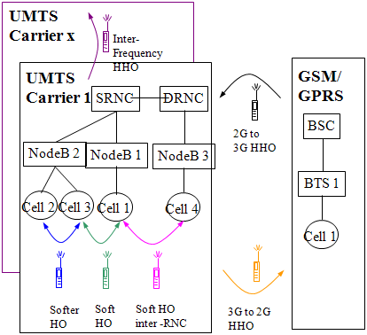
Handover Overview
Handover types:
  Soft handover
  Softer handover
  Hard handover
Handover technology:
  Intra-frequency handover
  Inter-frequency handover
  Inter-RAT handover
Handover steps:
  Measurement
  Handover decision
  Handover implementation

Slide 4
UMTS General Handover Steps
Measurement Control
  UTRAN demands the UE to start measurement through issuing a measurement control message.
Handover decision
  UTRAN makes the decision based on the measurement reports from UE. The implementation of handover decision is various for different vendors. It impacts on the system performance critically.
Handover execution
  UTRAN and UE execute different handover procedure according to the handover command.

Slide 5
Compressed Mode
Halving of Spreading Factor (SF)
  In one radio frame some timeslots can be specially assigned for inter-frequency/Inter-RAT measurement and some can be specially assigned for data transmission.
Higher Layer Scheduling
  The higher layer adjusts and controls the data transmission rate. The bandwidth remains unchanged.
 | Softer handover | Soft handover | Hard handover | Require compression or not
Intra-frequency | Y | Y | Y | N
Inter-frequency | N | N | Y | Y
Inter-RAT | N | N | Y | Y

Slide 6
Handover Flow
(A) RNC sends measurement control message to UE (Measurement Control)
Current carrier has good quality
(E) Quality
Decision
Other system has good quality
(B) UE starts measurement task with the parameters included in the message, and reports measurement results（Measurement Report）
Other carrier has good quality
(F) maintain the active set and monitored set
(G) Allocate resource in target cell, prepare to execute handover
(H) Allocate resource in target cell, prepare to execute handover
(C) RNC stores the measurement results according to frequencies and cells
(D) RNC Estimates the quality of each carrier (including intra-frequency and inter-frequency)
（I）If handover is required, RNC sends handover command with target cell to UE

Slide 7


Handover Flow
1.Measurement control
3.Measurement Report
5.Handover command
2.UE start measurement
4.RNC Handover Judgment
6.UE Handover Implement

Slide 8
Content
UMTS Handover Overview
UMTS Intra-Frequency Handover Strategy
UMTS Inter-Frequency Handover Strategy
UMTS Inter-RAT Handover Policy
UMTS SRNS Relocation

Slide 9
Intra-Frequency Handover
The intra-frequency handover can be triggered based on Ec/No or RSCP measurement through the parameter IntraMeasQuan.

Slide 10
Concepts Related to Handover
Active Set:
  A set of cells that have established radio links with a certain mobile station.
  User information is sent from all these cells.
Monitored Set:
  A set of cells that are not in the active set but are monitored according to the list of adjacent cells assigned by the UTRAN.
Detected Set:
  A set of cells that are neither in the active set nor in the monitor set.

Slide 11
Intra-Frequency Measurement
When conducting intra-frequency measurement, the UE needs to implement layer 3 filter for the measurement results to avoid measurement fluctuation:
F_{n} = (1-a) F_{n-1} + a M_{n}
  F_{n-1} refers to the result of last filter
  F_{n} refers to the result of current measurement filter
  M_{n} refers to current measurement result
  a = 1/2^{(k/2)} refers to the filter coefficient
  K refers to the filter factor

Slide 12
Neighboring Cells Configuration
If the number of intra-frequency neighboring cells exceeds 32, it needs to delete some cells to ensure that there are only 32 intra-frequency neighboring cells.
  Priority combination strategy
  Sorting strategy

Slide 13
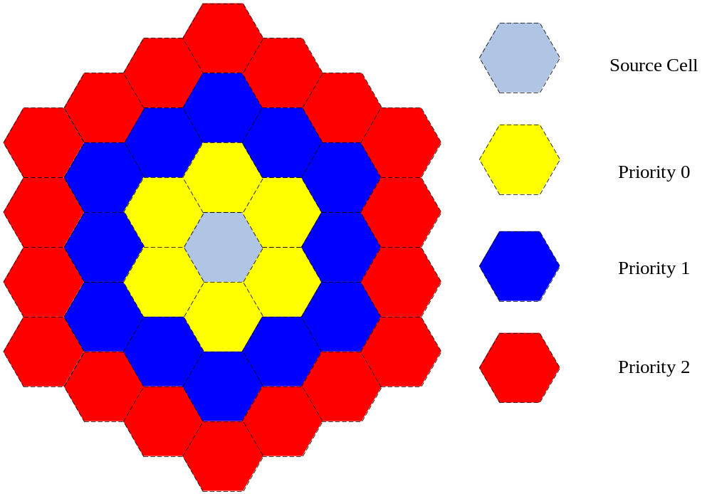
Cell Priority
The OMCR configuration parameter MeasPrio is used to define the priority of adjacent cells and includes three values:
  0: High priority
  1: Medium priority
  2: Low priority

Slide 14
Intra-frequency measurement events
A series of intra-frequency measurement events are defined in 3GPP as the judgment and trigger criteria for intra-frequency handover.
  Event 1A: A Primary CPICH enters the Reporting Range.
  Event 1B: A Primary CPICH leaves the Reporting Range.
  Event 1C: A Non-active Primary CPICH becomes better than an active Primary CPICH.
  Event 1D: The best cell changes.
  Event 1E: Quality of target cell improves, better than an absolute threshold.
  Event 1F: Quality of target cell decreases, worse than an absolute threshold.

Slide 15
Event 1A
R_{1a}: Refers to the reporting range of Event 1A. It is used to control the extent of difficulty in adding a cell into the active set.
H_{1a}: Refers to the reporting hysteresis of Event 1A. It is used to control the extent of difficulty in adding a cell into the active set.
M_{new}: Refers to measurement of the to-be-evaluated cell outside the active set.
CIO_{new}: Refers to offset of cell outside active set in relation to other.
M_{i}: Refers to the mean measurement value of other cells except the best cell in active set.
N_{A}: Refers to the number of other cells except the best cell in active set.
M_{best}: Refers to the measurement of the best cell in the active set.
W: Refers to the weight proportion of the best cell to the rest cells in the active set in evaluation standards.

Slide 16
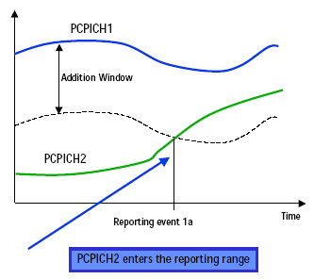
Event 1A

Slide 17
Event 1B
R_{1b}: Refers to the reporting range of Event 1B. It is used to control the extent of difficulty in dropping a cell from the active.
H_{1b}: Refers to the reporting hysteresis of Event 1B. It is used to control the extent of difficulty in dropping a cell from the active set.
M_{old}: Refers to measurement of the to-be-evaluated cell in the active set.
CIO_{old}: Refers to offset of cell in active set in relation to other cells.
M_{i}: Refers to the mean measurement value of other cells except the best cell in active set.
N_{A}: Refers to the number of other cells except the best cell in active set.
M_{best}: Refers to the measurement of the best cell in the active set.
W: Refers to the weight proportion of the best cell to the rest cells in the active set in evaluation standards.

Slide 18
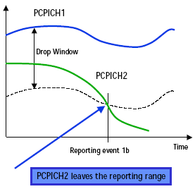
Event 1B

Slide 19
Event 1C
H_{1c}: Refers to the reporting hysteresis of Event 1C. It is used to control the extent of difficulty in replacing a cell in the active set.
M_{new}: Refers to measurement of the to-be-evaluated cell outside the active set.
M_{InAS}: Refers to the cell with poorest quality in the active set.
CIO_{new}: Refers to offset of the to-be-evaluated cell outside the active set in relation to other cells.
CIO_{InAS}: Refers to offset of cell with poorest quality in active set in relation to other cells.

Slide 20
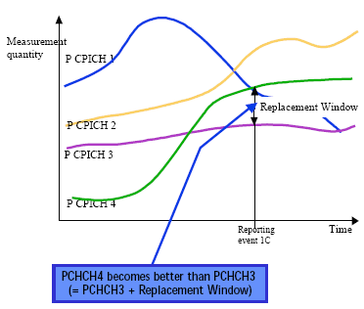
Event 1C

Slide 21
Event 1D
M_{Notbest}: Refers to the measurement of the to-be-evaluated cell within or outside the active set.
CIO_{Notbest}: Refers to the offset of the to-be-evaluated cell within the active set or outside the active set in relation to other cells.
CIO_{best}: Refers to offset of the to-be-evaluated cell in the active set in relation to other cells.
M_{best}: Refers to the measurement of the to-be-evaluated cell in the active set.
H_{1d}: Refers to Event 1D report hysteresis.

Slide 22
Event 1D
Ec_2
R1a-H1a/2
H1d/2
R1b+H1b/2
1A
Ec_1
1A
1D
1B
1D

Slide 23
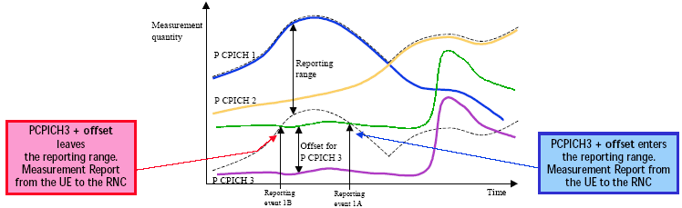
Cell Individual Offset
For each cell that is monitored, an offset can be assigned with inband signalling. The offset can be either positive or negative. The offset is added to the measurement quantity before the MS dose evaluate while an event has occurred.
Offset of neighbor cell parameter, CPICH Ec/No, can be set as the offset which MS pluses it to neighbor cell measurement result, CPICH Ec/No, before compares it with reporting principle value, Ec/No.
Cell individual offsets can be regarded as the tool of moving cell edge.

Slide 24
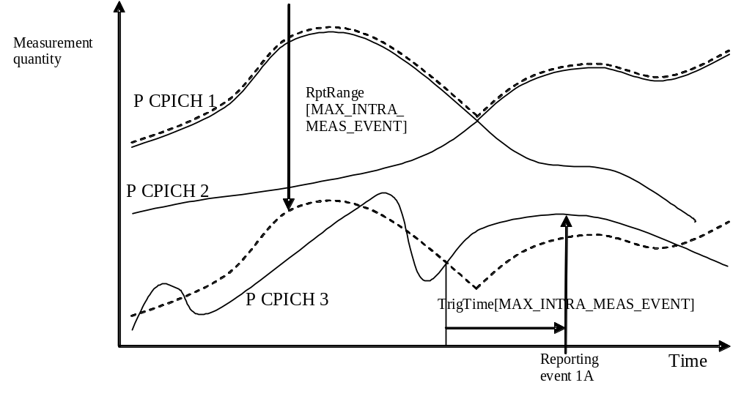
Time-To-Trigger
If a to-be-evaluated cell meets the reporting range or threshold of certain event, the condition must be met within a period of time before the reporting of this event to avoid intra-frequency event misreport due to the fluctuation of radio quality.

Slide 25
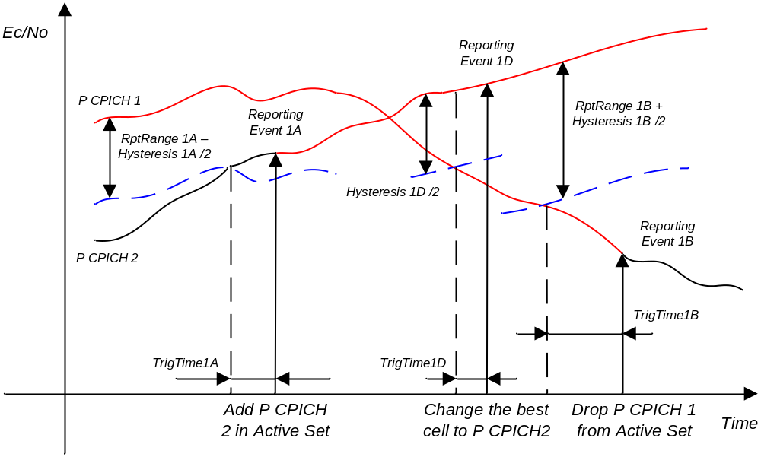
Intra-Frequency Handover

Slide 26
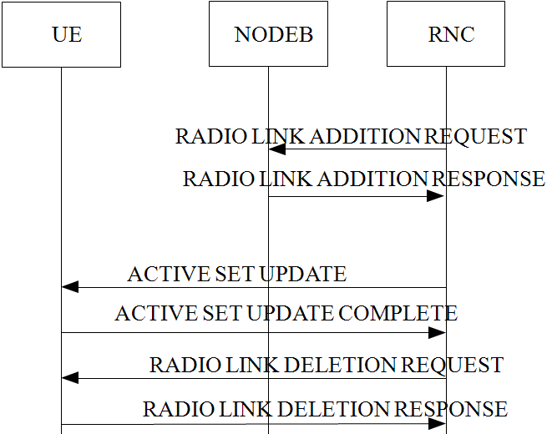
Softer Handover

Slide 27
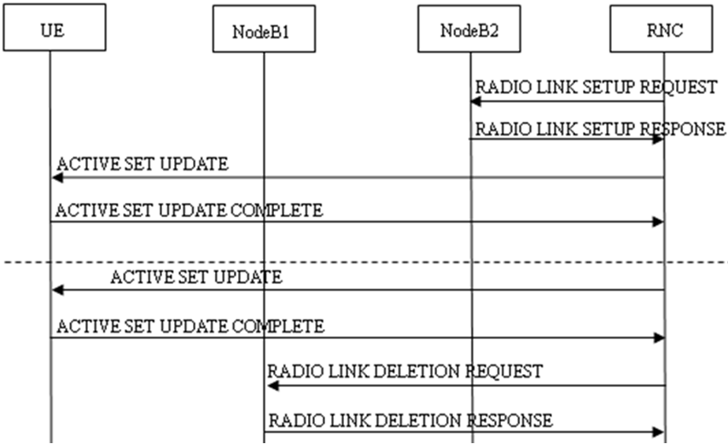
Intra-RNC Soft Handover

Slide 28
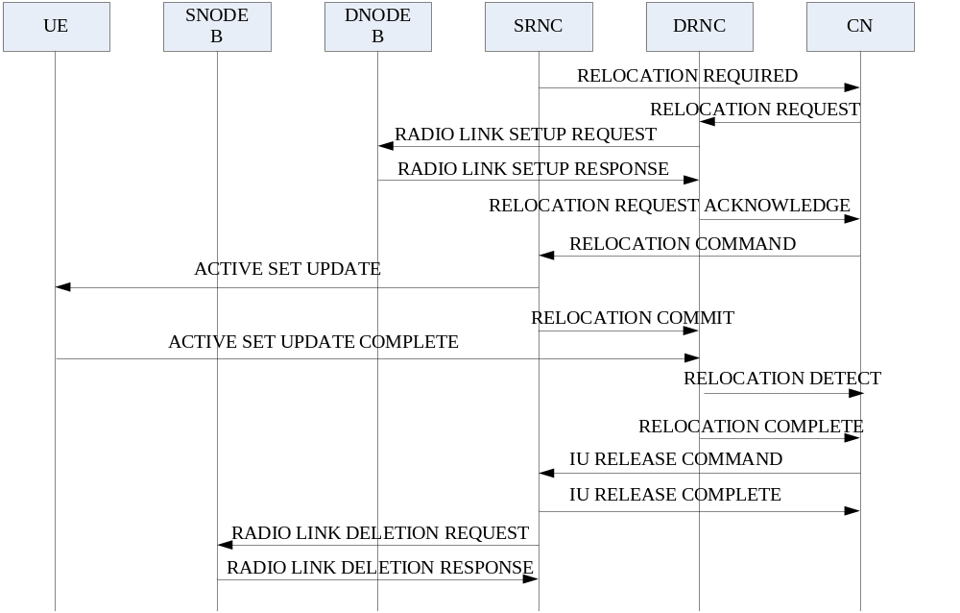
Inter-RNC Soft Handover

Slide 29
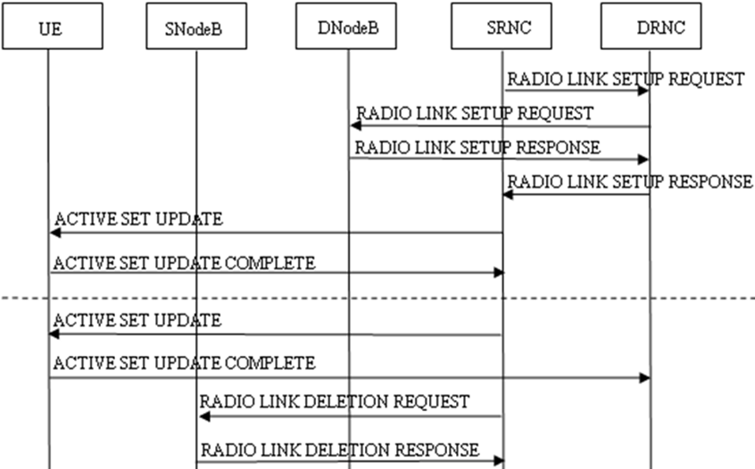
Inter-RNC Soft Handover(Iur)

Slide 30
Filter Coefficient
Parameter Name | FilterCoeff
Description | This parameter indicates the filtering factor that UE performs the L3 filtering on the measurement results of the intra-frequency measurement. The smaller the value of the filtering factor is, the larger effect the current measurement result will have on the measurement result reported to RNC (periodical report) or the judgment (event report).
Range and Step | （0， 1， 2， 3， 4， 5， 6， 7， 8， 9， 11，13， 15， 17， 19）
Default Value | UE Event Report Parameters for CPICH Ec/No: 2 UE Event Report Parameters for CPICH RSCP: 3
Configuration Path | View->Configuration Management->RNC NE->RNC Radio Resource Management-> Modify Advanced Parameter->UE Intra-frquence Measurement Configuration-> Filter Coefficient
Notes:
该参数优化时不做修改

Slide 31
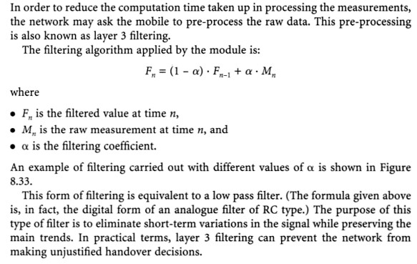
Notes:
该参数优化时不做修改

Slide 32
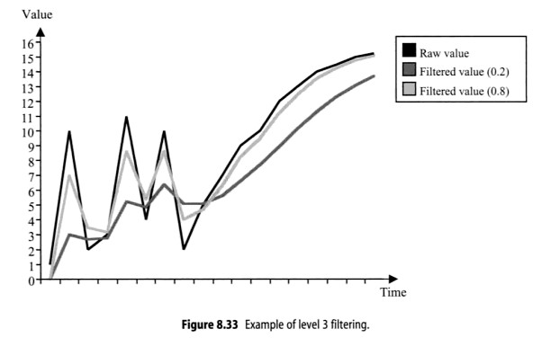
Notes:
该参数优化时不做修改

Slide 33
Measurement Priority of Neighboring Cell
Parameter Name | MeasPrio
Description | This parameter indicates the measurement priority of the neighbouring cell. The priority of the neighbouring cell can be set to 0, 1, or 2, of which, 0 represents the highest priority and 2 represents the lowest priority. The priority of the neighbouring is set by the configuration personnel according to the signal strength and distance of the neighboring cell.
Range and Step | ［0，2］
Default Value | 0
Configuration Path | View->Configuration Management->RNC NE->RNC Radio Resource Management->UltranCell->neighbouring cellXXX->Measurement Priority of Neighboring Cell

Slide 34
Report Criteria
Parameter Name | RptCrt
Description | This parameter indicates the reporting criteria of the intra-frequency measurement, including the event reporting criteria and the periodical reporting criteria.
Range | 1: Event Trigger Reporting Criteria 2: Periodical Reporting Criteria
Default Value | UE Event Report Parameters for CPICH Ec/No: Event Trigger Reporting Criteria UE Event Report Parameters for CPICH RSCP: Event Trigger Reporting Criteria
Configuration Path | View->Configuration Management->RNC NE->RNC Radio Resource Management->Modify Advanced Parameter->UE Intra-frequency Measurement Configuration->Report Criteria

Slide 35
Measurement Quantity
Parameter Name | MeasQuantity
Description | This parameter indicates the measurement quantity of the intra-frequency measurement that UE performs.
Range and Step | 0： CPICH Ec/No 1： CPICH RSCP 2： Pathloss
Default Value | UE Event Report Parameters for CPICH Ec/No: CPICH Ec/No UE Event Report Parameters for CPICH RSCP: CPICH RSCP
Configuration Path | View->Configuration Management->RNC NE->RNC Radio Resource Management->Modify Advanced Parameter->UE Intra-frequency Measurement Configuration->Measurement Quantity

Slide 36
Reporting Range Constant Event 1A/1B
Parameter Name | RptRange
Description | Event 1A is easier to be triggered when the reporting range constant for event 1A is set to a larger value; and vice verse. Event 1B is easier to be triggered when the reporting range constant for event 1B is set to a smaller value; and vice verse.
Range and Step | ［0，14.5］dB step 0.5dB
Default Value | UE Event Report Parameters for CPICH Ec/No: [3,5,0,0,0,0,0] UE Event Report Parameters for CPICH RSCP: [6,8,0,0,0,0,0]
Configuration Path | View->Configuration Management->RNC NE->RNC Radio Resource Management-> Modify Advanced Parameter->UE Intra-frquence Measurement Configuration->Reporting Range Constant Event 1A/1B(dB)
Notes:
1. 该参数的取值增大时，1a事件越容易触发，而1b事件越难触发
2. 只有RptCrt为1（事件上报）时并且MeaEvtId取值为1a/1b时， RptRange字段才有效。
3.该参数的功能：用于软切换的软加和软去。
该参数配置考虑的因素：软切换的区域大小、软切换的比例以及用户的切换成功率。
（1）1A事件：该参数配置越小，则不容易软加，可能会导致软切换区域过小，使得软加不及时而掉话。该参数配置越大，则越容易软加，软切换区域会增加，使得系统中软切换的比例增加，相应的多消耗了系统容量，软加的成功率可以相应提高。
（2）1B事件：该参数配置越小，则越容易软去，还有可能会导致乒乓切换；该参数配置越大，则越不容易软去，会使得激活集中存在无用的链路占用系统资源，浪费系统容量。

Slide 37
Hysteresis
Parameter Name | Hysteresis
Description | This parameter indicates the hysteresis when judging whether to trigger the event. This parameter avoids the change of the trigger status due to very small change. This parameter is related to the measurement quantity and the event type.
Range and Step | ［0，7.5］dB step 0.5dB
Default Value | UE Event Report Parameters for CPICH Ec/No: [0,0,4,4,2,2,4] UE Event Report Parameters for CPICH RSCP: [4,4,6,6,4,4,6]
Configuration Path | View->Configuration Management->RNC NE->RNC Radio Resource Management-> Modify Advanced Parameter->UE Intra-frquence Measurement Configuration-> Hysteresis

Slide 38
Cell Individual Offset (utranCell)
Parameter Name | CellIndivOffset(utranCell)
Description | This parameter defines the individual offset of cells in the active set relative to other cells. When the value is positive, a positive value is added to the measurement result. If the value is negative, a negative value is added to the measurement result.
Range and Step | ［-10，10］dB step 0.5dB
Default Value | 0dB
Configuration Path | View->Configuration Management->RNC NE->RNC Radio Resource Management->Utran Cell->Utran Cell XXX->Modify Advanced Parameter->Utran Cell->Cell Individual Offset(dB)
Notes:
该参数的功能：通过调整切换门限来控制切换的难易程度
该参数配置考虑因素：切换的难易程度、切换的及时性、切换的倾向性
配置的越大，越容易触发向邻区的切换，否则配置的越小，则越不容易触发向邻区的切换。针对不同的邻区可以取不同值，以控制不同邻区的切换倾向性。
调整建议：对于信号变化很快的地方，可以适当配大些，以保证切换及时性。

Slide 39
Cell Individual Offset (utranRelation)
Parameter Name | CellIndivOffset(utranRelation)
Description | This parameter defines the individual offset of cells outside the active set relative to other cells. When the value is positive, a positive value is added to the measurement result. If the value is negative, a negative value is added to the measurement result.
Range and Step | ［-10，10］dB step 0.5dB
Default Value | 0dB
Configuration Path | View->Configuration Management->RNC NE->RNC Radio Resource Management->Utran Cell->Utran Cell XXX->Neighbouring Cell->Neighbouring Cell XXX->Modify Advanced Parameter->Cell Individual Offset(dB)
Notes:
有些类似于GSM中的Margin value
该参数的功能：通过调整切换门限来控制切换的难易程度
该参数配置考虑因素：切换的难易程度、切换的及时性、切换的倾向性
配置的越大，越容易触发向邻区的切换，否则配置的越小，则越不容易触发向邻区的切换。针对不同的邻区可以取不同值，以控制不同邻区的切换倾向性。
调整建议：对于信号变化很快的地方，可以适当配大些，以保证切换及时性。

Slide 40
Weight for Event 1A/1B
Parameter Name | W
Description | This parameter is used for the quality judgment of event 1A and 1B. This parameter indicates the weight of the best cell in the quality judgment and is related to the measurement quantity and the event type.
Range and Step | ［0.0，2.0］ step 0.1
Default Value | UE Event Report Parameters for CPICH Ec/No: [0.0 0.0 0.0 0.0 0.0 0.0 0.0] UE Event Report Parameters for CPICH RSCP: [0.0 0.0 0.0 0.0 0.0 0.0 0.0]
Configuration Path | View->Configuration Management->RNC NE->RNC Radio Resource Management-> Modify Advanced Parameter->UE Intra-frquence Measurement Configuration-> Weight for Event 1A/1B

Slide 41
Time to Trigger
Parameter Name | TrigTime
Description | This parameter indicates the time difference between the time that the event generation is detected and the time that the event is reported. The event is triggered and the measurement report is reported only when the event generation is detected and still meets the requirements of event triggering after Time to trigger.
Range and Step | （0， 10， 20， 40， 60， 80， 100， 120， 160，200， 240， 320， 640， 1280， 2560， 5000）ms
Default Value | UE Event Report Parameters for CPICH Ec/No: [200,640,320,320,200,200,320]ms UE Event Report Parameters for CPICH RSCP: [200,200,200,200,200,200,200]ms
Configuration Path | View->Configuration Management->RNC NE->RNC Radio Resource Management-> Modify Advanced Parameter->UE Intra-frquence Measurement Configuration-> Time to Trigger(ms)

Slide 42
Amount of Reporting for Event 1A/1B/1C
Parameter Name | EvtRptAmount
Description | This parameter indicates the reporting amount for event 1A/1B/1C. Once Event 1A/1C meets the reporting range of quality standards, the UE will report Event 1A/1C periodically until this event does not meet reporting conditions or the reporting times reach the maximum allowed times.
Range and Step | (1, 2, 4, 8, 16, 32, 64, Infinity)
Default Value | UE Event Report Parameters for CPICH Ec/No: [4, 4, 4, -, -, -, 4] UE Event Report Parameters for CPICH RSCP: [4, 4, 4, -, -, -, 4]
Configuration Path | View->Configuration Management->RNC NE->RNC Radio Resource Management-> Modify Advanced Parameter->UE Intra-frquence Measurement Configuration-> Amount of Reporting for Event 1A/1B/1C/1J
Notes:
参数含义：1a/1b/1c/1j事件触发时周期上报的次数
为了避免1a/1b/1c/1j事件丢失而造成切换失败的发生，系统采用事件触发后重复多次上报方式。上报的次数越多，事件越不容易丢失，切换成功率越高，但是系统资源占用越多； 反之，上报的次数越少，切换成功率降低。

Slide 43
Reporting Interval for Event 1A/1B/1C
Parameter Name | EvtRptInterval
Description | This parameter indicates the reporting interval for event 1A/1B/1C. Once Event 1A/1C meets the reporting range of quality standards, the UE will report Event 1A/1C periodically until this event does not meet reporting conditions or the reporting times reach the maximum allowed times.
Range and Step | （0， 250， 500， 1000， 2000， 4000， 8000，16000）ms
Default Value | UE Event Report Parameters for CPICH Ec/No: [2000, 2000, 2000, -, -, -, 2000] ms UE Event Report Parameters for CPICH RSCP: [2000, 2000, 2000, -, -, -, 2000] ms
Configuration Path | View->Configuration Management->RNC NE->RNC Radio Resource Management-> Modify Advanced Parameter->UE Intra-frquence Measurement Configuration-> Reporting Interval for Event 1A/1B/1C/1J(ms)

Slide 44
Reporting Deactivation Threshold for Event 1A
Parameter Name | RptDeactThr
Description | This parameter indicates the maximum number of the cells allowed in the active set. When the UE detects that one cell in the monitoring set satisfies the trigger threshold of event 1A, it determines whether the number of the cells in the current active set greater than the value indicated by this parameter at first. If yes, the event 1A is not triggered.
Range and Step | （0， 1， 2， 3， 4， 5， 6， 7）
Default Value | UE Event Report Parameters for CPICH Ec/No: [2, -, -, -, -, -, -] UE Event Report Parameters for CPICH RSCP: [2, -, -, -, -, -, -]
Configuration Path | View->Configuration Management->RNC NE->RNC Radio Resource Management-> Modify Advanced Parameter->UE Intra-frquence Measurement Configuration-> Reporting Deactivation Threshold for Event 1A
Notes:
参数含义：激活集中允许小区的最多数目(1A事件)
该参数的功能：指示激活集中允许小区的最多数目。该参数配置考虑的因素：合理的宏分集增益
当UE监测到某个监测集小区的测量结果满足1a事件的判决门限时，首先要判断当前激活集中的小区个数是否小于等于该参数所指示的值，是则触发1a事件，否则不触发1a事件。因为配置的DCH激活集最大个数为3，该参数的设置要与DCH激活集最大个数相匹配（比激活集最大个数小1）
该参数不建议调整。

Slide 45
Detected Set Handover Switch
Parameter Name | DetSetHoSwch
Description | The measurement control message that contains the detected set information is sent only when the DetSetHO switch of the best cell in the current active set is set to 1 and the current number of intra-frequency neighbouring cells is less than 32.
Range and Step | 0: Closed 1: Open
Default Value | 1: Open
Configuration Path | View->Configuration Management->RNC NE->RNC Radio Resource Management->Utran Cell->Utran Cell XXX->Modify Advanced Parameter->Utran Cell->Detected Set Handover Switch
Notes:
DetSetHoSwch：小区启动检测集切换开关

Slide 46
Content
UMTS Handover Overview
UMTS Intra-Frequency Handover Strategy
UMTS Inter-Frequency Handover Strategy
UMTS Inter-RAT Handover Policy
UMTS SRNS Relocation

Slide 47
Carrier evaluation standard
Q_{frequency j}: Refers to active set quality of carrier j, that is, the measurement result of carrier j.
M_{frequency j}: Refers to the physical measurement value of the active set of carrier j.
M_{i j}: Refers to the physical measurement value of cell i of carrier j.
N_{A j}: Refers to the number of cells (excluding best cell) in the active set of carrier j.
M_{Best j}: Refers to the measurement result of the best cell in the active set of carrier j.
W_{j}: Refers to the weight of the best cell in the active set of carrier j during carrier measurement.

Slide 48
Inter-frequency measurement events
A series of inter-frequency measurement events are defined in 3GPP as the judgment and trigger criteria for inter-frequency handover:
  Event 2A: The best carrier frequency changes.
  Event 2B: The quality of working carrier frequency is lower than a threshold and that of non-working carrier frequency is higher than a threshold.
  Event 2C: The quality of non-working carrier frequency is higher than a threshold.
  Event 2D: The quality of working carrier frequency is lower than a threshold.
  Event 2E: The quality of non-working carrier frequency is lower than a threshold.
  Event 2F: The quality of working carrier frequency is higher than a threshold.

Slide 49
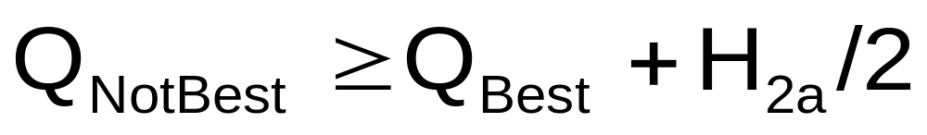
Event 2A
Q_{NotBest}: Refers to the measurement result of current non-best carrier frequency.
Q_{Best}: Refers to the measurement result of current best carrier frequency.
H_{2a}: Refers to handover decision hysteresis parameter of Event 2A.

Slide 50
Event 2A
2A
Ec_f2
H2a/2
Ec_f1
2A
t

Slide 51
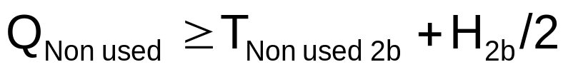
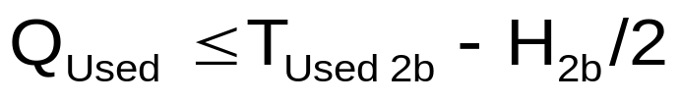
Event 2B
Q_{Non used}: Refers to the measurement result of current non-working carrier frequency.
T_{Non used 2b}: Refers to the absolute threshold of good quality of non-working carrier frequency in Event 2B decision.
H_{2b}: Refers to handover decision hysteresis parameter of Event 2B.
Q_{Used}: Refers to the measurement result of current working carrier frequency.
T_{Used 2b}: Refers to the absolute threshold of poor quality of working carrier frequency in Event 2B decision.
and

Slide 52
Event 2B
2A
Ec_f2
Tnon used 2b+ H2b/2
Tused 2b- H2b/2
Ec_f1
2B
t

Slide 53
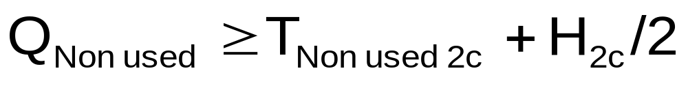
Event 2C
Q_{Non used}: Refers to the measurement result of current non-working carrier frequency.
T_{Non used 2c}: Refers to the absolute threshold of good quality of non-working carrier frequency in Event 2C decision.
H_{2c}: Refers to handover decision hysteresis parameter of Event 2C.

Slide 54
Event 2C
Ec_f1
Ec_f2
Tnon used 2b+ H2c/2
t
2C

Slide 55
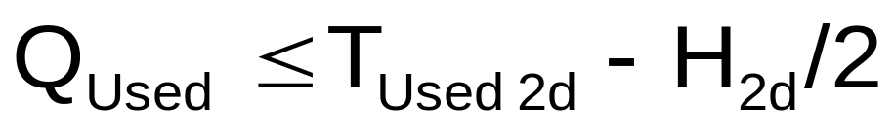
Event 2D
Q_{Used}: Refers to the measurement result of current working carrier frequency.
T_{Used 2d}: Refers to the absolute threshold of poor quality of working carrier frequency in Event 2D decision.
H_{2d}: Refers to handover decision hysteresis parameter of Event 2D.

Slide 56
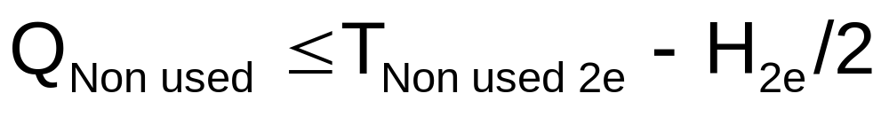
Event 2E
Q_{Non used}: Refers to the measurement result of current non-working carrier frequency.
T_{Non used 2e}: Refers to the absolute threshold of good quality of non-working carrier frequency in Event 2E decision.
H_{2e}: Refers to handover decision hysteresis parameter.

Slide 57

Event 2F
Q_{Used}: Refers to the measurement result of current working carrier frequency.
T_{Used 2f}: Refers to the absolute threshold of poor quality of working carrier frequency in Event 2F decision.
H_{2f}: Refers to handover decision hysteresis parameter of Event 2F.

Slide 58
Compressed Mode Enabling/Disabling
Among all inter-frequency measurement events, Event 2D and Event 2F only involve measurement of working carrier frequencies, so the compressed mode is not required during measurement and extra overhead will not be brought about to both UE and RNC. The compressed mode can be enabled and disabled based on the definition of 2D/2F.

Slide 59
Event of inter-frequency handover
The same cell can only use one of Event 2A, Event 2B and Event 2C to trigger inter-frequency handover. Which of the three events will be used is based on the inter-frequency handover recommendation strategy parameter InterHoTactic.

Slide 60
Handling of Event 2E
All non-working carrier frequencies report Event 2E, indicating that radio quality of all inter-frequency adjacent cells is poor and UMTS system quality deteriorates. Issue the Inter-RAT measurement Event 3A/3C.

Slide 61
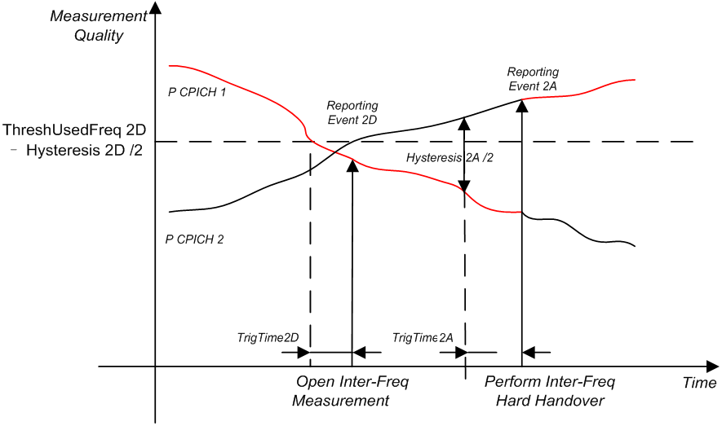
Inter-Frequency Handover

Slide 62
Inter-Frequency Handover
RSCP
Ec_f2
Ec_f1
2F
2D
2D
2F
2D
2A
t

Slide 63
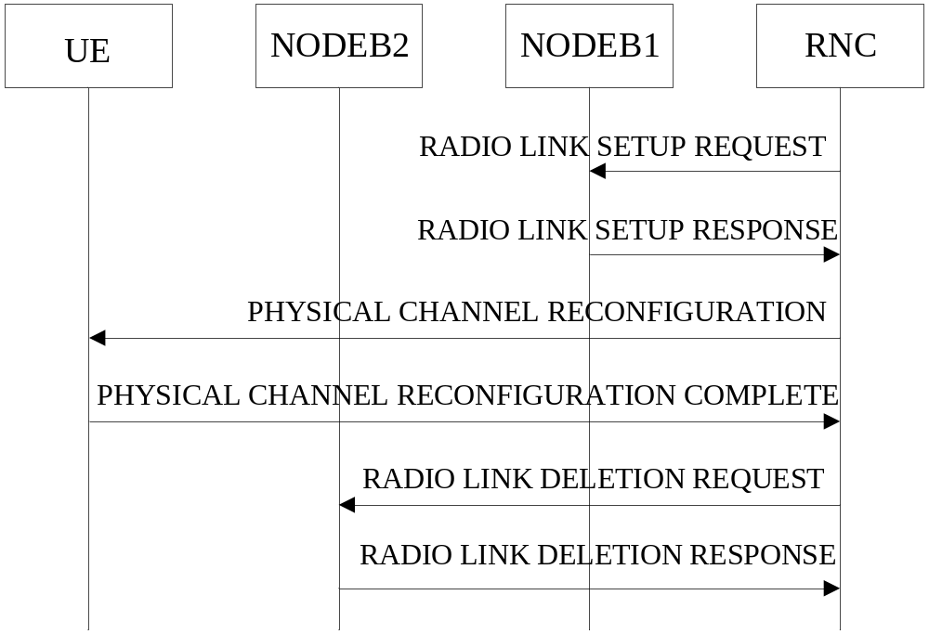
Intra-RNC Hard Handover

Slide 64
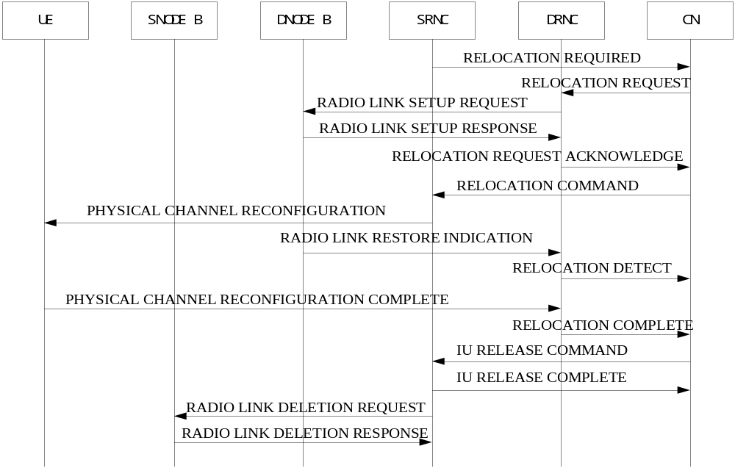
Inter-RNC Hard Handover

Slide 65
Filter Coefficient (Inter)
Parameter Name | FilterCoeff(Inter)
Description | This parameter indicates the filtering factor that UE performs the L3 filtering on the measurement results of the inter-frequency measurement. The smaller the value of the filtering factor is, the larger effect the current measurement result will have on the measurement result reported to RNC (periodical report) or the judgment (event report).
Range and Step | （0， 1， 2， 3， 4， 5， 6， 7， 8， 9，11，13，15，17，19）
Default Value | UE Inter-frequency Event Report Parameters for CPICH Ec/No: 3 UE Inter-frequency Event Report Parameters for CPICH RSCP: 3
Configuration Path | View->Configuration Management->RNC NE->RNC Radio Resource Management->Modify Advanced Parameter->UE Inter-frequence Measurement Configuration-> Filter Coefficient

Slide 66
Measurement Priority of Neighboring Cell (Inter)
Parameter Name | MeasPrio(Inter)
Description | The priority of a neighbouring cell can be set to 0, 1, and 2, of which, 0 represents the highest priority and 2 represents the lowest priority. The priority of the neighbouring is set by the configuration personnel according to the signal strength and the distance of the neighboring cell.
Range and Step | ［0，2］
Default Value | 0
Configuration Path | View->Configuration Management->RNC NE->RNC Radio Resource Management->Utran Cell->Utran Cell XXX->Neighbouring Cell-> Neighbouring Cell XXX->Measurement Priority of Neighboring Cell

Slide 67
Report Criteria (Inter)
Parameter Name | RptCrt(Inter)
Description | This parameter indicates the criteria of reporting the inter-frequency measurement, including the Event Reporting and periodical reporting.
Range and Step | 1: Inter-frequency Event Reporting Criteria 2: Periodical Reporting Criteria
Default Value | UE Inter-frequency Event Report Parameters for CPICH Ec/No: Inter-frequency Event Reporting Criteria UE Inter-frequency Event Report Parameters for CPICH RSCP: Inter-frequency Event Reporting Criteria
Configuration Path | View->Configuration Management->RNC NE->RNC Radio Resource Management-> Modify Advanced Parameter->UE Inter-frquence Measurement Configuration-> Report Criteria

Slide 68
Measurement Quantity (Inter)
Parameter Name | MeasQuantity(Inter)
Description | This parameter indicates the measurement quantity of the inter-frequency measurement that UE performs.
Range and Step | 0： CPICH Ec/No 1： CPICH RSCP
Default Value | UE Inter-frequency Event Report Parameters for CPICH Ec/No: CPICH Ec/No UE Inter-frequency Event Report Parameters for CPICH RSCP: CPICH RSCP
Configuration Path | View->Configuration Management->RNC NE->RNC Radio Resource Management-> Modify Advanced Parameter->UE Inter-frquence Measurement Configuration-> Measurement Quantity

Slide 69
Weight of the Currently Used Frequency for 2A/2B/2D/2F
Parameter Name | Wused
Description | This parameter is used for quality judgment of the currently used carrier frequency. It indicates the weight of the best RNC in the quality judgment (only for event 2a/2b/2d/2f) and is related to the measurement quantity and the event type.
Range and Step | ［0.0，2.0］ step 0.1
Default Value | UE Inter-frequency Event Report Parameters for CPICH Ec/No: [0.0, 0.0, 0.0,0.0,0.0,0.0] UE Inter-frequency Event Report Parameters for CPICH RSCP: [0.0, 0.0, 0.0,0.0,0.0,0.0]
Configuration Path | View->Configuration Management->RNC NE->RNC Radio Resource Management->Modify Advanced Parameter->UE Inter-frequence Measurement Configuration-> Weight of the Currently Used Frequency for 2A/2B/2D/2F

Slide 70
Absolute Threshold of the Quality of the Currently Used Frequency for 2B/2D/2F
Parameter Name | ThreshUsedFreq
Description | This parameter indicates the absolute threshold that should be configured for event 2b/2d/2f.In the case of event 2D, the less the threshold configured, the more difficult the event 2D been triggered. In the case of event 2F, the less the threshold configured, the easier the event 2F been triggered.
Range and Step | CPICH RSCP：［-115，-25］dBm step 1dBm CPICH Ec/No：［-24，0］dB step 1dB
Default Value | UE Inter-frequency Event Report Parameters for CPICH Ec/No: [-24,-13, -24,-13,-24,-8]dB UE Inter-frequency Event Report Parameters for CPICH RSCP: [-115,-95, -115,-95,-115,-80]dBm
Configuration Path | View->Configuration Management->RNC NE->RNC Radio Resource Management->Modify Advanced Parameter->UE Inter-frequence Measurement Configuration-> Absolute Threshold of the Quality of the Currently Used Frequency for 2B/2D/2F

Slide 71
Hysteresis (Inter)
Parameter Name | Hysteresis(Inter)
Description | This parameter indicates the hysteresis used when judging whether to trigger the event. This parameter avoids the trigger status change due to very small change. Different events are configured separately and the events can be configured with different values.
Range and Step | ［0，14.5］dB step 0.5dB
Default Value | UE Inter-frequency Event Report Parameters for CPICH Ec/No: [4,4,4,4,4,4]dB UE Inter-frequency Event Report Parameters for CPICH RSCP: [4,4,4,4,4,4]dB
Configuration Path | View->Configuration Management->RNC NE->RNC Radio Resource Management->Modify Advanced Parameter->UE Inter-frequence Measurement Configuration-> Hysteresis(dB)

Slide 72
Time to Trigger (Inter)
Parameter Name | TrigTime(Inter)
Description | This parameter indicates the time difference between the time that the event generation is detected and the time that the event is reported. The event is triggered and the measurement report is reported only when the event generation is detected and still meets the requirements of event triggering after Time to trigger.
Range and Step | （0， 10， 20， 40， 60， 80， 100， 120， 160， 200， 240， 320， 640， 1280， 2560， 5000）ms
Default Value | UE Inter-frequency Event Report Parameters for CPICH Ec/No: [100,100,100,640,100,640] UE Inter-frequency Event Report Parameters for CPICH RSCP: [100,100,100,640,100,640]
Configuration Path | View->Configuration Management->RNC NE->RNC Radio Resource Management->Modify Advanced Parameter->UE Inter-frequency Measurement Configuration-> Time to Trigger(ms)

Slide 73
Inter- frequency Handover Tactic
Parameter Name | InterHoTactic
Description | This parameter indicates the event that is used to trigger the inter-frequency handover. The default value of the parameter is 2A, that is, the handover can be triggered when the conditions for best carrier frequency change are satisfied.
Range and Step | 0: Algorithm Deciding 1: 2A Event Trigger 2: 2B Event Trigger 3: 2C Event Trigger
Default Value | 1: 2A Event Trigger
Configuration Path | View->Configuration Management->RNC NE->RNC Radio Resource Management->Utran Cell->Utran Cell XXX->Modify Advanced Parameter->Utran Cell-> Inter- frequency Handover Tactic

Slide 74
Share Cover Indication
Parameter Name | ShareCover
Description | This parameter describes the neighboring relationship of the current cell and the neighboring cell. The relationship between the neighbouring cell and the current cell may be Neighbor, Overlap, Covers, or Contained in.
Range and Step | 0: Neighbor 1: Overlap 2: Covers 3: Contained in
Default Value | 0: Neighbor
Configuration Path | View->Configuration Management->RNC NE->RNC Radio Resource Management->Utran Cell->Utran Cell XXX->Neighbouring Cell->Neighbouring Cell XXX -> Share Cover Indication

Slide 75
Inter Frequency or Inter RAT Handover Switch
Parameter Name | IfOrRatHoSwch
Description | This parameter indicates how to perform neighbor measurement if a cell has both inter-frequency and inter-RAT cells as its neighbors.
Range and Step | 0: Turn off Inter-frequency and Inter-RAT Handover 1: Only Inter Frequency 2: Only Inter Rat 3: Inter Frequency is Prior to Inter Rat
Default Value | 3: Inter Frequency is Prior to Inter Rat
Configuration Path | View->Configuration Management->RNC NE->RNC Radio Resource Management->Utran Cell->Utran Cell XXX->Modify Advanced Parameter->Utran Cell->Inter Frequency or Inter RAT Handover Switch

Slide 76
Content
UMTS Handover Overview
UMTS Intra-Frequency Handover Strategy
UMTS Inter-Frequency Handover Strategy
UMTS Inter-RAT Handover Policy
UMTS SRNS Relocation

Slide 77
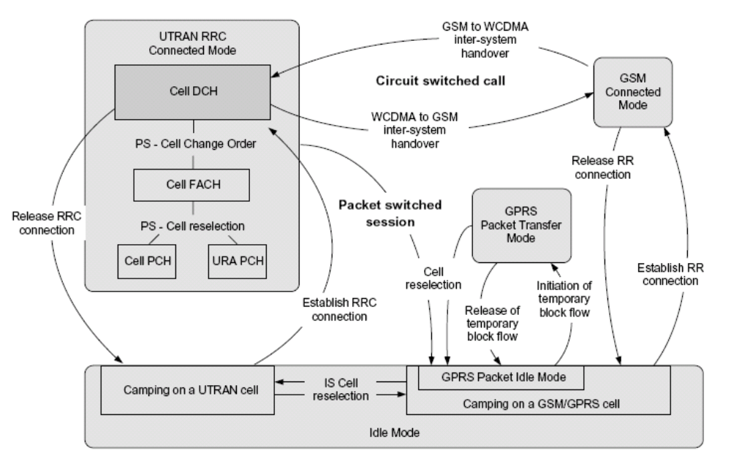
Inter-RAT Transition State Diagram

Slide 78
Inter-RAT measurement events
3GPP defies a series of Inter-RAT measurement events. An UE reports the corresponding events when defined conditions are met.
  3A: The currently used UTRAN carrier quality is lower than a threshold, and the quality of other radio systems is higher than a threshold. It is used for decision of Inter-RAT handover.
  3C: The quality of other radio systems is higher than a threshold. It can be used for Inter-RAT handover decision.

Slide 79

Event 3A
Q_{used}: indicates the estimated quality of the used frequency of the UTRAN.
T_{used}: indicates the absolute threshold of the currently used frequency difference.
H_{3a}: is the hysteresis parameter for 3A event decision.
M_{Other RAT}: is the quality measurement result of other systems.
CIO_{Other RAT}: is the quality offset of other system cells.
T_{Other RAT}: is the absolute threshold of other systems.
and

Slide 80
Event 3C
M_{Other RAT}: is the quality measurement result of other systems.
CIO_{Other RAT}: is the quality offset of other system cells.
T_{Other RAT}: is the absolute threshold of other systems.
H_{3c}: is the hysteresis parameter for 3C event decision.

Slide 81
Processing of Inter-RAT Events
In a cell, inter-RAT handover can only be triggered by 3A or 3C event, which is controlled by Inter-RAT handover tactic RatHoTactic.
When only PS service exists, adopt cell reselection process of PS service handover.
When CS service and PS service exist simultaneity, suspend PS service firstly, then handover CS service to GSM and handover PS service to GSM in sequence.

Slide 82
Inter-RAT Handover
The RNC transmits the 2D ad 2F event configuration to the UE when the service is set up. If the UE reports a 2D event, that is, the current carrier is in poor signal quality, the UE reports a 2E event after inter-frequency measurement is started (that is, the signal quality of the measured inter-frequency neighboring cell is also poor), the RNC needs to configure and start Inter-RAT measurement 3A or 3C event to the UE, and then performs the corresponding decision process for Inter-RAT handover according to the 3A, or 3C event subsequently reported by the UE.

Slide 83
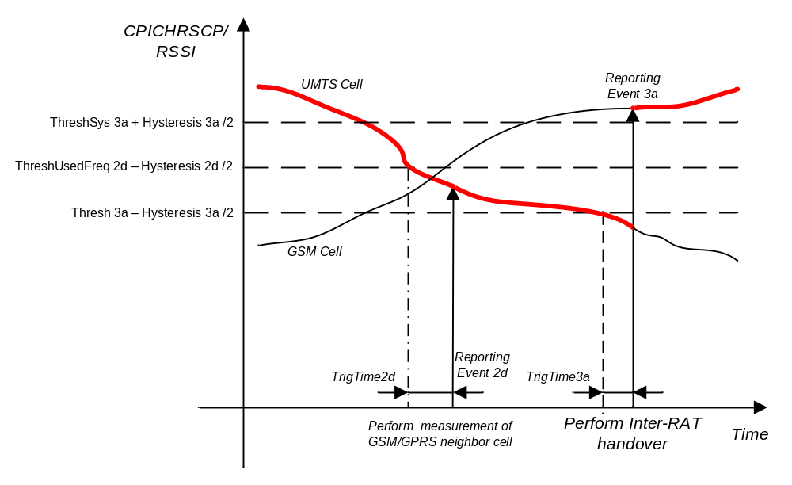
Inter-RAT Handover

Slide 84
Inter-RAT Handover
RSCP
GSM
3A(G)
Ec_f1
2F
2D
3A(W)
2D
2F
2D
3A
t

Slide 85
Inter-frequency + Inter-RAT Handover
RSCP
GSM
3A(G)
Ec_f1
2F
2D
2E
3A(W)
Ec_f2
2D
2F
2D
2E
3A
t

Slide 86
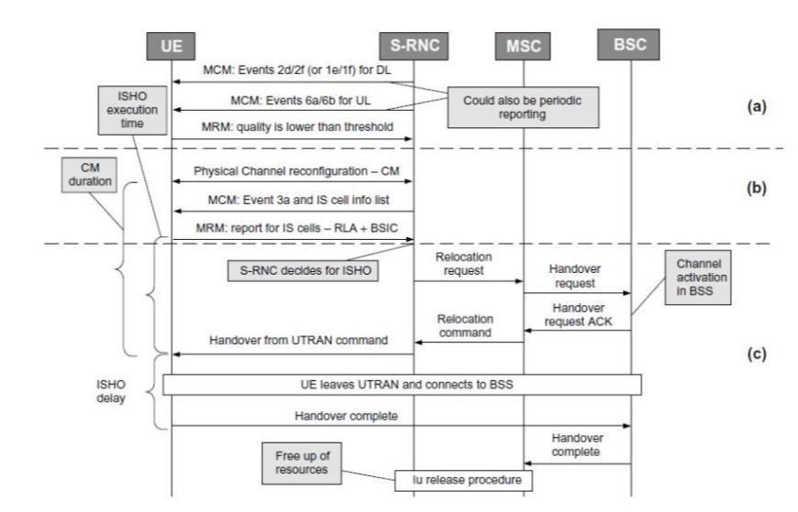
UMTS to GSM CS service handover

Slide 87
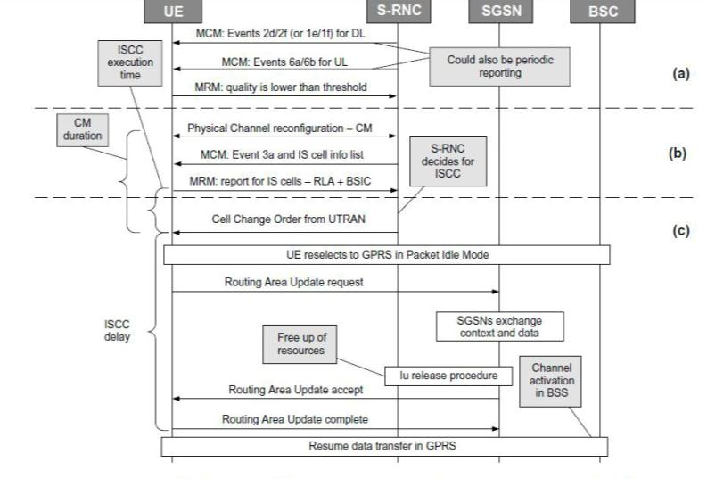
UMTS to GSM PS service handover

Slide 88
UTRAN Filter Coefficient(Rat)
Parameter Name | FilterCoeff(Rat)
Description | This parameter indicates the filtering factor that UE performs the L3 filtering on the UTRAN measurement results of the inter-RAT measurement. The smaller the filtering factor, the larger the effect of the measurement on the final result.
Range and Step | （0， 1， 2， 3， 4， 5， 6， 7， 8， 9，11，13，15，17，19）
Default Value | UE Event Report Parameters for Own System CPICH Ec/No: 3 UE Event Report Parameters for Own System CPICH RSCP: 3
Configuration Path | View->Configuration Management->RNC NE->RNC Radio Resource Management->Modify Advanced Parameter->UE Inter-Rat Measurement Configuration Information->UTRAN Filter Coefficient

Slide 89
GSM Filter Coefficient(Rat)
Parameter Name | GsmFilterCoeff
Description | This parameter indicates the filtering factor that UE performs the L3 filtering on the GSM measurement results of the inter-RAT measurement. The smaller the filtering factor, the larger the effect of the measurement on the final result.
Range and Step | （0， 1， 2， 3， 4， 5， 6， 7， 8， 9，11，13，15，17，19）
Default Value | UE Event Report Parameters for Own System CPICH Ec/No: 3 UE Event Report Parameters for Own System CPICH RSCP: 3
Configuration Path | View->Configuration Management->RNC NE->RNC Radio Resource Management->Modify Advanced Parameter->UE Inter-Rat Measurement Configuration Information->GSM Filter Coefficient

Slide 90
Measurement Priority of Neighboring GSM Cell
Parameter Name | MeasPrio(Rat)
Description | This parameter indicates the measurement priority of the neighboring cell. 0 presents the highest priority and 2 presents the lowest priority. This parameter should be configured by the network planning engineer according to the actual conditions of the current network, including the quality and geographic position of the inter-RAT neighbouring cell.
Range and Step | ［0，2］
Default Value | 0
Configuration Path | View->Configuration Management->RNC NE->RNC Radio Resource Management->Utran Cell->Utran Cell XXX->GSM Neighbouring Cell->GSM Neighbouring Cell XXX-> Measurement Priority of Neighboring GSMCell

Slide 91
Report Criteria
Parameter Name | RptCrt(Rat)
Description | This parameter indicates the criteria of reporting the inter-RAT measurement, including the Event Reporting and Periodical Reporting.
Range and Step | 1: Inter-RAT Event Reporting Criteria 2: Periodical Reporting Criteria
Default Value | UE Event Report Parameters for Own System CPICH Ec/No: Inter-RAT Event Reporting Criteria UE Event Report Parameters for Own System CPICH RSCP: Inter-RAT Event Reporting Criteria
Configuration Path | View->Configuration Management->RNC NE->RNC Radio Resource Management-> Modify Advanced Parameter->UE Inter-Rat Measurement Configuration Information-> Report Criteria

Slide 92
UTRAN Measurement quantity
Parameter Name | OwnMeasQuantity
Description | This parameter indicates the measurement quantity of the inter-RAT measurement that UE performs. After a new inter-RAT measurement configuration index is added, the measurement quantity is fixed when the function of the set of the inter-RAT measurement parameters is selected.
Range and Step | 0: CPICH Ec/No 1: CPICH RSCP
Default Value | UE Event Report Parameters for Own System CPICH Ec/No: CPICH Ec/No UE Event Report Parameters for Own System CPICH RSCP: CPICH RSCP
Configuration Path | View->Configuration Management->RNC NE->RNC Radio Resource Management-> Modify Advanced Parameter->UE Inter-Rat Measurement Configuration Information->UTRAN Measurement quantity

Slide 93
Weight of the UTRAN System for 3A
Parameter Name | W(Rat)
Description | This parameter indicates the weight of the best cell in the quality judgment of event 3a. It is used in judging the quality of the UTRAN system in inter-RAT measurement.
Range and Step | [0.0, 2.0], step 0.1
Default Value | UE Event Report Parameters for Own System CPICH Ec/No: [0, -, -, -] UE Event Report Parameters for Own System CPICH RSCP: [0, -, -, -]
Configuration Path | View->Configuration Management->RNC NE->RNC Radio Resource Management-> Modify Advanced Parameter->UE Inter-RAT Measurement Configuration Information->Weight of the UTRAN System for 3A

Slide 94
Absolute Threshold of the Quality of UTRAN Cell for 3A
Parameter Name | Thresh(Rat)
Description | This parameter indicates the absolute threshold of the UTRAN cell quality that is used by UE to judge event 3a. The range and unit of the parameter are related to the measurement quantity of the cells of the UTRAN system. The smaller the value configured, the more difficult the event 3a been reported.
Range and Step | CPICH RSCP: [-115, -25] dBm, step 1dBm CPICH Ec/No: [-24, 0] dB, step 1dB
Default Value | UE Event Report Parameters for Own System CPICH Ec/No: [-6, -24,-24,-24] UE Event Report Parameters for Own System CPICH RSCP: [-95, -115,-115,-115]
Configuration Path | View->Configuration Management->RNC NE->RNC Radio Resource Management-> Modify Advanced Parameter->UE Inter-RAT Measurement Configuration Information->Absolute Threshold of the Quality of UTRAN Cell for 3A

Slide 95
Absolute Threshold of the Quality of Other RAT for 3A/3B/3C
Parameter Name | ThreshSys
Description | This parameter indicates the absolute threshold used when judging the quality of other RAT configured for event 3a/3b/3c. The value range and unit of this parameter are related to the measurement quantity of the cells of other systems. At present, the measurement quantity can only be GSM Carrier RSSI of the GSM system, which corresponds to the CPICH RSCP of the UMTS system.
Range and Step | CPICH RSCP： ［-115，-25］dBm step 1dBm CPICH Ec/No： ［-24，0］ dB step 1dB
Default Value | UE Event Report Parameters for Own System CPICH Ec/No: [-90, -95, -95, -115] dBm UE Event Report Parameters for Own System CPICH RSCP: [-90, -95, -95, -115] dBm
Configuration Path | View->Configuration Management->RNC NE->RNC Radio Resource Management-> Modify Advanced Parameter->UE Inter-RAT Measurement Configuration Information-> Absolute Threshold of the Quality of Other RAT for 3A/3B/3C

Slide 96
Hysteresis(Rat)
Parameter Name | Hysteresis(Rat)
Description | This parameter indicates the hysteresis used when judging whether the event meets the conditions of been triggered. This parameter is related to the measurement quantity and the event type. If a small hysteresis is configured, the corresponding event will be reported in a high probability; and vice versa.
Range and Step | [0., 7.5] dB, step 0.5 dB
Default Value | UE Event Report Parameters for Own System CPICH Ec/No: [4,4,2,4] dB UE Event Report Parameters for Own System CPICH RSCP: [4,4,4,4] dB
Configuration Path | View->Configuration Management->RNC NE->RNC Radio Resource Management-> Modify Advanced Parameter->UE Inter-RAT Measurement Configuration Information-> Hysteresis

Slide 97
Cell individual offset(gsmRelation)
Parameter Name | CellIndivOffset(gsmRelation)
Description | This parameter indicates the individual offset of GSM cells. When the value is positive, a positive value is added to the measurement result to be judged. If the value is negative, a negative value is added to the measurement result to be judged. Through the configuration of the individual offset of a single cell, the trigger difficulty of the cell can be adjusted to meet the actual requirements of network planning, thus avoiding the need to modify the global handover parameters.
Range and Step | [-10, 10] dB, step 0.5
Default Value | 0dB
Configuration Path | View->Configuration Management->RNC NE->RNC Radio Resource Management->External GSM Cell->GSM Cell XXX->Modify Advanced Parameter->Cell Individual Offset(dB)

Slide 98
Time to Trigger(Rat)
Parameter Name | TrigTime(Rat)
Description | This parameter indicates the time difference between the time that the event generation is detected and the time that the event is reported. The event can be triggered and reported only when the event is detected and still meets all requirements of event triggering after Time to trigger. The larger the value is, the stricter the judgment is for the event to be triggered.
Range and Step | (0, 10, 20, 40, 60, 80, 100, 120, 160, 200, 240, 320, 640, 1280, 2560, 5000) ms
Default Value | UE Event Report Parameters for Own System CPICH Ec/No: [100,100,100,100] ms UE Event Report Parameters for Own System CPICH RSCP: [100,100,100,100] ms
Configuration Path | View->Configuration Management->RNC NE->RNC Radio Resource Management-> Modify Advanced Parameter->UE Inter-RAT Measurement Configuration Information-> Time to Trigger

Slide 99
Inter-Rat Handover Tactic
Parameter Name | RatHoTactic
Description | Event 3C can be triggered when the quality of the inter-RAT carrier frequency signal is higher than a certain value. In contrast, the trigger of event 3A requires an additional condition, that is, the quality of the carrier frequency signal of the current RAT must be less than a certain value. Hence, the inter-RAT handover can be triggered more easily when the parameter is set to 3C Event Trigger.
Range and Step | 0: Algorithm Deciding 1: 3A Event Trigger 2: 3C Event Trigger
Default Value | 1: 3A Event Trigger
Configuration Path | View->Configuration Management->RNC NE->RNC Radio Resource Management->Utran Cell->Utran Cell XXX->Modify Advanced Parameter->Utran Cell->Inter-RAT Handover Tactic

Slide 100
Share Cover Indication
Parameter Name | GsmShareCover
Description | This parameter indicates the neighboring relationship of the current cell and GSM neighboring cell, including Neighbor, Overlap, Covers, and Contained in.
Range and Step | 0: Neighbor 1: Overlap 2: Covers 3: Contained in
Default Value | 0: Neighbor
Configuration Path | View->Configuration Management->RNC NE->RNC Radio Resource Management->Utran Cell->Utran Cell XXX->GSM Neighbouring Cell-> GSM Neighbouring Cell XXX ->Share Cover Indication

Slide 101
GERAN Cell Indicator
Parameter Name | GeranCellInd
Description | This parameter indicates whether the cell is a GERAn cell.
Range and Step | 0: Not GERAN Cell 1: GERAN Cell
Default Value | N/A
Configuration Path | View->Configuration Management->RNC NE->RNC Radio Resource Management->External GSM Cell->GSM Cell XXX->GERAN Cell Indicator

Slide 102
PS Inter-System Handover Indicator
Parameter Name | PsInterSysHoSupp
Description | This parameter indicates whether RNC supports PS inter-RAT handover. 0 indicates not support, 1 indicates support.
Range and Step | Not Support Support
Default Value | Not Support
Configuration Path | View->Configuration Management->RNC NE->RNC Radio Resource Management-> RNC Configuration Supplement Information ->PS Inter-System Handover Indicator

Slide 103
Inter-System DTM Support Indicator
Parameter Name | DtmSuppInd
Description | This parameter indicates whether RNC supports DTM mode, that is whether supports inter-RAT handover both for CS domain services and PS domain services at the same time. 0 indicates not support, 1 indicates support.
Range and Step | Not Support Support
Default Value | Not Support
Configuration Path | View->Configuration Management->RNC NE->RNC Radio Resource Management-> RNC Configuration Supplement Information ->Inter-System DTM Support Indicator
Notes:
1. 该参数指示系统间切换时是否支持双域传输模式（Dual Transfer Mode ），即是否支持并发域业务的同时系统间切换。取值为0时不支持，取值为1时支持。
2. 该参数的功能：CS+PS系统间切换能力
该开关配置的影响：GSM的支持能力，用户体验
打开该功能，对于并发业务，两个域的业务可以同时进行系统间切换，从而保证并发业务的业务连接性，提高用户的业务体验。
关闭该功能，对于并发业务，PS业务走小区重选的流程，业务会中断一段时间。

Slide 104
Handover to GSM Penalty Timer
Parameter Name | HoToGsmPenTimer
Description | When handover from UMTS to GSM is failed, the timer initiates, and RNC will not handle inter-RAT measurement report until the timer is expiry.
Range and Step | [0,65535]s step 1s
Default Value | 20s
Configuration Path | View->Configuration Management->RNC NE->RNC Radio Resource Management-> Modify Advanced Parameter-> RNC Radio Resource Management->Handover to GSM Penalty Timer
Notes:
该参数的功能：系统间切换失败后，再次允许切换的时间间隔
该参数配置考虑的因素：系统资源
当系统间切换失败后，配置的越大，再次允许系统间切换的时间间隔越大，由于本系统质量变差引起的掉话可能性越高。配置的越小，再次尝试的时间间隔越小，越容易出现反复的切换失败情况，浪费系统的资源。

Slide 105
Timer for Stopping Inter-frequency Measurement and Activating Inter-RAT Measurement
Parameter Name | T4StpIfMeaActRat
Description | This parameter indicates the time interval of issuing inter-frequency measurement and inter-RAT measurement. When RNC issues inter-frequency measurement, the timer is start. If the quality of non-used frequency is bad during the time length indicated by this parameter, RNC will issue inter-RAT measurement if there is an inter-RAT neighboring cell. The larger the value is, the slower the inter-RAT measurement is initialized, and vice versa.
Range and Step | (0…20)s
Default Value | 5
Configuration Path | View->Configuration Management->RNC NE->RNC Radio Resource Management-> Modify Advanced Parameter->RNC Radio Resource Management->Timer for Stopping Inter-frequency Measurement and Activating Inter-RAT Measurement
Notes:
该参数的功能：频间测量启动后，终止频间测量启动系统间测量定时器
该参数配置考虑因素：业务性能
IFORRATHOSWCH取值为"Inter Frequency Is Prior to Inter RAT"，该参数配置的越小，越容易启动系统间测量关闭频间测量；该参数越大，越不容易终止频间测量启动系统间测量。
调整建议：针对特殊组网场景，UE上报不了频间测量，需要配置该参数，使得UE可以切换到GSM邻区，以减少压缩模式的启动时间以及避免掉话。

Slide 106
Content
UMTS Handover Overview
UMTS Intra-Frequency Handover Strategy
UMTS Inter-Frequency Handover Strategy
UMTS Inter-RAT Handover Policy
UMTS SRNS Relocation

Slide 107

RNS Relocation
Core Network
Core Network
Iu
Iu
Serving RNS
Iur
Target RNS
Serviing RNS
Target RNS
RNS
Radio Network Sub-system
RNS relocation can :
  Reduce the Iur traffic significantly
  Enhance the system adaptability

Slide 108
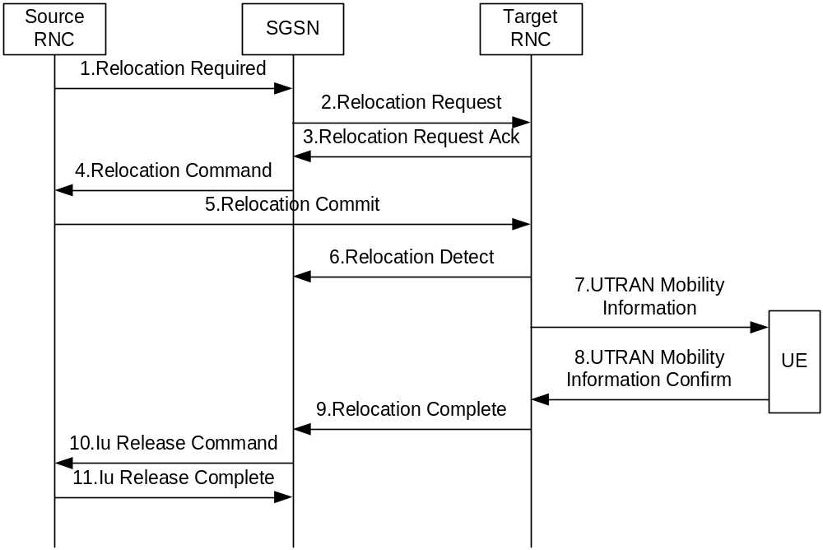
Relocation Triggered by Soft Handover
CN

Slide 109
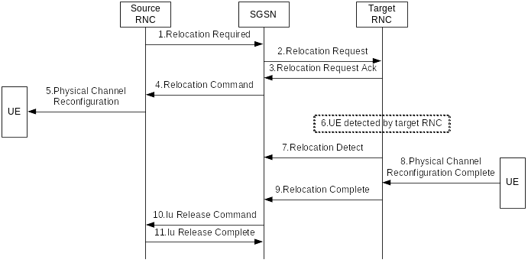
Relocation Triggered by Hard Handover
CN

