Slide 1
Air Interface

Slide 2
Air Interface
Radio Transmission Techniques
  FDMA
  TDMA
  CDMA
Channels
  Physical channels
  Logical channels

Slide 3
FDMA
Frequency
Channel
Time

Slide 4
TDMA
Frequency
Time Slot
Channel
Time
0
1
2
3
4
5
6
7

Slide 5
CDMA
Frequency
Code
Time
Code 1
Code 2
Code 3

Slide 6
Channels
Physical Channels
  Associated with frequency bands, time slots, codes
  Physical channels transfer bits from one network element to another
Logical Channels
  Distinguished by the nature of carried information and the way to assemble bits into data units
  Three types
    one-to-one: traffic channels between a BTS and a MS
    one-to-many: synchronization signals from BTS to MSs in a cell
    many-to-one: from MSs to the same BTS

Slide 7
Air Interface Layers
Messages
Layer 3
Messages
Messages
Logical
Channels
Layer 2
Packets
Logical
Channels
Radio
Transmission
Layer 1
Bits
Radio
Transmission
Terminal
Base
Station

Slide 8
GSM Frame Structure
Superframe
6.12 sec
...
51 Multiframe
120 msec
...
26 Frames
4.615 msec
0
7
8 Multiframe
Coded data
Midamble
0.57692 msec
156.25 bits
3
57
1
26
1
57
3
8.25
Tail bit
Stealing Flag
Guard period

Slide 9
Frame Types
There are two types of multiframe
  26 TDMA-frame multiframe is used to carry TCH, SACCH and FACCH
  51 TDMA-frame multiframe is used to carry BCCH, CCH, SDCCH and SACCH

Slide 10
Burst and Frames
The information contained in one time slot on the TDMA frame is call a burst.
Five types of burst
  Normal Burst (NB)
  Frequency Correction Burst (FB)
  Synchronization Burst (SB)
  Access Burst (AB)
  Dummy Burst

Slide 11
Logical Channel List
Traffic
channels
(TCH)
TCH/F: Full-rate Traffic Channel
Two-way
TCH/H: Half-rate Traffic Channel
FCCH: Frequency correction
BCH
SCH: Synchronization
BCCH: Broadcast control
Base-to-
mobile
Signaling
channel
PCH: Paging
CCCH
AGCH: Access grant
RACH: Random access
SDCCH: Stand-alone dedicated control
DCCH
SACCH: Slow associated control
Two-way
FACCH: Fast associated control

Slide 12
Logical Channels
Control Channels
  Broadcast Channels (BCH)
  Common Control Channels (CCCH)
  Dedicated Control Channels (DCCH)
Traffic Channels (TCH)
  Full Rate (TCH/F)
  Half Rate (TCH/H)

Slide 13
UP / Down-Link
Down-link: the transmission path from Base Station to Mobile Station
Up-link: the transmission path from Mobile Station to Base Station

Slide 14
Control Channels
Broadcast Channels (BCH)
  Frequency Correction Channel (FCCH)
  Synchronization Channel (SCH)
  Broadcast Control Channel (BCCH)
Common Control Channels (CCCH)
  Paging Channel (PCH)
  Random Access Channel (RACH)
  Access Grant Channel (AGCH)
Dedicated Control Channels (DCCH)
  Stand alone Dedicated Control Channel (SDCCH)
  Cell Broadcast Channel (CBCH)
  Slow Associated Control Channel (SACCH)
  Fast Associated Control Channel (FACCH)

Slide 15
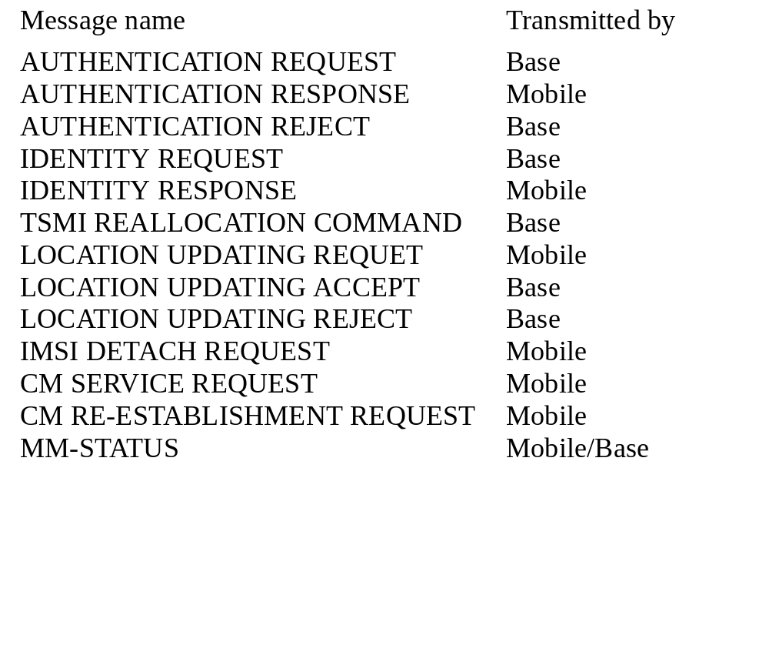
Mobility Management Messages

Slide 16
Call management messages
Message name
Transmitted by
Starting a call
SETUP
EMERGENCY SETUP
CALL PROCEEDING
PROGRESS
CALL CONFIRMED
ALERTING
CONNECT
Mobile/base
mobile
base
base
mobile
mobile/base
mobile/base
During a call
START DTMF
STOP DTMF
MODIFY
USER INFORMATION
Mobile
mobile
mobile/base
mobile/base
Ending a call
DISCONNECT
RELEASE
RELEASE COMPLET
Mobile/base
mobile/base
mobile/base
Abnormal conditions
STATUS
STATUS ENQUIRY
CONGESTION CONROL
Mobile/base
mobile/base
mobile/base

Slide 17
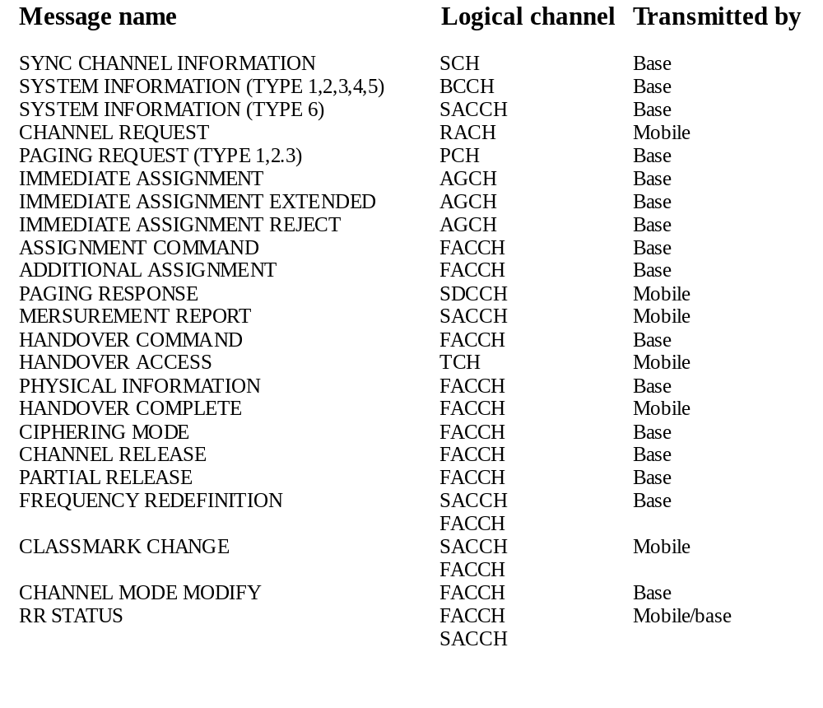
Radio Resources Management Messages

Slide 18
Message sequence and system operations for registration
of a terminal in a visited service area
Prior
MSC
Prior
VLR
Serving
VLR
Serving
MSC
Serving
Base
HLR
Store info
Registration info
REGISTRATION NOTIFICATION INVOKE
Store info
REGISTRATION NOTIFICATION INVOKE
Change info
REGISTRATION NOTIFICATION RESULT
REGISTRATION NOTIFICATION RESULT
REGISTRATION CANCELLATION INVOKE
remove info
REGISTRATION CANCELLATION RESULT
REGISTRATION CANCELLATION INVOKE
remove info
QUALIFICATION REQUEST INVOKE
REGISTRATION CANCELLATION RESULT
QUALIFICATION REQUEST RESULT
PROFILE REQUEST INVOKE
PROFILE REQUEST RESULT
Store info

Slide 19
Location-Updating Procedure
Mobile
station
Base
station
Category
Logical
Channel
Carrier sine wave
FCCH
SYNC CHANNEL INFORMATION
RRM
SCH
SYSTEM INFORMATION TYPE3
RRM
BCCH
CHANNEL REQUEST
RACH
RRM
IMMEDIATE ASSIGNMENT
AGCH
RRM
LOCATION UPDATING REQUEST
MM
SDCCH
AUTHENTICATION REQUEST
MM
SDCCH
AUTHENTICATION RESPONSE
MM
SDCCH
CIPHERING MODE COMMAND
RRM
SDCCH
CIPHERING MODE ACK
RRM
SDCCH
LOCATION UPDATING ACCEPT
MM
SDCCH
TMSI ALLOCATION COMPLETE
MM
SDCCH
CHANNEL RELEASE
RRM
SDCCH

Slide 20
Call Deliver to MH
Mobile
station
Base
station
Category
Logical
Channel
Carrier sine wave
SYNC CHANNEL INFORMATION
SYSTEM INFORMATION
PAGING REQUEST
CHANNEL REQUEST
IMMEDIATE ASSIGNMENT
PAGING RESPONSE
AUTHENTICATION REQUEST
AUTHENTICATION RESPONSE
CIPHERING MODE
CIPHERING MODE ACK
SETUP
CALL CONFIRMED
ALERTING
CONNECT
ASSIGNMENT COMMAND
ASSIGNMENT ACK
CONNECT ACK
conversation
conversation
conversation
DISCONNECT
RELEASE
RELEASE COMPLETE
CHANNEL RELEASE
RRM
RRM
RRM
RRM
RRM
RRM
MM
MM
RRM
RRM
CMCM
CM
CM
RRM
RRM
CM
CM
CM
CM
RRM
FCCH
SCH
BCCH
PCH
RACH
AGCH
SDCCH
SDCCH
SDCCH
SDCCH
SDCCH
SDCCH
SDCCH
SDCCH
SDCCH
SDCCH
SDCCH
FACCH
TCH
TCH
FACCH
FACCH
FACCH
FACCH

Slide 21
Mobile-Assisted Handover
Mobile
station
Base
station
Logical
Channel
conversation
conversation
MEASUREMENT REPORT
conversation
conversation
conversation
MEASUREMENT REPORT
conversation
HANDOVER COMMAND
HANDOVER ACCESS
HANDOVER ACCESS
HANDOVER ACCESS
PHYSICAL INFORMATION
HANDOVER COMPLETE
conversation
conversation
MEASUREMENT REPORT
conversation
conversation
conversation
MEASUREMENT REPORT
conversation
TCH
TCH
SACCH
TCH
TCH
TCH
SACCH
TCH
FACCH
new TCH
TCH
TCH
TCH
FACCH
TCH
TCH
SACCH
TCH
TCH
TCH
SACCH
TCH

Slide 22
Broadcast Channels (BCH)
To help the MH (Mobile Handset) measures
  to turn to a BTS
  to listen for the cell information
    to start roaming, waiting for calls to arrive, making calls
  Because BTSs are not synchronized with each other, every time a MH decides to camp to another cell, its FCCH, SCH, and BCCH must be read.

Slide 23
Frequency Correction Channel (FCCH)
Provide MH with the frequency reference of the system
  To enable the Mobile Handset (MH) to synchronize with the frequency
Transmission properties
  Transmit on the down-link
  Point to multi-point.

Slide 24
Synchronization Channel (SCH)
MH synchronize with the structure within the locative cell
  MH can receive information from the proper time slots on the TDMA structure
To ensure a GSM BTS is chose
  The Base Station Identity Code (BSIC) can only be decoded by a GSM BTS
Transmission properties
  Transmit on down-link
  Point to multi-point.

Slide 25
Broadcast Control Channel (BCCH)
BTS broadcast cell information to MH
  LAI ( Location Area Identity), to start roaming, waiting for calls to arrive, making calls
  maximum output power allowed in the cell
  information about BCCH carriers for the neighboring cells
    MH will perform measurement to BTS
Transmission properties
  Transmit on down-link
  Point to multi-point

Slide 26
Common Control Channels (CCCH)
CCCH support the establishment of a dedicated communication path (dedicated channel) between the MH and the BTS
Three types of CCCH
  Paging Channel (PCH)
  Random Access Channel (RACH)
  Access Grant Channel (AGCH)

Slide 27
Paging Channel (PCH)
Used by BTS to page particular MH in the cell
  MH actively listen to PCH to check contact info within certain time
  Contact could be incoming call or short message
Contact info on PCH include
  IMSI (MH’s identity number), or
  TMSI (temporary number)
Transmission properties
  Transmit on down-link
  point to point

Slide 28
Random Access Channel (RACH)
Used by MH to request a dedicated channel for call setup
  Shared by any MH attempts to access the network
  Channel request message contains the reason for the access attempt
Transmission properties
  Transmit on up-link
  Point to pint.

Slide 29
Access Grant Channel (AGCH)
The network assigns a signaling channel via AGCH
  A Stand alone Dedicated Control Channel (SDCCH) is assigned
Transmission properties
  Transmit on down-link
  Point to point

Slide 30
Dedicated Control Channels (DCCH)
DCCH are used for transferring nonuser information between the network and the MH
  Messages on DCCH Including
    channel maintenance
    mobility management
    radio resource management
Four kinds of DCCH
  Stand alone Dedicated Control Channel (SDCCH)
  Cell Broadcast Channel (CBCH)
  Slow Associated Control Channel (SACCH)
  Fast Associated Control Channel (FACCH)

Slide 31
Stand alone Dedicated Control Channel (SDCCH)
Transfer signaling information between the BTS and the MH
Typically used for location updating prior to use of a traffic channel
Transmission properties
  Bidirectional channel, transmit on both up and down-link
  Point to point.

Slide 32
Cell Broadcast Channel (CBCH)
To carry Short Message Service Cell Broadcast (SMSCB)
Use the same physical channel as SDCCH
Transmission properties
  Transmit on down-link
  Point to multi-point

Slide 33
Slow Associated Control Channel (SACCH)
Carries control and measurement parameters along with routine data necessary to maintain a radio link between the MH and the BTS
  On the uplink, MS sends averaged measurements (signal strength and quality) of current and neighboring BCCH
  On downlink, MS receives information about transmitting power to use and an instruction with time advance/retard
Transmission properties
  Bidirection channel, transmit on both up and down link
  Point to point

Slide 34
Fast Associated Control Channel (FACCH)
An FACCH is used over a TCH where it steals time slots from a TCH
  a 20 ms segment of speech is stolen to carry handover signaling information
Appears on demand

Slide 35
Traffic Channels (TCH)
TCH transport user information (speech/data)
TCH are bidirectional dedicated channels between the network and the MH

Slide 36
Location-Updating Procedure
Mobile
station
Base
station
Category
Logical
Channel
Carrier sine wave
FCCH
SYNC CHANNEL INFORMATION
RRM
SCH
SYSTEM INFORMATION TYPE3
RRM
BCCH
CHANNEL REQUEST
RACH
RRM
IMMEDIATE ASSIGNMENT
AGCH
RRM
LOCATION UPDATING REQUEST
MM
SDCCH
AUTHENTICATION REQUEST
MM
SDCCH
AUTHENTICATION RESPONSE
MM
SDCCH
CIPHERING MODE COMMAND
RRM
SDCCH
CIPHERING MODE ACK
RRM
SDCCH
LOCATION UPDATING ACCEPT
MM
SDCCH
TMSI ALLOCATION COMPLETE
MM
SDCCH
CHANNEL RELEASE
RRM
SDCCH

Slide 37
Call Deliver to MH
Mobile
station
Base
station
Category
Logical
Channel
Carrier sine wave
SYNC CHANNEL INFORMATION
SYSTEM INFORMATION
PAGING REQUEST
CHANNEL REQUEST
IMMEDIATE ASSIGNMENT
PAGING RESPONSE
AUTHENTICATION REQUEST
AUTHENTICATION RESPONSE
CIPHERING MODE
CIPHERING MODE ACK
SETUP
CALL CONFIRMED
ALERTING
CONNECT
ASSIGNMENT COMMAND
ASSIGNMENT ACK
CONNECT ACK
conversation
conversation
conversation
DISCONNECT
RELEASE
RELEASE COMPLETE
CHANNEL RELEASE
RRM
RRM
RRM
RRM
RRM
RRM
MM
MM
RRM
RRM
CMCM
CM
CM
RRM
RRM
CM
CM
CM
CM
RRM
FCCH
SCH
BCCH
PCH
RACH
AGCH
SDCCH
SDCCH
SDCCH
SDCCH
SDCCH
SDCCH
SDCCH
SDCCH
SDCCH
SDCCH
SDCCH
FACCH
TCH
TCH
FACCH
FACCH
FACCH
FACCH

Slide 38
Mobile-Assisted Handover
Mobile
station
Base
station
Logical
Channel
conversation
conversation
MEASUREMENT REPORT
conversation
conversation
conversation
MEASUREMENT REPORT
conversation
HANDOVER COMMAND
HANDOVER ACCESS
HANDOVER ACCESS
HANDOVER ACCESS
PHYSICAL INFORMATION
HANDOVER COMPLETE
conversation
conversation
MEASUREMENT REPORT
conversation
conversation
conversation
MEASUREMENT REPORT
conversation
TCH
TCH
SACCH
TCH
TCH
TCH
SACCH
TCH
FACCH
new TCH
TCH
TCH
TCH
FACCH
TCH
TCH
SACCH
TCH
TCH
TCH
SACCH
TCH

Slide 39
Burst
The information contained in one time slot is a burst
Five types of burst
  Normal Burst (NB)
    To carry information on traffic and control channels
  Frequency Correction Burst (FB)
    To synchronize the frequency of the mobile
  Synchronization Burst (SB)
    To synchronize the frames of the mobile
  Access Burst (AB)
    For random and handover access
  Dummy Burst
    For padding the frame

Slide 40
Bursts and Frames
There are two types of multiframe
  26 TDMA-frame multiframe is used to carry TCH, SACCH and FACCH
  51 TDMA-frame multiframe is used to carry BCCH, CCH, SDCCH and SACCH

Slide 41
Bursts and Frames
1 hyperframe = 2048 superframes = 2,715,648 TDMA frames (3 hours 28 minutes 53 seconds 760 microseconds)
...
0
1
2
3
4
5
2043
2044
2045
2046
2047
1 superframe = 1326 TDMA frames (6.12 seconds)
= 51 (26-frame) multiframes or 26 (51-frame) multiframes
...
0
1
2
3
47
48
49
50
0
1
...
24
25
0
1
...
24
25
0
1
...
49
50
1 (26-frame) multiframe
= 26 TDMA frames (120 ms)
1 (51-frame) multiframe
= 51 TDMA frames (120 ms)
0
1
2
3
4
5
6
7
1TDMA frame = 8 timeslots
(120/26 =~ 4.615 ms)

Slide 42
Bursts and Frames
1 TDMA frame = 8 timeslots
0
1
2
3
4
5
6
7
1 timeslot = 156.25 bit durations (15/26 =~ 0.577 ms)
(1 bit duration 48/13 =~ 3.69 micro sec)
Normal Burst (NB)
TB
3
Encrypted bits 57
flag
1
Training sequence 26
flag
1
Encrypted bits 57
TB
3
GP
8.25
TB: Tail bits
GP: Guard period
Frequency correction
burst (FB)
TB
3
Fixed bits 142
TB
3
GP
8.25
Synchronization
burst (SB)
TB
3
Encrypted bits 39
Synchronization sequence 64
Encrypted bits 39
TB
3
GP
8.25
Access burst (AB)
TB
3
Synchronization sequence
41
Encrypted bits 36
TB
3
GP 68.25
Dummy burst (DB)
TB
3
Mixed bits 58
Training sequence 26
Mixed bits 58
TB
3
GP
8.25

Slide 43
Normal Burst
T3
Coded Data
57
S1
Training
Sequence 26
S1
Coded
Data 57
T3
GP
8.25
148 bits = 0.54612 msec
This burst is used to carry information on TCH and on the control channels
BCCH, PCH, AGCH, SDCCH, ASCCH and FACCH.
Note: GP (Guard Period)

Slide 44
Random Access Burst
T8
Synchronization
sequence 41
Coded Data
36
T3
Guard Period
68.25
88 bits = 0.32472 msec
68.25 bits = 0.252 msec which is equivalent to 75.5 km
propagation delay.
That is, the max. allowed distance between mobile station
and BTS is 37.75 km. Based on other system parameters,
the max cell size is 35 km in GSM.

Slide 45
Logical Channels Characteristics
Logical
Uplink-
Downlink-
Both
uplink
Point-
Broadcast
Dedicated
shared
Channel
only
only
&
downlink
to-pint
BCCH
√
√
√
FCCH
√
√
√
SCH
√
√
√
RACH
√
√
√
PCH
√
√
√
AGCH
√
SDCCH
√
√
√
√
√
SACCH
√
√
√
FACCH
√
√
TCH
√
√
√
√

Slide 46
GSM Architecture

Slide 47


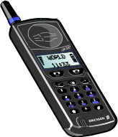

GSM System Architecture
HLR/
VLR
UM
Handset
A-bis
BSC
A
MSC
SS7
PSTN
X.25
BTS
OMC
(Operation & Maintenance
Center)
Operation
Terminal
Data Terminal
SIM
card
Mobile
station
Radio
sub-system
Network sub-system
PSTN

Slide 48
GSM Network Elements
Handset
BTS: Base Transceiver Station
MSC: Mobile Switching Center
BSC: Base Station Controller
HLR/VLR: Home Location Register/Visiting Location Register
SIM Card: Subscriber Identity Module Card
Service Centers: USSD, SMS, ...

Slide 49
Mobile Handset (MH)
Used by the subscriber to access the GSM network via the air interface
Contains the hardware and software specific to the radio interface
Need a Subscriber Identity Module (SIM) which contains the subscriber-specific data to access GSM network, except emergency call

Slide 50
Base Transceiver Station (BTS)
/ Base Station
Responsible for communication to and from MHs via air interface
  MH communicates with the mobile system using a radio channel to a BTS
BTS comprises radio transmission and reception devices
  Including the antennae and signaling processing specific to the radio interface
BTS separates the speech and control signaling associated with a MH and sends them to the BSC on separate channels

Slide 51
Mobile services Switching
Center (MSC)
Responsible for all switching functions related to call processing
  Coordinate the setting up of calls to and from GSM users
MSC is the interface between GSM network & PSTN (Public Switched Telephone Network)

Slide 52
Base Station Controller (BSC)
Monitor and Control several base stations
  Frequency administration, control of BTSs, exchange functions
Responsible for all the radio interface management
  Channel allocation and release, handover management
BSC is the interface between MSC and BTS
  BSC is connected on one side to several BTSs and on the other side to the MSC

Slide 53
Home Location Register (HLR)
A database in charge of the management of mobile subscribers
Contains information of network subscribers
  Information on teleservices and bearer services subscription, service restrictions, and supplementary services
  The data stored in HLR is of a semipermanent nature and does not usually change from call to call

Slide 54
Visitor Location Register (VLR)
Contains the relevant data of all MHs currently located in a serving MSC
  The permanent data is the same as data in the HLR
  The temporary data includes
    Temporary Subscriber Identity (TMSI)
    Location Area Identity (LAI) of an MH
  VLR allocates mobile subscriber roaming numbers (MSRNs) for the incoming call setup

Slide 55
Subscriber Identity Module (SIM)
Subscriber Identity Module
  Contains
    phone number (MSISDN)
    international mobile subscriber identity (IMSI)
    status of SIM
    service code
    authentication key
    PIN (personal identification code)
    PUK (personal unlock code)

Slide 56
SIM Cards
SIM cards are embedded with a microprocessor
  Stores customer identity information and is made to fit inside the cellular phone
Memory capacity
  1K, 3K, 8K, 16K
  With/Without OTAC (Over The Air Customization)
Two types of SIM card form factors
  ID-1 SIM
  Plug-In SIM

Slide 57
Application Service Centers
Responsible for GSM network add-on services
  Operation and Maintenance Center (OMC)
    Monitoring and control the network
    Usually connect with MSC, BSC, HLR, and other service centers
  Short Message Service Center (SMSC)
    provide short message services
    usually connect to MSC
  Unstructured Supplementary Service Data Center (USSDC)
    provide USSD service in the form of *ID*ID*info#
    usually connect to HLR

Slide 58
Geographical Network Structure
Location Units
  Cell
  Location Area (LA)
  MSC/VLR Service Area
  PLMN (Public Land Mobile Network) Service Area
  GSM Service Area
Cell Planning

Slide 59
Location Information --
GSM Service Area Hierarchy
The area in which a subscriber can access the network.
GSM Service Area
PLMN Service Area
(one per operator)
MSC/VLR
Location Area
cell

Slide 60
Cell Characteristics
The Basic Union In The System
  defined as the area where radio coverage is given by one base station.
Addressed by Cell Global Identity (CGI)
A cell has one or several frequencies, depending on traffic load.
  Frequencies are reused, but not used in neighboring cells due to interference.

Slide 61
Cell Planning
Reusing frequencies in different geographic areas:
  7 cell repeat pattern is typical, but other patterns are also common
7-cell reuse
pattern
A3
A1
A1
G1
A2
B1
A3
G3
B3
A2
B1
G2
C1
B2
G3
G1
B3
C3
G2
C1
B2
F1
C2
D1
C3
F3
D3
C2
D1
F2
E1
D2
F3
F1
D3
E3
E1
D2
E2
F2
E3
E2
Frequency
reuse

Slide 62
Cell Patterns
4
1
3
5
1
2
2
6
3
7
K=7
K=3

Slide 63
Frequency Utilization v.s. K
Frequency can’t be reused in the same pattern
Larger K
  More channels in a pattern
  Higher subscriber number
  Worse frequency reusability
Smaller K
  Less channels in a pattern, high channel distortion
  Smaller subscriber number
  Better frequency reusability

Slide 64
Numbering & Routing

Slide 65
Numbering
Mobile Subscriber ISDN Number (MSISDN)
  Mapping to Mobile Station Roaming Number (MSRN) by HLR
International Mobile Subscriber Identify (IMSI)
  Stored in SIM/HLR
Temporary Mobile Subscriber Identity (TMSI)
  Assigned by VLR, Stored in VLR
International Mobile Equipment Identity (IMEI)
  Unique ID to handset, used by air interface

Slide 66
ID-Numbers
MSISDN = CC + NDC + SN
  MSISDN: Mobile Station ISDN Number
  CC Country Code
  NDC National Destination Code
  SN Subscriber Number
IMSI = MCC + MNC + MSIN
  IMSI International Mobile Subscriber Identity
  MCC Mobile Country Code
  MNC Mobile Network Code
  MSIN Mobile Station Identification Number

Slide 67
ID-Numbers (cont.)
IMEI = TAC + FAC + SNR + spare
  IMEI Internal Mobile Equipment Identity
  TAC Type Approval Code, determined by a central GSM/PCS body
  FAC Final Assembly Code, identifies the manufacturer
  SNR Serial Number, uniquely identifies all equipment within each TAC and FAC
IMEISV = TAC + FAC + SNR + SVN
  IMEISV International Mobile Equipment Identity and Software Version Number
  SVN Software Version Number

Slide 68
ID-Numbers (cont.)
MSRN = CC + NDC + SN
  MSRN Mobile Station Roaming Number
  CC Country Code
  NDC National Destination Code
  SN Subscriber Number. In this case, the address to the serving MSC
LAI = MCC + MNC + LAC
  MCC Mobile Country Code
  MNC Mobile Network Code
  LAC Location Area Code

Slide 69
ID-Numbers (cont.)
CGI = MCC + MNC + LAC + CI
  CGI Cell Global Identity
  CI Cell Identity
BSIC = NCC + BCC
  BSIC Base Station Identity Code
  NCC Network Color Code (3bits)
  BCC Base Station Color Code (3bits)
LN = CC + NCD + LSP
  LN Location Number
  CC Country Code
  NCD National Destination Code
  LSP Locally Significant Part

Slide 70
ID -Numbers (cont.)
LN = CC + NCD + LSP
  LN Location Number
  CC Country Code
  NCD National Destination Code
  LSP Locally Significant Part
RSZI = CC + NDC + ZC
  RSZI Regional Subscription Zone Identity
  CC Country Code
  NDC National Destination Code
  ZC length of the Zone code (2 octets)

Slide 71
Routing
Information resident in MS & SIM
  IMSI, TMSI, IMEI, and misc. information
Routing Information used by Network
  MSISDN, MSRN

Slide 72
Location Registry

Slide 73
Location Registry
Registration Message Flow
  Inter-LA movement
    In the same MSC
  Inter-MSC movement
    In the same GSM Operator
  Inter-VLR movement

Slide 74
Registration Message Flow
-- Inter-LA Movement
HLR
VLR1
VLR2
3
2
MSC1
MSC2
4
1
LA1
LA2

Slide 75
Registration Message Flow
-- Inter-MSC Movement
HLR
4
VLR2
3
VLR1
5
2
MSC1
MSC2
6
1
LA1
LA2

Slide 76
Registration Message Flow
-- Inter-VLR Movement
HLR
7
5
VLR1
8
4
VLR2
3
2
MSC1
MSC2
1
6
LA1
LA2

Slide 77
Message sequence and system operations for registration
of a terminal in a visited service area
Prior
MSC
Prior
VLR
Serving
VLR
Serving
MSC
Serving
Base
HLR
Store info
Registration info
REGISTRATION NOTIFICATION INVOKE
Store info
REGISTRATION NOTIFICATION INVOKE
Change info
REGISTRATION NOTIFICATION RESULT
REGISTRATION NOTIFICATION RESULT
REGISTRATION CANCELLATION INVOKE
remove info
REGISTRATION CANCELLATION RESULT
REGISTRATION CANCELLATION INVOKE
remove info
QUALIFICATION REQUEST INVOKE
REGISTRATION CANCELLATION RESULT
QUALIFICATION REQUEST RESULT
PROFILE REQUEST INVOKE
PROFILE REQUEST RESULT
Store info

Slide 78
Call Setup

Slide 79
Mobile-originated call, mobile to land call flow (part 1 of 2)
MS
BSS
MSC/VLR
HLR
PSTN
Channel REQuest
IMMediate ASSign
Complete layer 3 Info,
AUThentication REQuest
AUThentication RESponse
Cipher Mode Complete
Cipher Mode CMD
Cipher Mode CMD
Cipher Mode Complete
TMSI REALlocation CoMmanD
TMSI REALlocation COMplete
SETUP

Slide 80
Mobile-originated call, mobile to land call flow (part 2 of 2)
MS
BSS
MSC/VLR
HLR
PSTN
CALL PROCeeding
Assignment Request
ASSignment CoMmanD
Assignment Complete
Assignment Complete
Initial Address Message (IAM)
Address Complete message (ACM)
Alerting
Answer Signal/answer Message(ANM)
connect
Connect Acknowledge

Slide 81
Call setup to a roaming subscriber
Prior
MSC
Prior
VLR
Serving
VLR
Serving
MSC
Serving
Base
HLR
Receive call
setup request
LOCATION REQUEST INVOKE
ROUTE REQUEST INVOKE
ROUTE REQUEST INVOKE
ROUTE REQUEST RESULT
ROUTE REQUEST RESULT
LOCATION REQUEST RESULT
Call setup request
(temporary phone number)
Page command
PAGE
Delete MIN
VMPS call setup
conversation

Slide 82

Call Delivery
2.
HLR
MSISDN
GMSC
1.
PSTN
3.
5.
MSISDN-->IMSI-->
MSC/VLR Service Area
5.
MSRN
MSISDN
6.
IMSI
4.
MSC/VLR
IMSI<-->MSRN
7.
BSC
8.
8.
9.
BTS
BTS
BTS

Slide 83
Mobile-terminated call, land to mobile call flow (part 1 of 2)
MS
BSS
MSC/VLR
HLR
PSTN
Send routing info.
Provide roaming number
Roaming number
Routing information
Initial address message
Paging command
Paging request
Channel request
Immediate assign
Complete layer 3 info.
Authentication request
Authentication response
Cipher mode cmd
Cipher mode cmd
Cipher mode cmd
Cipher mode complete

Slide 84
Mobile-terminated call, mobile to land call flow (part 2 of 2)
MS
BSS
MSC/VLR
HLR
PSTN
TMSI reallocation command
TMSI reallocation complete
SETUP
Call confirmed
Assignment request
Assignment command
Assignment complete
Assignment complete
alerting
Address complete message
connect
Connect acknowledge
Answer signal /answer message

Slide 85
Call request at
home MSC
Terminal
idle and
subscriber
responds
Terminal
busy
No answer
or no page
response
Unconditional
call forwarding
Call
waiting
Call
forwarding
Fig. 4.5
Busy
indication
to caller
Action by
serving
MSC
Announcement
to caller
HLR sends call forwarding
number to home MSC
Example of call management scenarios

Slide 86
Handover

Slide 87
Location update call flow
MS
BSS
MSC
VLR
HLR
VLR
Location Update in new MSC
Send para
(authentication)
Authenticate
Authentication Prar.
Authentication Resp,
Update location
Insert subscriber data
Subs. Data Ins. Acc.
Loc.n update acc
Start ciphering
Cancel location
Forward new TMSI
Loc.n cancellation acc.
Loc.n area up. acc

Slide 88
Inter-MSC handover
BSS1
MSC-A
MSC-B
BSS2
VLR-B
MS
Handover request
Perform handover
Allocate handover number
Handover request
Send handover report
Handover request ack
Radio channel ack
Initial address message
Address complete message
Handover command
Handover command
Handover access
Handover detect physical information
Handover complete
Handover complete
Answer signal
Send end signal
Clear command
Clear complete
End signal
Remove handover report

Slide 89
The Use of MSRN
HLR
MSISDN
2
MSISDN
GMSC
MSRN
PSTN
5
1
3
4
IMSI
MSRN
MSRN
6
VLR
MSC
IMSI
MSRN

