Slide 1
Click Modular Router
Research Internship
2011-2012
Hoang Trung Hieu
Notes:
Telecommunicatiesystemen II
Academiejaar 1999-2000
Part I : Digital Telephony
Telecommunicatiesystemen II
Academiejaar 1999-2000
Part I : Digital Telephony
Telecommunicatiesystemen II
Academiejaar 1999-2000
Part I : Digital Telephony

Slide 2
Click Modular Router Overview
  Dr. Eddie Kohler PhD thesis at MIT (2000)
  A new software architecture for building flexible and configurable router [*]
  A Click router is a set of connected packet processing modules (elements) [*]
  Provide framework to develop elements with specific purpose
  [*] Dr. Eddie Kohler PhD thesis
Notes:
Telecommunicatiesystemen II
Academiejaar 1999-2000
Part I : Digital Telephony
Telecommunicatiesystemen II
Academiejaar 1999-2000
Part I : Digital Telephony
Telecommunicatiesystemen II
Academiejaar 1999-2000
Part I : Digital Telephony

Slide 3
Internship Objectives
  Have understanding of Click architecture and apply in building software router
  Identify the functionalities available for IPv4 but missing for IPv6
  Implement some missing functionalities according to their priority of importance
  Benchmark IPv4 and IPv6 elements implementation
Notes:
Telecommunicatiesystemen II
Academiejaar 1999-2000
Part I : Digital Telephony
Telecommunicatiesystemen II
Academiejaar 1999-2000
Part I : Digital Telephony
Telecommunicatiesystemen II
Academiejaar 1999-2000
Part I : Digital Telephony

Slide 4
Internship Objectives
  Have understanding of Click architecture and apply in building software router
  Identify the functionalities available for IPv4 but missing for IPv6
  Implement some missing functionalities according to their priority of importance
  Benchmark IPv4 and IPv6 elements implementation
Notes:
Telecommunicatiesystemen II
Academiejaar 1999-2000
Part I : Digital Telephony
Telecommunicatiesystemen II
Academiejaar 1999-2000
Part I : Digital Telephony
Telecommunicatiesystemen II
Academiejaar 1999-2000
Part I : Digital Telephony

Slide 5
Configuration Script
  Example of Click router elements
  Diagram
  Script
  source::ICMPPingSource(10.0.0.1, 10.0.0.2);
  responder::ICMPPingResponder;
  source->responder;
  responder->source;
  Note
  ICMPPingSource: periodically sends ICMP echo requests
  ICMPPingResponder: respond to ICMP echo requests
ICMPPingSource
ICMPResponder
Notes:
Telecommunicatiesystemen II
Academiejaar 1999-2000
Part I : Digital Telephony
Telecommunicatiesystemen II
Academiejaar 1999-2000
Part I : Digital Telephony
Telecommunicatiesystemen II
Academiejaar 1999-2000
Part I : Digital Telephony

Slide 6
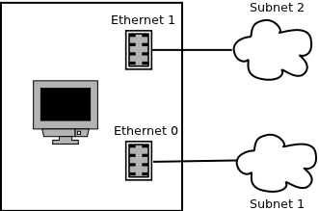
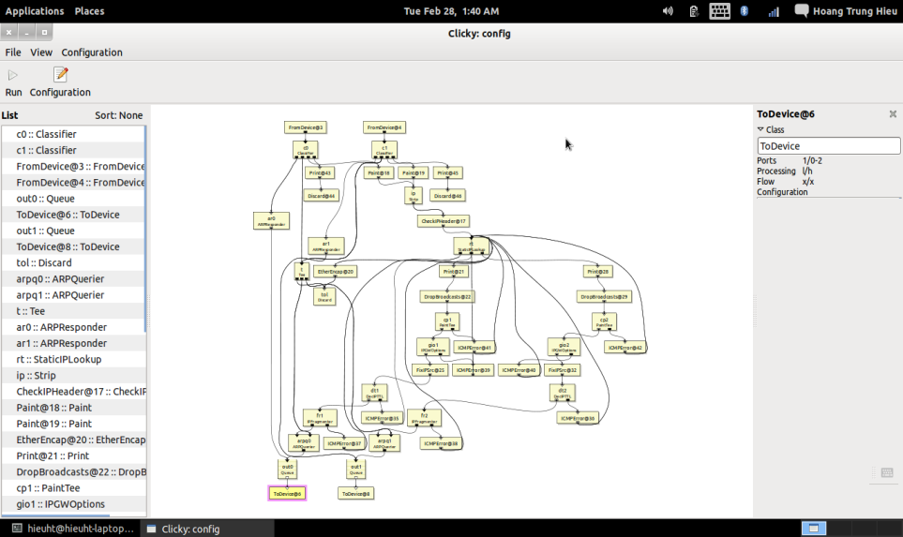
Configuration Script
IP Router implementation
Notes:
Telecommunicatiesystemen II
Academiejaar 1999-2000
Part I : Digital Telephony
Telecommunicatiesystemen II
Academiejaar 1999-2000
Part I : Digital Telephony
Telecommunicatiesystemen II
Academiejaar 1999-2000
Part I : Digital Telephony

Slide 7
Internship Objectives
  Have understanding of Click architecture and apply in building software router
  Identify the functionalities available for IPv4 but missing for IPv6
  Implement some missing functionalities according to their priority of importance
  Benchmark IPv4 and IPv6 elements implementation
Notes:
Telecommunicatiesystemen II
Academiejaar 1999-2000
Part I : Digital Telephony
Telecommunicatiesystemen II
Academiejaar 1999-2000
Part I : Digital Telephony
Telecommunicatiesystemen II
Academiejaar 1999-2000
Part I : Digital Telephony

Slide 8
IPv6 Support in Click
Originally, Click Modular Router mainly developed for IPv4 stack
IPv4 address pool is depleted and IPv6 is gradually becoming popular
Only few IPv6 elements have been implemented
Some critical functionalities are missing
Some existing IPv6 elements are not implemented efficiently
Notes:
Telecommunicatiesystemen II
Academiejaar 1999-2000
Part I : Digital Telephony
Telecommunicatiesystemen II
Academiejaar 1999-2000
Part I : Digital Telephony
Telecommunicatiesystemen II
Academiejaar 1999-2000
Part I : Digital Telephony

Slide 9
List of missing functionalities
Basic functionalities:
  IPv6 classifier
  Set IPv6 header fields
  Process IPv6 header extensions
ICMPv6 functionalities
DHCPv6 functionalities
Notes:
Telecommunicatiesystemen II
Academiejaar 1999-2000
Part I : Digital Telephony
Telecommunicatiesystemen II
Academiejaar 1999-2000
Part I : Digital Telephony
Telecommunicatiesystemen II
Academiejaar 1999-2000
Part I : Digital Telephony

Slide 10
Internship Objectives
  Have understanding of Click architecture and apply in building software router
  Identify the functionalities available for IPv4 but missing for IPv6
  Implement some missing functionalities according to their priority of importance
  Benchmark IPv4 and IPv6 elements implementation
Notes:
Telecommunicatiesystemen II
Academiejaar 1999-2000
Part I : Digital Telephony
Telecommunicatiesystemen II
Academiejaar 1999-2000
Part I : Digital Telephony
Telecommunicatiesystemen II
Academiejaar 1999-2000
Part I : Digital Telephony

Slide 11
Missing functionalities implementation
Selected elements
  IPv6 classifier
  IPv6 fragmenter
  Hop-by-Hop and Routing Header processing elements
Why?
  Frequently used in configuration script
  Cover almost all fields in IPv6 packet
  Easily re-used when implement other IPv6 elements
Notes:
Telecommunicatiesystemen II
Academiejaar 1999-2000
Part I : Digital Telephony
Telecommunicatiesystemen II
Academiejaar 1999-2000
Part I : Digital Telephony
Telecommunicatiesystemen II
Academiejaar 1999-2000
Part I : Digital Telephony

Slide 12
IP6Classifier Element
Usage
  IP6Classifier classifies IPv6 packet stream by patterns regulated by user. Each element's output port is associated with corresponding pattern
Implementation
  Not re-use code in IPv4 classifier
  Use union data structure for all IPv6 header extension
  Implementation consists of parser module and packet processing module
Limitation
  Not support combination of primitive patterns
Notes:
Telecommunicatiesystemen II
Academiejaar 1999-2000
Part I : Digital Telephony
Telecommunicatiesystemen II
Academiejaar 1999-2000
Part I : Digital Telephony
Telecommunicatiesystemen II
Academiejaar 1999-2000
Part I : Digital Telephony

Slide 13
IP6Fragmenter Element
Usage
  If the packet size is greater than MTU, IP6Fragmenter splits packet into fragments with size <=MTU and emits to output port
Implementation
  Divide packet into unfragmentable and fragmentable parts
  Keep unfragmentable part unchanged (*) and insert fragment extension header to every new fragments
  Emit fragments to output port
Limitation
  Extension header data structure does not support Encapsulating Security Payload header.
  (*) except Payload Length and Next Header field of the last header in unfragmentable part
Notes:
Telecommunicatiesystemen II
Academiejaar 1999-2000
Part I : Digital Telephony
Telecommunicatiesystemen II
Academiejaar 1999-2000
Part I : Digital Telephony
Telecommunicatiesystemen II
Academiejaar 1999-2000
Part I : Digital Telephony

Slide 14
IP6HopByHop Element
Usage
  If the packet is jumbo packet then push to output port 1, if it is Router Alert packet then emits on output port 2, error jumbo packet emits on output port 3. Default output port is 0 (for the rest)
Implementation
  Process the Hop by Hop header extension for different Option Type
Notes:
Telecommunicatiesystemen II
Academiejaar 1999-2000
Part I : Digital Telephony
Telecommunicatiesystemen II
Academiejaar 1999-2000
Part I : Digital Telephony
Telecommunicatiesystemen II
Academiejaar 1999-2000
Part I : Digital Telephony

Slide 15
IP6Routing Element
Usage
  If the packet has Routing header extension type 0, it will be processed accordingly before being emitted to output port.
Implementation
  The current destination address and the address in the (N – Segments Left + 1) position in the list of addresses are swapped, where N is the total number of addresses in the Routing header.
  The Segments Left field is decremented.
  Emit fragments to output port
Limitation
  Routing Type 0 header is deprecated by IETF
  Routing Type 2 header used in Mobile IPv6 is not supported.
Notes:
Telecommunicatiesystemen II
Academiejaar 1999-2000
Part I : Digital Telephony
Telecommunicatiesystemen II
Academiejaar 1999-2000
Part I : Digital Telephony
Telecommunicatiesystemen II
Academiejaar 1999-2000
Part I : Digital Telephony

Slide 16
Internship Objectives
  Have understanding of Click architecture and apply in building software router
  Identify the functionalities available for IPv4 but missing for IPv6
  Implement some missing functionalities according to their priority of importance
  Benchmark IPv4 and IPv6 elements implementation
Notes:
Telecommunicatiesystemen II
Academiejaar 1999-2000
Part I : Digital Telephony
Telecommunicatiesystemen II
Academiejaar 1999-2000
Part I : Digital Telephony
Telecommunicatiesystemen II
Academiejaar 1999-2000
Part I : Digital Telephony

Slide 17
IPv4&6 Elements Performance
Performance of elements is measured merely by CPU consumption while running a configuration script with different bit rates
The configuration scripts used should be as simple as possible in order to have accurate evaluation
Notes:
Telecommunicatiesystemen II
Academiejaar 1999-2000
Part I : Digital Telephony
Telecommunicatiesystemen II
Academiejaar 1999-2000
Part I : Digital Telephony
Telecommunicatiesystemen II
Academiejaar 1999-2000
Part I : Digital Telephony

Slide 18
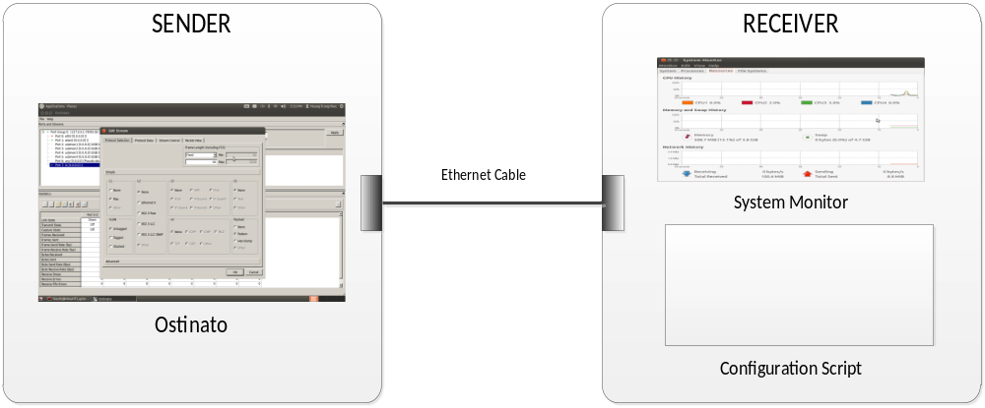
Experiment Model
Ostinato is used to generate traffic with different bit rates
CPU consumption is monitored by System Monitor package
Notes:
Telecommunicatiesystemen II
Academiejaar 1999-2000
Part I : Digital Telephony
Telecommunicatiesystemen II
Academiejaar 1999-2000
Part I : Digital Telephony
Telecommunicatiesystemen II
Academiejaar 1999-2000
Part I : Digital Telephony

Slide 19
Testbed
Sender
  Processor: Intel(R) Core(TM) i5-2410M CPU @ 2.30GHz 2.30GHz
  Installed memory (RAM): 4.00GB
  System type: 64-bit Operating System
  Operating System: Ubuntu 12.04 LTS 64-bit
  Interface card: 1000Mbps LAN
Limitation
  Processor: Intel(R) Atom(TM) CPU N455 @1.66Ghz 1.67Ghz
  Installed memory (RAM): 2.00GB
  System type: 32-bit Operating System
  Operating System: Ubuntu 12.04 LTS 32-bit
  Interface card: 100Mbps LAN
Notes:
Telecommunicatiesystemen II
Academiejaar 1999-2000
Part I : Digital Telephony
Telecommunicatiesystemen II
Academiejaar 1999-2000
Part I : Digital Telephony
Telecommunicatiesystemen II
Academiejaar 1999-2000
Part I : Digital Telephony

Slide 20
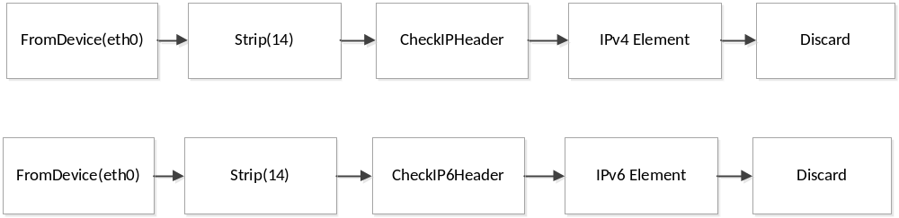
Experiment
Elements selected to test
  IPCheckHeader and IP6CheckHeader
  IPClassifier and IP6Classifier
  IPFragmenter and IP6Fragmenter
  SetIPAddress and SetIP6Address
  MarkIPHeader and MarkIP6Header
Test configuration
Notes:
Telecommunicatiesystemen II
Academiejaar 1999-2000
Part I : Digital Telephony
Telecommunicatiesystemen II
Academiejaar 1999-2000
Part I : Digital Telephony
Telecommunicatiesystemen II
Academiejaar 1999-2000
Part I : Digital Telephony

Slide 21
Experiment Result
With low bit rates (around 1 Mbps) there is no big difference in performance between IPv4 and IPv6 implementation but in higher bit rates, IPv4 elements consume less CPU resource than corresponding IPv6 elements.
As compared to the other built-in IPv6 elements in Click (version 2.0.1), new elements written in this internship are less efficient
Notes:
Telecommunicatiesystemen II
Academiejaar 1999-2000
Part I : Digital Telephony
Telecommunicatiesystemen II
Academiejaar 1999-2000
Part I : Digital Telephony
Telecommunicatiesystemen II
Academiejaar 1999-2000
Part I : Digital Telephony

Slide 22
Future Work
Implement elements supporting ICMPv6 and DHCPv6 functionalities.
Optimize code in current implementation in order to improve performance
Benchmark IPv6 elements when they co-work together in more complex configuration and compare to IPv4 implementation.
Notes:
Telecommunicatiesystemen II
Academiejaar 1999-2000
Part I : Digital Telephony
Telecommunicatiesystemen II
Academiejaar 1999-2000
Part I : Digital Telephony
Telecommunicatiesystemen II
Academiejaar 1999-2000
Part I : Digital Telephony

Slide 23
THANK YOU
Notes:
Telecommunicatiesystemen II
Academiejaar 1999-2000
Part I : Digital Telephony
Telecommunicatiesystemen II
Academiejaar 1999-2000
Part I : Digital Telephony
Telecommunicatiesystemen II
Academiejaar 1999-2000
Part I : Digital Telephony

