Slide 1
FC Twente Players analysis
FC TWENTE PROJECT GROUP 1
Using Pitch Control and Expected Threat for evaluating and ranking players

Slide 2



Understand football data
Analysis and pre-processing of football match data for key insights and easier usage
1
Fair performance evaluation
2
Find a metric to evaluate player's performance not only by assists or goals but by their impact during the game
FC TWENTE PROJECT GROUP 1
Project Goals
Comparision and ranking
3
Use visual charts to show the comparison and ranking between all players
An analytics project on evaluating and ranking player performance
4

Slide 3
Performance Evaluation
PITCH CONTROL & EXPECTED THREAT
For evaluating players' actions based on their performance during the game, 2 models have been used.
Pitch Control: To evaluate the possession region of each team - the success probability of player's actions
Expected Threat(xT): To evaluate the threat value of each location - the scoring chance given the ball is moved to that position
FC Twente Players analysis

Slide 4



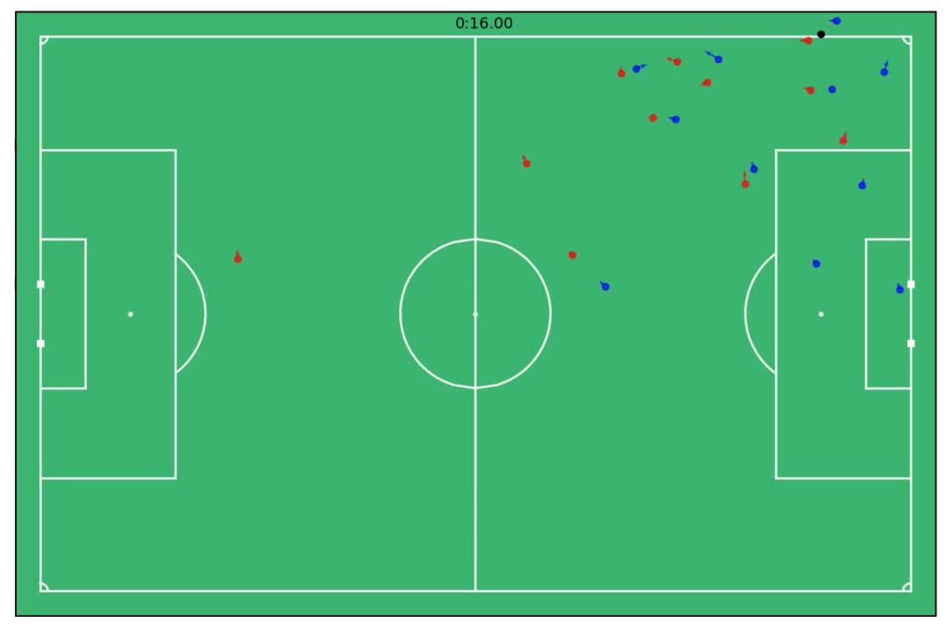
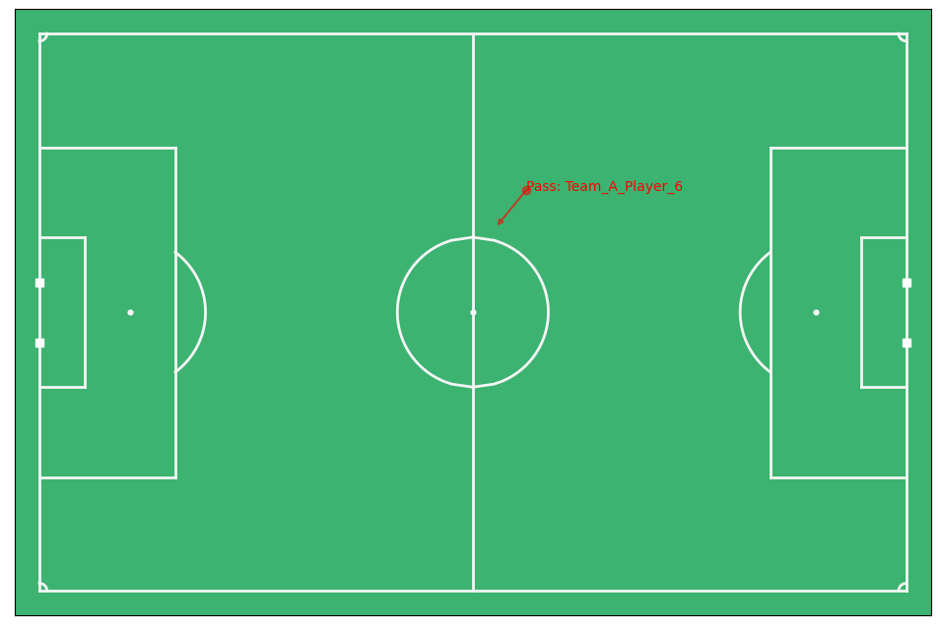
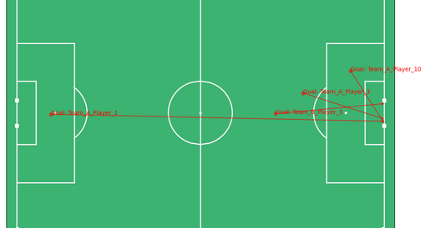
EVENT ANALYSIS
Plot the specific event by type and players
plot sequences of events
all players transition all over the sequence of events
Single passing event
Sequence of event that lead to a goal
Passing stats
Passing Accuracy per team
1
Passing Rate
Passing Accuracy
Passing Accuracy
0.75
Team A
0.5
0.25
Team B
0
0
0.25
0.5
0.75
1
A video that captures the motion of all players in a sequence of event
Team A
Team B

Slide 5
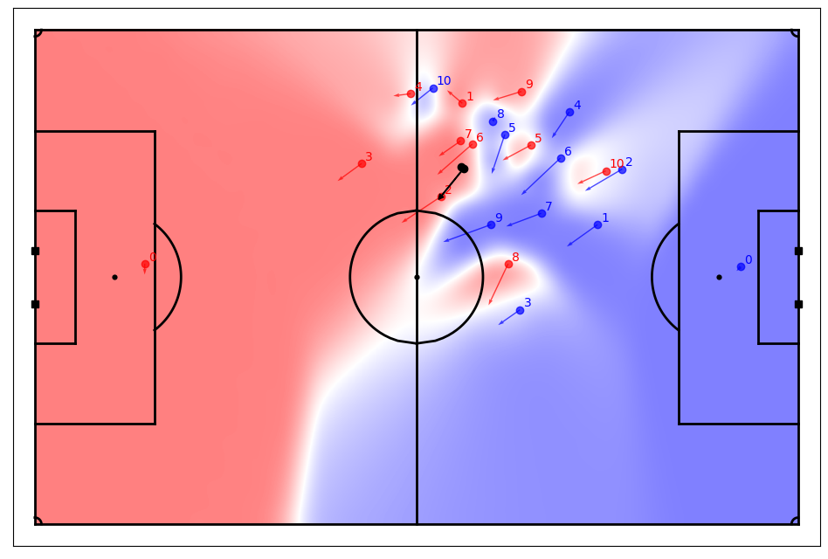
Pitch Control Analysis
FC Twente Players analysis
REPRESENT COVERAGE OF PLAYERS
Pitch control shows the possession region of each team in a specific event of the game
Assumptions:
Ball speed = 15m/s
End position - Start position of ball = 30m
Player max speed = 5m/s

Slide 6
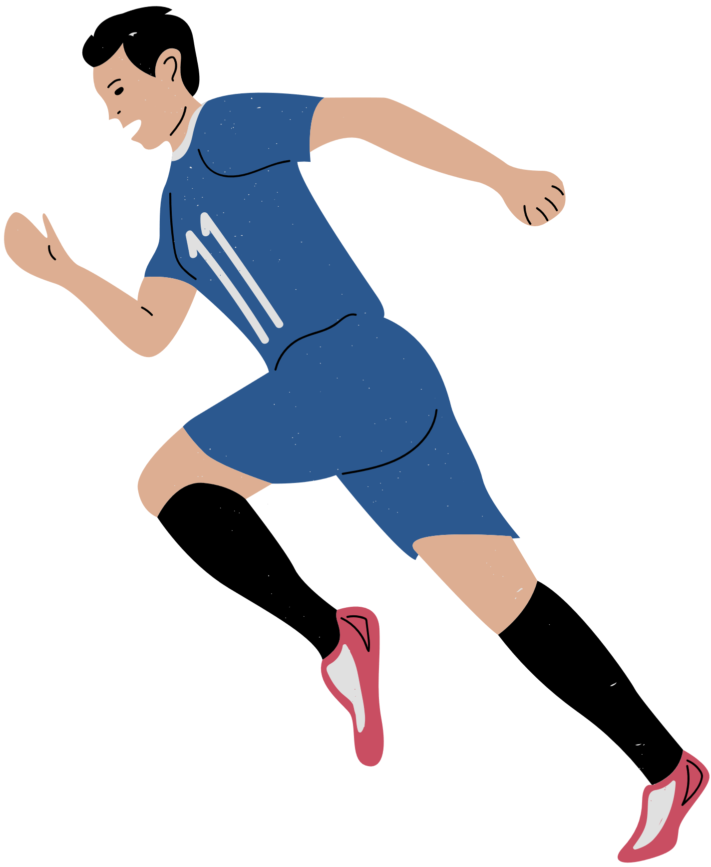


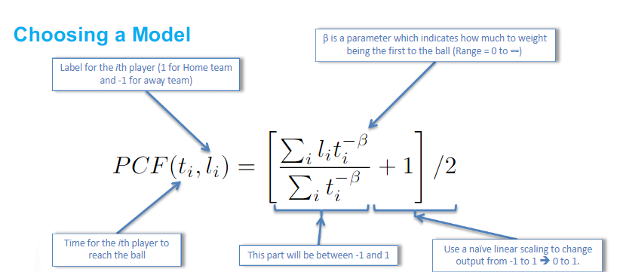
PITCH CONTROL DETAILS
Calculate the velocities
of players
finding the passing direction
player and ball position
Ball possession & Passing rate
Team A
Team B
Ball Possession
Passing rate
0
0.25
0.5
0.75
1

Slide 7
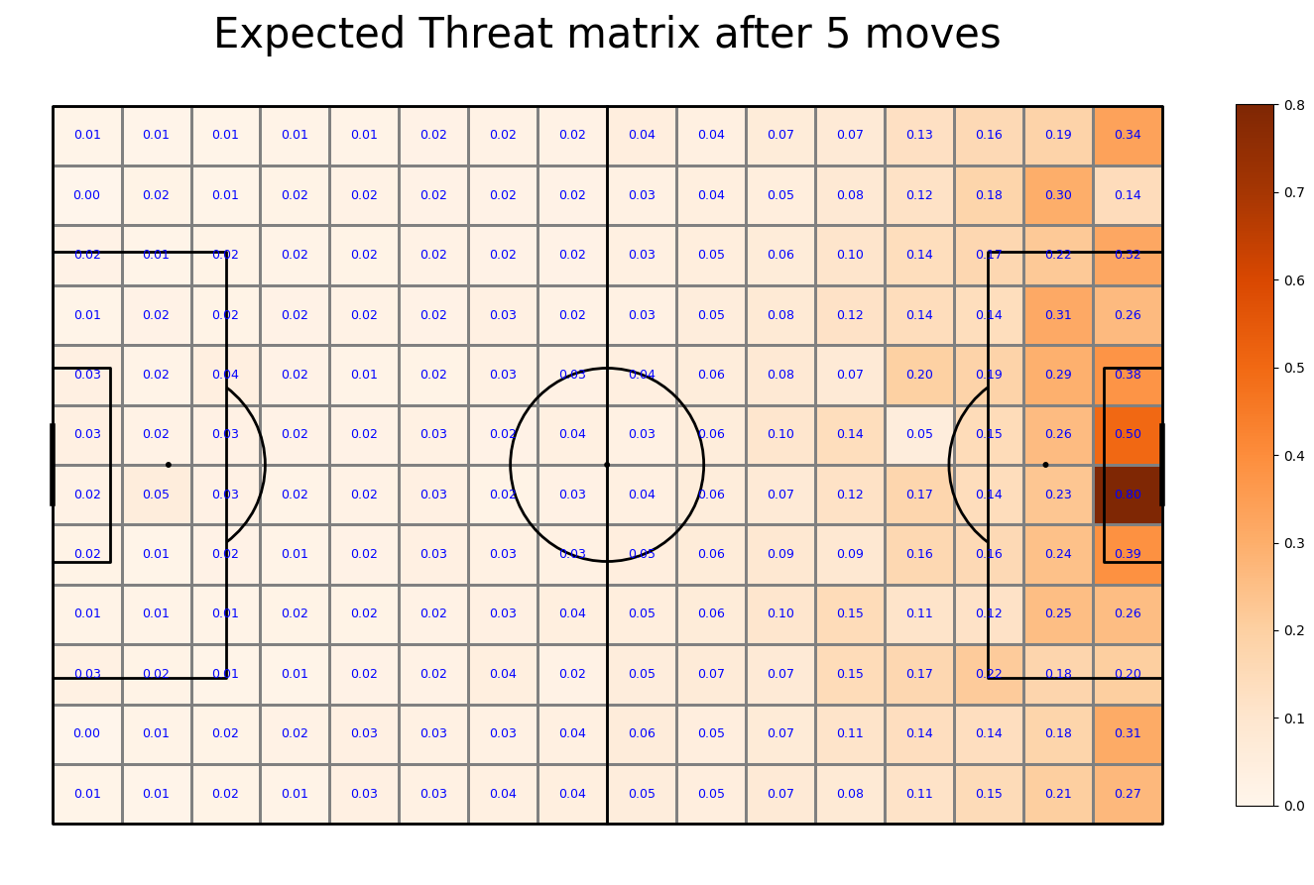
Expected Threat Analysis
Expected Threat (xT): Probability of attacking team to score in next 5 actions, given ball position (x,y)
FC Twente Players analysis

Slide 8
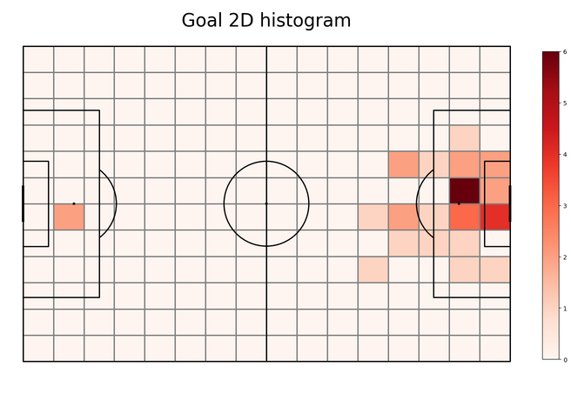
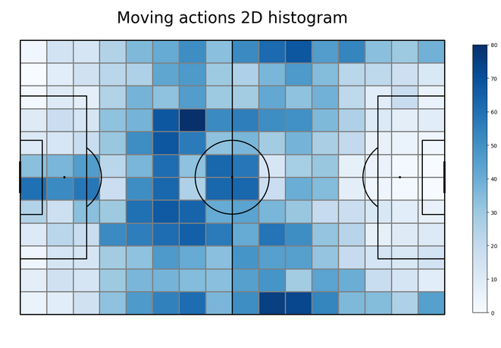
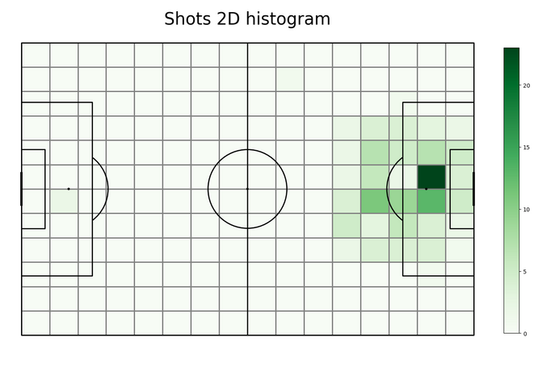
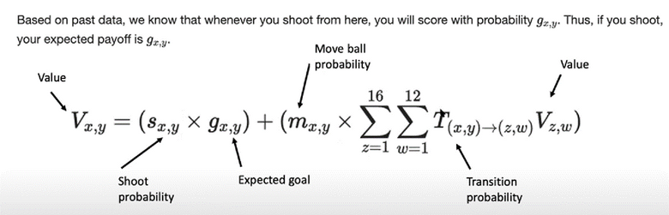
EXPECTED THREAT DETAILS
Goal probability
Shot probability
Move probability
Goal events
Moving events
Shoot events

Slide 9
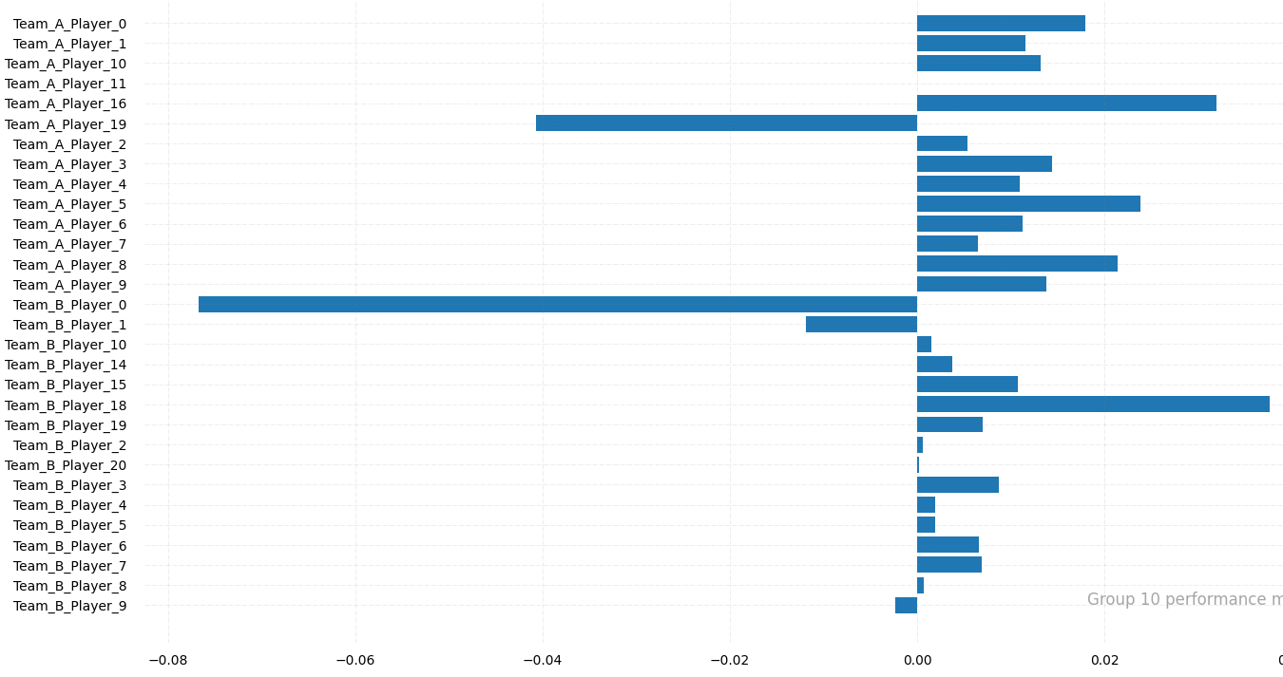
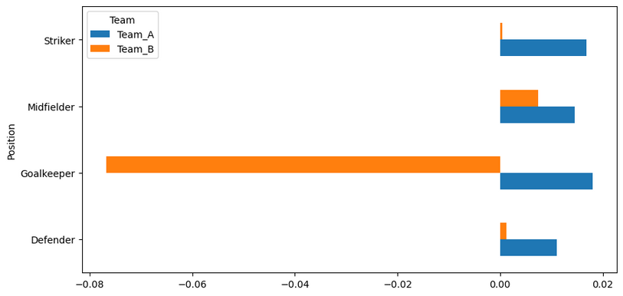
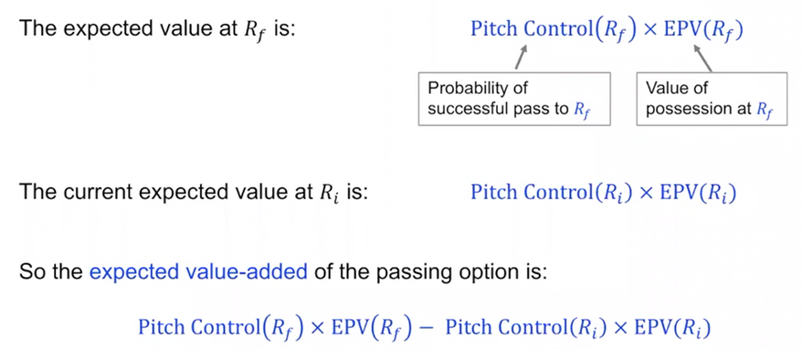
METRICS FOR PLAYER RANKING
Number of passes
125
100
75
50
25
0
A_0
A_10
A_16
A_2
A_4
A_6
A_8
B_0
B_10
B_15
B_19
B_20
B_4
B_6
B_8
Performance by position

Slide 10

Analyze and Visualize
1
Use visual charts to effectively analyze different metrics of the data
Analyze and Combine Pitch Control & xT
2
Combine 2 approaches to rank players for more accurate evaluation
Conclusion
FC TWENTE PROJECT GROUP 1
Rank players
3
Use visual charts to show the ranking of each position in team as well as each players
Project provide a general ranking value for players based on performance and player impact to the game
Makes an impact
All the analytics make an impact on showing player contributions to the game, result in the rank for players.
4

Slide 11
Questions ?
FC TWENTE PROJECT GROUP 1

