Slide 1
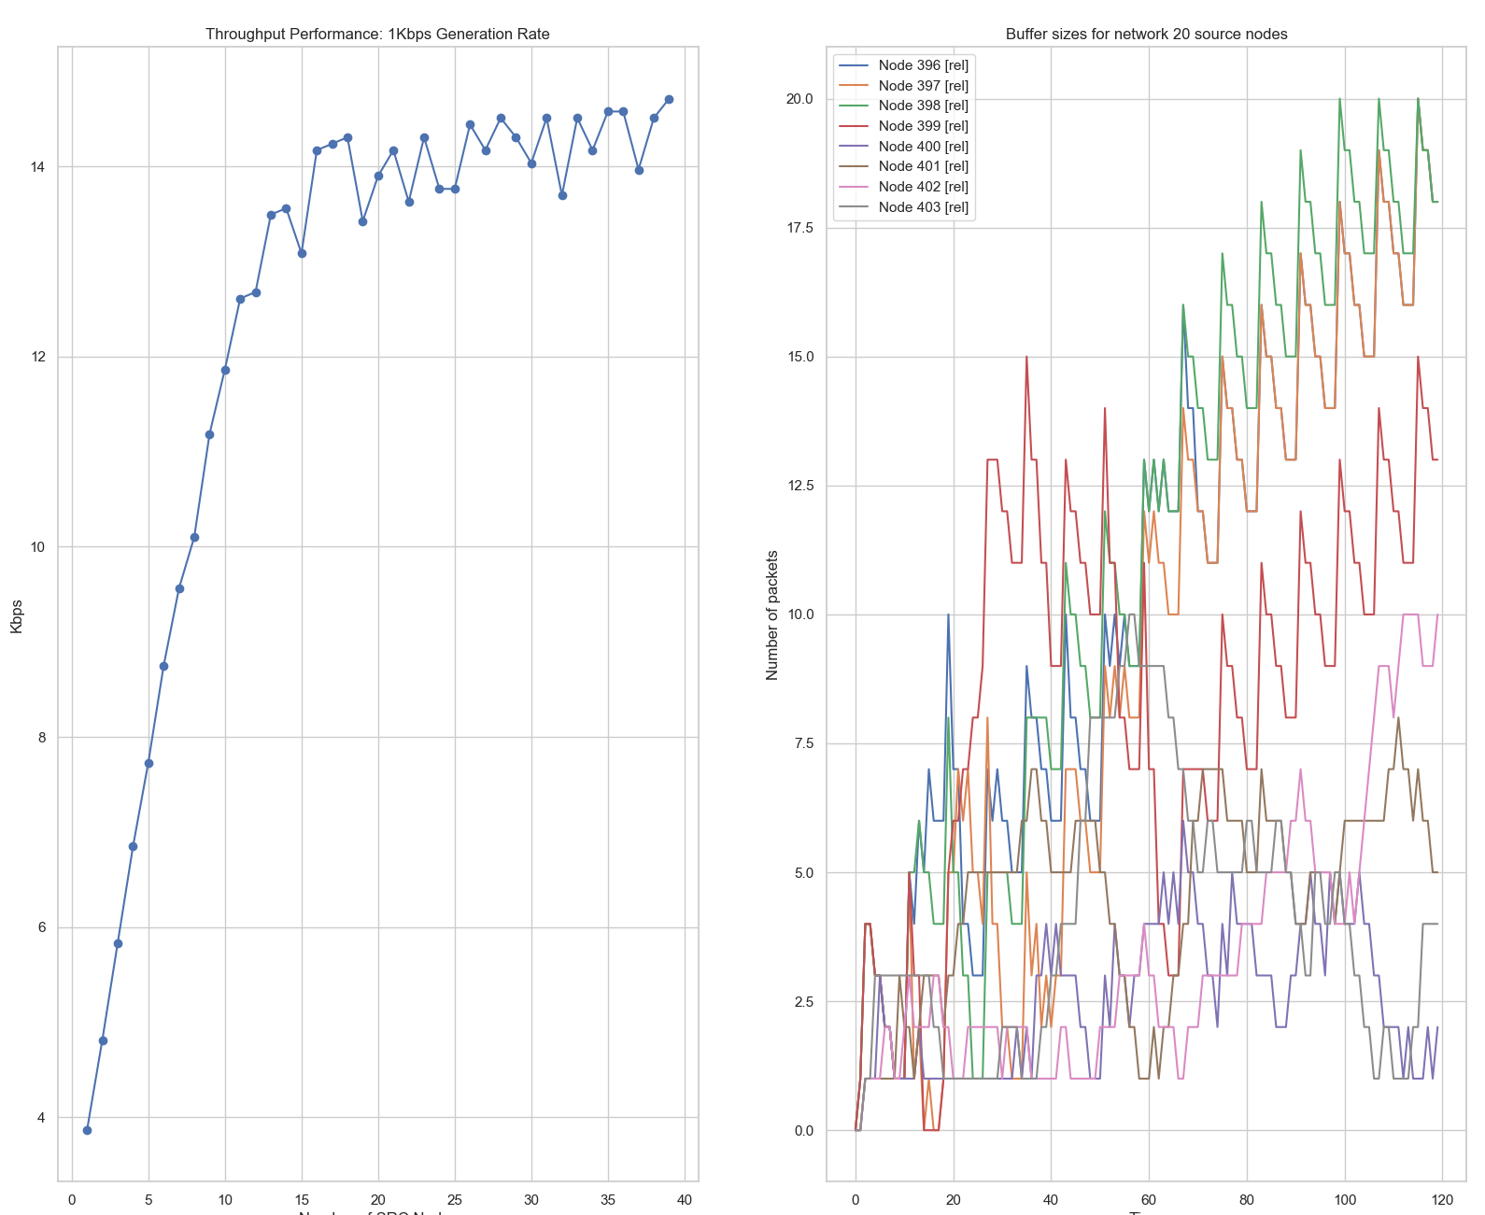
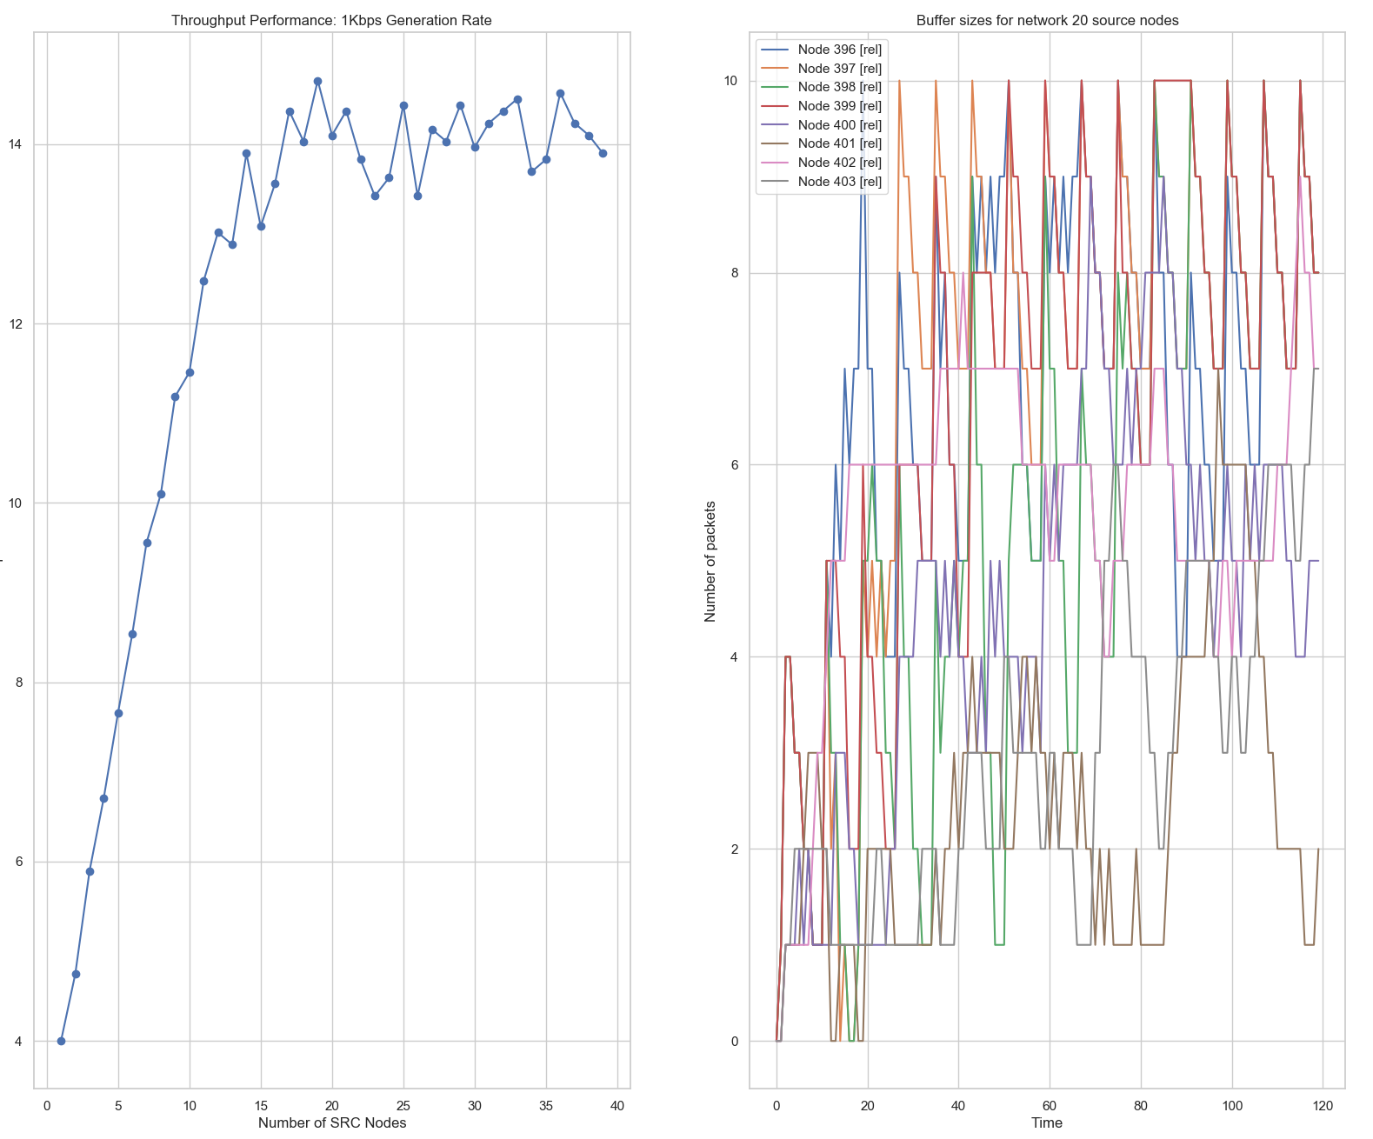
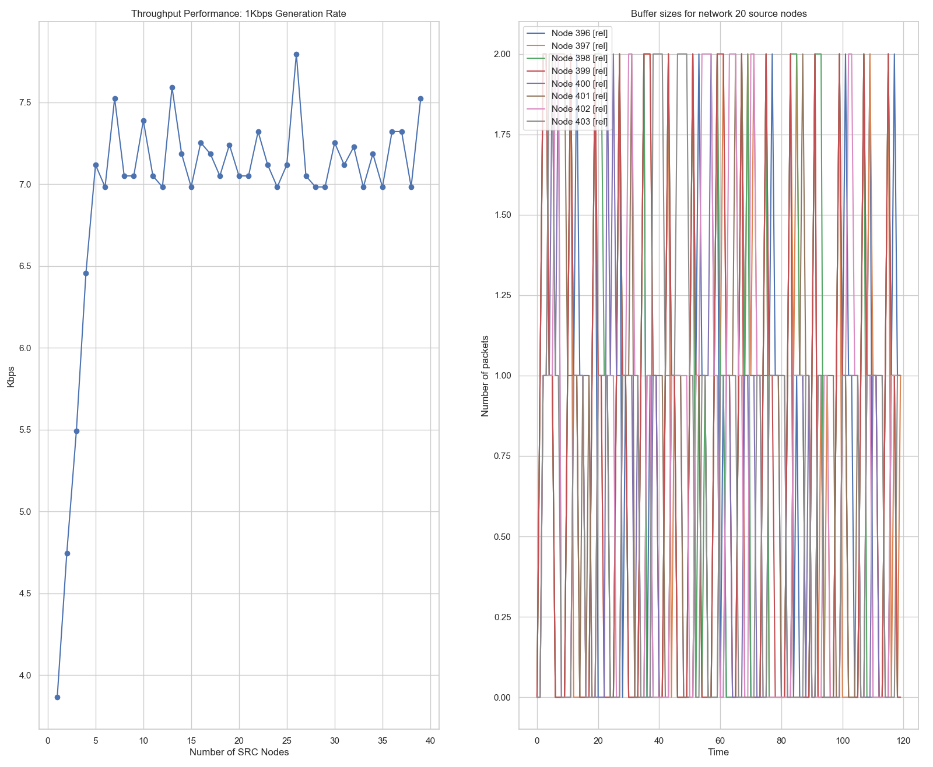
4x4 Grid with decreasing buffer size maximum
Bandwidth (all links): 8Kbps
Generation Rate (all source nodes): 1Kbps
Packet Size (all packets): 500 Bytes
Max. Buffer Size: 10 KiloBytes
Max. Buffer Size: 5 KiloBytes
Max. Buffer Size: 1 KiloByte
20
10
2
14.3
14
7.2
Kbps
Num. of packets
Kbps
Num. of packets
Kbps
Num. of packets

