Slide 1
Discrete Fourier Transform
COS 463: Wireless Networks
LAB 1

Slide 2
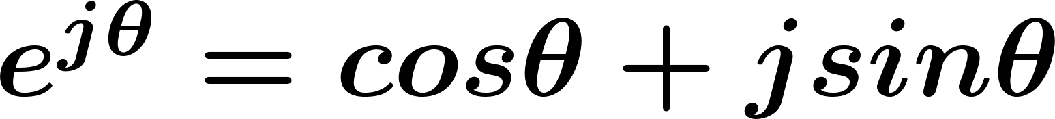
Complex Signal
Euler’s Formula
Complex Signal

Slide 3
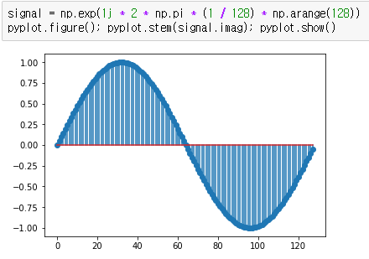
DFT
Sine in time domain

Slide 4
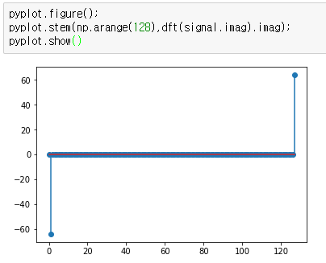
DFT
Sine in frequency domain (DFT)

Slide 5
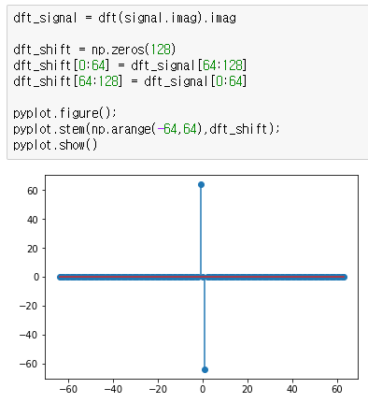
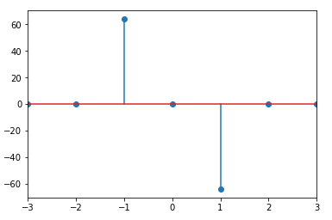
DFT Shift
Sine in frequency domain (DFT)
DFT Shift (central frequency = 0)
Frequency at k-th bin is
f = k * sample rate / N

Slide 6
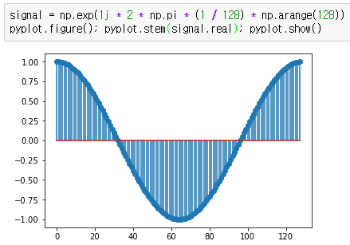
DFT
Cosine in time domain

Slide 7
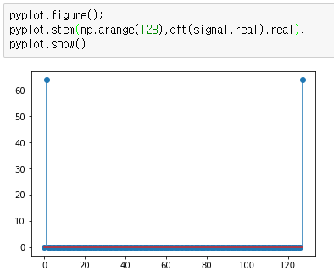
DFT
Cosine in frequency domain (DFT)

Slide 8
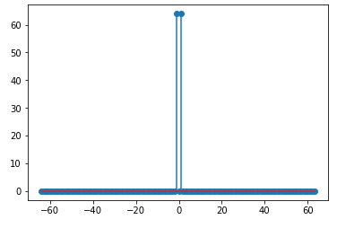
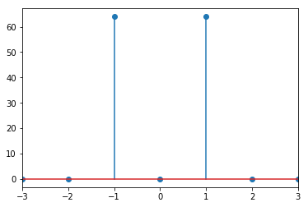
DFT Shift
Cosine in frequency domain (DFT)
DFT Shift (central frequency = 0)

Slide 9
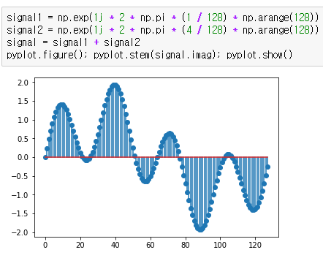
DFT
Sum of 2 Sins in time domain

Slide 10
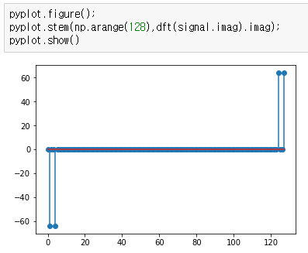
DFT
Sum of 2 Sins in frequency domain

Slide 11
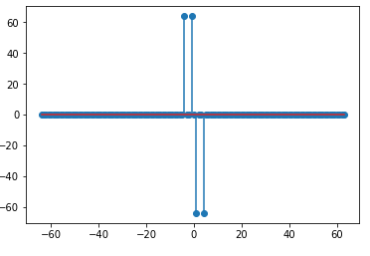
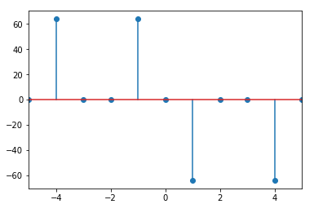
DFT
Sum of 2 Sins in frequency domain
DFT Shift (central frequency = 0)

Slide 12
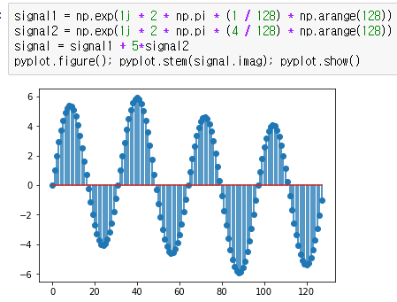
DFT
Sum of 2 Sins in time domain
Different Amplitude

Slide 13
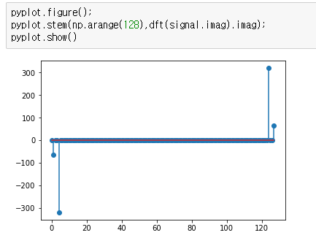
DFT
Sum of 2 Sins in frequency domain

Slide 14
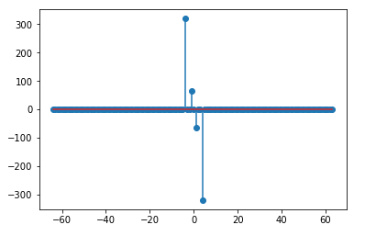
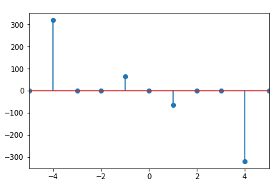
DFT
Sum of 2 Sins in frequency domain
DFT Shift (central frequency = 0)

