Slide 1
Irrigation Recommendation System (IRS) Project Project Objectives, Features, and Design
Raulie Raulerson
COT6931

Slide 2
Problem Description
Soil Moisture Sensors (SMS) could revolutionize the irrigation industry by:
Conserving water
Preventing nutrient leaching
Problem is steep learning curve for:
Interacting with SMS data
Data Analysis
Data Interpretation
Developing Recommendation

Slide 3
Project Objectives
Create a recurrent neural network (RNN) that analyzes input data
Create simple graphical user interface (GUI)
GUI allows user to enter site-specific data
Data format template for uploading files
Provide irrigation recommendation to user

Slide 4
Project Information
Client
Katie Hallas
Florida Department of Agriculture and Consumer Services
Mentor/Management
Dr. Donna Lohr
University of West Florida – Computer Science Department

Slide 5
Project Specs
Product will utilize:
Java
DeepLearning4J API
Maven
CSV files for data uploads
Zip files for loading RNN from previous run
IntelliJ IDE
Product will execute on the following systems with limited functionality:
MacOSX Sierra or later

Slide 6
System Features
Enter Required Data into GUI
Upload SMS and Weather Data
Train the RNN/Model
Save RNN/Model Parameters
Load Parameters from File
Generate Irrigation Recommendation Report

Slide 7
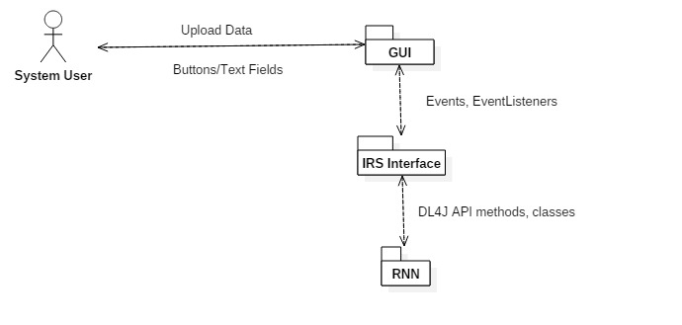
System Architecture – Components
GUI
IRS Interface
DL4J/RNN

Slide 8
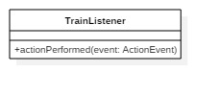
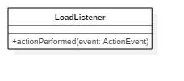
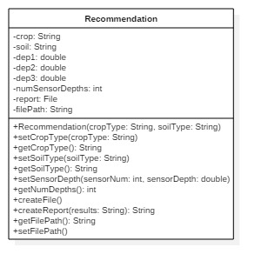
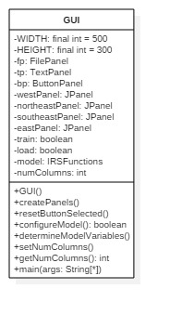
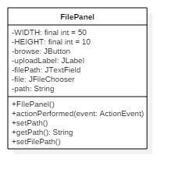
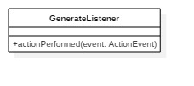
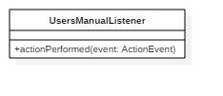
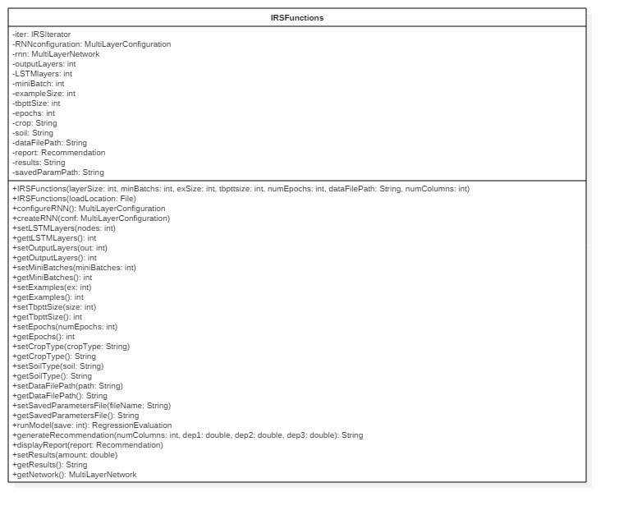
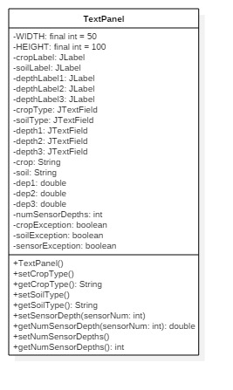
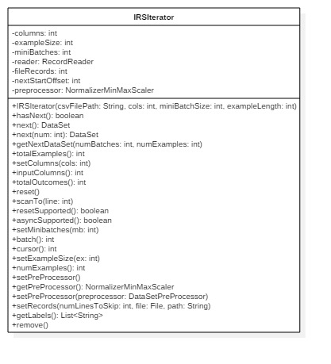
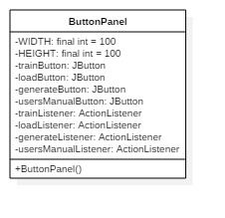
System Classes

Slide 9
GUI Wireframe

Slide 10
Testing
White Box Testing
Unit Testing
Black Box Testing
Unit Testing
Functional Testing
Deployment Testing

