Slide 1

PET SHOP – PISI.BG
PREPARED BY VALENTIN NENKOV AND HRISTO HRISTOV

Slide 2
USED TECHNOLOGIES
JAVA 11
IntelliJ
Postman
MySQL
MySQL Workbench
Git
Spring Boot
Spring Rest
Tomcat
Maven
Lombok
Hibernate
Java Mail Sender
Bcrypt
Swagger
Logger
Spring Validation Framework

Slide 3
MAIN FUNCTIONALITY
USER
REGISTER
LOGIN/LOGOUT
EDIT PROFILE
DELETE PROFILE
SEARCH/FILTER PRODUCTS BY MULTIPLY CRITERIAS
SORT BY PRICE
PERSONAL DISCOUNT
BUY PRODUCTS
E-MAIL NOTIFICATIONS
ADMIN
CREATE ADMIN
DELETE ADMIN
ADD/EDIT CATEGORY
ADD/EDIT SUBCATEGORY
ADD/EDIT MANUFACTURER
ADD/EDIT/STOP PROMOTIONS
ADD/EDIT/DELETE PRODUCTS
ADD IMAGES
REPORT MODULE
DAILY
MONTHLY
ANNUAL

Slide 4
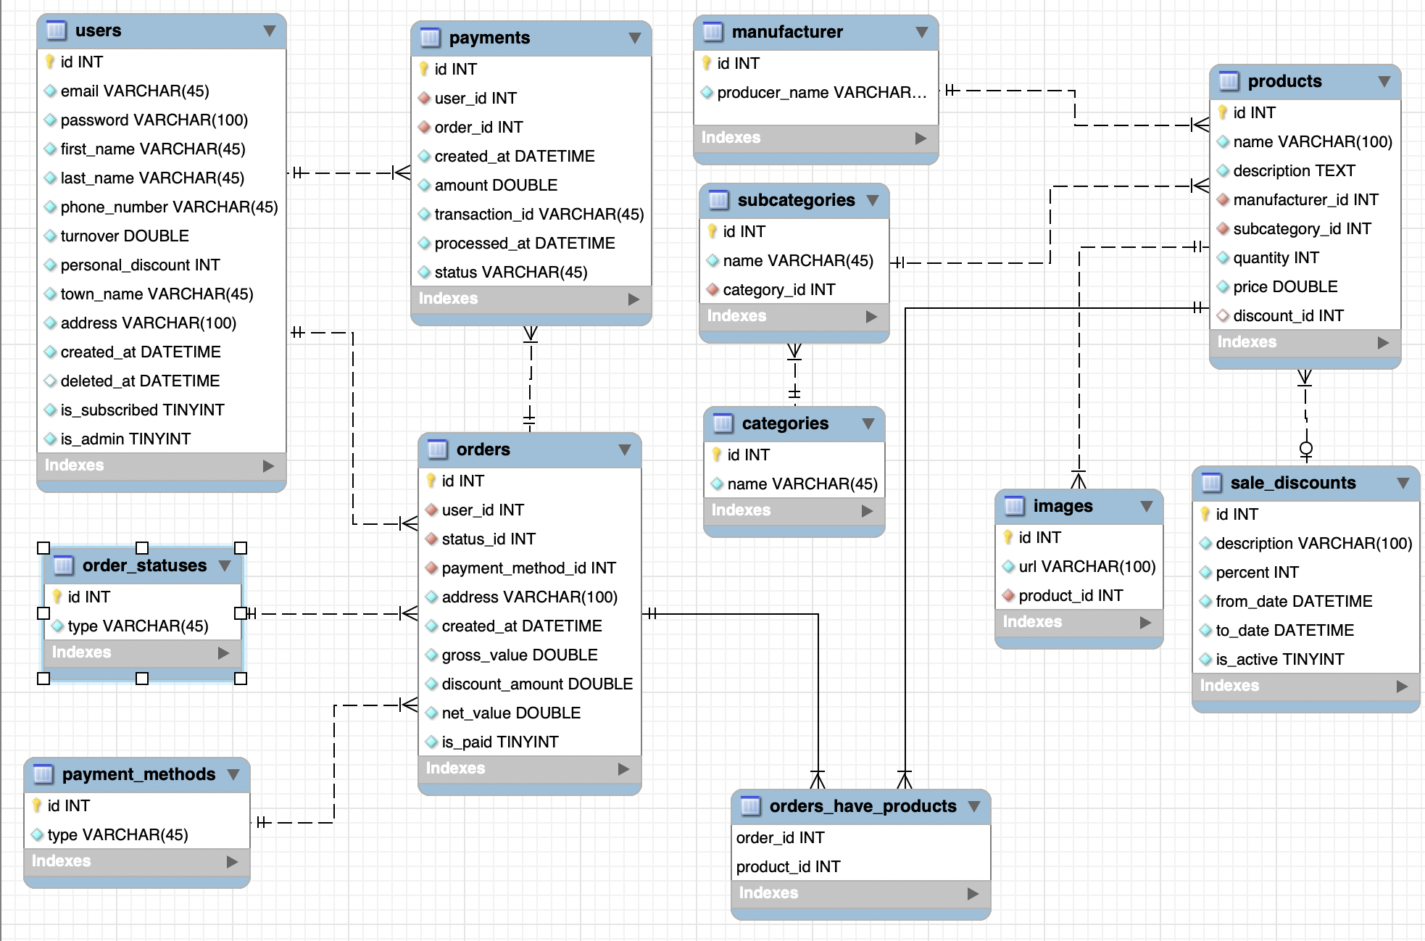

E/R DIAGRAM

Slide 5
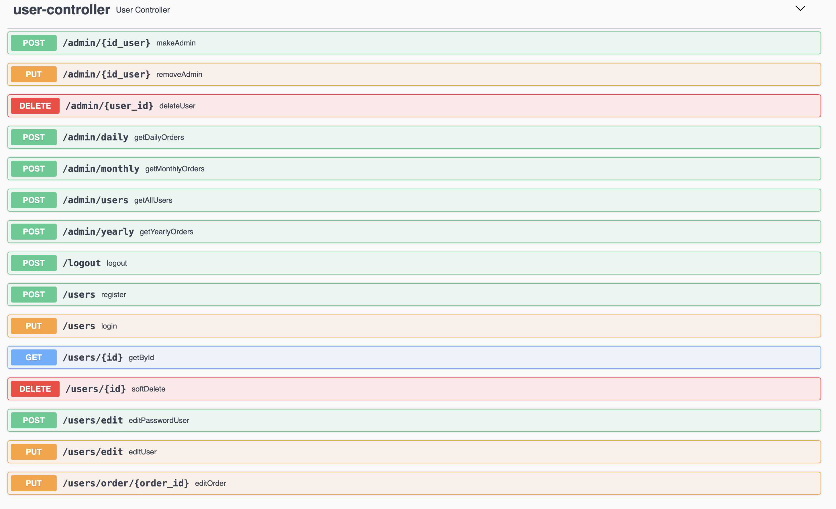
USER CONTROLLER

Slide 6
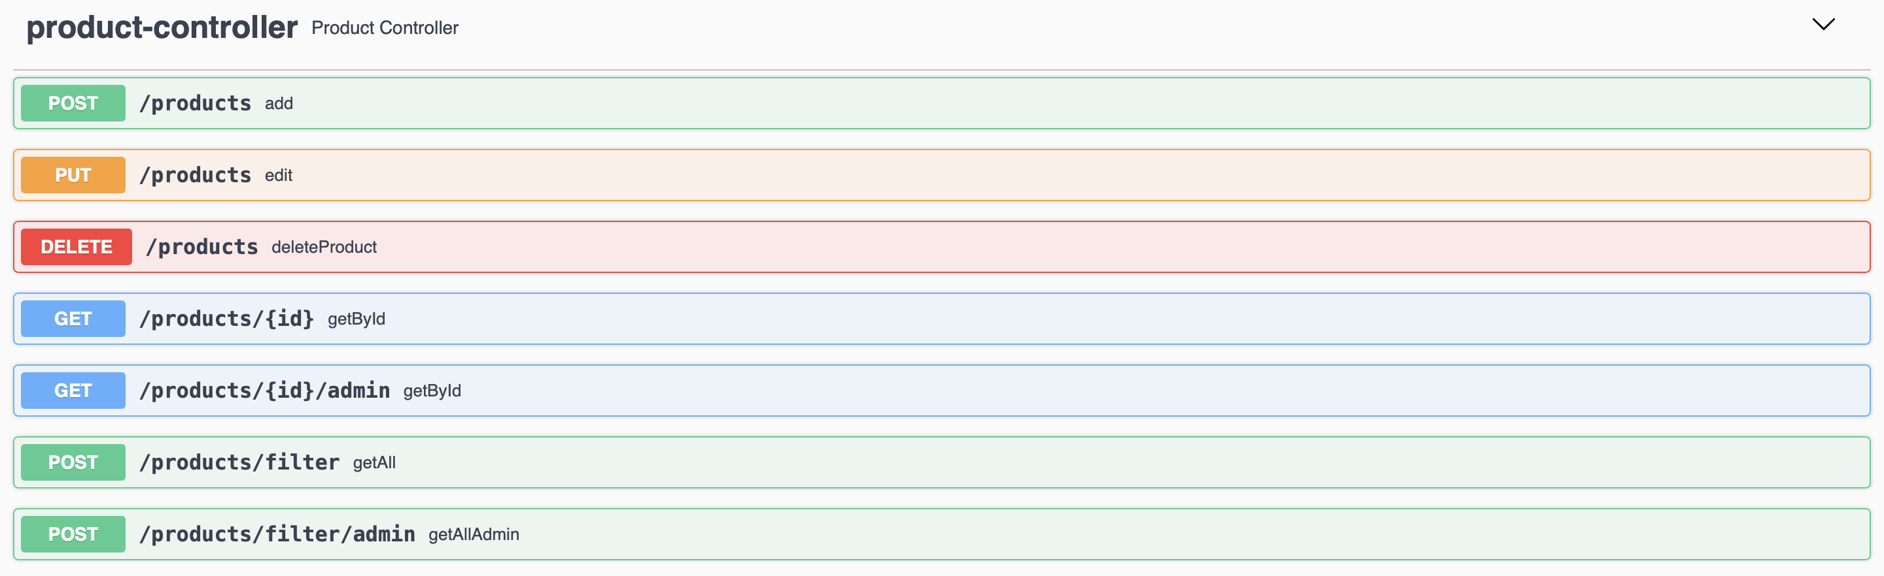
PRODUCT CONTROLLER

Slide 7
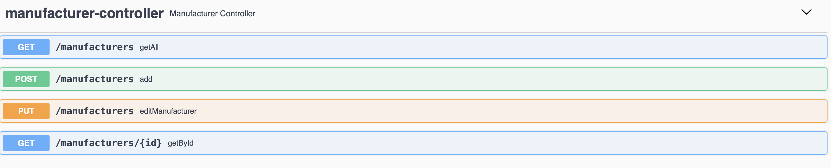
MANUFACTURER CONTROLLER

Slide 8
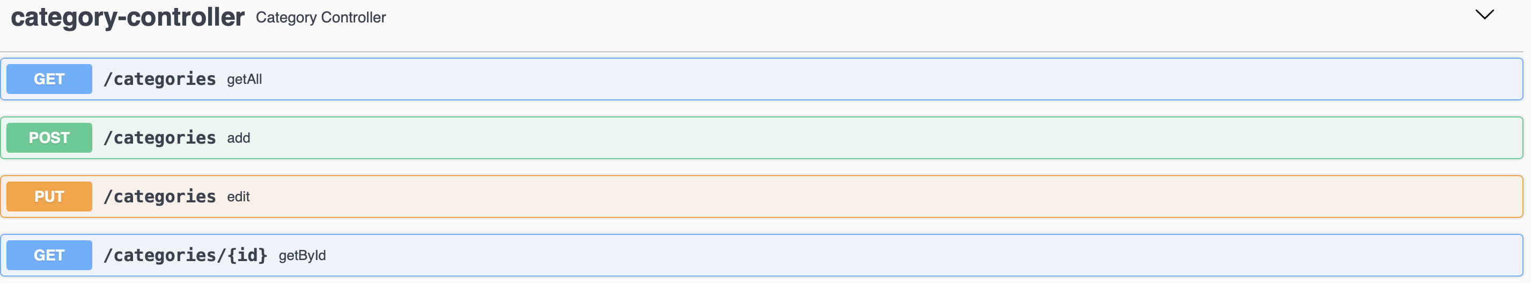
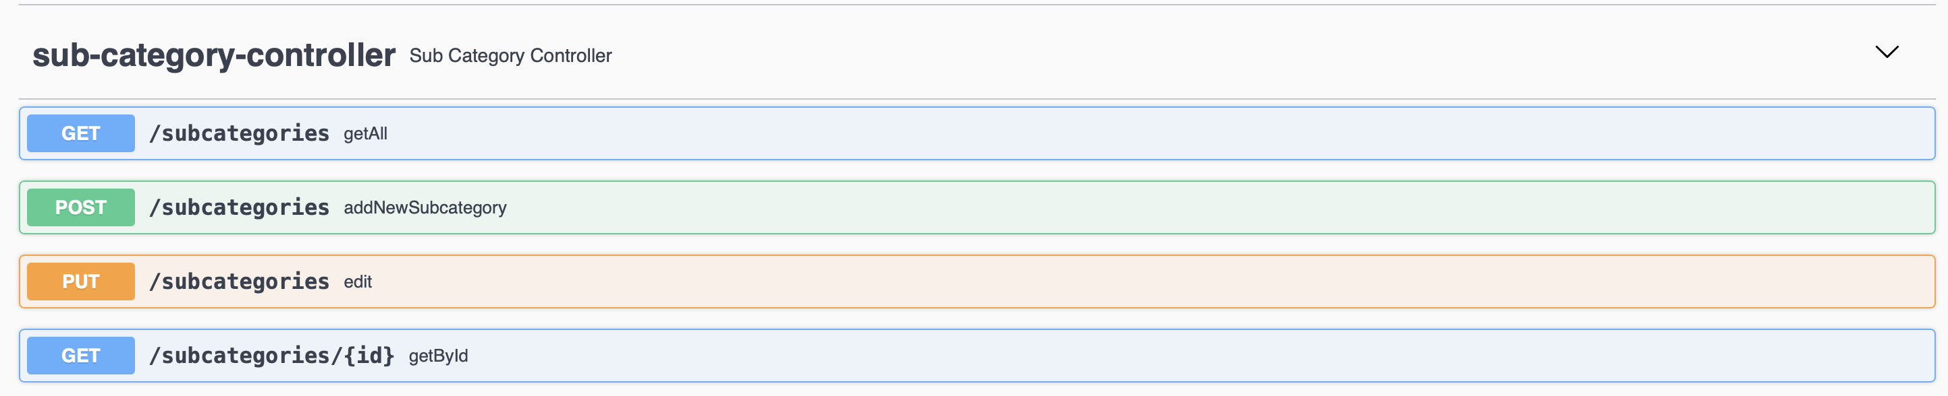
CATEGORY AND SUBCATEGORY CONTROLLER

Slide 9
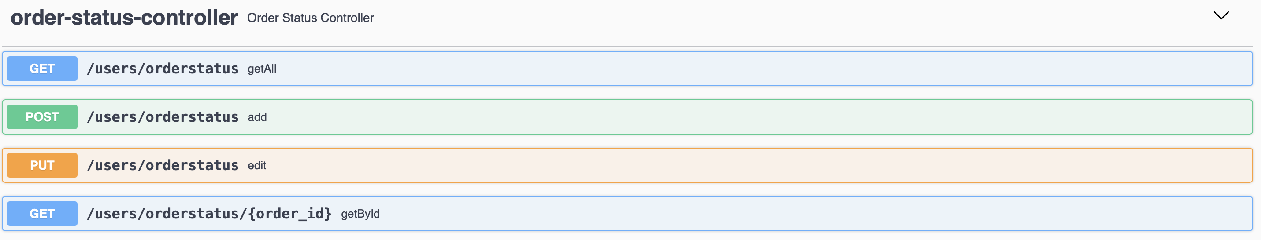
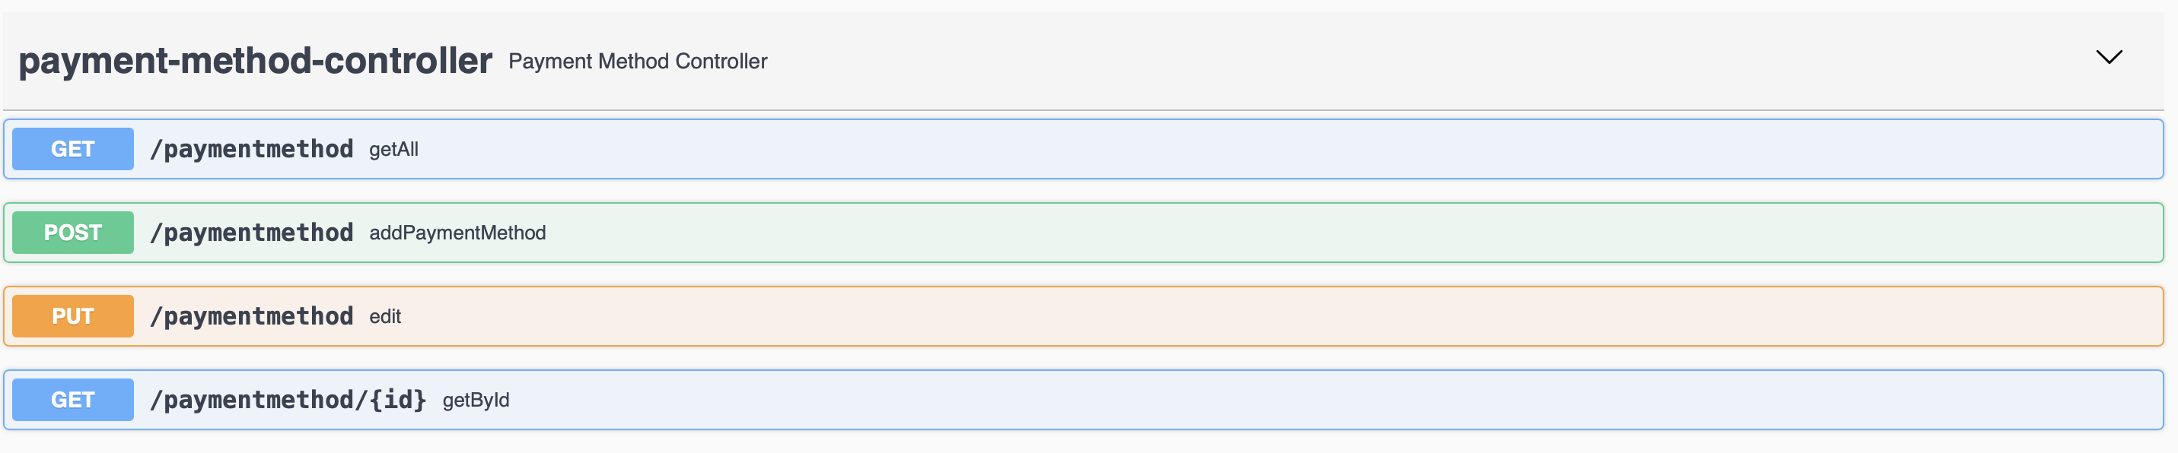
ORDER STATUS AND PAYMENT CONTROLLER

Slide 10
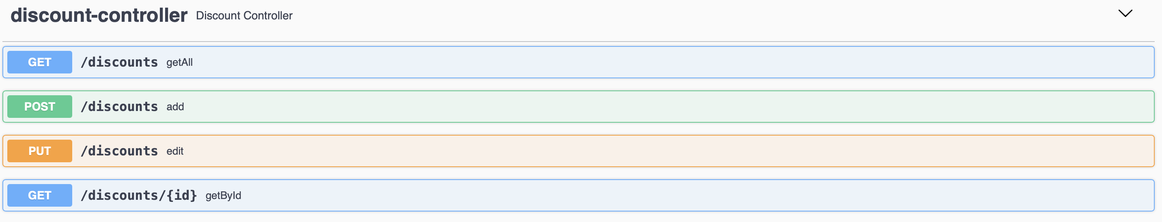
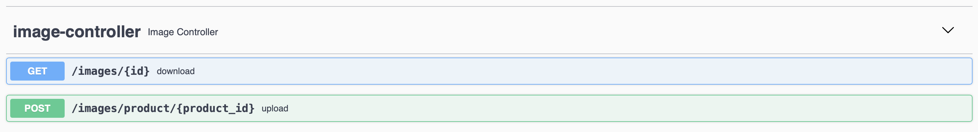
DISCOUNT AND IMAGE CONTROLLER

Slide 11
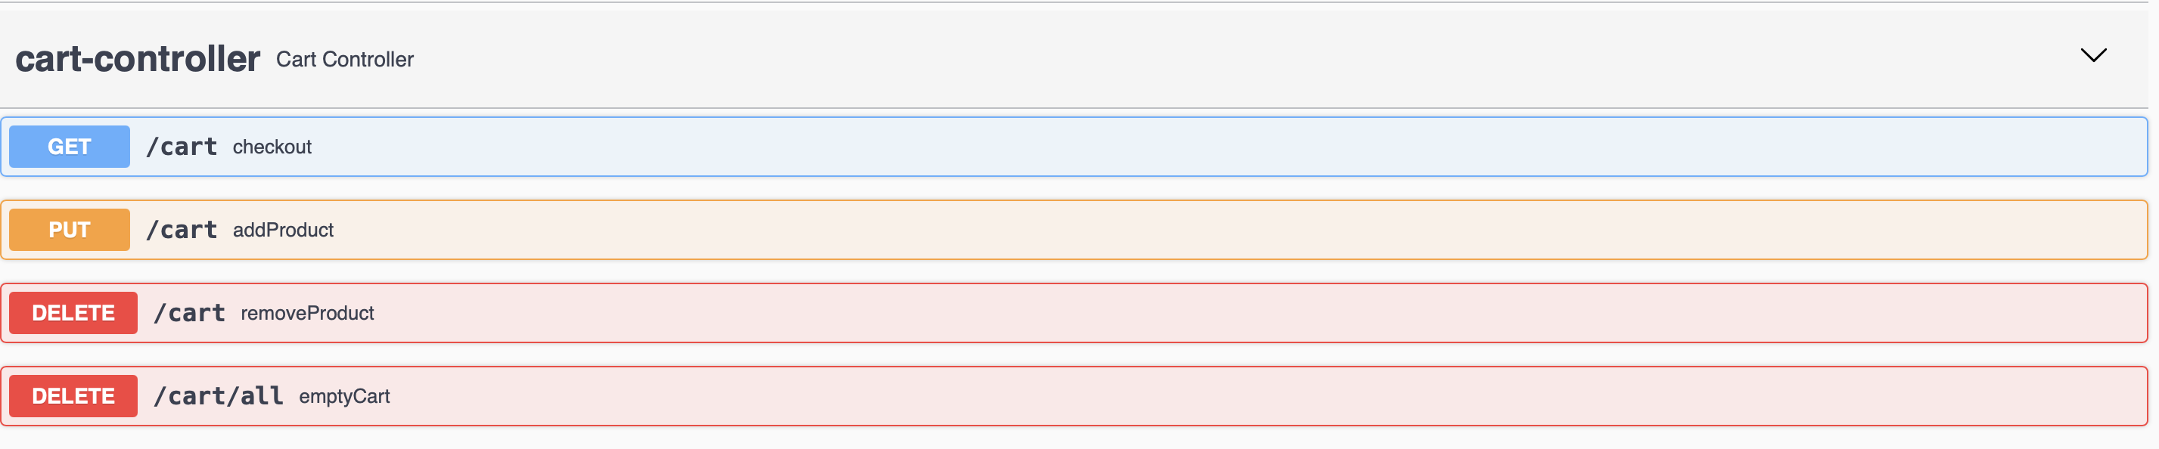
CART AND ORDER CONTROLLER

Slide 12

QUESTIONS

Slide 13
THANK YOU FOR YOUR ATTENTION!

