Slide 1


Project goals
1
Learn how to deploy an infrastructure in the Azure cloud platform
2
Gain experience in creating continuous (CI/CD) pipelines in the Azure DevOps
3
Explore Azure cloud services

Slide 2
What was planned
1
Choose a method to deploy to Azure
2
Setting up the environment
3
Learning AZ-400
4
Use of tools such as Jenkins, Ansible, Terraform
Одна мысль на слайде
без картинок
Использование цифр для опроса
0-9
5
Find application to deploy

Slide 3
Technologies that were used in the project
1
Azure DevOps
2
Выделение фигурой/маркером инфы
Terraform
3
Azure web app (Node.js, .NET)
4
Azure Database (PostgreSQL)

Slide 4
Project OnlineStore deploy

Slide 5
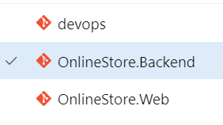
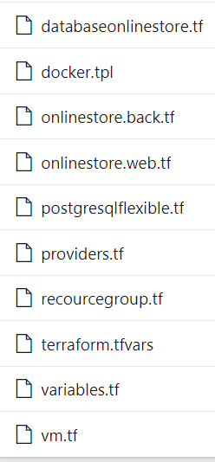
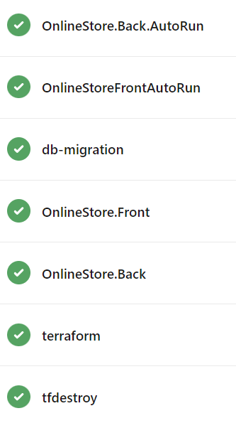

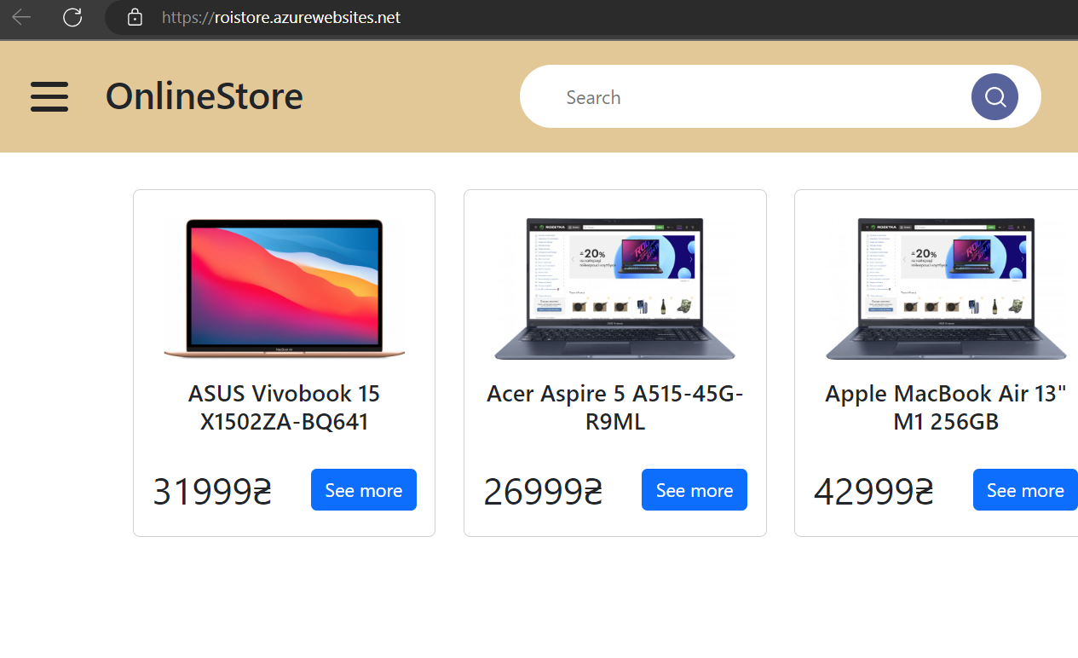
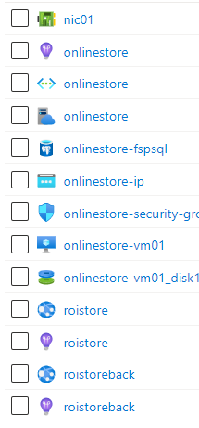
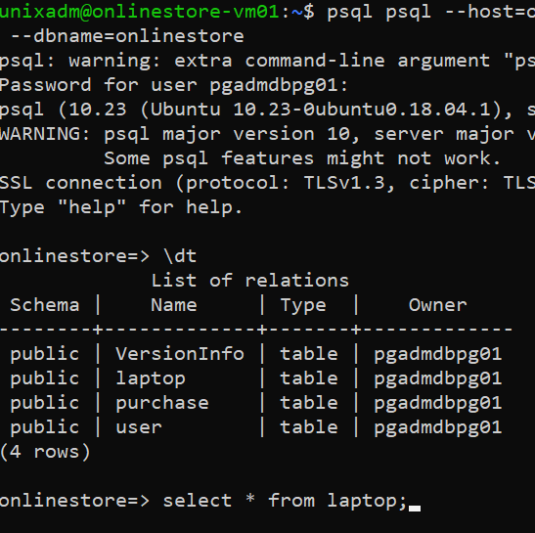
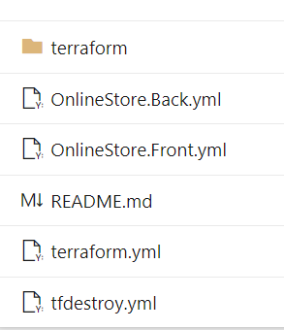
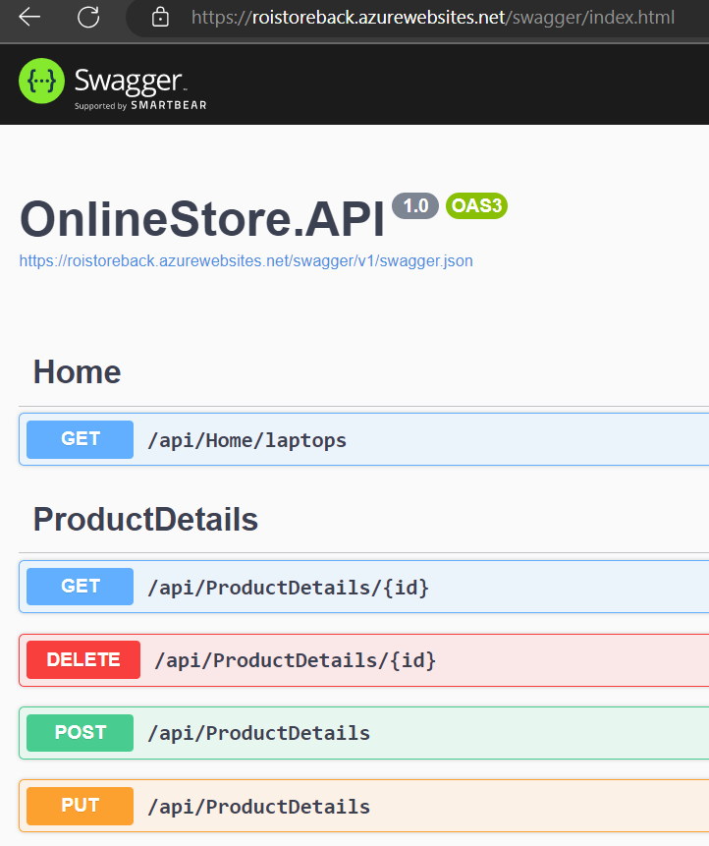
https://github.com/hhrnol/OnlineStore
Outcomes
https://dev.azure.com/gagarin0326/HomeWork
https://roistore.azurewebsites.net/

Slide 6

Points to improve
Parameterize .yaml pipelines
Move variables and output for terraforms to separate files
Deploy a flexible server into Azure Vnet in a subnet delegated
Split subnet for data base, API and frontend
Inbound and outbound network access for the subnet
must be opened through network security groups

