Slide 1


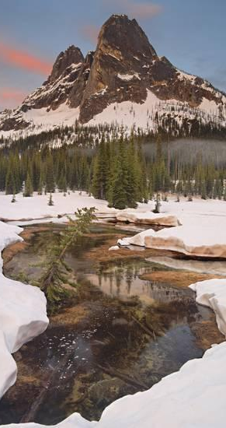
Rescrutinize Snow Sensitivity To Climate Change In Mountainous Areas
July 2018

Slide 2
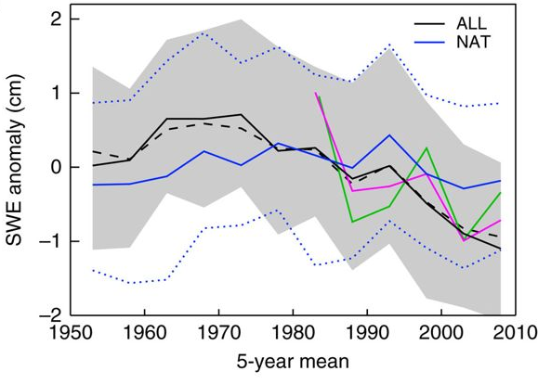
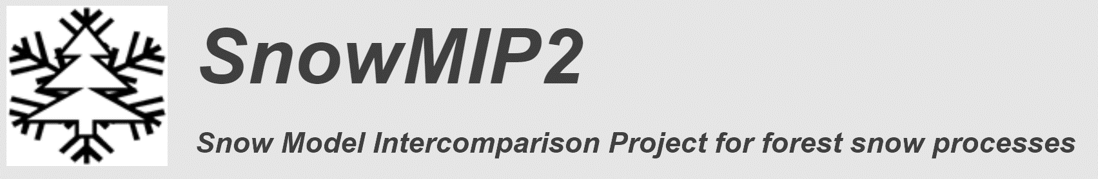
How Will Snow Ablation Change With Warming Temperature
Temperature will rise:
Snow cover declines
Model Predictions:
How acceptable/uncertain are our models in simulating snowmelt
How good do our models predict change in snowmelt under climate change
Fyfe et al., 2017

Slide 3
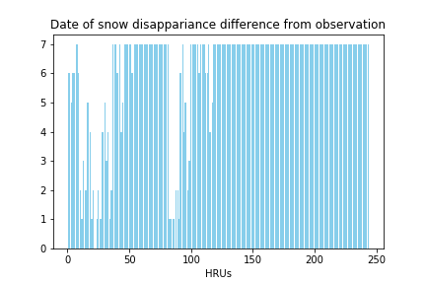
SUMMA For Future Snowmelt Projection
How sensitive is snowmelt modeling to different levels of decision model complexity and different parameterizations?
How consistent are our projected SWE?
How variable is SWE to the future warming Temperature?
Day of snow disappearance
Different Parameters

Slide 4
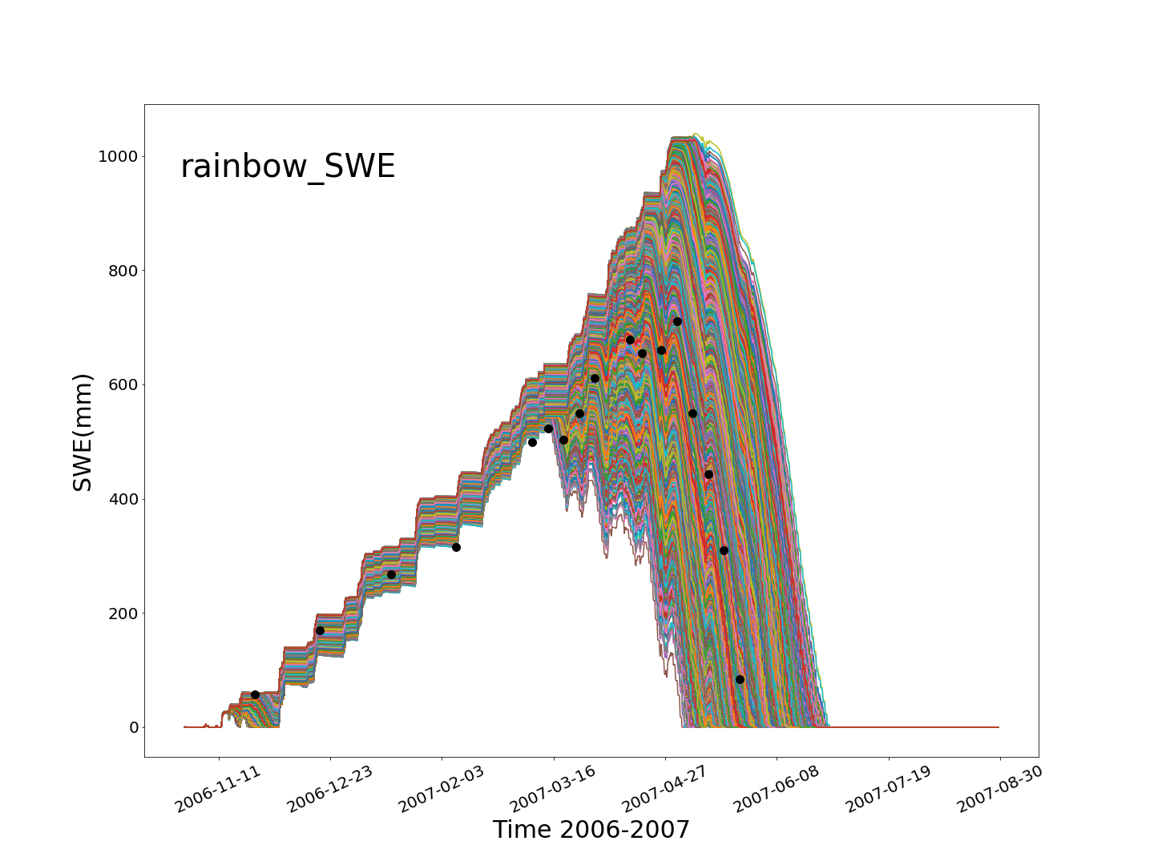
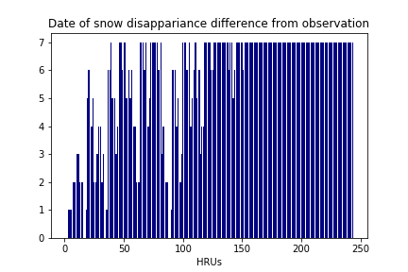
Snow Cover Analysis In Swamp Angel In 2007
Executing SUMMA for about 20,000 combinations of decision models and parameters for Swamp Angel.
Analyzing the sensitivity of SWE to different combinations
Day of snow disappearance
Different Parameters

Slide 5
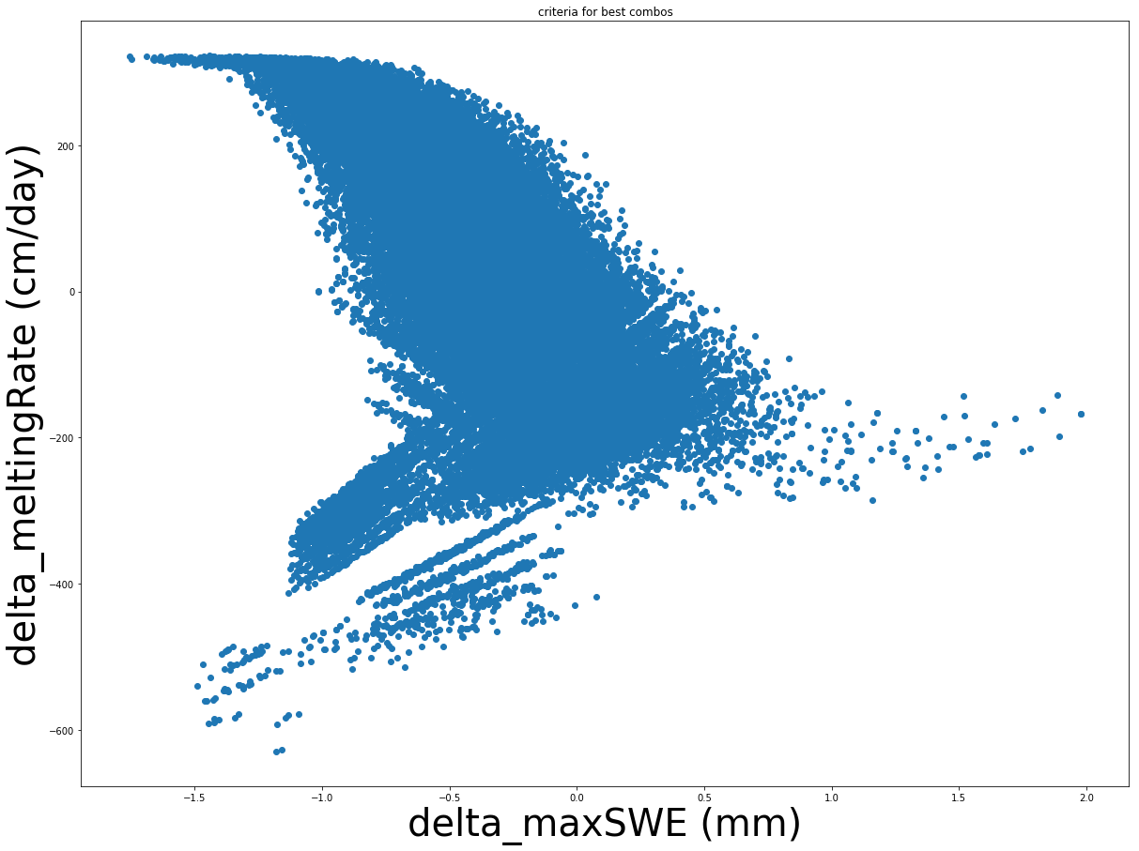
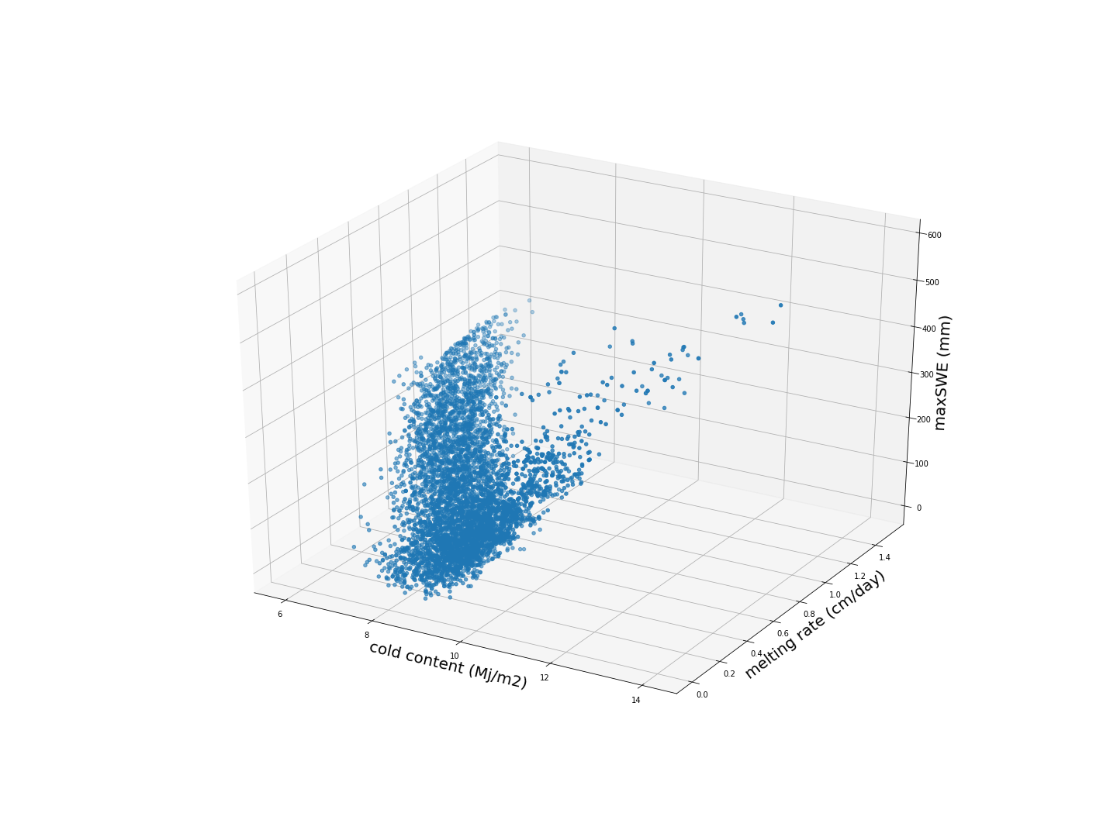
Multi-Dimensional Objective Function
Representative max SWE in the date of observed max SWE
Average melting rate in ablation season
Max cold content (sum of all layers)
What if we add cold content

Slide 6
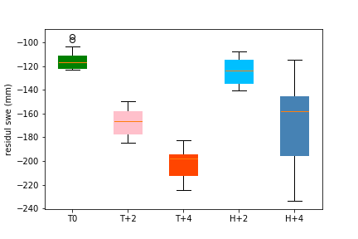
Impact Of Future Climate On Snowmelt
WRF Pseudo Global Warming (PGW) experiment data
Average monthly specific humidity, temperature, longwave and shortwave radiations data at 9 grid cells centered on Swamp Angel

