Slide 1

Interactive Kiosk For Travel Service
CAPSTONE PROJECT
Supervisor: Nguyễn Thế Hoàng

Slide 2





Team
Phạm Càn Long
Vũ Sơn Tùng
Tô Ngọc Lam Linh
Huỳnh Hữu Tín
Trần Thế Đông Anh
Leader
Member
Member
Member
Member
2

Slide 3
TABLE OF CONTENT
Introduction
01
System Design
02
Feature
03
Demonstration
04
Conclusion
05

Slide 4
I. Introduction Overview and Software System

Slide 5



I. Introduction
PROBLEMS
What's tourist troubled when traveling ?
Which places to visit ?
Which events to join ?
Which services to experiment ?

Slide 6
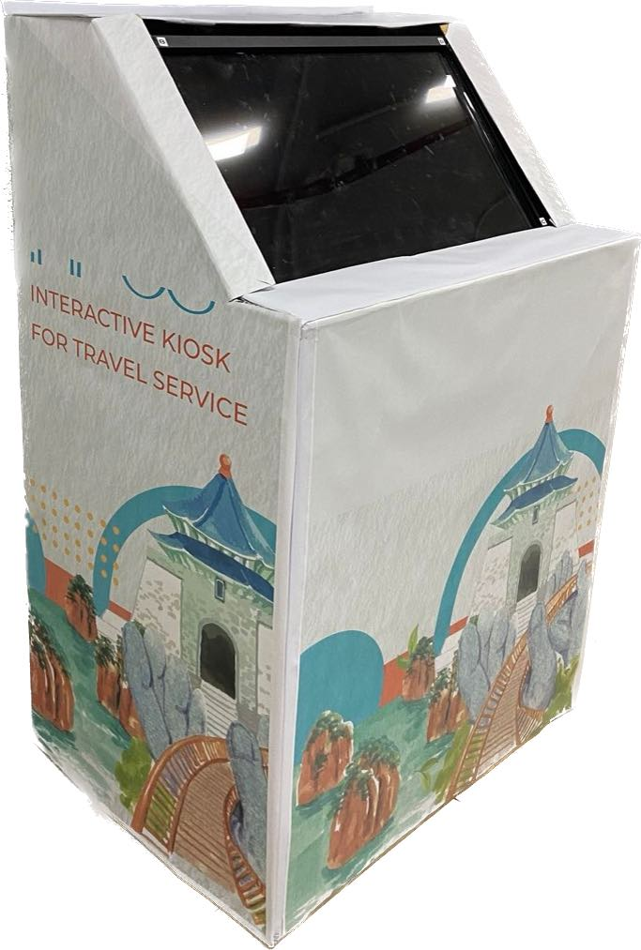
I. Introduction
SOLUTIONS

Slide 7
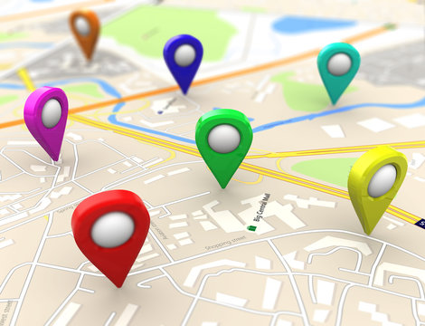


I. Introduction
SOLUTIONS
Point of interest
(POIs)
Events nearby
Service Applications (Cooperation with third parties)

Slide 8
II. SYSTEM DESIGN How the System work

Slide 9






II. System Design
OVERVIEW
Anotation
Call / Send
Return
Image
Backend Server
Database
Web App
Notification
Kiosk

Slide 10










II. System Design
OVERVIEW
Anotation
Call / Send
Return
Image
Backend Server
Database
Web App
Notification
Kiosk

Slide 11
II. System Design
TECHNOLOGIES

Slide 12
III. Feature

Slide 13




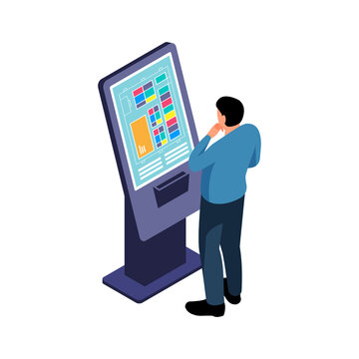

ROLE
III. Feature
Admin
Location Owner
Service Provider
Web Application
Interactive Kiosk
Tourist

Slide 14




MAIN PROCESS
III. Feature
Interact with kiosk
Upload and publish application to system
Set up kiosk
View Dashboard

Slide 15
IV. DEMONSTRATION

Slide 16







INTERACT WITH KIOSK
IV. Demonstration
View event
Event
View POI
POI
Interact with kiosk
Tourist
Kiosk
View map
Map
View kiosk location
Kiosk Location
View app
App

Slide 17




UPLOAD AND PUBLISH APPLICATION TO SYSTEM
IV. Demonstration
2. Create new application
3. Send request to publish
1. Login
Service Provider
IKFTS
Web Portal

Slide 18


UPLOAD AND PUBLISH APPLICATION TO SYSTEM
IV. Demonstration
1. Login
2. Receive request
3. Response request
IKFTS Web portal
Admin

Slide 19



SET UP KIOSK
IV. Demonstration
1. Login
2. View list account
3. Find location owner
IKFTS Web portal
Admin
4. Create kiosk

Slide 20






SET UP KIOSK (BASIC SET UP)
IV. Demonstration
2. Create kiosk location
3. Set location to kiosk
1. Login
IKFTS Web portal
Location Owner
4. Input password
5. Choose kiosk setting
Kiosk

Slide 21




SET UP KIOSK (ADVANCED SET UP)
IV. Demonstration
1. Create event
3. Create template
5. Create scenario
Location Owner
2. Create POI
4. Create schedule

Slide 22





EARN MONEY FROM 3RD PARTY APPLICATIONS
IV. Demonstration
1. Use app in kiosk to buy ticket
3rd Party Service application
Tourist
2. Send order record to IKFTS
4.Create Commission record to Admin
4.Create Commission record to Location Owner
Location Owner
System
System
3.System calculate commission

Slide 23



VIEW DASHBOARD
IV. Demonstration
2. View list application
3. Choose Specific application
1. Login
Location Owner
IKFTS Web portal
4. View revenue

Slide 24
V. CONCLUSION

Slide 25
V. Conclusion
CHALLENGES
Difficulty in building user-friendly and easy-to-use interfaces
Difficulty in finding kiosk deployment equipment

Slide 26
V. Conclusion
ACHIEVEMENTS
Help tourists find out local spots or events around them when they go on vacation.
3rd party application embedded in our system help toursists to have better vacation. Moreover, Location Owner can earn money from 3rd party application.

Slide 27

Thank you for paying
attention
Thank you for paying
attention

