Slide 1
HeineOS Assignment material: Keyboard
Prof. Dr. Michael Schöttner
Dr. Fabian Ruhland

Slide 2
PS/2 Keyboard - Components
Keyboard chip inside the keyboard:
Serial communication with the keyboard controller
Queries the keyboard via its scan matrix
Keyboard controller on the mainboard:
Nowadays, integrated inside the South Bridge
Additional port for a PS/2 mouse
Uses IRQ1 and IO-Ports 0x60 and 0x64
Modern PC: USB keyboard:
USB Legacy Support: Backwards compatible
communication via the PS/2 controller
Keyboard chip
Keyboard controller
Keyboard controller
Clock
Ground
Data
+5 Volt
Reset

Slide 3
PS/2 Keyboard - Scancodes
Keyboards send scancodes (7-bit unique number for each key)
Driver needs to translate scancodes into characters (according to the configured layout)
Lock keys functionality (e.g. Caps Lock) is also implemented inside the driver
Example for an MF II keyboard:

Slide 4
PS/2 Keyboard - Scancodes
Example: Scancodes and ASCII-codes:
Keyboard controller sends additional information
Make-Code when pressing/holding a key
Break-Code when releasing a key
Char | ASCII
( | 40
0 | 48
1 | 49
2 | 50
A | 65
B | 66
a | 97
Key | Scancode
A | 30
a | 30
S | 31
D | 32
Cursor Up | 72
Cursor Down | 80
a | 97

Slide 5
PS/2 Keyboard - Scancodes
Usually, the following applies:
Make-Code (key pressed) → Scancode
Break-Code (key release) → Scancode + 128 (Bit 7 is set)
However, some keys send multiple codes
For example the function keys (F1-F12)
Up to three codes per key
Builtin repeat functionality
Hardware sends Make-Codes multiple times, when a key is held down
Decoding is cumbersome
HeineOS already contains implemented function fn decode_byte(&mut self, mut code: u8) -> bool
Returns true if a key has been fully decoded, false if more codes are expected by the controller
Decoded key is stored in variable Keyboard::gather

Slide 6
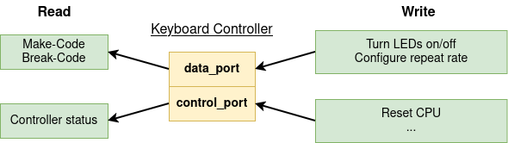
PS/2 Keyboard - Communication
Communication with the keyboard controller works via two I/O-ports:
Input/Output register (data_port) 0x60
Status/Control register (control_port) 0x64

Slide 7
PS/2 Keyboard – Status Register
Access by reading from I/O-port 0x64
Bit 7: PARE Parity error
Bit 6: TIM Response timeout
Bit 5: AUXB Byte available vom auxiliary device (mouse) → Please read byte from output buffer
Bit 4: KEYL Keyboard available (1) or locked (0)
Bit 3: C/D Command or data byte written
Bit 2: SYSF Self test successful
Bit 1: INPB Input buffer busy → Please wait
Bit 0: OUTB Byte available → Please read byte from output buffer

Slide 8
PS/2 Keyboard – Control Register
Access by writing to I/O-port 0x64
Keyboard controller commands (1 byte)
0xAA Self test
0xAE Enable keyboard
0xED Turn on/off LEDs
0xF3 Set repeat rate
Caution: Before sending a command, make sure the input buffer is empty → Check Bit 1 (INPB) in status register
An overview of keyboard commands is given here: https://wiki.osdev.org/PS/2_Keyboard

Slide 9
PS/2 Keyboard – Reading Keys
Call Keyboard::poll_key_event()
Calls Keyboard::try_read_next_byte() in a loop until a key is returned
try_read_next_byte() checks if a byte is available in the output buffer by checking BIT 0 (OUTB) in the status register
If a byte is available it is decoded using Keyboard::decode_byte()
If decode_byte() returns true return Keyboard::gather, otherwise return None
Actively reading the keyboard in a loop (polling) is rather inefficient
Will be replaced by an interrupt based implementation later on in the project

Slide 10
PS/2 Keyboard – Send Commands
General sequence:
Wait until the input buffer is empty → Check Bit 1 INPB in status register
Write the command byte to the data port
Wait for an answer → Check Bit 0 OUTB in status register
Read answer from data port
If the answer is not an ACK (0xFA) abort and return -1
Otherwise write parameter byte to the data port
Wait for an answer → Check Bit 0 OUTB in status register
If the answer is an ACK (0xFA) return 0, othwerwise return -1

Slide 11
PS/2 Keyboard – Control LEDs
Structure of the parameter byte:
Bit | Meaning
7 | -
6 | -
5 | -
4 | -
3 | -
2 | Caps Lock
1 | Num Lock
0 | Scroll Lock

Slide 12
PS/2 Keyboard – Repeat Rate
Typematic rate:
Determines how fast the same scan code is sent, when a key is held down
Simulates multiple key presses
Repeat rate is configurable between 2 and 30 repetitions per second
Delay rate:
Determines the timespan, after which the repetition should start (tolerance ca. 20%)
Code | Delay
00 | ¼ s
01 | ½ s
10 | ¾ s
11 | 1 s

Slide 13
PS/2 Keyboard – Repeat Rate
Typematic rate:
The codes are calculated using the following formula: Repetitions per second = 1 / (( 8 + A) * 2^{B} * 0.00417) A = Bits 0-2 of code; B = Bits 3-4 of code
Code | Repetitions | Code | Repetitions | Code | Repetitions | Code | Repetitions
11111 | 2.0s | 10111 | 4.0s | 01111 | 8.0s | 00111 | 16.0s
11110 | 2.1s | 10110 | 4.3s | 01110 | 8.6s | 00110 | 17.1s
11101 | 2.3s | 10101 | 4.6s | 01101 | 9.2s | 00101 | 18.5s
11100 | 2.5s | 10100 | 5.0s | 01100 | 10.0s | 00100 | 20.0s
11011 | 2.7s | 10011 | 5.5s | 01011 | 10.9s | 00011 | 21.8s
11010 | 3.0s | 10010 | 6.0s | 01010 | 12.0s | 00010 | 24.0s
11001 | 3.3s | 10001 | 6.7s | 01001 | 13.3s | 00001 | 26.7s
11000 | 3.7s | 10000 | 7.5s | 01000 | 15.0s | 00000 | 30.0s

Slide 14
PS/2 Keyboard – Repeat Rate
Structure of the full parameter byte:
Bit | Meaning
7 | -
6 | Delay rate
5 | Delay rate
4 | Typematic rate
3 | Typematic rate
2 | Typematic rate
1 | Typematic rate
0 | Typematic rate

Slide 15
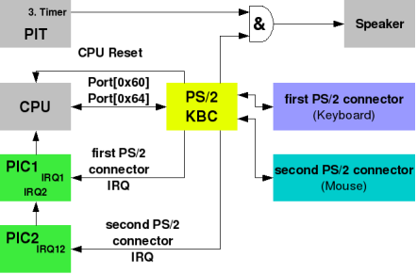
PS/2 Keyboard – Mouse support
Both the mous and the keyboard are connected to the PS/2 controller
Keyboard uses IRQ1 and mous IRQ12
Whether a data byte came from the keyboard or the mouse is signaled via the status register (Bit 5 AUXB)
https://wiki.osdev.org/File:Ps2-kbc.png

